Slide 1


NETFLIX
EXPLORATORY DATA ANALYSIS
Netflix Movies & TV Shows
A data-driven view of catalog composition,
content growth, audience ratings and genres
HARISH S – DATA SCIENCE – 27/10/2026
EDA PROJECT

Slide 2
NETFLIX
02
PROJECT WORKFLOW
From raw catalog to actionable insight
The notebook follows a structured EDA pipeline: ingest → validate → clean → enrich → analyze → conclude.
01
02
03
04
05
06
INGEST
AUDIT
CLEAN
ENGINEER
EXPLORE
INSIGHT
→
→
→
→
→
7,787 titles
12 attributes
Schema + missingness
+ quality checks
Targeted imputation
+ row filtering
Years, months,
runtime features
Distribution,
relationships, outliers
Business findings
+ strategy
7,787
12
99.78%
6+
Tools: Python • Pandas • NumPy • Matplotlib • Seaborn
raw records
attributes
retained after cleaning
visual analysis families
Exploratory Data Analysis • Netflix Titles

Slide 3
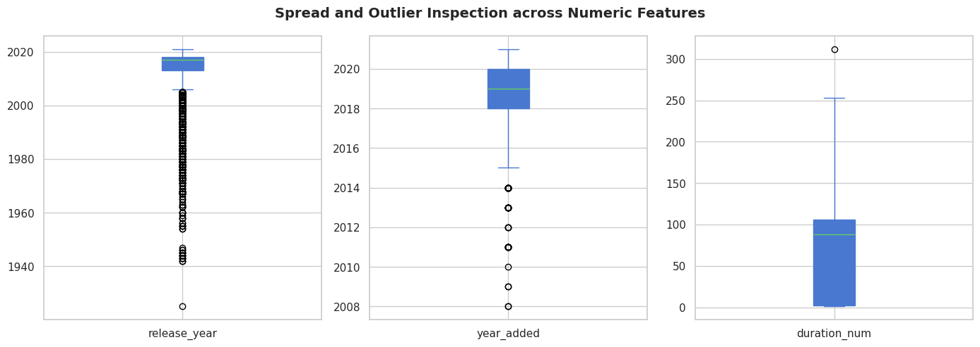
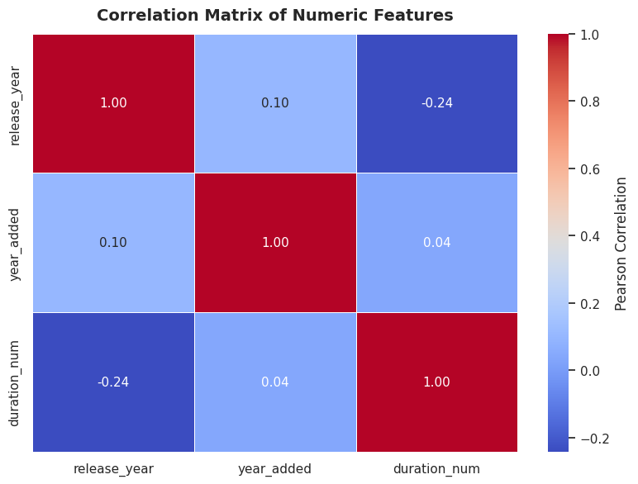
NETFLIX
03
PREPARATION
Data quality first — then analysis
DATA QUALITY CHECK
FEATURE ENGINEERING
Missing-value diagnosis
Turn raw fields into analysis-ready signals
• Director: 2,389 missing (30.68%)
• Cast: treated as an incomplete field
• Country: imputed using the mode
• Core-field gaps were filtered rather than blindly filled
YEAR ADDED
MONTH ADDED
DURATION NUM
calendar year
month number/name
runtime / seasons
Cleaning outcome
7,787 → 7,770
99.78% data retained
Preparation • Cleaning • Feature engineering • Quantitative diagnostics

Slide 4
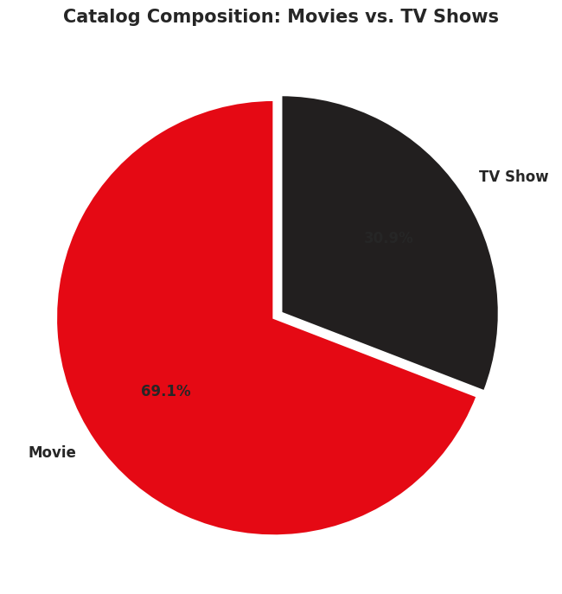
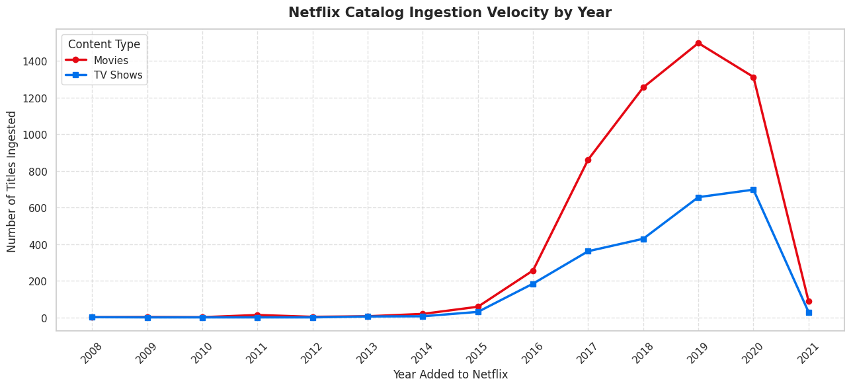
NETFLIX
04
CONTENT LANDSCAPE
What is inside the Netflix catalog?
CATALOG SIGNAL
Movies dominate the catalog at ~69%, while TV Shows account for ~31%.
The ingestion timeline shows a pronounced expansion in content additions in the late 2010s, followed by a sharp decline in 2021.
Exploratory Data Analysis • Netflix Titles

Slide 5
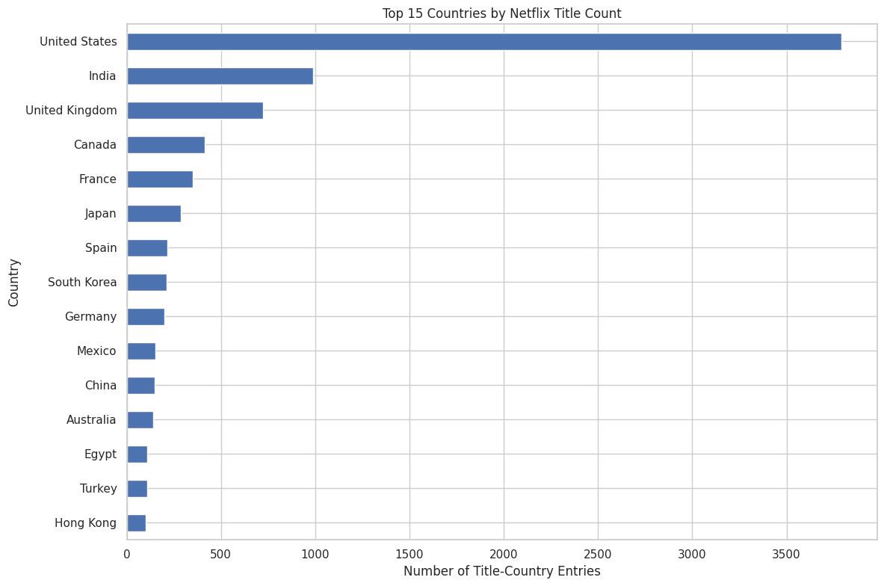
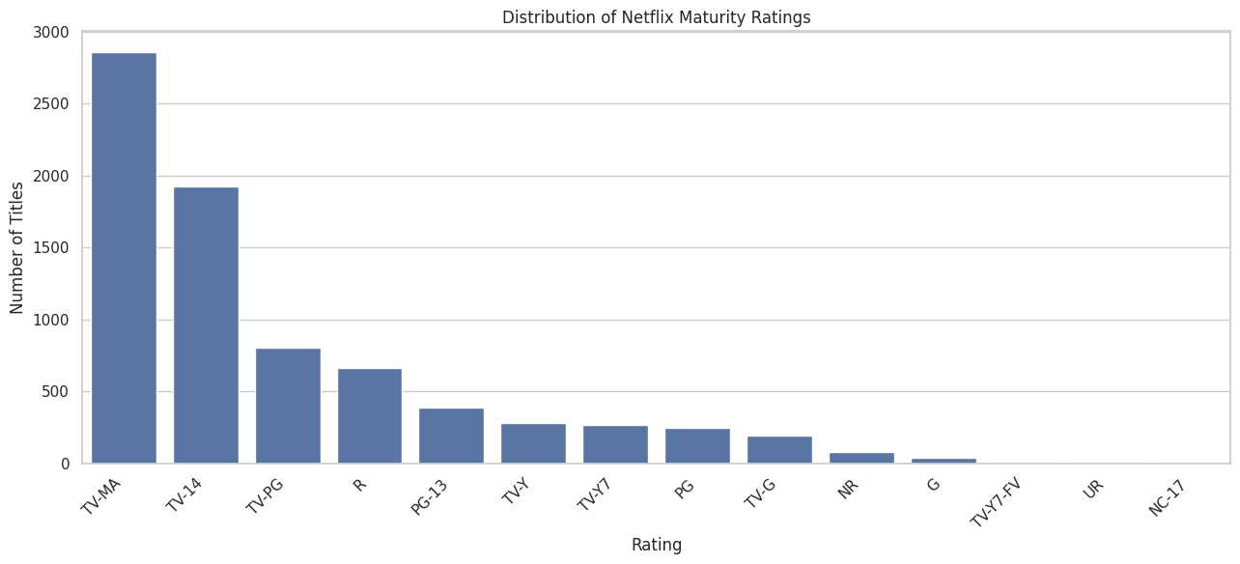
NETFLIX
05
MULTIVARIATE EDA
Geography meets audience
KEY PATTERN
The United States is the leading production hub.
TV-MA and TV-14 are the two largest maturity-rating tiers in the catalog.
Exploratory Data Analysis • Netflix Titles

Slide 6
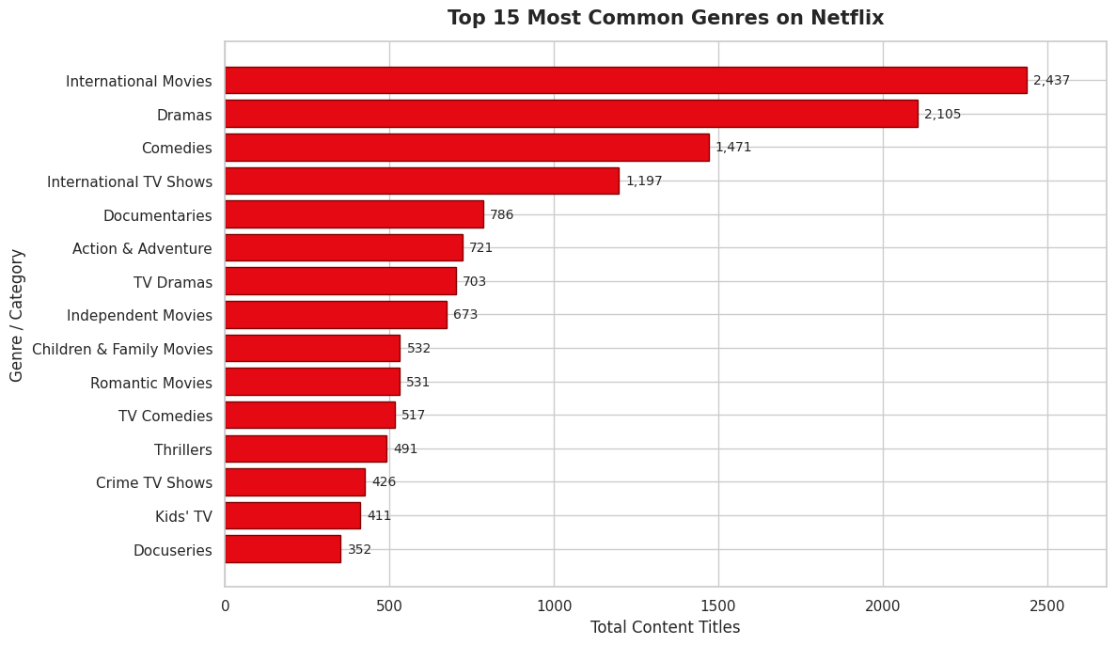
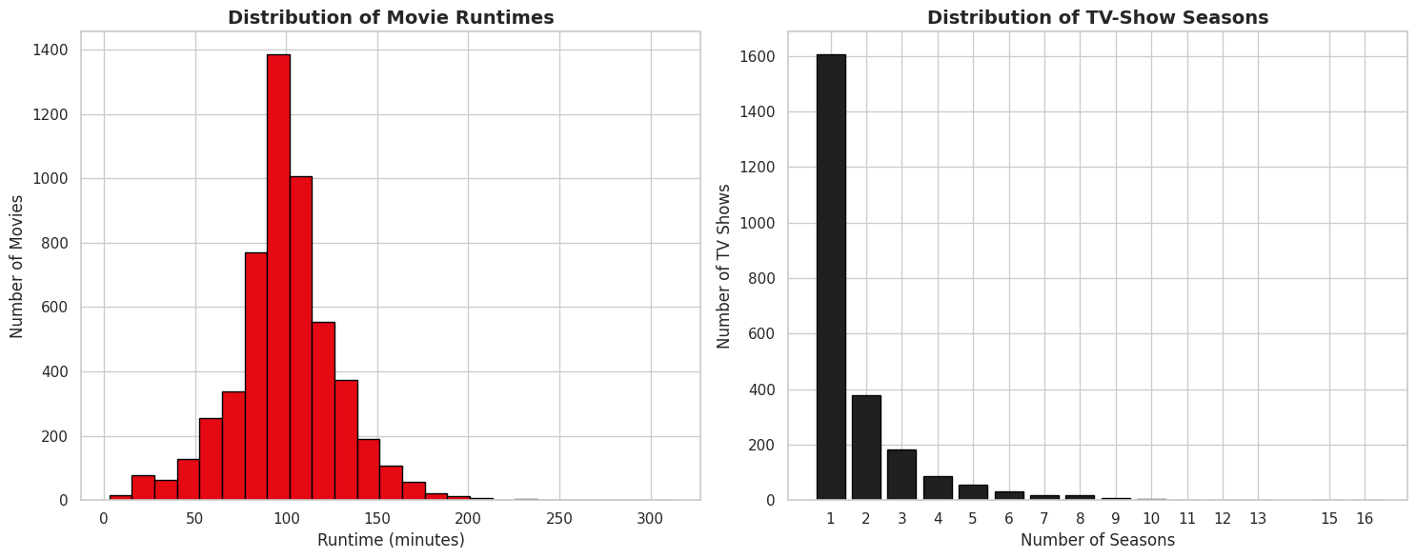
NETFLIX
06
DEEP-DIVE
Genres and runtime reveal the format strategy
RUNTIME SIGNAL
Movie runtimes cluster around ~100 minutes;
TV series are strongly concentrated at 1 season.
Exploratory Data Analysis • Netflix Titles

Slide 7
NETFLIX
07
STRATEGIC CONCLUSIONS
What the EDA tells us
69%
Movies
70%+
1-season TV
Feature films form the majority of the catalog.
TV shows are heavily concentrated at one season.
#1
United States
TOP
TV-MA / TV-14
The US is the dominant production hub.
Mature and teen audiences dominate the rating mix.
TAKEAWAY
Netflix’s catalog shows a dual-engine strategy: high-volume movies + contemporary, localized episodic content.
Source: project notebook • Netflix Titles dataset • EDA outputs

