Slide 1


Slide 2


HOW IT WORKS
One Resume Context powers Four Career tools
Upload, extract, reuse, and act, all grounded in the supplied resume.
PDF upload
PyPDFLoader
Gemini + LangChain
1
2
Upload
Extract
Upload a text-based resume PDF in Streamlit.
PyPDFLoader reads the text, and the result is cached.
3
4
Reuse
Act
Non-empty page text becomes one shared resume context.
Gemini via LangChain powers each tool.
Notes:
Explain that every tool starts from the same extracted resume context.

Slide 3
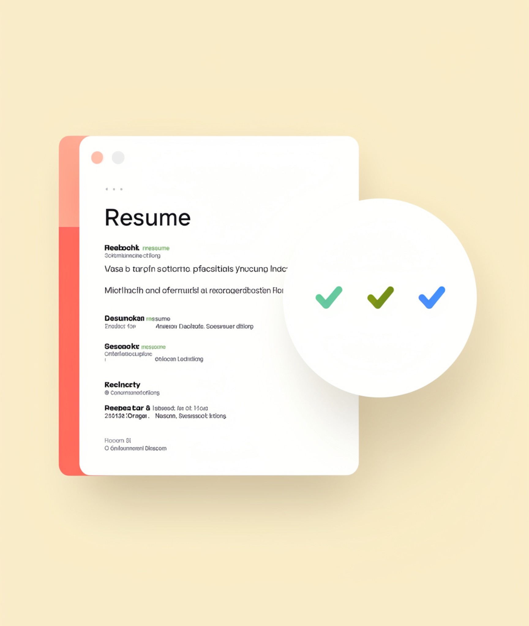
TOOL 1 · RESUME CHECKER
Resume Checker reviews the uploaded resume
The extracted resume text is sent to Gemini for review feedback.
Input
Output
A text-based resume PDF from the sidebar upload.
Gemini feedback on the resume content.
Input: uploaded PDF
Output: Gemini feedback
Notes:
Resume Checker is the first of the four tools.

Slide 4
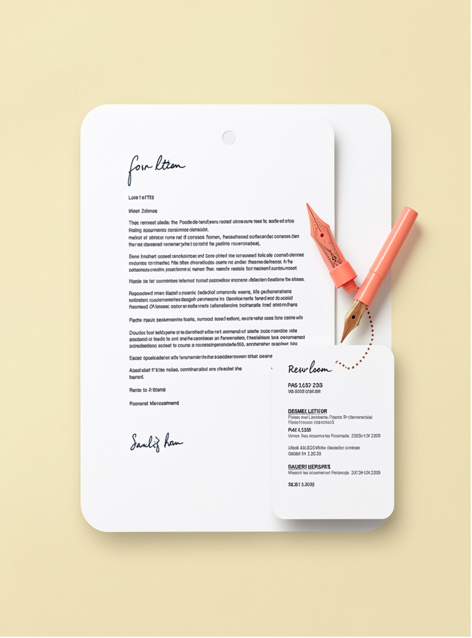
TOOL 2 · COVER LETTER GENERATOR
Cover Letter Generator drafts from resume context
Turns the shared resume context into a tailored cover letter draft.
Input
Output
The uploaded resume context.
A generated cover letter draft.
Resume context
Cover letter draft

Slide 5
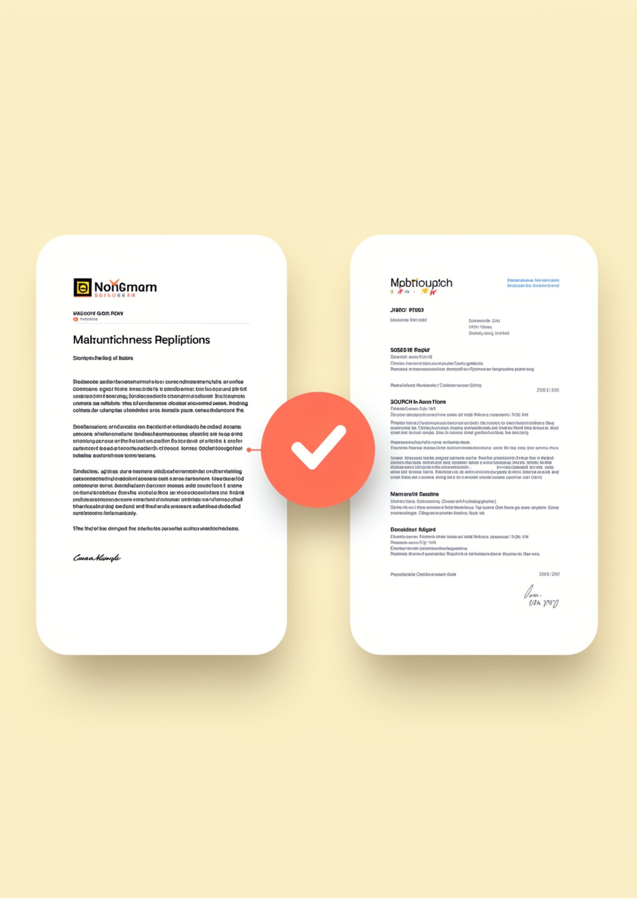
TOOL 3 · RESUME SCORER (JD MATCHER)
Resume Scorer compares resume against the job description
Match analysis, missing keywords, skill gaps, and a resume upgrade.
Job description ↔ resume
Match
Scores fit against the job description.
Gaps
Lists missing keywords and skill gaps.
Upgrade
Suggests resume improvements.

Slide 6
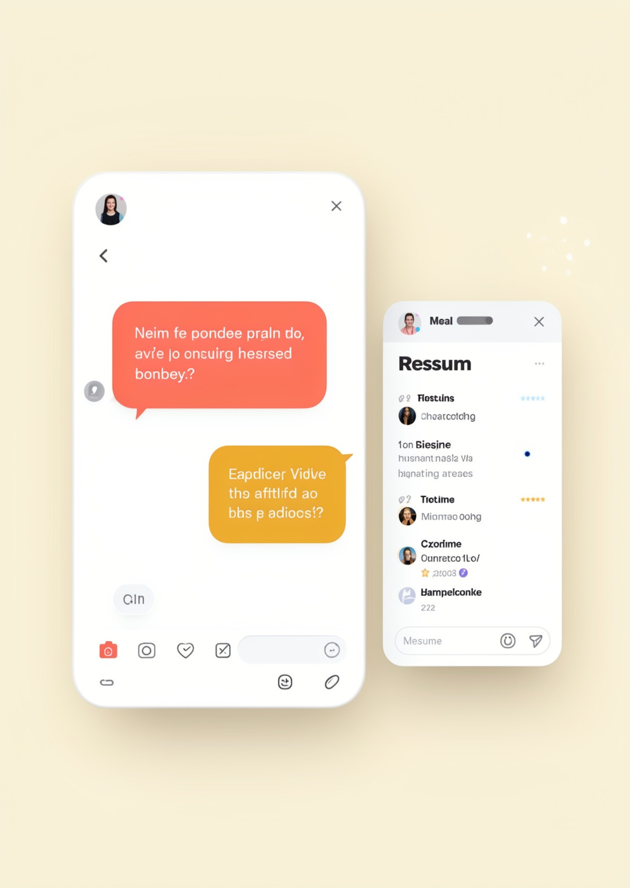
TOOL 4 · AI CAREER COACH
AI Career Coach answers from your resume
Coaching replies grounded in the uploaded resume context.
Resume-grounded
Career advice
Ask
Answer
A career question in the chat.
Advice tied to the uploaded resume.

Slide 7

CONCLUSION
ResumePulse closes the loop from document to career action
One resume context drives four tools, from review to next step.
Upload
Extract
Reuse
Act
Resume PDF
Shared text context
Four tools
Next career step
Resume Checker
Cover Letter Generator
Resume Checker
Cover Letter Generator
Reviews the uploaded resume
Drafts from resume context
Resume Scorer
AI Career Coach
Resume Scorer
AI Career Coach
Compares resume against the job description
Answers from your resume
Notes:
Summarize the four tools and the next action the user takes.

Slide 8

THANK YOU
Thank You
ResumePulse · Streamlit + Gemini via LangChain
Resume Checker
Cover Letter Generator
Resume Scorer
AI Career Coach

