Slide 1
RATHINAM
CENTRE OF EXCELLENCE
Procedural language in PGSQL
by
Mrs.B.Sharmila
Assistant Professor

Slide 2
Why we need function?
Storing and Retrieving Data from DB
What is the need of SQL?
But, What if you want to use programming in SQL?
FUNCTIONS

Slide 3

PLSQL
Programming Features?
If else
For
While
Functions
Programming language in SQL is called PLSQL

Slide 4
What is the need of PLSQL?
Student Table
Name | RegNo | Marks | Grade
Shiva | 1 | 70 | B
Arun | 2 | 80 | A
Aruna | 3 | 90 | A+
What if we want to update the grade column based on the marks?
Conditions
Multiple updatation of conditions
Loops
Embedding programming features in SQL is called PLSQL

Slide 5
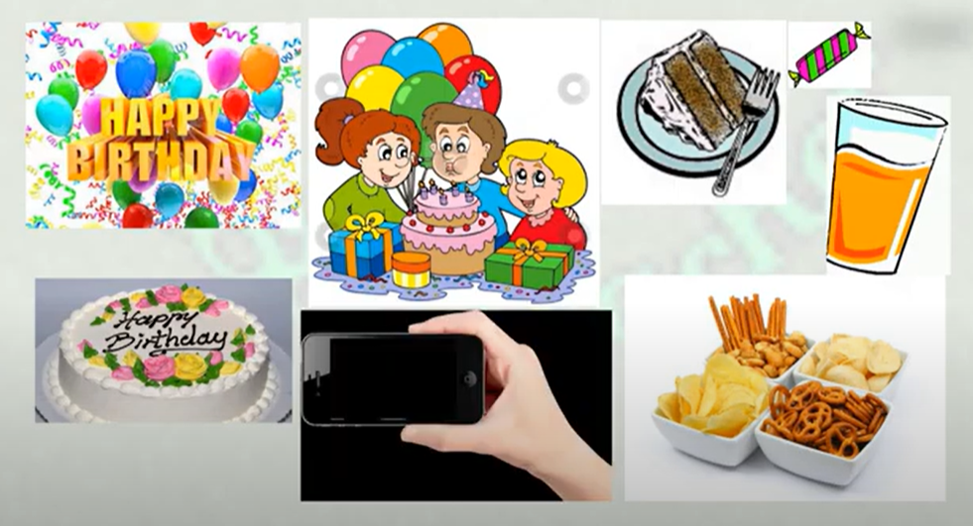

Slide 6
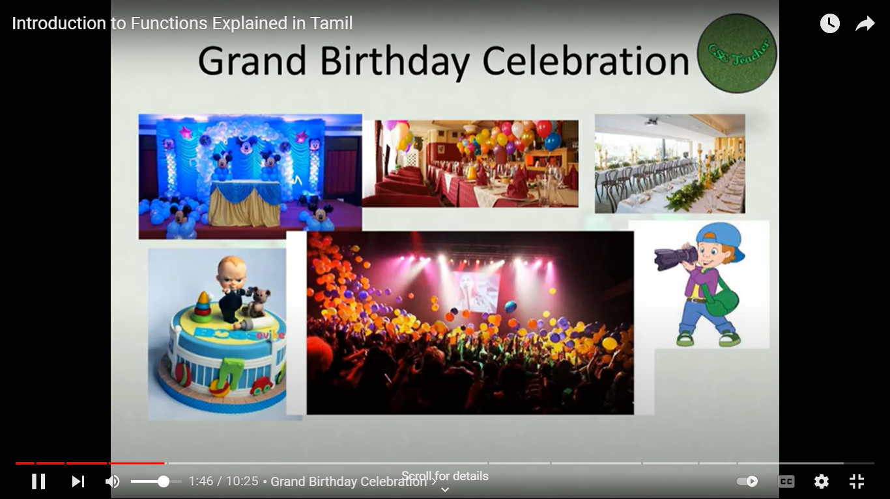

Slide 8
Introduction to function
Definition:
A function is a set of SQL statements that carried out any operation, such as select, insert delete, and update.
Syntax:
CREATE [OR REPLACE] FUNCTION function_name (arguments)
RETURNS return_datatype
AS $variable_name$
DECLARE declaration; [...]
BEGIN < function_body > [...]
RETURN { variable_name | value }
END;
LANGUAGE plpgsql;
FUNCTIONS

Slide 9
Functions
function-name specifies the name of the function.
[OR REPLACE] option allows modifying an existing function.
The function must contain a return statement.
RETURN clause specifies that data type you are going to return from the function. The return_datatype can be a base, composite, or domain type, or can reference the type of a table column.
function-body contains the executable part.
The AS keyword is used for creating a standalone function.
plpgsql is the name of the language that the function is implemented in. Here, we use this option for PostgreSQL, it Can be SQL, C, internal, or the name of a user-defined procedural language. For backward compatibility, the name can be enclosed by single quotes.
FUNCTIONS

Slide 10
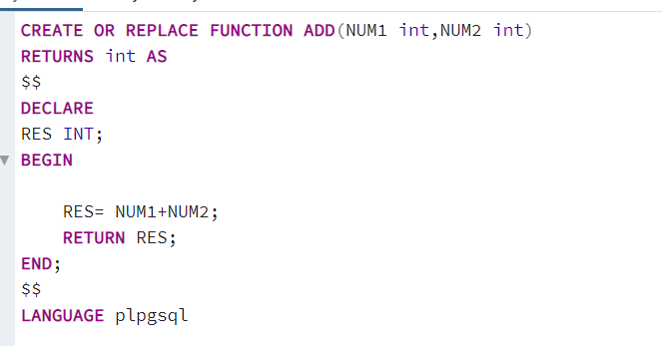
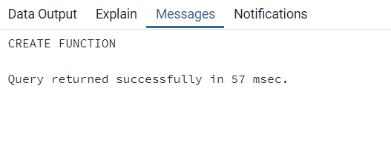
Syntax of Functions
Notes:
CREATE OR REPLACE FUNCTION ADD(NUM1 int,NUM2 int)
RETURNS int AS
$$
DECLARE
RES INT;
BEGIN
RES= NUM1+NUM2;
RETURN RES;
END;
$$
LANGUAGE plpgsql
SELECT ADD(10,20);

Slide 11

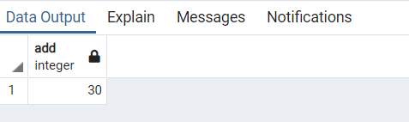
Execution statements of Function

Slide 12
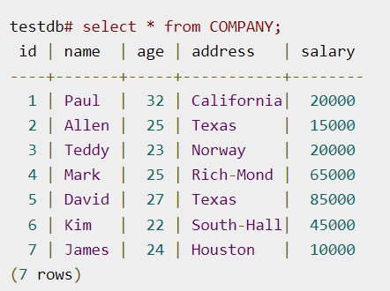
Examples of functions
CREATE OR REPLACE FUNCTION totalRecords ()
RETURNS integer
AS $total$
declare total integer;
BEGIN
SELECT count(*) into total FROM COMPANY;
RETURN total;
END;
$total$ LANGUAGE plpgsql;

Slide 13

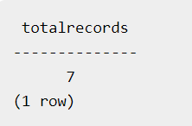
Examples of functions
Executing a Function:
Output:

Slide 14
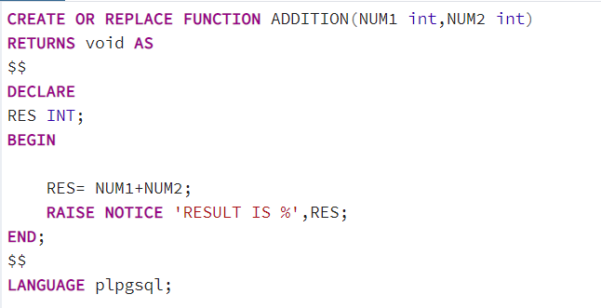
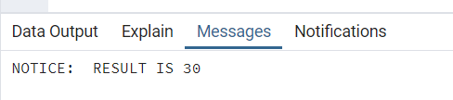
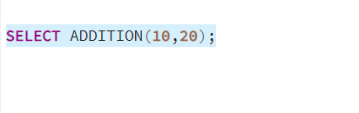
Use Of RAISE in functions
Notes:
CREATE OR REPLACE FUNCTION ADDITION(NUM1 int,NUM2 int)
RETURNS void AS
$$
DECLARE
RES INT;
BEGIN
RES= NUM1+NUM2;
RAISE NOTICE 'RESULT IS %',RES;
END;
$$
LANGUAGE plpgsql;
SELECT ADDITION(10,20);

Slide 15
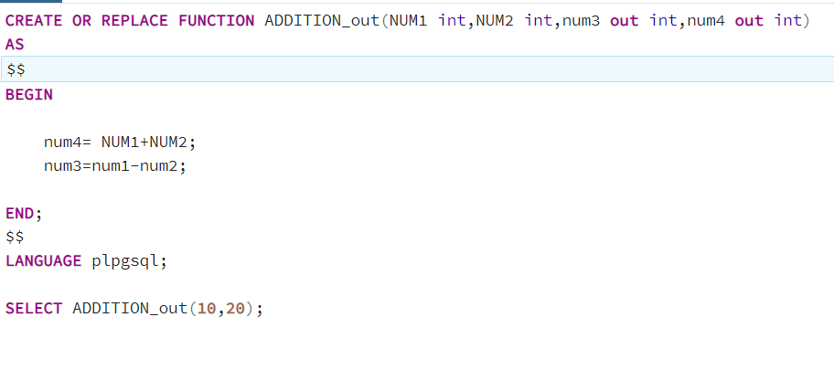
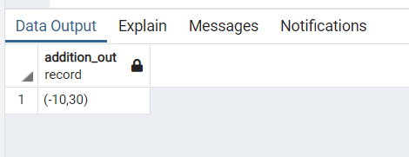
Use Of out parameter in functions
Notes:
CREATE OR REPLACE FUNCTION ADDITION_out(NUM1 int,NUM2 int,num3 out int,num4 out int)
AS
$$
BEGIN
num4= NUM1+NUM2;
num3=num1-num2;
END;
$$
LANGUAGE plpgsql;
SELECT ADDITION_out(10,20);

Slide 16
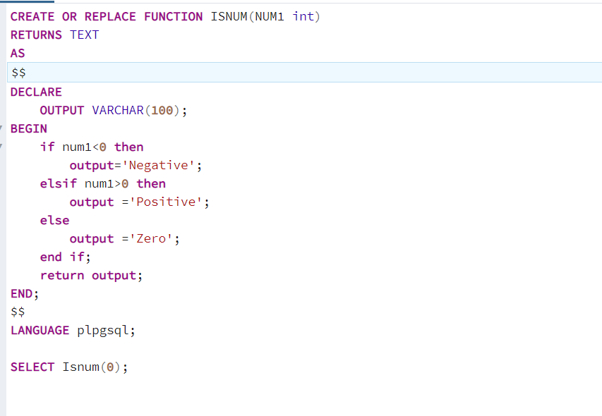
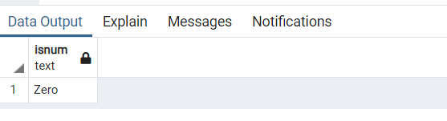
Positive or negative number using functions
Notes:
CREATE OR REPLACE FUNCTION ISNUM(NUM1 int)
RETURNS TEXT
AS
$$
DECLARE
OUTPUT VARCHAR(100);
BEGIN
if num1<0 then
output='Negative';
elsif num1>0 then
output ='Positive';
else
output ='Zero';
end if;
return output;
END;
$$
LANGUAGE plpgsql;
SELECT Isnum(0);

Slide 17
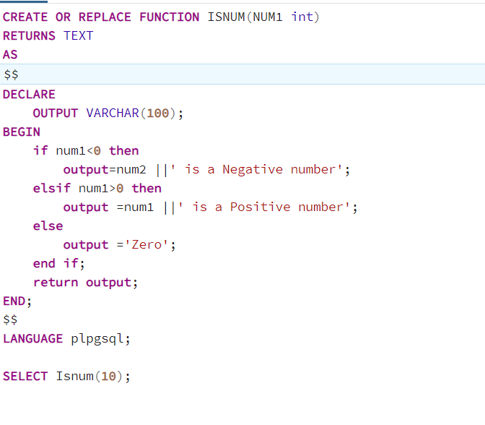
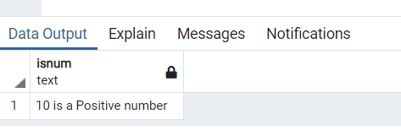
Positive or negative number using functions
|| is used to concate the text with variables.
Notes:
CREATE OR REPLACE FUNCTION ISNUM(NUM1 int)
RETURNS TEXT
AS
$$
DECLARE
OUTPUT VARCHAR(100);
BEGIN
if num1<0 then
output=num2 ||' is a Negative number';
elsif num1>0 then
output =num1 ||' is a Positive number';
else
output ='Zero';
end if;
return output;
END;
$$
LANGUAGE plpgsql;
SELECT Isnum(10);

Slide 18
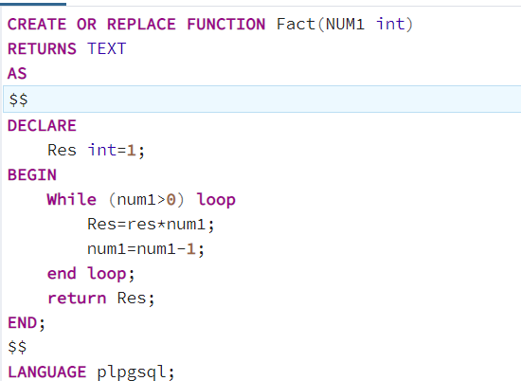
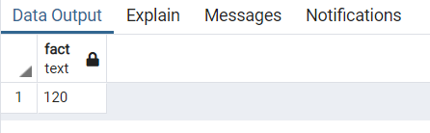

Factorial of a number using functions
Notes:
CREATE OR REPLACE FUNCTION Fact(NUM1 int)
RETURNS TEXT
AS
$$
DECLARE
Res int=1;
BEGIN
While (num1>0) loop
Res=res*num1;
num1=num1-1;
end loop;
return Res;
END;
$$
LANGUAGE plpgsql;
SELECT Fact(5);

Slide 19
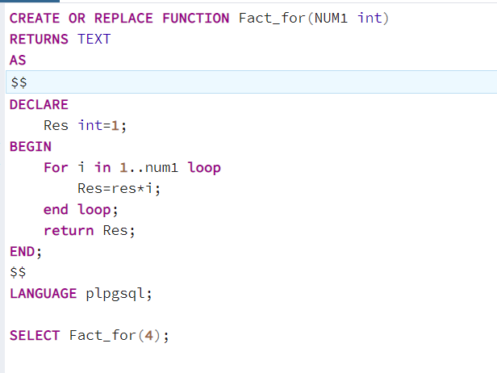
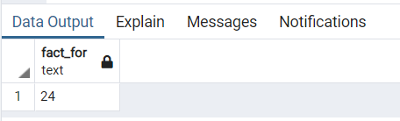
Factorial of a number using functions – For loop
Notes:
CREATE OR REPLACE FUNCTION Fact_for(NUM1 int)
RETURNS TEXT
AS
$$
DECLARE
Res int=1;
BEGIN
For i in 1..num1 loop
Res=res*i;
end loop;
return Res;
END;
$$
LANGUAGE plpgsql;
SELECT Fact_for(4);

Slide 20

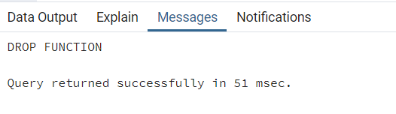
Deleting a Functions
Notes:
Drop function Fact_for;

