Slide 1
RATHINAM
CENTRE OF EXCELLENCE
Database Management System
Combining the Data
by
Mrs.B. Sharmila
Technical Trainer

Slide 2
Introduction to JOINS
SQL provides the concepts of Unions and Joins to combine the data from multiple tables.
Joins are used to retrieve data from multiple tables i.e. it is used for data merging.
SQL Joins

Slide 3
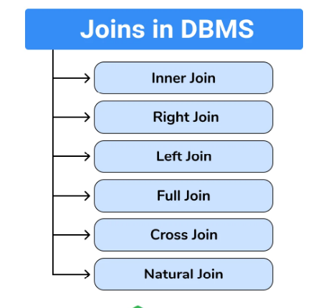
Types of Joins
SQL Joins

Slide 4
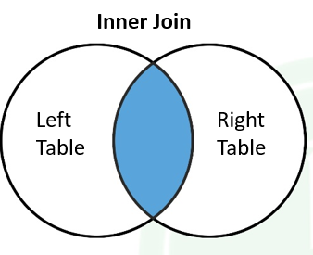
Inner Join
The inner join returns only matching rows from tables.
SQL Joins

Slide 5
Inner Join
Consider the two tables
Employee:
EMPNO | ENAME | JOB | MGR | HIREDATE | SAL | COMM | DEPTNO
7839 | KING | PRESIDENT | – | 17-NOV-81 | 5000 | – | 10
7698 | BLAKE | MANAGER | 7839 | 01-MAY-81 | 2850 | – | 30
7782 | CLARK | MANAGER | 7839 | 09-JUN-81 | 2450 | – | 10
7566 | JONES | MANAGER | 7839 | 02-APR-81 | 2975 | – | 20
7788 | SCOTT | ANALYST | 7566 | 19-APR-87 | 3000 | – | 20
7902 | FORD | ANALYST | 7566 | 03-DEC-81 | 3000 | – | 20
7369 | SMITH | CLERK | 7902 | 17-DEC-80 | 800 | – | 20
7499 | ALLEN | SALESMAN | 7698 | 20-FEB-81 | 1600 | 300 | 30
Department:
DEPTNO | DNAME | LOC
10 | ACCOUNTING | NEW YORK
20 | RESEARCH | DALLAS
30 | SALES | CHICAGO
40 | OPERATIONS | BOSTON
SQL Joins

Slide 6
QUERY:
SELECT ename,loc FROM
Employee emp
JOIN
Department dept
ON emp.deptno=dept.deptno
WHERE dept.location =‘CHICAGO’;
ENAME | LOC
BLAKE | CHICAGO
ALLEN | CHICAGO
WARD | CHICAGO
MARTIN | CHICAGO
TURNER | CHICAGO
JAMES | CHICAGO
SQL Joins

Slide 7
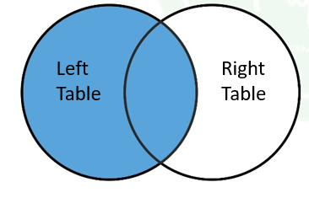
Left Outer Join
Left join always returns all rows from the left table and matching rows from right side table and also returns null values in the place of nonmatching rows in another table
SQL Joins

Slide 8
Left Outer Join
Consider the two tables
Employee:
EMPNO | ENAME | JOB | MGR | HIREDATE | SAL | COMM | DEPTNO
7839 | KING | PRESIDENT | – | 17-NOV-81 | 5000 | – | 10
7698 | BLAKE | MANAGER | 7839 | 01-MAY-81 | 2850 | – | 30
7782 | CLARK | MANAGER | 7839 | 09-JUN-81 | 2450 | – | 10
7566 | JONES | MANAGER | 7839 | 02-APR-81 | 2975 | – | 20
7788 | SCOTT | ANALYST | 7566 | 19-APR-87 | 3000 | – | 20
7902 | FORD | ANALYST | 7566 | 03-DEC-81 | 3000 | – | 20
7369 | SMITH | CLERK | 7902 | 17-DEC-80 | 800 | – | 20
7499 | ALLEN | SALESMAN | 7698 | 20-FEB-81 | 1600 | 300 | 30
7521 | WARD | SALESMAN | 7698 | 22-FEB-81 | 1250 | 500
Department:
DEPTNO | DNAME | LOC
10 | ACCOUNTING | NEW YORK
20 | RESEARCH | DALLAS
30 | SALES | CHICAGO
40 | OPERATIONS | BOSTON
SQL Joins

Slide 9
Left Outer Join
QUERY:
SELECT ename,loc FROM
Employee emp
LEFT JOIN
Department dept
on emp.deptno=dept.deptno;
ENAME | loc
KING | NEW YORK
BLAKE | CHICAGO
CLARK | NEW YORK
JONES | DALLAS
SCOTT | DALLAS
FORD | DALLAS
SMITH | DALLAS
ALLEN | CHICAGO
WARD
SQL Joins

Slide 10
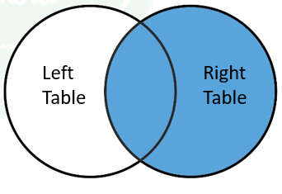
Right Outer Join
Right join always return all rows from right side table and matching rows from the left table and also returns null values in the place of nonmatching rows in another table
SQL Joins

Slide 11
Left Outer Join
Consider the two tables
Employee:
EMPNO | ENAME | JOB | MGR | HIREDATE | SAL | COMM | DEPTNO
7839 | KING | PRESIDENT | – | 17-NOV-81 | 5000 | – | 10
7698 | BLAKE | MANAGER | 7839 | 01-MAY-81 | 2850 | – | 30
7782 | CLARK | MANAGER | 7839 | 09-JUN-81 | 2450 | – | 10
7566 | JONES | MANAGER | 7839 | 02-APR-81 | 2975 | – | 20
7788 | SCOTT | ANALYST | 7566 | 19-APR-87 | 3000 | – | 20
7902 | FORD | ANALYST | 7566 | 03-DEC-81 | 3000 | – | 20
7369 | SMITH | CLERK | 7902 | 17-DEC-80 | 800 | – | 20
7499 | ALLEN | SALESMAN | 7698 | 20-FEB-81 | 1600 | 300 | 30
7521 | WARD | SALESMAN | 7698 | 22-FEB-81 | 1250 | 500
Department:
DEPTNO | DNAME | LOC
10 | ACCOUNTING | NEW YORK
20 | RESEARCH | DALLAS
30 | SALES | CHICAGO
40 | OPERATIONS | BOSTON
SQL Joins

Slide 12
Right Outer Join
QUERY:
SELECT ename,loc FROM
Employee emp
RIGHT JOIN
Department dept
ON emp.deptno=dept.deptno;
ENAME | loc
KING | NEW YORK
BLAKE | CHICAGO
CLARK | NEW YORK
JONES | DALLAS
SCOTT | DALLAS
FORD | DALLAS
SMITH | DALLAS
ALLEN | CHICAGO
WARD
 | BOSTON
SQL Joins

Slide 13
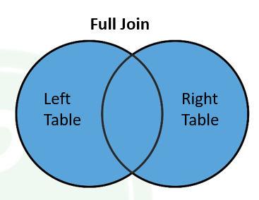
Full Outer Join
Full join returns all rows from both tables because it is viewed as a union of a left, right and inner join, It also returns null values in the place of nonmatching rows tuples
SQL Joins

Slide 14
FullOuter Join
Consider the two tables
Employee:
EMPNO | ENAME | JOB | MGR | HIREDATE | SAL | COMM | DEPTNO
7839 | KING | PRESIDENT | – | 17-NOV-81 | 5000 | – | 10
7698 | BLAKE | MANAGER | 7839 | 01-MAY-81 | 2850 | – | 30
7782 | CLARK | MANAGER | 7839 | 09-JUN-81 | 2450 | – | 10
7566 | JONES | MANAGER | 7839 | 02-APR-81 | 2975 | – | 20
7788 | SCOTT | ANALYST | 7566 | 19-APR-87 | 3000 | – | 20
7902 | FORD | ANALYST | 7566 | 03-DEC-81 | 3000 | – | 20
7369 | SMITH | CLERK | 7902 | 17-DEC-80 | 800 | – | 20
7499 | ALLEN | SALESMAN | 7698 | 20-FEB-81 | 1600 | 300 | 30
7521 | WARD | SALESMAN | 7698 | 22-FEB-81 | 1250 | 500
Department:
DEPTNO | DNAME | LOC
10 | ACCOUNTING | NEW YORK
20 | RESEARCH | DALLAS
30 | SALES | CHICAGO
40 | OPERATIONS | BOSTON
SQL Joins

Slide 15
Right Outer Join
QUERY:
SELECT ename, loc FROM
Employee emp
FULL OUTER JOIN
Department dept
on emp.deptno=dept.deptno ;
ENAME | loc
KING | NEW YORK
BLAKE | CHICAGO
CLARK | NEW YORK
JONES | DALLAS
SCOTT | DALLAS
FORD | DALLAS
SMITH | DALLAS
ALLEN | CHICAGO
 | BOSTON
SQL Joins

Slide 16
Natural Join
In this join, you are not required to use join condition explicitly, in this case, resource tables must have a common column, based on the common column internal establishes join condition.
The resulting table will contain all the attributes of both the table but keep only one copy of each common column.
Student
Marks
ROLLNO | NAME
1 | A
2 | B
3 | C
ROLLNO | MARKS
2 | 80
3 | 70
4 | 60
SQL Joins

Slide 17
Natural Join
QUERY:
SELECT * FROM Student NATURAL JOIN Marks;
ROLLNO | NAME | MARKS
2 | B | 80
3 | C | 70
SQL Joins

Slide 18
Difference between Natural Join and Inner Join
S.NO. | NATURAL JOIN | INNER JOIN
1. | Natural Join joins two tables based on same attribute name and datatypes. | Inner Join joins two table on the basis of the column which is explicitly specified in the ON clause.
2. | In Natural Join, The resulting table will contain all the attributes of both the tables but keep only one copy of each common column | In Inner Join, The resulting table will contain all the attribute of both the tables including duplicate columns also
3. | In Natural Join, If there is no condition specifies then it returns the rows based on the common column | In Inner Join, only those records will return which exists in both the tables
4. | SYNTAX: SELECT * FROM table1 NATURAL JOIN table2; | SYNTAX: SELECT * FROM table1 INNER JOIN table2 ON table1.Column_Name = table2.Column_Name;
SQL Joins

Slide 19
CROSS Join
In this type of join data in each and, every row in one table is added to all the rows in another table
Here cross product operation performed.
Student
Marks
ROLLNO | NAME
1 | A
2 | B
3 | C
ROLLNO | MARKS
2 | 80
3 | 70
4 | 60
ROLLNO | NAME | ROLLNO | MARKS
1 | A | 2 | 70
2 | B | 2 | 70
3 | C | 2 | 70
1 | A | 3 | 75
2 | B | 3 | 75
3 | C | 3 | 75
1 | A | 4 | 60
2 | B | 4 | 60
3 | C | 4 | 60
QUERY:
SELECT * FROM Student NATURAL JOIN Marks;
SQL Joins

Slide 20
QUIZ
1. _____ is a query that retrieves rows from more than one table or view
Start
End
Join
All of the above
2. In SQL the statement Select * from R, S is equivalent to
Select * from R natural join S
Select * from R Cross join S
Select * from R Unioin join S
Select * from R Innervjoin S
SQL Joins

Slide 21
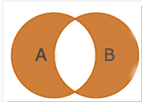
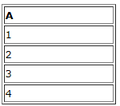
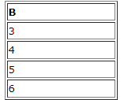
QUIZ
3.
Choose the query that matches the above image.
A.Select [List] from [Table A] A inner join [Table B] B on A.value=B.value
B.Select [List] from [Table A] A full outer join [Table B] B on A.value=B.value where A.value is null or B.value is null
C.Select [List] from [Table A] A right join [Table B] B on A.value=B.value where A.value is null
D.Select [List] from [Table A] A full outer join [Table B] B on A.value=B.value
4.
What will be the result of inner join between these tables?
SQL Joins

Slide 22
QUIZ
A.
A | B
1 | 3
4 | 4
B.
A | B
3 | 1
4 | 4
C.
A | B
2 | 3
2 | 4
D.
A | B
3 | 3
4 | 4
5. Orders table (Order_no, Cust, Prodt, Qty, Amt, Discount )
Customers table (Custnbr, Company, Custrep, Creditlim)
Print all the orders showing order number, amount, company name and credit limit of customers. A)Select Order_no, Amt, Company, Creditlim from Customers outer join Orders on customers.custnbr = orders.cust;
B)Select Order_no, Amt, Company, Creditlim from Customers left outer join Orders on customers.custnbr = orders.cust;
C)Select Order_no, Amt, Company, Creditlim from Customers inner join Orders on customers.custnbr = orders.cust;
D)Select Order_no, Amt, Company, Creditlim from Customers right outer join Orders on customers.custnbr = orders.cust;
SQL Joins

Slide 23
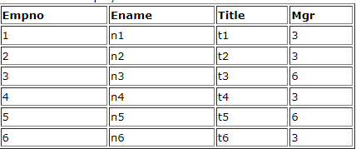
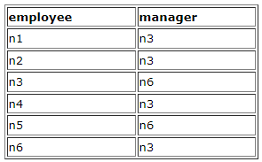
QUIZ
6. Select * from Employees
We want the result as shown below:
What query or queries can be used to get the above result. A)Select emp.ename as employee, manager.ename as manager from Employees1 as emp join Employees1 as manager on emp.Mgr = manager.Empno
B)Select emp.ename as employee, manager.ename as manager from Employees1 as emp inner join Employees2 as manager on emp.Mgr = manager.Empno
C)Select emp.ename as employee, manager.ename as manager from Employees1 as emp inner join Employees1 as manager on emp.Mgr = emp.Empno
D)Select emp.ename as employee, manager.ename as manager from Employees1 as emp inner join Employees1as manager on emp.Mgr = manager.Empno
SQL Joins

Slide 24
QUIZ
7.Customers table (Custnbr, Company, Custrep, Creditlim)
Orders table (Order_no, Cust, Prodt, Qty, Amt, Discount)
Find all the customers with orders more than 500 or credit limits greater than or equal to 500. A)Select distinct Custnbr from Customers Right JOIN Orders on Custnbr = Cust where (Creditlim >= 500 OR Amt > 500)
B)Select distinct Custnbr from Customers LEFT JOIN Orders on Custnbr = Cust where (Creditlim > 500 OR Amt >= 500)
C)Select Custnbr from Customers LEFT JOIN Orders on Custnbr = Cust where (Creditlim > 500 OR Amt > 500)
D)Select distinct Custnbr from Customers LEFT JOIN Orders on Custnbr = Cust where (Creditlim >= 500 OR Amt > 500)
8.It is not necessary that only primary and foreign keys should be used for joins. The join can match a row in one table with a row in another table using any column as long as the columns share compatible data types and the data match. A) True B) False
9.Which type of JOIN is used to returns all rows from right table and only matched rows from left table?INNER JOIN
RIGHT JOIN
FULL JOIN
LEFT JOIN
SQL Joins

