Slide 1
RATHINAM
CENTRE OF EXCELLENCE
Subqueries in SQL
by
Mrs.B. Sharmila
Assistant Professor

Slide 2
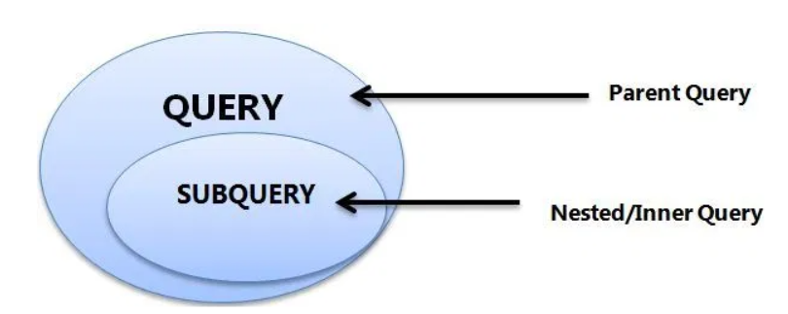
Sub Queries
Subquery is Query within a query in which the value of inner query is assigned to the outer query and outer query is executed.

Slide 3
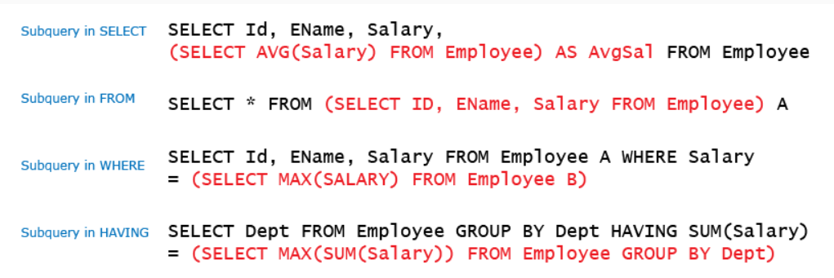
Sub Queries

Slide 4
Sub Queries
The subquery can be nested inside a SELECT, INSERT, UPDATE, or DELETE statement or inside another subquery.
A subquery is usually added within the WHERE Clause of another SQL SELECT statement.
You can use the comparison operators, such as >, <, or =. The comparison operator can also be a multiple-row operator, such as IN, ANY, or ALL.
A subquery is also called an inner query or inner select, while the statement containing a subquery is also called an outer query or outer select.
The inner query executes first before its parent query so that the results of an inner query can be passed to the outer query.

Slide 5
Types of Subqueries
Subquery in SELECT and FROM clause are not used often.
Subqueries in WHERE and HAVING clauses are classified into the following:-
1. Independent subquery
2. Correlated subquery

Slide 6
Independent Subqueries
In an independent subquery, the inner queries and outer queries are independent of each other. You can run an inner query and inspect its result independent of the outer query.
Independent subquery is further classified into
single row
multiple row
types depending upon the number of rows returned.

Slide 7
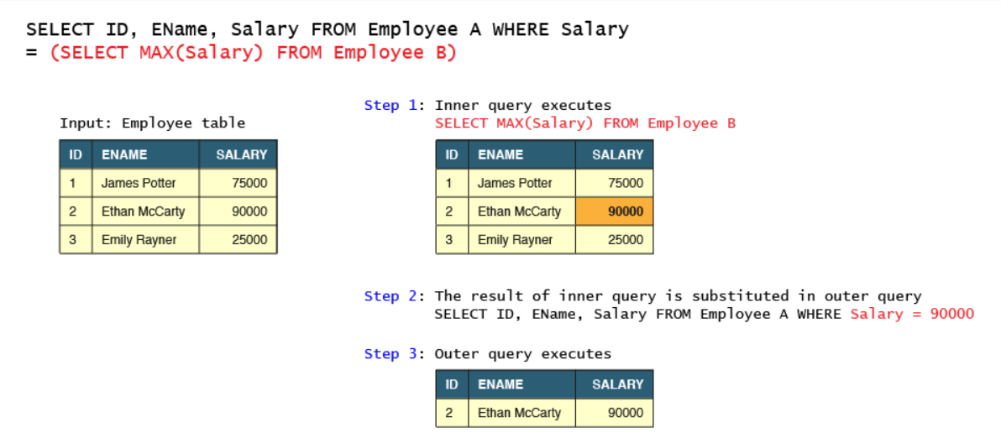
Single row Subquery

Slide 8

Correlated Subquery
A Correlated subquery is the type of query in which the inner query depends upon the outer query for its execution.
Specifically, the inner query uses an attribute from one of the tables in the outer query.
The inner query is executed iteratively for each selected record of the outer query. In the case of independent subquery, the inner query just executes once.
Below is a correlated subquery is written, to fetch the details of the employee(s) who are earning salary more than or same as the average salary earned by employees of the same designation.
Notes:
Select sname from salesman where sid in (select sid from sale group by sid having count(saleid)>=2)

Slide 9
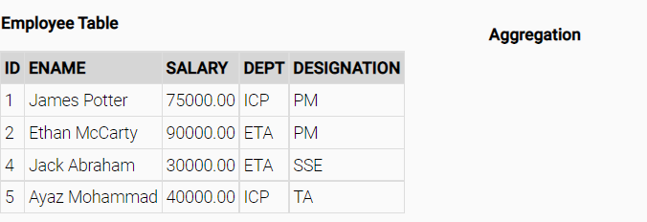
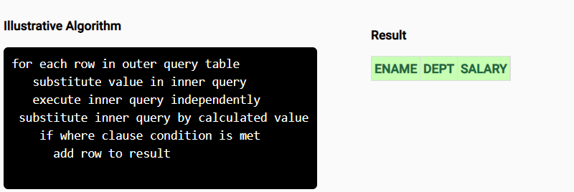
Correlated Subquery

