Slide 1
RATHINAM
CENTRE OF EXCELLENCE
Database Management System
Triggers
Mrs.B.Sharmila
Technical Trainer

Slide 2
Triggers
A database trigger is a set of SQL statements which is automatically fired or executed when some events occur.
A trigger can execute in response to any of the following events:
1. A database manipulation (DML) statement like DELETE, INSERT or UPDATE.
2. A database definition (DDL) statement like CREATE, ALTER or DROP.
3. A database operation like SERVERERROR, LOGON, LOGOFF, STARTUP, or SHUTDOWN.
Note: A trigger can be defined on the table, view, schema or database with which the event is associated.
Notes:
Examples : Images, Text, videos etc.

Slide 3
Parts of a trigger
Triggering Event or Statement
Trigger Restriction
Trigger Action

Slide 4
Trigerring Event or Statement
The statements due to which a trigger occurs is called triggering event or statement.
Such statements can be DDL statements, DML statements or any database operation, executing which gives rise to a trigger.

Slide 5
Trigger Restrictions
The condition or any limitation applied on the trigger is called trigger restriction.
Thus, if such a condition is TRUE then trigger occurs otherwise it does not occur.

Slide 6
Trigger action
The body containing the executable statements that is to be executed, when trigger occurs that is with the execution of Triggering statement and upon evaluation of Trigger restriction as True is called Trigger Action.

Slide 7
Types of SQL Triggers
Triggers can be classified into three categories:
Level Triggers
Event Triggers
Timing Triggers

Slide 8
Level Triggers
1.Row level trigger:
It fires for every record that got affected with the execution of DML statements like INSERT, UPDATE, DELETE etc.
It always use a FOR EACH ROW clause in a triggering statement.
2. Statement level trigger:
An event is triggered at table level i.e. for each sql statement executed.

Slide 9
Event Triggers
There are 3 different types of event triggers, they are:
DDL EVENT TRIGGER:
It fires with the execution of every DDL statement(CREATE, ALTER, DROP, TRUNCATE).
DML EVENT TRIGGER:
It fires with the execution of every DML statement(INSERT, UPDATE, DELETE).
DATABASE EVENT TRIGGER:
It fires with the execution of every database operation which can be LOGON, LOGOFF, SHUTDOWN, SERVERERROR etc.

Slide 10
Timing Triggers
There are 2 different types of timing triggers, they are:
BEFORE TRIGGER:
It fires before executing DML statement.
Triggering statement may or may not executed depending upon the before condition block.
AFTER TRIGGER:
It fires after executing DML statement.

Slide 11
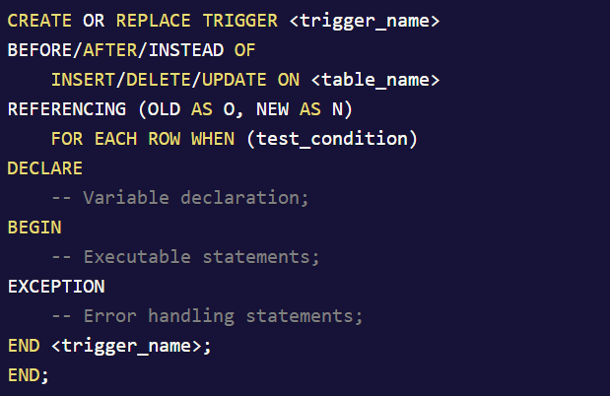
Syntax for creating a trigger
Notes:
where,
CREATE OR REPLACE TRIGGER is a keyword used to create a trigger and <trigger_name> is user-defined where a trigger can be given a name.
BEFORE/AFTER/INSTEAD OF specify the timing of the trigger's occurance. INSTEAD OF is used when a view is created.
INSERT/UPDATE/DELETE specify the DML statement.
<table_name> specify the name of the table on which DML statement is to be applied.
REFERENCING is a keyword used to provide reference to old and new values for DML statements.
FOR EACH ROW is the clause used to specify row level tigger.
WHEN is a clause used to specify condition to be applied and is only applicable for row-level trigger.
DECLARE, BEGIN, EXCEPTION, END are the different sections of PL/SQL code block containing variable declaration, executable statements, error handling statements and marking end of PL/SQL block respectively where DECLARE and EXCEPTION part are optional.

Slide 12
Example of trigger
CREATE OR REPLACE TRIGGER CheckAge
BEFORE
INSERT OR UPDATE ON student
FOR EACH ROW
BEGIN
IF :new.Age > 30 THEN
raise_application_error(-20001, 'Age should not be greater than 30');
END IF;
END;

Slide 13
Example of trigger
Consider the following tables,
ROLLNO | SNAME | AGE | COURSE
11 | Anu | 20 | BSC
12 | Asha | 21 | BCOM
13 | Arpit | 18 | BCA
14 | Chetan | 20 | BCA
15 | Nihal | 19 | BBA
Notes:
After initializing the trigger CheckAge, whenever we will insert any new values or update the existing values in the above table STUDENT our trigger will check the age before executing INSERT or UPDATE statements and according to the result of triggering restriction or condition it will execute the statement.

Slide 14


Example of trigger

Slide 15




Example of trigger

Slide 16
Drop trigger
DROP TRIGGER trigger_name;

Slide 17
Uses of trigger
Maintaining complex constraints which is either impossible or very difficult via normal constraint(like primary, foreign, unique etc) applying technique.
Recording the changes made on the table.
Automatically generating primary key values.
Prevent invalid transactions to occur.
Granting authorization and providing security to database.
Enforcing referential integrity.

Slide 18
Quiz
1.Triggers are not supported in
a) Delete
b) Update
c) Views
d) All of the mentioned
2.The variables in the triggers are declared using
a) –
b) @
c) /
d) /@
3.Triggers ________ enabled or disabled
a) Can be
b) Cannot be
c) Ought to be
d) Always
4.Which of the following are Benefits of Triggers?
A. Enforcing referential integrity
B. Auditing
C. Imposing security authorizations
D. All of the above
DBMS

Slide 19
Quiz
5. Point out the wrong statement.
We can have an INSTEAD OF insert/update/delete trigger on a table that successfully executed
DML Triggers are used to evaluate data after data manipulation using DML statements
INSTEAD OF triggers cause their source DML operation to skip
AFTER triggers cause their source DML operation to skip.
6. Which of the following is not a typical trigger action?
a) Insert
b) Select
c) Delete
d) All of the mentioned
7. What is def in the following MySQL statement?
CREATE TRIGGER abc (...) (...) ON def FOR EACH ROW ghi;
a) trigger name
b) table name
c) trigger statement
d) update statement
DBMS

