Slide 1
RATHINAM
CENTRE OF EXCELLENCE
Database Management System
SQL Views
by
Mrs.B. Sharmila
Technical Trainer

Slide 2
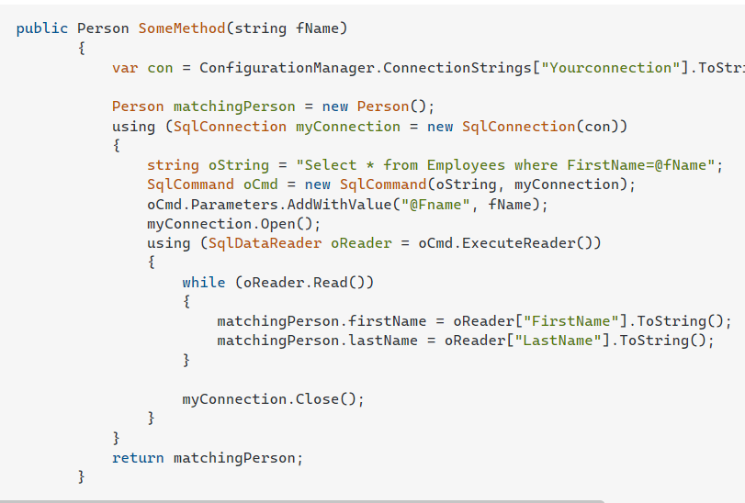
Introduction to Views
Select * from Employees where FirstName=@fName

Slide 3
Introduction to Views
A view in SQL is a virtual table that is based upon the result-set of an SQL statement.
A view will also have rows and columns just like a real table in a database.
Simply a view is nothing but a stored SQL Query.
A view can contain all the rows of a table or specific rows based on some condition.
SQL functions conditions and join statements to a view and present the data just like the data is produced from a single table

Slide 4
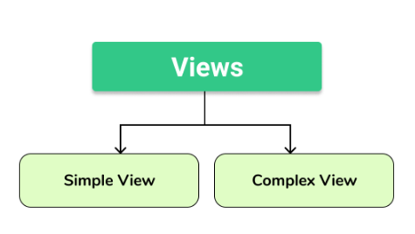
Syntax for View
Creating a view:
A view is created by selecting fields from one or more tables present in a database.
Syntax:
CREATE VIEW view_name AS
SELECT column1, column2, ...
FROM table_name
WHERE condition;
Note: Whenever a user creates a view, database engine recreates the data using the views SQL statement i.e. view always shows upto date data

Slide 5
Queries to create view
Simple Views in DBMS: Creating a view from a single table:
CREATE VIEW DetailsView AS
SELECT NAME, ADDRESS
FROM StudentDetails
WHERE S_ID < 5;
StudentDetails
S_ID | NAME | ADDRESS
1 | Harini | Kolkata
2 | Preity | Hyderabad
3 | Divya | Chennai
4 | Kushi | Mumbai
5 | Amitha | Bangalore
The data present in a view can be seen just like a normal table select query:
SELECT * FROM DetailsView;
DetailsView
NAME | ADDRESS
Harini | Kolkata
Preity | Hyderabad
Divya | Chennai
Kushi | Mumbai

Slide 6
Queries to create view
Complex view: Creating a view from multiple tables:
To create a View from multiple tables just simply include multiple tables in the SELECT statement.
CREATE VIEW MarksView AS
SELECT StudentDetails.NAME, StudentDetails.ADDRESS, StudentMarks.MARKS
FROM StudentDetails, StudentMarks
WHERE StudentDetails.NAME = StudentMarks.NAME;
Student Marks
ID | NAME | MARKS | AGE
1 | Harini | 96 | 20
2 | Manisha | 90 | 19
3 | Divya | 94 | 21
4 | Kushi | 92 | 19
5 | Amitha | 95 | 21
StudentDetails
S_ID | NAME | ADDRESS
1 | Harini | Kolkata
2 | Preity | Hyderabad
3 | Divya | Chennai
4 | Kushi | Mumbai
5 | Amitha | Bangalore

Slide 7
Queries to create view
To display data of View Marks:
SELECT * FROM MarksView;
Marks View
NAME | MARKS | ADDRESS
Harini | 96 | Kolkata
Divya | 94 | Chennai
Kushi | 92 | Mumbai
Amitha | 95 | Bangalore

Slide 8
Deleting a view
Deleting views in DBMS:
You can simply delete a view by using the Drop statement.
That view is not used anymore.
DROP VIEW view_name;

Slide 9
Updating a view
Updating views in DBMS:
Views are updated only if certain conditions are met otherwise if any one of the conditions are not met views will not be updated.
Criteria for View Updating:
The select statement used in the create view statement should not include group by clause or order by clause.
The select statement must not contain distinct keyword.
A view should not be created from nested or Complex queries.
A view should be created from a single table but if the view is created from more than one table then it is not allowed for updating.

Slide 10
Create Or Replace a view
Create or replace view statement is used to add or remove fields from existing views.
Syntax:
CREATE OR REPLACE VIEW view_name AS
SELECT column1,coulmn2,..
FROM table_name
WHERE condition;
Update the view MarksView and add the field AGE to this View from StudentMarks Table,
CREATE OR REPLACE VIEW MarksView AS
SELECT StudentDetails.NAME, StudentDetails.ADDRESS, StudentMarks.MARKS, StudentMarks. AGE
FROM StudentDetails, StudentMarks
WHERE StudentDetails.NAME = StudentMarks.NAME;

Slide 11
Create Or Replace a view
Fetch all the data from MarksView now as:
SELECT * FROM MarksView;
Marks View
NAME | ADDRESS | MARKS | AGE
HARINI | Kolkata | 96 | 20
Divya | Chennai | 94 | 21
Kushi | Mumbai | 92 | 19
Amitha | Bangalore | 95 | 21

Slide 12
Inserting a row into a view
We can use insert into statement of SQL to insert a row in a view just like inserting a row in an ordinary table.
Syntax:
INSERT view_name(column1, column2 , column3,..)
VALUES (value1, value2, value3..);
Example
INSERT INTO DetailsView (NAME, ADDRESS)
VALUES ("Preity","Hyderabad");
Fetch all the data from DetailsView now as,
SELECT * FROM DetailsView;
DetailsView
NAME | ADDRESS
HARINI | Kolkata
Divya | Chennai
Kushi | Mumbai
Amitha | Bangalore
Preity | Hyderabad

Slide 13
Deleting a row from a view
A row in a view can be deleted just like simply deleting rows from a Table using delete statement.
But remember a row in a view can be deleted only if the row is actually deleted in the original table from which it is created.
Syntax:
DELETE FROM view_name
WHERE condition;
Example
DELETE FROM DetailsView
WHERE NAME="Preity";
Fetch all the data from DetailsView now as,
SELECT * FROM DetailsView;
DetailsView
NAME | ADDRESS
HARINI | Kolkata
Divya | Chennai
Kushi | Mumbai
Amitha | Bangalore
Preita | Hyderabad

Slide 14




Advantages and Disadvantages of view
Notes:
Advantages
Enforce Business Rules: By placing complicated or misunderstood business logic into the view, you can be sure to present a unified portrayal of the data which increases use and quality.
Consistency: Once defined their calculations are referenced from the view rather than being restated in separate queries. This makes for less mistakes and easier maintenance of code.
Security: For example, you can restrict access to the employee table, that contains social security numbers, but allow access to a view containing name and phone number.
Simplicity: Databases with many tables possess complex relationships, which can be difficult to navigate if you aren’t comfortable using Joins.
Space: Views take up very little space, as the data is stored once in the source table.
Limitations:
Modifications: Not all views support INSERT, UPDATE, or DELETE operations. Complex multi-table views are generally read-only.
Performance: Hugely complex job for the database engine. That is because each time a view is referenced, the query used to define it, is rerun.

