Slide 1
SCSA-1504 BIG DATA ANALYTICS FOR AI

Slide 2
INTRODUCTION TO BIG DATA:
The term Big Data is referred to as large amount of complex and unprocessed data.
Large volume of data, which are both structured and unstructured
Analysis can be performed on big data for insight and predictions, which can lead to a better decisions.
Big data is a spreading technology used in each business sector.

Slide 3
Sub categories of Bigdata
Operational Big Data:
Comprises of data on systems such as MongoDB, Apache Cassandra, or CouchDB,
It offer equipped capabilities in real-time for large data operations.
Analytical Big Data:
Comprises systems such as MapReduce, BigQuery, Apache Spark, or Massively Parallel Processing (MPP) database
It offer analytical competence to process complex analysis on large datasets.

Slide 4
Applications of Big Data
Travel and Tourism
Financial and banking sector
Healthcare
Telecommunication and media
Government and Military
E-commerce

Slide 5
CHALLENGES OF CONVENTIONAL SYSTEM:
Data Challenges
Process Challenges
Management Challenges
Common challenges

Slide 6
Data Challenges
Volume, Velocity, Variety & Veracity
Data discovery and comprehensiveness
Scalability
Storage issues
It cannot work on unstructured data efficiently

Slide 7
Process Challenges
Capturing data
Aligning data from different sources
Transforming data into suitable form for data analysis
Modeling data(mathematically, simulation)
Understanding output, visualizing results and display issues on mobile devices
Inadequate support of aggregated summaries of data

Slide 8
Management Challenges
Security
Privacy
Governance
Ethical issues

Slide 9
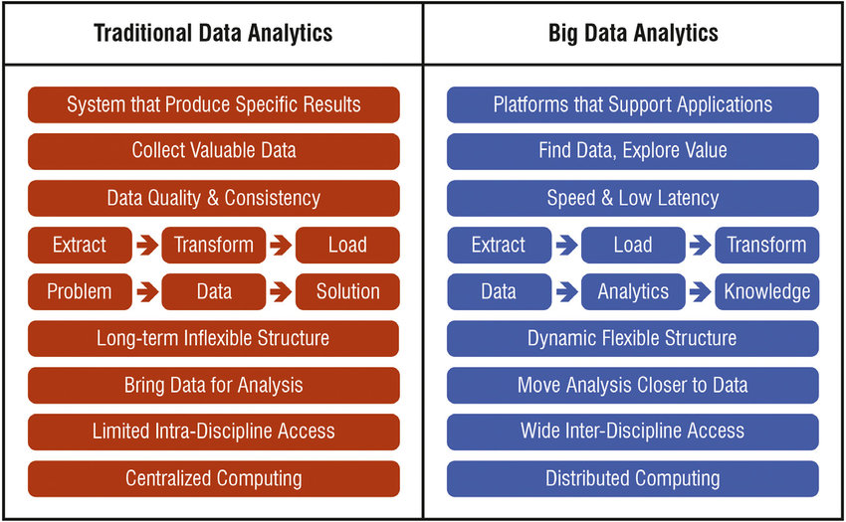
Traditional Data vs Big Data

Slide 10
Business analytics
Business analytics is the process of transforming data into insights to improve business decisions.
Data management, data visualization, predictive modeling, data mining, forecasting simulation, and optimization are some of the tools used to create insights from data.
Business analytics refers to new skills, naive practices, marketing, new technologies, and business tools algorithms for continuous iterative exploration.
It is used for deep investigation of past business performance

Slide 11
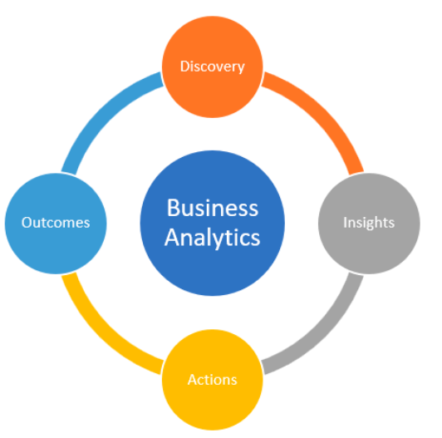

Slide 12
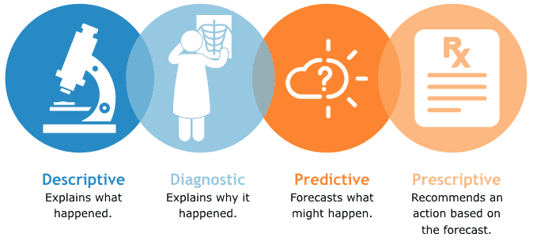
Types of Analytics

Slide 13
Descriptive Analysis:
It describes what is contained in a data set or database.
Simple statistical techniques that are used from the earlier period to describe future insights.

Slide 14
Diagnostic Analysis:
Diagnostic analytics is the successor of the Descriptive analytics
It allows an analyst to dig deeper into a problem or issue to arrive at the source of the problem.
It is generally characterized by techniques like data discovery, drill-down, data mining, etc.

Slide 15
Predictive Analysis
Predictive analytics is an application of advanced statistical techniques and tools.
It is used to build predictive models which are used in real time to identify trends and relationships.

Slide 16
Prescriptive Analysis:
Prescriptive analytics is the use of advanced processes and tools to analyze data and content to recommend the optimal course of action or strategy moving forward.
Prescriptive analysis is actually an application of decision science, management science, and operational research methodologies .

Slide 17
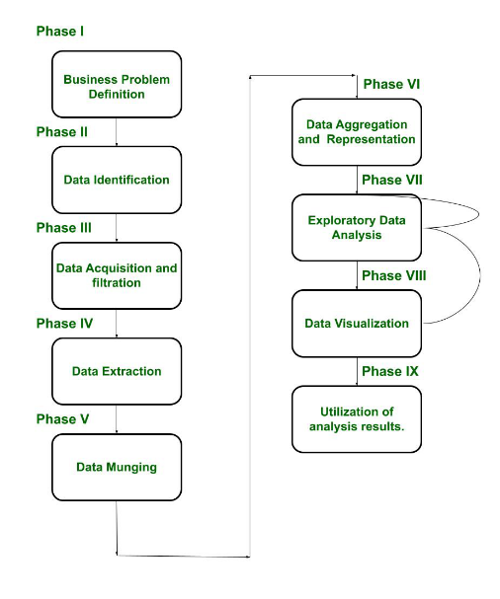
Big Data Analytics Life cycle

Slide 18
Business Problem Definition
In this stage, the team learns about the business domain, which presents the motivation and goals for carrying out the analysis.
.It helps the decision-makers understand the business resources that will be required to be utilized thereby determining the underlying budget required to carry out the project.
In this stage, the problem is identified, and assumptions are made

Slide 19
Data Definition
Once the business case is identified, now it’s time to find the appropriate datasets to work with.
In this stage, analysis is done to see what other companies have done for a similar case.
Depending on the business case and the scope of analysis of the project is been addressed.

Slide 20
Data Acquisition and filtration
Once the source of data is identified, now it is time to gather the data from such sources.
Filtration refers toremoval of the corrupt data or irrelevant data, which is of no scope to the analysis objective.
After filtration, a copy of the filtered data is stored and compressed, as it can be of use in the future, for some other analysis.

Slide 21
Data Extraction
Some of the entries of the data might be incompatible, to rectify this issue, a separate phase is created, known as the data extraction phase.
In this phase, the data, which don’t match with the underlying scope of the analysis, are extracted and transformed in such a form.

Slide 22
Data Munging
Preparing your data for a dedicated purpose.
Taking the data from its raw state and transforming and mapping into another format, normally for use beyond its original intent.
It includes removing any invalid data and establishing complex validation rules

Slide 23
Data Aggregation & Representation
The process of compiling typically [large] amounts of information from a given database .
Organizing it into a more consumable and comprehensive medium.
This phase calls for intensive operation since the amount of data can be very large. Automation can be brought into consideration, so that these things are executed, without any human intervention.

Slide 24
Exploratory Data Analysis
Depending on the nature of the big data problem, analysis is carried out.
Data analysis can be classified as Confirmatory analysis and Exploratory analysis.
In confirmatory analysis, the cause of a phenomenon is analyzed before.
In an exploratory analysis, the data is explored to obtain information.

Slide 25
Data Visualization
A sort of representation is required to obtains value or some conclusion from the analysis.
Some tools are used to visualize the data in graphic form, which can easily be interpreted by business users.
It allows the users to discover answers to questions that are yet to be formulated.

Slide 26
Utilization of analysis results
The business users needs to make decisions to utilize the results.
The results can be used for optimization, to refine the business process.
It can also be used as an input for the systems to enhance performance.

Slide 27
Big Data Analytics
Big Data analytics is a process used to extract meaningful insights, such as hidden patterns, unknown correlations, market trends, and customer preferences.
Big Data analytics provides various advantages in business fields.
It can be used for better decision making, preventing fraudulent activities, among other things.

Slide 28
Advantages of Big Data Analytics
Risk Management
Product Development and Innovations
Quicker and Better Decision Making Within Organizations
Improve Customer Experience

Slide 29
Big Data Characteristics
5 V's of Big Data
Volume
Veracity
Variety
Value
Velocity

Slide 30
Volume:
Big Data is a vast 'volumes' of data generated from many sources daily, such as business processes, machines, social media platforms, ne tworks, human interactions, and many more.
Variety:
Big Data can be structured, unstructured, and semi-structured that are being collected from different sources.
Veracity:
Veracity means how much the data is reliable. Veracity is the process of being able to handle and manage data efficiently. Big Data is also essential in business development.

Slide 31
Value
Value is an essential characteristic of big data.
It is not the data that we process or store. It is valuable and reliable data that we store, process, and also analyze.
Velocity
Velocity plays an important role compared to others. Velocity creates the speed by which the data is created in real-time.
It contains the linking of incoming data sets speeds, rate of change, and activity bursts.

Slide 32
Business Analytics Phases
Data Acquisition:
Data acquisition is the processes for bringing data that has been created by a source outside the organization, into the organization, for production use.
Data acquisition has been understood as the process of gathering, filtering, and cleaning data before the data is put in a data warehouse or any other storage solution.
The acquisition of big data is most commonly governed by four of the Vs: volume, velocity, variety, and value.

Slide 33
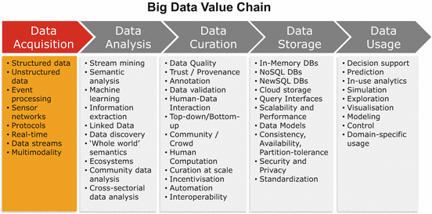

Slide 34
Frameworks and tech for data gathering
Data gathering frameworks and technologies are very specific when it comes to their functionalities and ideal usage, so it’s important to define your overall goals before you lock- in on any of them.
When it comes to data gathering, some of the most widely used frameworks and technologies are:

Slide 35
Storm
Storm is an open-source framework for robust distributed real-time computation on streams of data. It supports a wide range of programming languages and storage facilities, and one of its main advantages is that it can be utilized in many data gathering scenarios including stream processing and distributed RPC for solving intensive functions on-the-fly.
It’s used by a number of big systems, with some of the largest ones being Groupon, The Weather Channel and Twitter.

Slide 36
Simply Scalable Streaming System
Simply Scalable Streaming System or S4 is a distributed, general-purpose platform for developing applications that process streams of data which was launched by Yahoo! Inc. It is designed to work on commodity hardware, avoiding I/O bottlenecks by relying on an all-in- memory approach.
S4 provides a simple programming interface for processing data streams in a decentralized, symmetric, and pluggable architecture.

Slide 37
Kafka
Kafka is a distributed publish-subscribe messaging system designed to support persistent messaging with high-throughput. It aims to unify offline and online processing with its ability to partition real-time consumption over a cluster of machines, and is built in a way that minimizes the network overhead and sequential disk operations.
It was originally developed at LinkedIn to track the huge volume of activity events generated by the website.

Slide 38
Flume
Flume is a service whose purpose is to provide a distributed, reliable and available system for efficiently collecting, aggregating and moving large amounts of log data from many different sources to a centralized data store. Its architecture is based on streaming data flows — it is simple and flexible, but also robust and fault tolerant with tuneable reliability mechanisms and many failover and recovery mechanisms.
Flume was designed with these four key goals in mind — reliability, scalability, manageability and extensibility.

Slide 39
Hadoop
Hadoop is an open-source project that focuses on developing a framework for reliable, scalable, and distributed computing on big data using clusters of commodity hardware.
It’s used and supported by a large number of big organizations like Facebook, AOL, Baidu, IBM, Imageshack, and Yahoo.

Slide 40
Data Cleaning
Data cleaning is the process of fixing or removing incorrect, corrupted, incorrectly formatted, duplicate, or incomplete data within a dataset.
Data cleaning is a process by which inaccurate, poorly formatted, or otherwise messy data is organized and corrected.

Slide 41
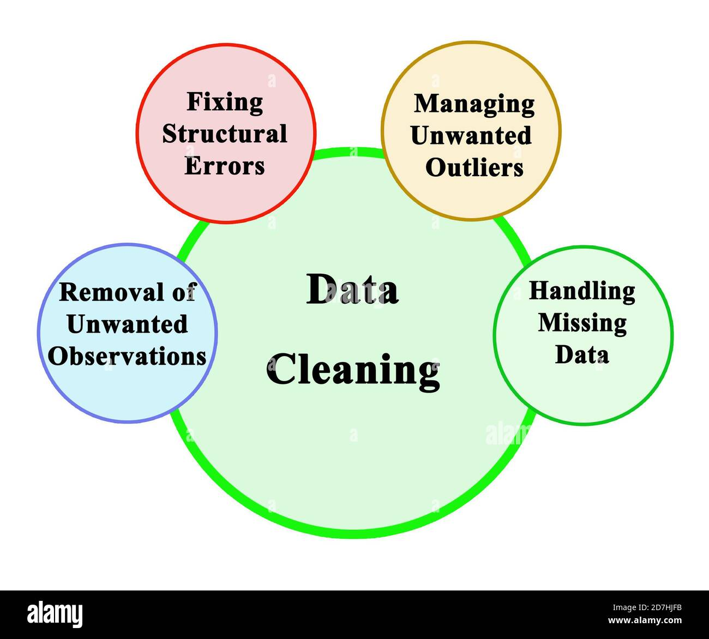

Slide 42
Remove duplicate or irrelevant observations
Remove unwanted observations from your dataset, including duplicate observations or irrelevant observations.
Duplicate observations will happen most often during data collection.
This can make analysis more efficient and minimize distraction from your primary target as well as creating a more manageable and more performant dataset.

Slide 43
Fix structural errors
Structural errors are when you measure or transfer data and notice strange naming conventions, typos, or incorrect capitalization
These inconsistencies can cause mislabeled categories or classes

Slide 44
Filter unwanted outliers
This step is needed to determine the validity of that data.
If an outlier proves to be irrelevant for analysis or is a mistake, consider removing it.

Slide 45
Handle missing data
you can drop observations that have missing values, but doing this will drop or lose information.
you can input missing values based on other observations.
you might alter the way the data is used to effectively navigate null values.

Slide 46
Validate and QA
At the end of the data cleaning process, you should be able to answer these questions as a part of basic validation:
Does the data make sense?
Does the data follow the appropriate rules for its field?
Does it prove or disprove your working theory, or bring any insight to light?
Can you find trends in the data to help you form your next theory?
If not, is that because of a data quality issue?

Slide 47
Data manipulation
Data manipulation is the method of organizing data to make it easier to read or more designed or structured.
Data manipulation is a key feature for business operations and optimization.

Slide 48
Advantages of Data manipulation
Consistent data: Data manipulation provides a way to organize your data inconsistent format that makes it structured, which can be read easily and better understood.
Project data: Especially when it comes to finances, data manipulation is more useful as it helps to provide more in-depth analysis by using historical data to project the future.
Delete or neglect redundant data: Data manipulation helps to maintain your data and delete unusable data that is always present.

Slide 49
Data analysis
Data analysis is the process of cleaning, changing, and processing raw data and extracting actionable, relevant information that helps businesses make informed decisions. ‘
This is the process of analyzing the past or future and making a decision based on that analysis.

Slide 50
Data Analysis Importance:
Better Customer Targeting
You Will Know Your Target Customers Better
Reduce Operational Costs
Better Problem-Solving Methods
You Get More Accurate Data

Slide 51
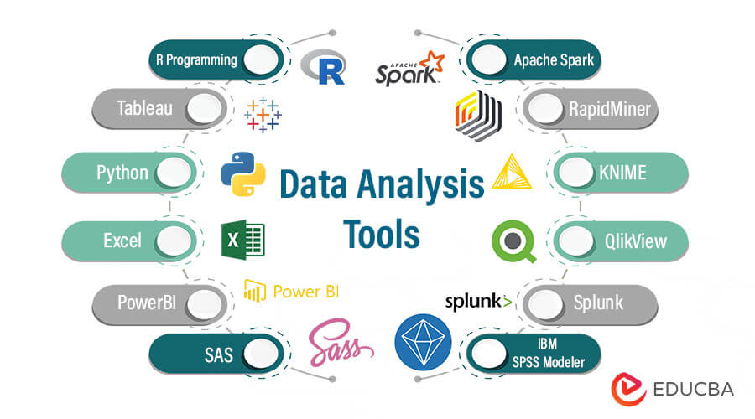

Slide 52
Data visualization:
Data visualization is the practice of translating information into a visual context, such as a map or graph, to make data easier for the human brain to understand and pull insights from.
The term is often used interchangeably with others, including information graphics, information visualization and statistical graphics.

Slide 53
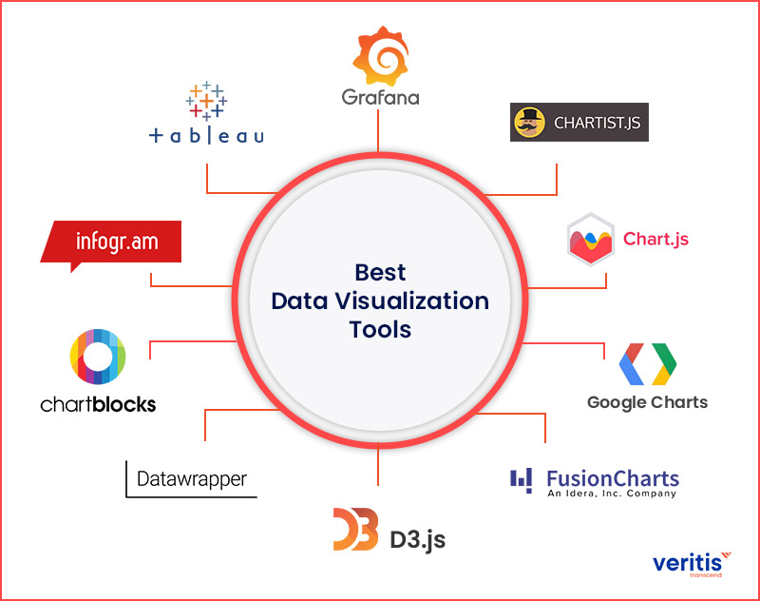

Slide 54
Benefits of data visualization
Absorb information quickly, improve insights and make faster decisions
An improved ability to maintain the audience's interest.
An easy distribution of information that increases the opportunity to share insights.
Achieve success with greater speed and less mistakes.

