Slide 1
Fraud Detection

Slide 2
Problem Statement
The dataset here is a list of all credit card transactions done by a customer. The bank wants to know based on the customer transaction whether it is a fraud or genuine purchase. Specifically, here the problem is a classification problem where we are trying to predict the dependent variable (Fraud) with the help of the information contained in the other variables.

Slide 3
Exploratory Data Analysis

Slide 4
Variables in Dataset
‘Distance from Home’,
‘Distance from Last Transaction’,
‘Ratio to Median Purchase Price’,
‘Repeat Retailer’,
‘Used Chip’,
‘Used Pin Number’,
‘Online Order’,
‘Fraud’

Slide 5
Nulls in Each column
'Distance_from_home': 0,
'Distance_from_last_transaction': 0,
'Ratio_to_median_purchase_price': 0,
'Repeat_retailer': 0,
'Used_chip': 0,
'Used_pin_number': 0,
'Online_order': 0,
'Fraud': 0,

Slide 6
Percentage of Nulls in each column
'Distance_from_home': 0.0,
'Distance_from_last_transaction': 0.0,
'Ratio_to_median_purchase_price': 0.0,
'Repeat_retailer': 0.0,
'Used_chip': 0.0,
'Used_pin_number': 0.0,
'Online_order': 0.0,
'Fraud': 0.0

Slide 7
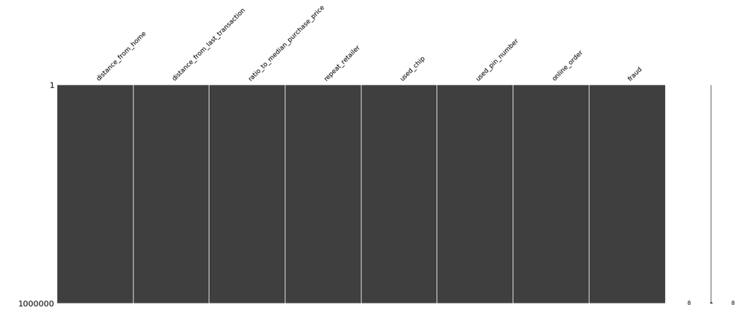
Pictorial representation of Null data

Slide 8




Frequency Analysis:

Slide 9
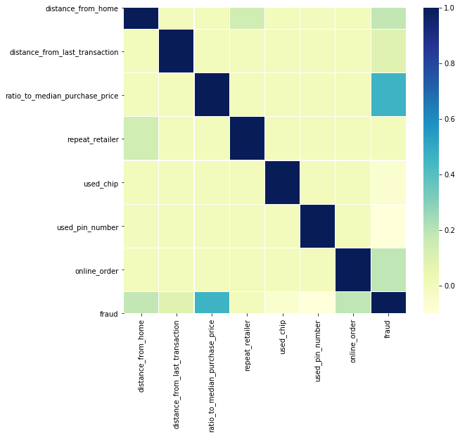
Correlation Matrix

Slide 10
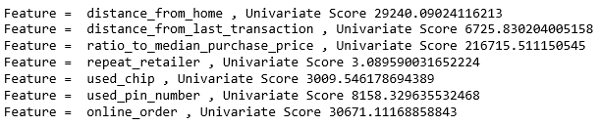
Solution Architect and Approach : Fraud Detection
From Univariate Analysis we can see that Ratio to Median Purchase Price feature contributes more to predicting Fraud and Repeat Retailer feature can be ignored.

Slide 11
Exploratory Analysis on the Data- Conclusion
Based on the Exploratory Data analysis we see that data is well polished without any nulls in any columns.
90% of the time he didn’t use the pin while performing a transaction.
Close to 90% of the time the customer goes to same retailer for purchasing products.
Only 35% of time the customer used Chip.
Customer prefers Online transaction as suggested by the 65% of the data.

Slide 12
Solution Architect and Approach : Predict Age of a Consumer
As per Exploratory Data Analysis we can see the Age is classified into 7 different Categories.
As we are dealing with Categorical data, we can safely say this is a Classification problem.
I will start eliminating few columns which are non-numeric like Product ID and Stay in Current City in Years.
I’ll be performing Univariate Analysis to reduce the dimensionality, if necessary.
I’ll clean the data starting with filling the gaps in Product Category 2 and Product Category 3 columns which has nulls in it.
As this is a Classification problem, I’ll start with Decision Tree. If this model didn’t yield good results, I’ll use Random Forest algorithm.

Slide 13
Solution Architect and Approach : Predict Amount of Purchase based on rest of data.
Purchase mainly depends on different products we buy. So I’ll start my analysis with different Product Categories.
My features will be Product Category 1, Product Category 2, Product Category 3.
I’ll clean the columns Product Category 2 and Product Category 3 to fill out the null values.
Calculating price/cost is a regression problem.
I’ll build my model using Linear Regression approach.

Slide 14
Results of the analysis
I’ve taken 80% as training data and 20 % as test data.
For both Classification and Regression problems I’ve considered columns with only Numerical data.
I’ve trained the Classification model using Decision Tree and Regression model using Linear Regression.
I’ve used Accuracy score and confusion matrix to calculate Accuracy of the model and also show the TP, TN, FP, FN.
I didn’t encounter overfitting in this particular data set. If I had, I’ll start reducing more dimensions to get the best output.

Slide 15

Conclusion and how does the analysis help the business to solve the problem
Recommendation
Suggest products based on age.
Suggest products based on their buying pattern.
Suggest products based on location customers belong to.
Suggest products based on gender.

Slide 16
THANK YOU

