Slide 1
Fraud Detection

Slide 2
Problem Statement
The dataset here is a list of all credit card transactions done by a customer. The bank wants to know based on the customer transaction whether it is a fraud or genuine purchase. Specifically, here the problem is a classification problem where we are trying to predict the dependent variable (Fraud) with the help of the information contained in the other variables.

Slide 3
Exploratory Data Analysis

Slide 4
Variables in Dataset
‘Distance from Home’,
‘Distance from Last Transaction’,
‘Ratio to Median Purchase Price’,
‘Repeat Retailer’,
‘Used Chip’,
‘Used Pin Number’,
‘Online Order’,
‘Fraud’

Slide 5
Nulls in Each column
'Distance_from_home': 0,
'Distance_from_last_transaction': 0,
'Ratio_to_median_purchase_price': 0,
'Repeat_retailer': 0,
'Used_chip': 0,
'Used_pin_number': 0,
'Online_order': 0,
'Fraud': 0,

Slide 6
Percentage of Nulls in each column
'Distance_from_home': 0.0,
'Distance_from_last_transaction': 0.0,
'Ratio_to_median_purchase_price': 0.0,
'Repeat_retailer': 0.0,
'Used_chip': 0.0,
'Used_pin_number': 0.0,
'Online_order': 0.0,
'Fraud': 0.0

Slide 7
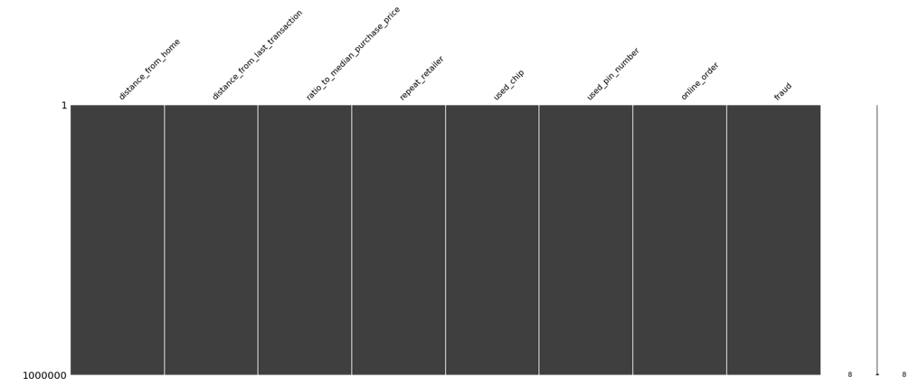
Pictorial representation of Null data

Slide 8




Frequency Analysis:

Slide 9
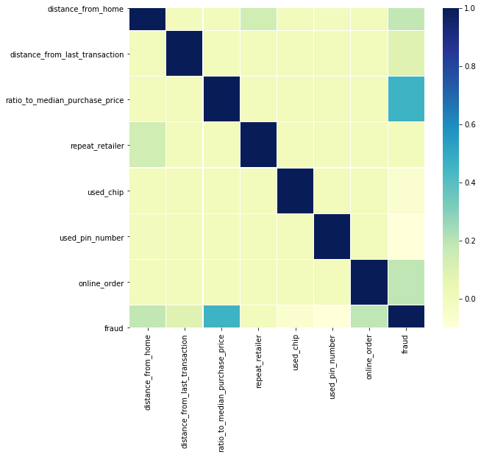
Correlation Matrix

Slide 10
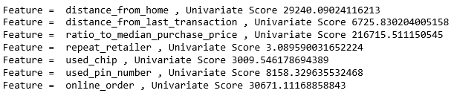
Solution Architect and Approach : Fraud Detection
From Univariate Analysis we can see that Ratio to Median Purchase Price feature contributes more to predicting Fraud and Repeat Retailer feature can be ignored.

Slide 11
Exploratory Analysis on the Data- Conclusion
Based on the Exploratory Data analysis we see that data is well polished without any nulls in any columns.
90% of the time customer didn’t use the pin while performing a transaction.
Close to 90% of the time the customer goes to same retailer for purchasing products.
Only 35% of time the customer used Chip.
Customer prefers Online transaction as suggested by the 65% of the data.

Slide 12
Solution Architect and Approach : Detect Fraud
As per Exploratory Data Analysis we can see that the dataset is valid but statistically imbalanced as 90% of the data is categorized into Label 0 and the rest in Label 1.
As we are dealing with Categorical Label, we can safely say this is a Classification problem.
I will start with feature engineering and decide important features required for model.
I’ll be performing Univariate Analysis to reduce the dimensionality, if necessary.
As this is a Classification problem, I’ll start with Decision Tree. If this model didn’t yield good results, I’ll use Random Forest algorithm.
Feature “Repeat_Retailer” scored less in Univariate Analysis, so we can safely remove this feature.

Slide 13
Decision Trees
I chose Decision Trees as my first Model to solve the Fraud Detection problem.
Decision Tree was able to perfectly fit the training data and was near to perfect on test dataset.
It’s not a case of overfitting as it was able to fit both Train and test data.
So we can call this a Perfect Fit.
As we have achieved high accuracy we didn’t go for Cross Validation.
In the next slide please find all the metrics for this model.

Slide 14
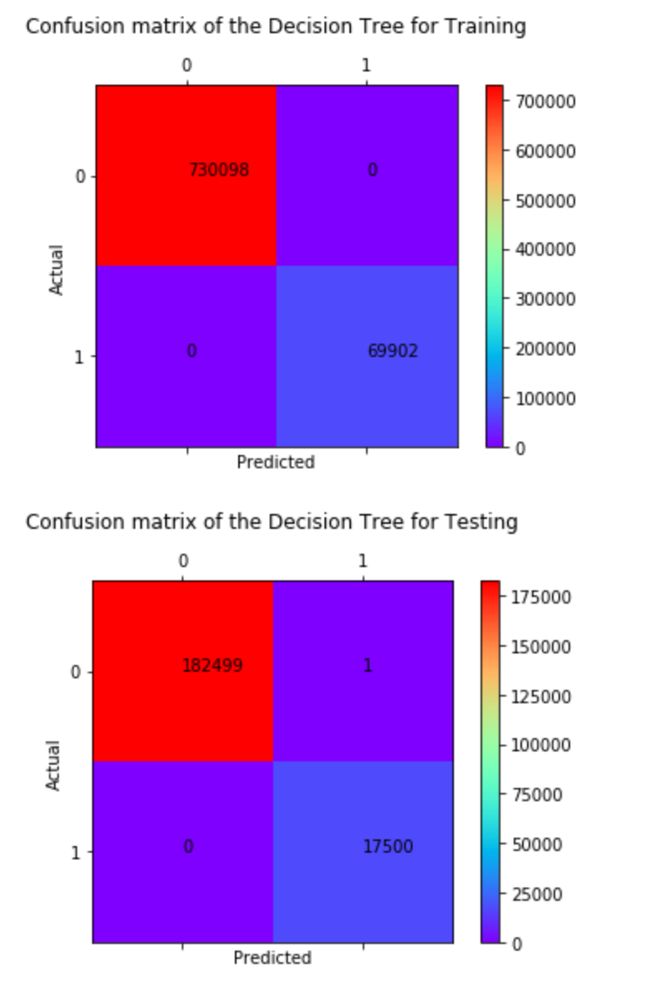
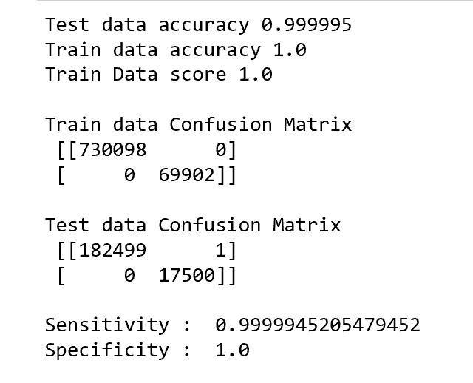
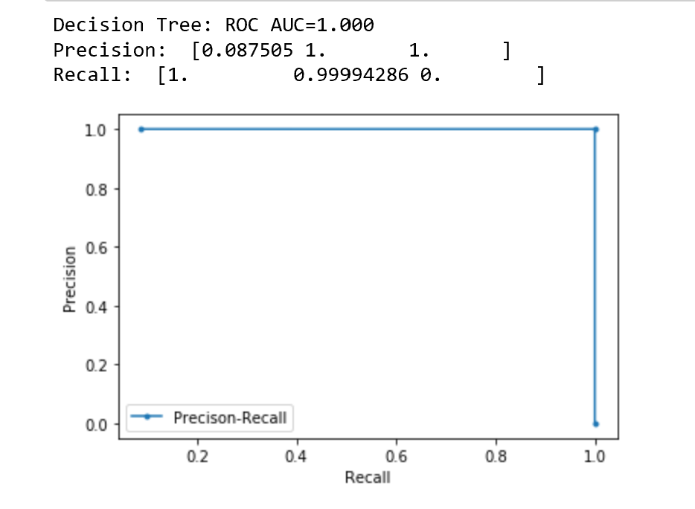
Decision Trees Metrics

Slide 15
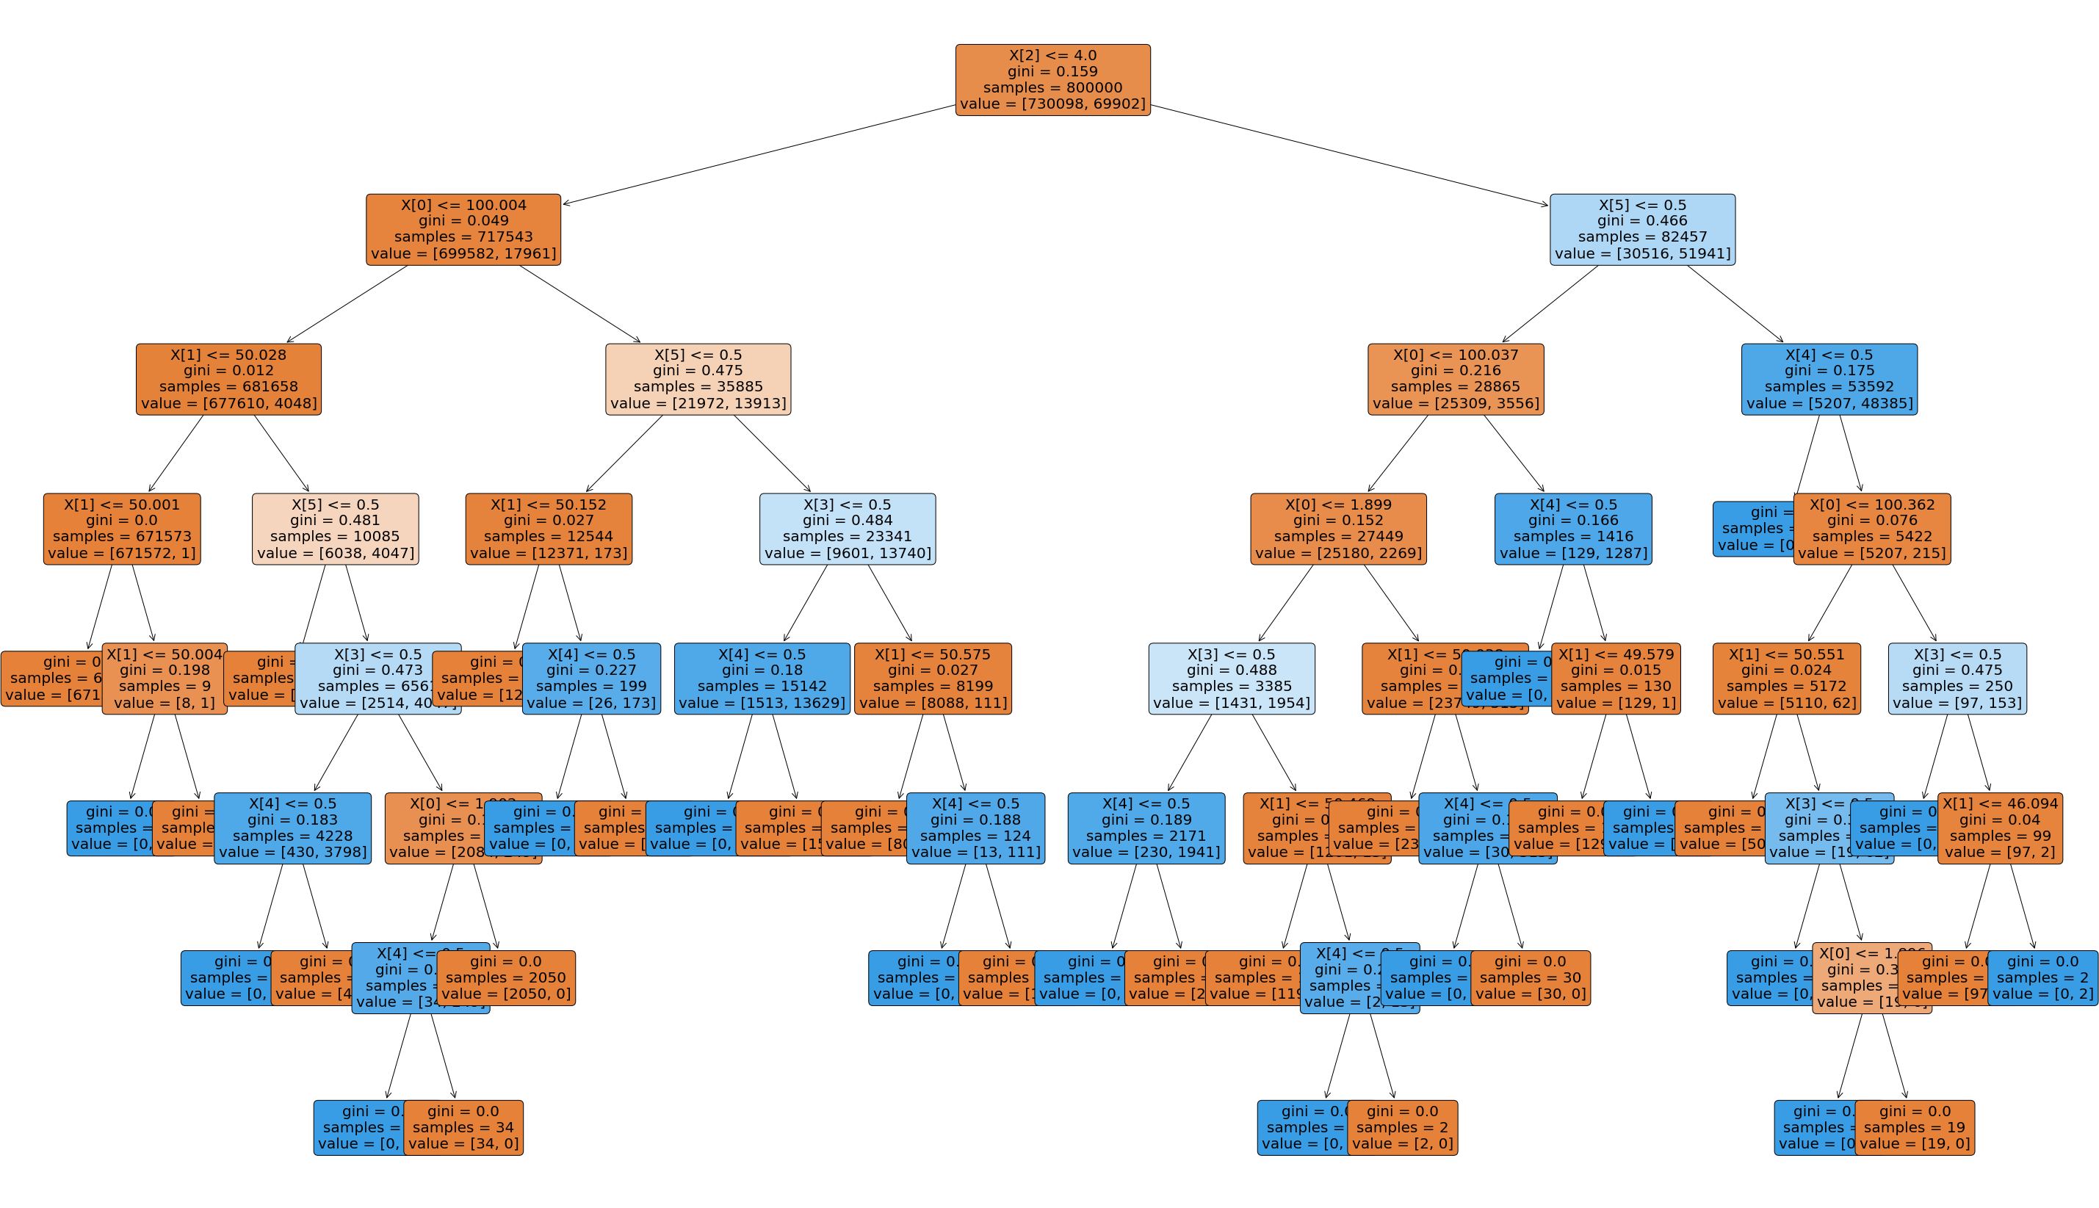

Slide 16
Random Forest
Random Forest is an ensemble model where average of multiple decision trees are taking into consideration.
It’s always better to go with a Random Forest instead of a single decision tree.
When a new data point is introduced, decision tree might not perform as good classification as Random Forest.
So when in doubt we should go with Random Forest.
In the next slide we can see the performance metrics of this model.

Slide 17
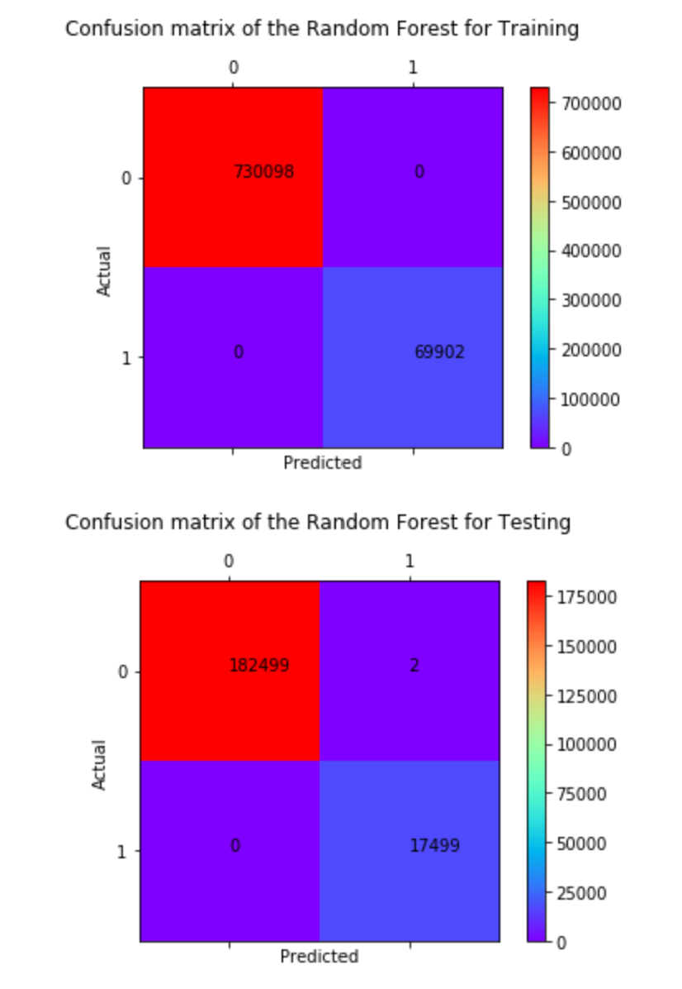
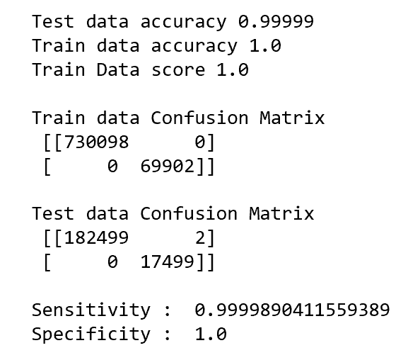
Random Forest Metrics

Slide 18
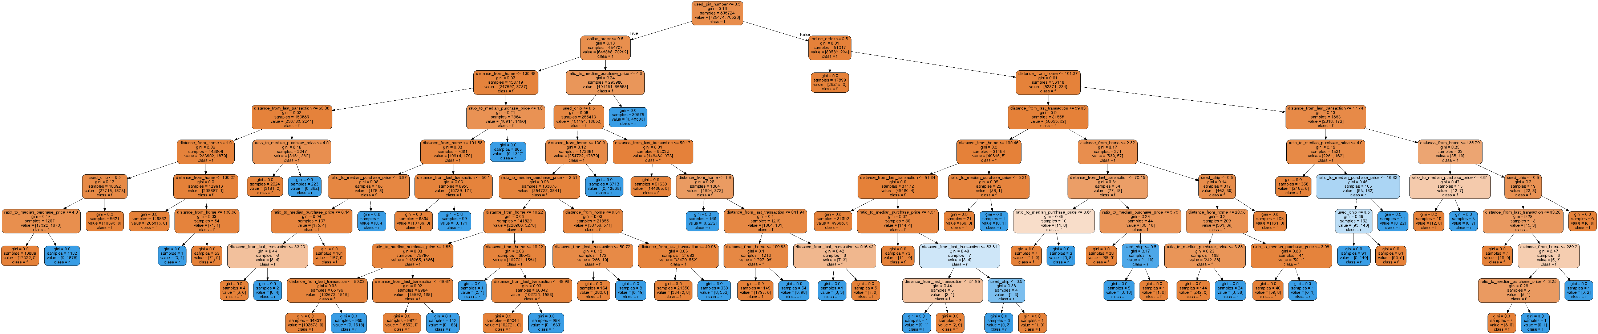

Slide 19
Logistic Regression and Naïve Bayes
I tried Logistic Regression and Naïve Bayes models to see how these models performs against the data.
Both models provided good accuracy, but when compared to Random Forest or decision tree they fell short.
Accuracy is between to 95-96% for both models.
So it’s better go with Random Forest instead of Logistic or Naïve Bayes.
In the next few pages we can see the performance metrics of these 2 models.

Slide 20
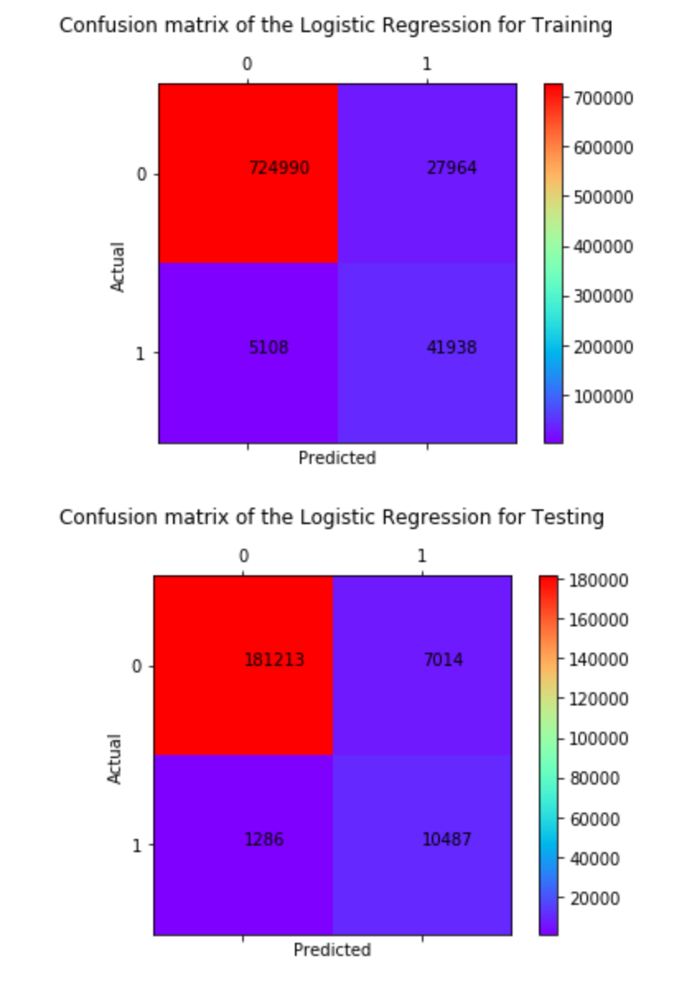
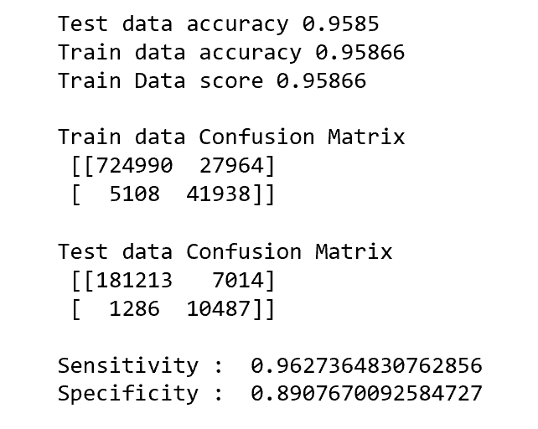
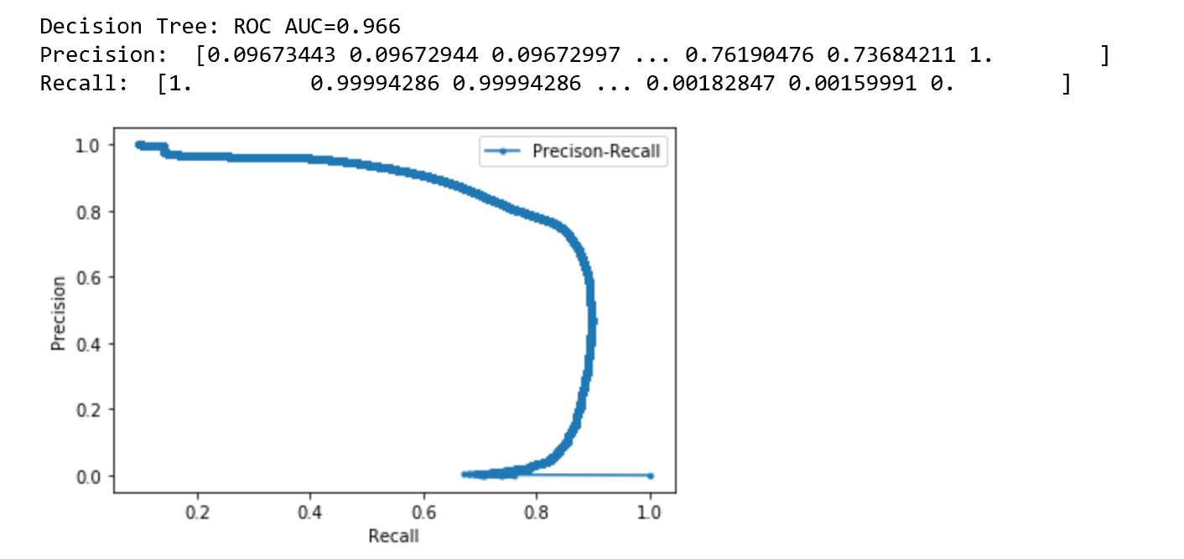
Logistic Regression

Slide 21
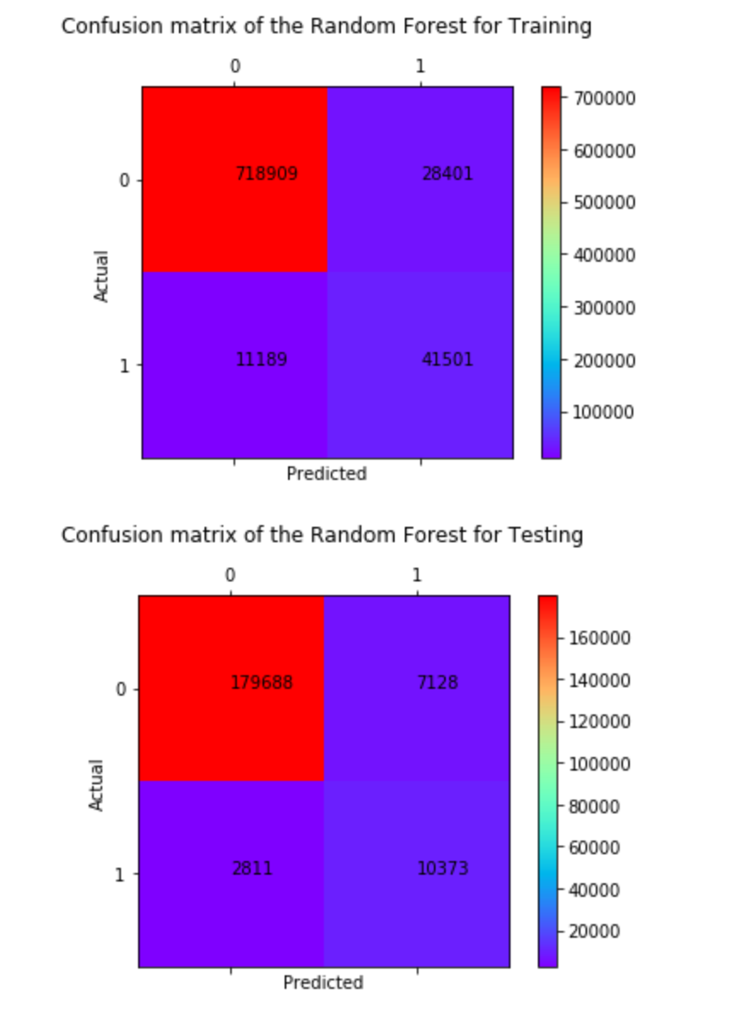
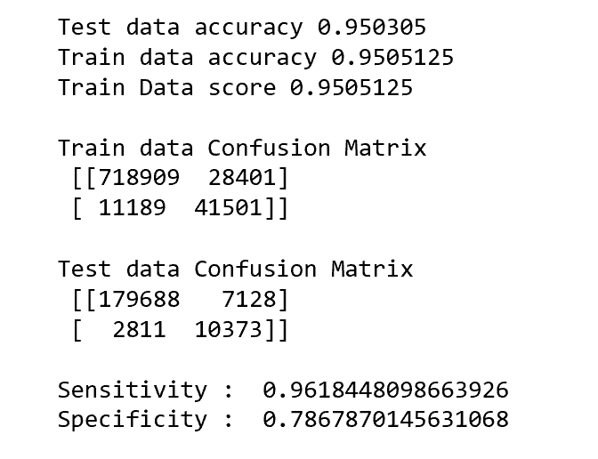
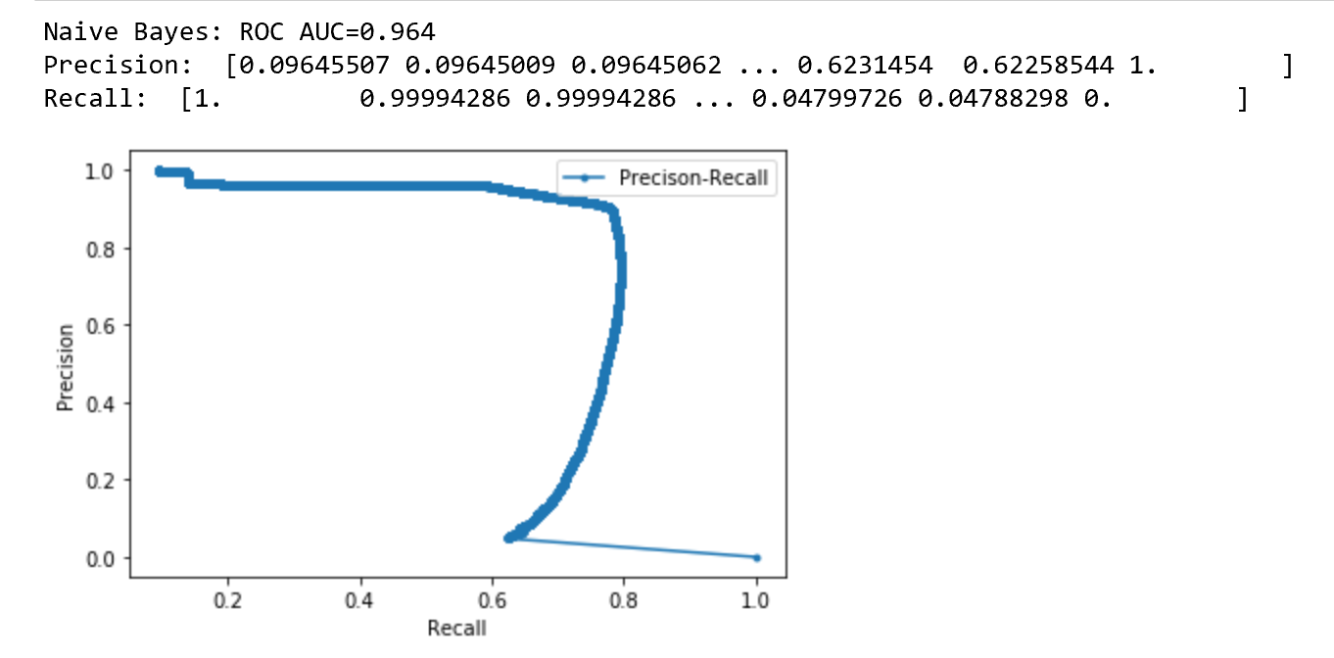
Naïve Bayes

Slide 22
Conclusion
Decision Tree, Random Forest, Logistic Regression and Naïve Bayes models are used to detect fraud.
Decision Tree and Random Forest came out on top with an accuracy ~ 100%.
Logistic Regression and Naïve Bayes were able to produce accuracy close to 96%.
Out of Decision Tree and Random Forest, I’ll go with Random Forest as my model to perform Fraud Detection because when new data points are introduced into the model, Random Forest performs better than Decision tree as it takes the Average of multiple decision trees to classify the data.

Slide 23
THANK YOU

