Slide 1
Black Friday Kaggle Data set

Slide 2
Problem Statement
The dataset here is a sample of the transactions made in a retail store. The store wants to know better the customer purchase behaviour against different products. Specifically, here the problem is a regression problem where we are trying to predict the dependent variable (the amount of purchase) with the help of the information contained in the other variables.
Classification problem can also be settled in this dataset since several variables are categorical, and some other approaches could be "Predicting the age of the consumer" or even "Predict the category of goods bought". This dataset is also particularly convenient for clustering and maybe find different clusters of consumers within it.

Slide 3
Exploratory Data Analysis

Slide 4
Variables in Dataset
'User_ID’,
'Product_ID',
'Gender',
'Age',
'Occupation',
'City_Category',
'Stay_In_Current_City_Years',
'Marital_Status',
'Product_Category_1',
'Product_Category_2',
'Product_Category_3',
'Purchase'

Slide 5
Nulls in Each column
'User_ID': 0,
'Product_ID': 0,
'Gender': 0,
'Age': 0,
'Occupation': 0,
'City_Category': 0,
'Stay_In_Current_City_Years': 0,
'Marital_Status': 0,
'Product_Category_1': 0,
'Product_Category_2': 166986,
'Product_Category_3': 373299,
'Purchase': 0

Slide 6
Percentage of Nulls in each column
'User_ID': 0.0,
'Product_ID': 0.0,
'Gender': 0.0,
'Age': 0.0,
'Occupation': 0.0,
'City_Category': 0.0,
'Stay_In_Current_City_Years': 0.0,
'Marital_Status': 0.0,
'Product_Category_1': 0.0,
'Product_Category_2': 31.0,
'Product_Category_3': 69.0,
'Purchase': 0.0

Slide 7
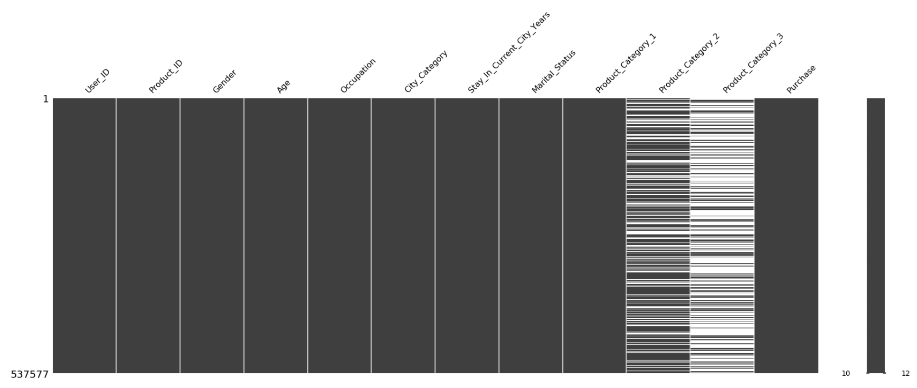
Pictorial representation of Null data

Slide 8
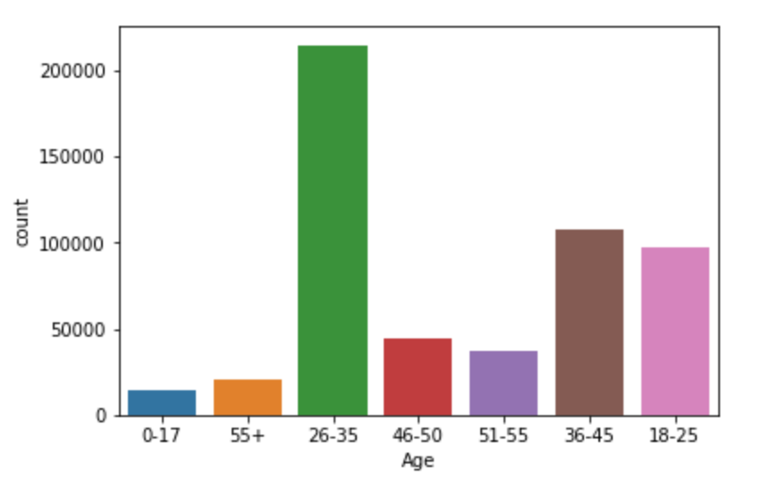
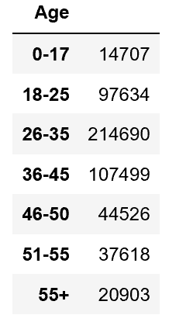
Frequency Analysis: Age

Slide 9
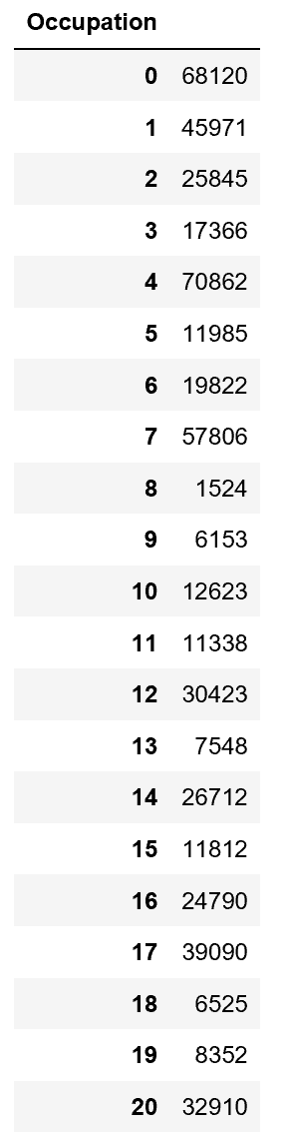
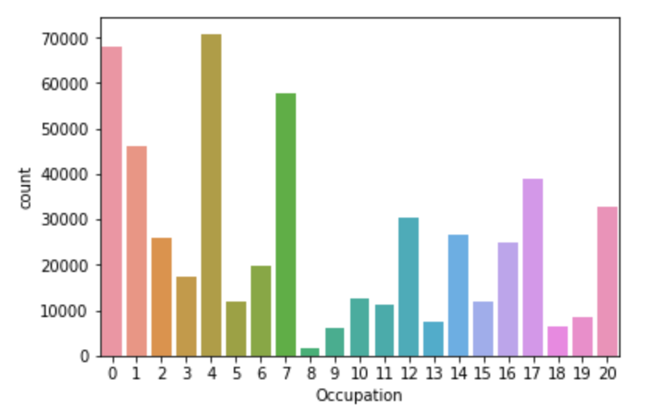
Frequency Analysis: Occupation

Slide 10
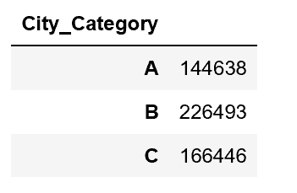
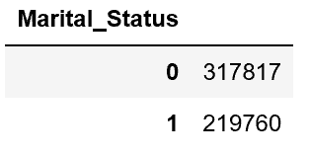
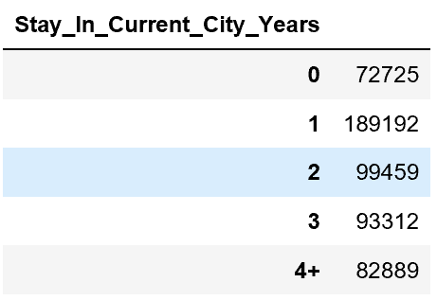
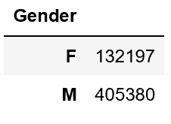
Frequency Analysis:

Slide 11
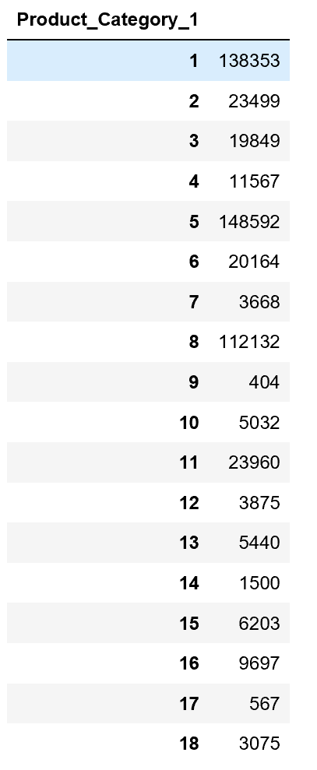
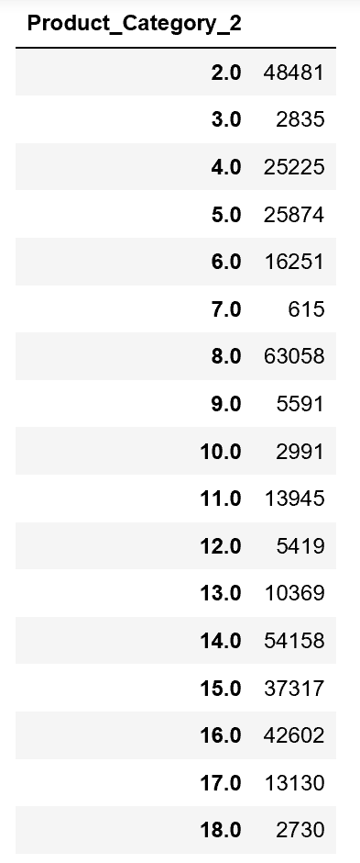
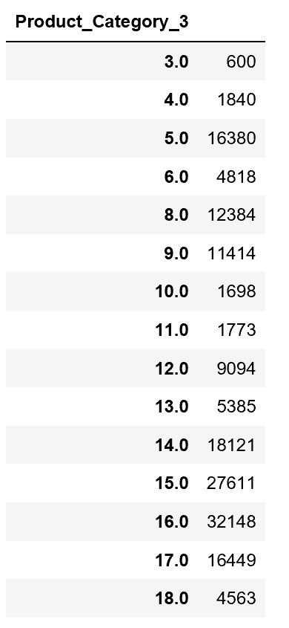
Frequency Analysis:

Slide 12
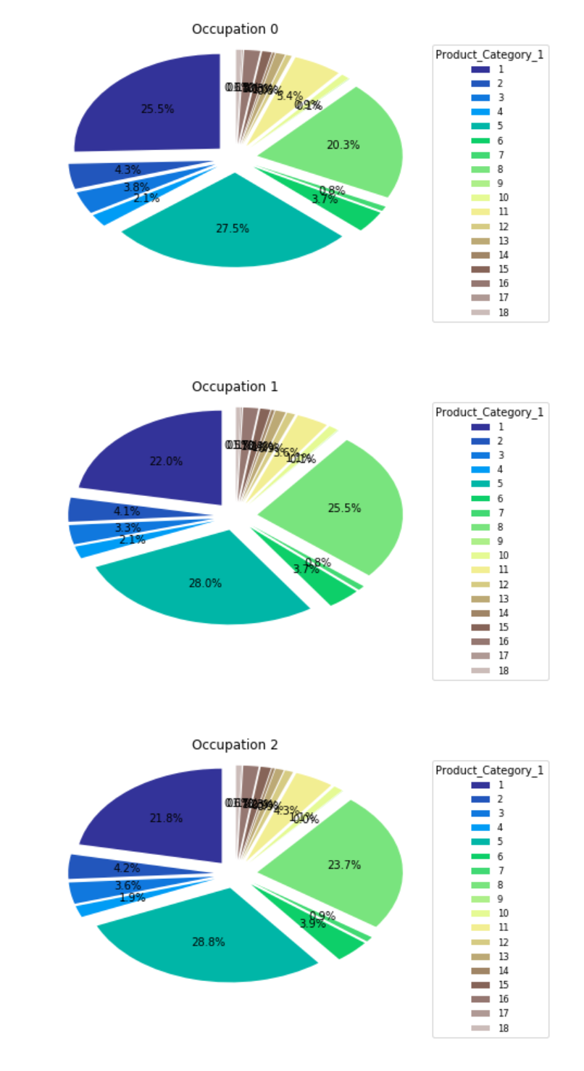
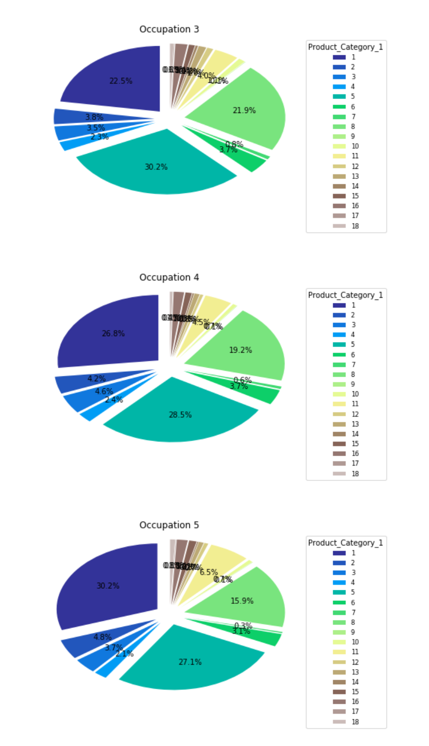
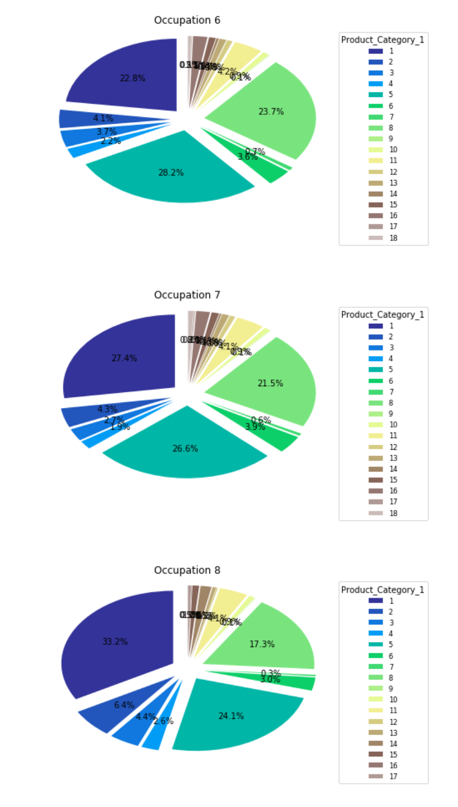

Slide 13
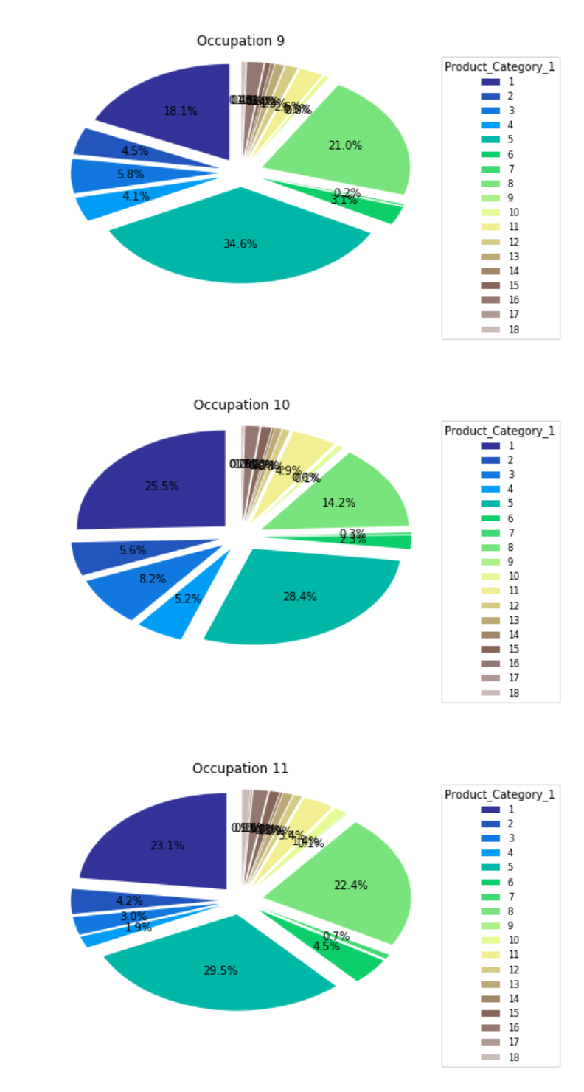
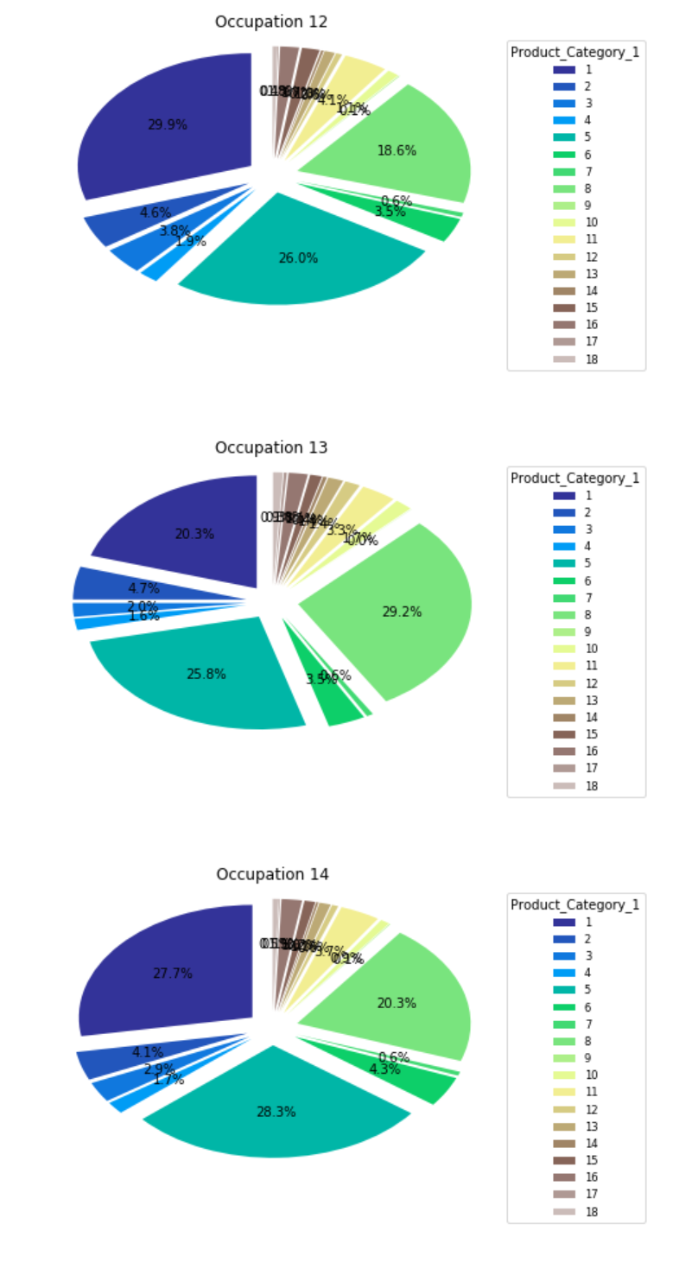
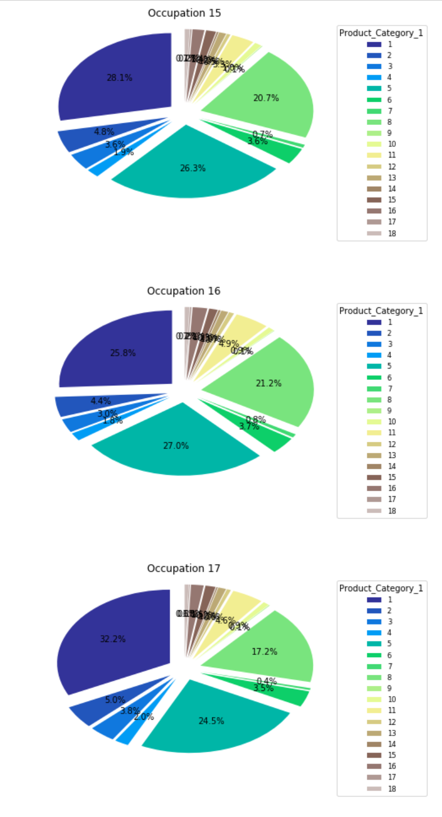
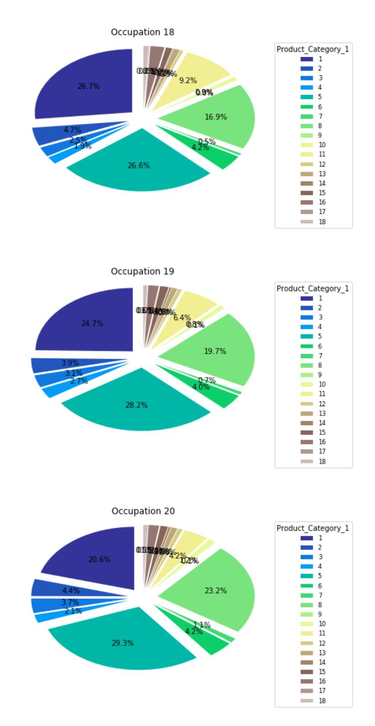

Slide 14
Exploratory Analysis on the Data- Conclusion
Based on the Exploratory Data analysis we see that Products 1 and 5 are the most bought products.
Also products 13 to 18 are least bought.
All Product Category columns are useful for the analysis and the Products purchased can predict the Age of the customer and pricing too.
Occupation and Marital Status are also key columns to Predict Age of a Consumer.
I’ll be transforming Product Category 2 and Product Category 3 columns as there are nulls in these columns.

Slide 15
Solution Architect and Approach : Predict Age of a Consumer
As per Exploratory Data Analysis we can see the Age is classified into 7 different Categories.
As we are dealing with Categorical data we can safely say this is a Classification problem.
I will start eliminating few columns which are non-numeric like Product ID and Stay in Current City in Years.
I’ll be performing Univariate Analysis to reduce the dimensionality, if necessary.
I’ll clean the data starting with filling the gaps in Product Category 2 and Product Category 3 columns which has nulls in it.
As this is a Classification problem I’ll start with Decision Tree. If this model didn’t yield good results I’ll use Random Forest algorithm.

Slide 16
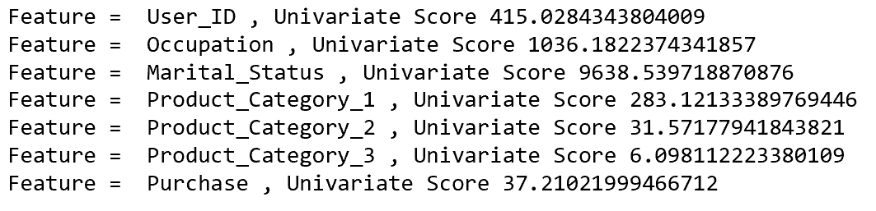
Solution Architect and Approach : Predict Age of a Consumer
From Univariate Analysis we can see that Marital Status and Occupation are the main factors to predict the Age Group of Consumer.

Slide 17
Solution Architect and Approach : Predict Amount of Purchase based on rest of data.
Purchase mainly depends on different products we buy. So I’ll start my analysis with different Product Categories.
My features will be Product Category 1, Product Category 2, Product Category 3.
I’ll clean the columns Product Category 2 and Product Category 3 to fill out the null values.
Calculating price/cost is a regression problem.
I’ll build my model using Linear Regression approach.

Slide 18
Results of the analysis
I’ve taken 80% as training data and 20 % as test data.
For both Classification and Regression problems I’ve considered columns with only Numerical data.
I’ve trained the Classification model using Decision Tree and Regression model using Linear Regression.
I’ve used Accuracy score and confusion matrix to calculate Accuracy of the model and also show the TP, TN, FP, FN.
I didn’t encounter overfitting in this particular data set. If I had, I’ll start reducing more dimensions to get the best output.

Slide 19

Conclusion and how does the analysis helps the business to solve the problem
Recommendation
Suggest products based on age.
Suggest products based on their buying pattern.
Suggest products based on location customers belong to.
Suggest products based on gender.

Slide 20
THANK YOU

