Slide 1
Domain: Deep Learning
Technology: Python
<
IMAGE CAPTION GENERATOR USING CNN & LSTM

Slide 2
Index
Abstract
Introduction
Literature review
Existing Method
Drawbacks
Proposed method
Advantages
Applications
Hardware and Software Requirements
UML Diagrams
Results
Conclusion
References

Slide 3
Abstract
When we see an image, we can quickly recognize what is going on in the image, what objects are present and what they are doing. With the progress in Artificial Intelligence (AI), we are trying to do the same automatically by our computers. The need for such a system is increasing especially due to the advent of autonomous vehicles / semi-autonomous vehicles which involves reading and understanding millions of images. Automatically generating captions for any given image requires the use of Natural Language Processing (NLP) techniques and Neural Networks to classify the images. The ability for a computer to generate captions to an image has various business and individual benefits.

Slide 4
Introduction:
Unlike Humans, machines have a hard time in understanding what is going on in a natural scenic image.
However, The need for a system to understand images is increasing especially with the advent of Autonomous/ Semi-Autonomous driving systems.
Understanding images is also vital in order for an image search engine to work.
Such an application can be used for Image tagging by social media networks, governments for aerial reconnaissance, helping the visually impaired.

Slide 5
To understand an image and generate captions, we are proposing a Deep learning based method.
Deep learning can provide increased accuracy and decrease in computational power.
We will use Convolution Neural Networks (CNN) and Long Short Term Memory (LSTM) to do so.
Convolution Neural Network (CNN) is widely used for automatic feature extraction from images. It uses the mathematical operator convolution.
Whereas, usual Neural Networks uses matrix multiplication.

Slide 6
LSTM is used to handle sequences of images at a time.
It is a type of Recurrent Neural Network (RNN) but RNN have the problem of vanishing gradients which can make it harder to train.
To counter the problem of vanishing gradients, we implement a model using Long Short Term Memory (LSTM).
The Features from CNN and Sequences from LSTM are merged to generate the captions of any image.

Slide 7
Literature review:
S. NO | Journal Type with year | Authors | Title | Outcomes
1 | Physica D: Nonlinear Phenomena 404 (2020) | Sherstinsky, Alex | Fundamentals of Recurrent Neural Network (RNN) and Long Short-Term Memory (LSTM) Network | Fundamentals of RNN and LSTM and the relation between them.
2 | Journal of Physics: Conference Series 1087 (2018) | Liu, Yu Han | Feature Extraction and Image Recognition with Convolutional Neural Networks | The working of CNN. Its characteristics etc are defined.

Slide 8
S. NO | Journal Type with year | Authors | Title | Outcomes
3 | Proceedings of the 1st Joint SLTU and CCURL Workshop (SLTU-CCURL 2020) | Aung, San & Pa, Win & nwe, tin | Automatic Myanmar Image Captioning using CNN and LSTM-Based Language Model | Created corpus of images to caption in Burmese. VGG is used with CNN and LSTM for image captioning.
4 | IEEE Conference on Computer Vision and Pattern Recognition (CVPR) (2017) | Chollet, Francois | Xception: Deep Learning with Depthwise Separable Convolutions | A new architecture based on depthwise separable convolutions is proposed.

Slide 9
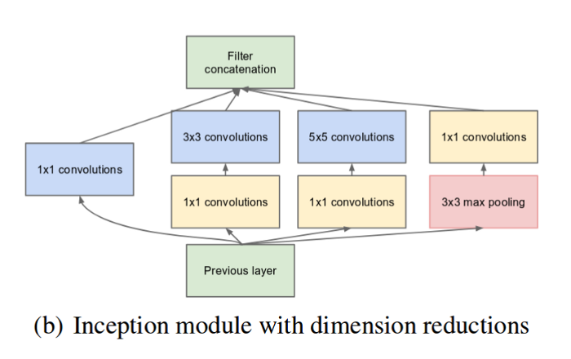
Existing method:
The below block describes the existing method.

Slide 10
Features in an image can have very high variations from image to image.
It makes it difficult to select the appropriate kernel size and weight for convolution.
Going deeper with more layers can be a valid solution but it is computationally intensive.
In 2014, It was proposed that the layers should not just be deeper, but also be wider by adding multiple parallel layers known as Inception.
It also reduces the chances of overfitting.
Since then, we currently have Inception v3.

Slide 11
Disadvantages in Existing method:
Inception v3 has lower accuracy compared to the proposed system especially when trained on large datasets.
Computational complexity is also higher than the proposed system.

Slide 12
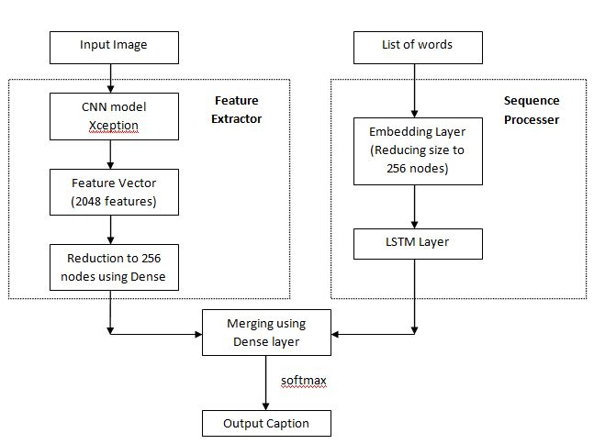
Proposed method:
We propose the same deep learning model using Xception architecture.

Slide 13
The Xception architecture is defined as an extreme version of Inception.
It is a modified form of depthwise seperable convolutions.
In this modified version, pointwise convolution is performed first using a 1x1 kernel size followed by a depthwise convolution (inception modules) in multiple levels.
Since, we are using Flickr8k dataset (which is a considerably small dataset), the difference between our proposed system and the existing system is minimal.

Slide 14
Procedure
An image is taken as an input.
It is resized to (299,299) pixels.
It is scaled by diving by 127.5 and the values are subtracted by 1
The image is then fed into the CNN model build over the Xception architecture to extract the feature from it.
In total Xception is 71 layers deep.

Slide 15
Modern image captioning methods uses deep learning techniques does not requires us to specify all the features that we want.
They automatically captures the features and hence such methods are highly scalable.
Deep learning solves the problem of feature extraction and selection by representing the representation in the form in simpler representations in multiple layer (hence the name Deep Learning).
Convolution Neural Network (CNN) is widely used for automatic feature extraction from images.

Slide 16
Convolution Neural Networks are followed by Long Short Term Memory (LSTM) to predict the captions one by one in sequence of words.
Long Short Term Memory (LSTM) cannot just process individual images, but can also process sequence of images or videos.
It is a type of RNN model.
An RNN is a type of neural network which is repeated again and again and the newer repetitions are only dependent on the previous one computation enabling the processing of a sequence of data.

Slide 17
But, RNN poses the problem of vanishing gradient for multi layered model.
It can make the model harder to train.
If a gradient value becomes extremely small, it doesn’t contribute too much learning.
To prevent the problem to vanishing gradients, we use Long Short Term Memory (LSTM) which is a modified version of RNN.
LSTMs have an edge over conventional feed-forward neural networks and RNN in many ways. This is because of their property of selectively remembering patterns for long durations of time.

Slide 18
We merge both CNN and LSTM model to produce the captions.
Softmax takes in a vector of numbers and converts them to probabilities which are then used for image generating results.
Softmax converts logits into probabilities by taking the exponents from every output and then normalize each of these numbers by the sum of such exponents, such that the entire output vector adds up to one.

Slide 19
Advantages of Proposed method:
Increased accuracy especially for large dataset.
Decrease in complexities.

Slide 20
Hardware and Software Requirements:(Font : Times New Roman, Font size : 24, Bold)
Python v3.6+
RAM: 4GB minimum (8GB recommended especially if using only CPU to process data).
Dedicated graphics card (optional)

Slide 21
Use Case Diagram
A use case diagram in the Unified Modeling Language (UML) is a type of behavioral diagram defined by and created from a Use-case analysis. Its purpose is to present a graphical overview of the functionality provided by a system in terms of actors, their goals (represented as use cases), and any dependencies between those use cases. The main purpose of a use case diagram is to show what system functions are performed for which actor. Roles of the actors in the system can be depicted.

Slide 23
Class Diagram
In software engineering, a class diagram in the Unified Modeling Language (UML) is a type of static structure diagram that describes the structure of a system by showing the system's classes, their attributes, operations (or methods), and the relationships among the classes. It explains which class contains information.

Slide 24
Sequence Diagram
A sequence diagram in Unified Modeling Language (UML) is a kind of interaction diagram that shows how processes operate with one another and in what order. It is a construct of a Message Sequence Chart. Sequence diagrams are sometimes called event diagrams, event scenarios, and timing diagrams.

Slide 26
Collaboration Diagram
In collaboration diagram the method call sequence is indicated by some numbering technique as shown below. The number indicates how the methods are called one after another. We have taken the same order management system to describe the collaboration diagram. The method calls are similar to that of a sequence diagram. But the difference is that the sequence diagram does not describe the object organization where as the collaboration diagram shows the object organization.

Slide 28
Deployment Diagram
Deployment diagram represents the deployment view of a system. It is related to the component diagram. Because the components are deployed using the deployment diagrams. A deployment diagram consists of nodes. Nodes are nothing but physical hardware used to deploy the application.

Slide 29
Activity Diagram
Activity diagrams are graphical representations of workflows of stepwise activities and actions with support for choice, iteration and concurrency.
In the Unified Modeling Language, activity diagrams can be used to describe the business and operational step-by-step workflows of components in a system.
An activity diagram shows the overall flow of control.

Slide 31
Component Diagram
A component diagram, also known as a UML component diagram, describes the organization and wiring of the physical components in a system. Component diagrams are often drawn to help model implementation details and double-check that every aspect of the system's required functions is covered by planned development.

Slide 32
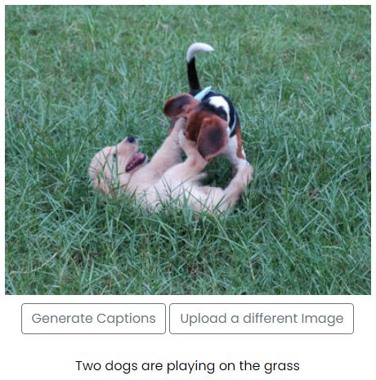
Results
Some of the generated captions are: (This is a good one)

Slide 33
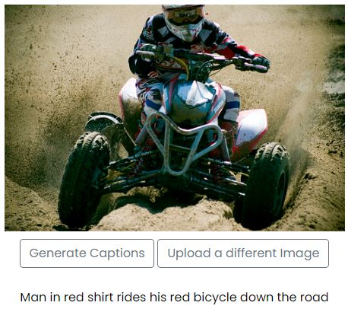

Slide 34
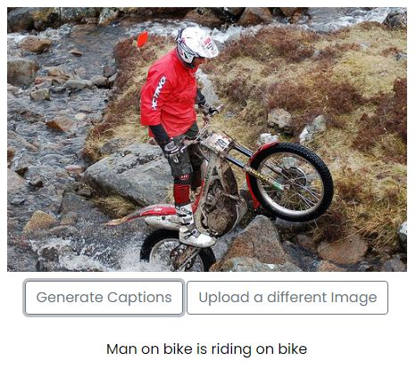

Slide 35
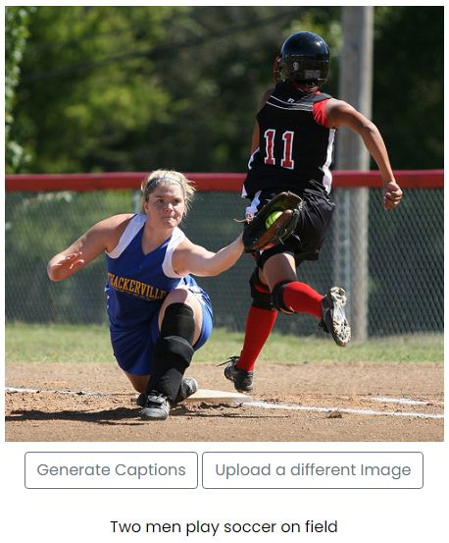

Slide 36
Conclusion:
Deep learning systems are able to generate good results.
We have successfully developed a deep learning model using the Xception architecture to generate automatic captions.
So far, most of the image captioning models have used inception (v3). We have framed our project in a web based application using the Flask architecture.
Some of the automatically generated captions based on our model are as shown below.

Slide 37
References:
[1] Sherstinsky, Alex. "Fundamentals of Recurrent Neural Network (RNN) and Long Short-Term Memory (LSTM) Network." Physica D: Nonlinear Phenomena 404 (2020): 132306. Print.
[2] Liu, Yu Han. "Feature Extraction and Image Recognition with Convolutional Neural Networks." Journal of Physics: Conference Series 1087 (2018): 062032. Print.
[3] Aung, San & Pa, Win & nwe, tin. (2020). "Automatic Myanmar Image Captioning using CNN and LSTM-Based Language Model." Proceedings of the 1st Joint SLTU and CCURL Workshop (SLTU-CCURL 2020), pages 139–143. Print.

Slide 38
References:
[4] Chollet, Francois. "Xception: Deep Learning with Depthwise Separable Convolutions." 2017 IEEE Conference on Computer Vision and Pattern Recognition (CVPR) (2017). Print.
[5] Hossain, M., Sohel, F., Shiratuddin, M. and Laga, H., 2019. A Comprehensive Survey of Deep Learning for Image Captioning. ACM Computing Surveys, 51(6), pp.1-36.
[6] O. Vinyals, A. Toshev, S. Bengio and D. Erhan, "Show and tell: A neural image caption generator," 2015 IEEE Conference on Computer Vision and Pattern Recognition (CVPR), Boston, MA, 2015, pp. 3156-3164

