Slide 1
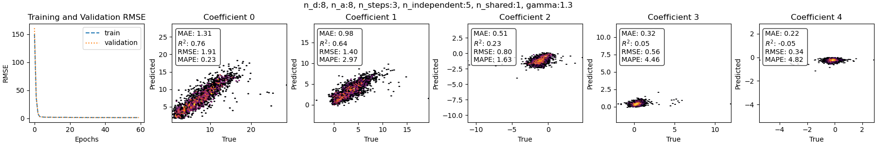
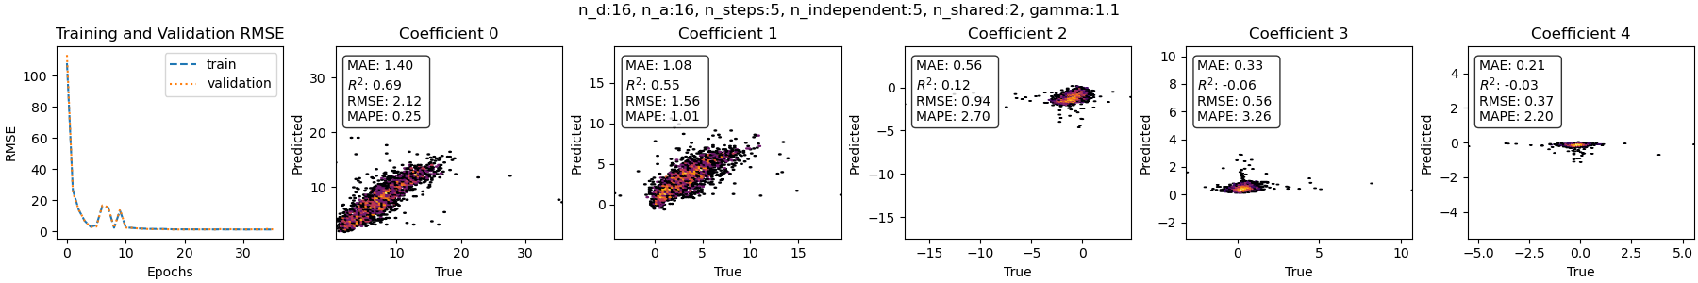
PROF_OWEG
MSE Loss, Ens 5
MSE Loss, Ens 8

Slide 2
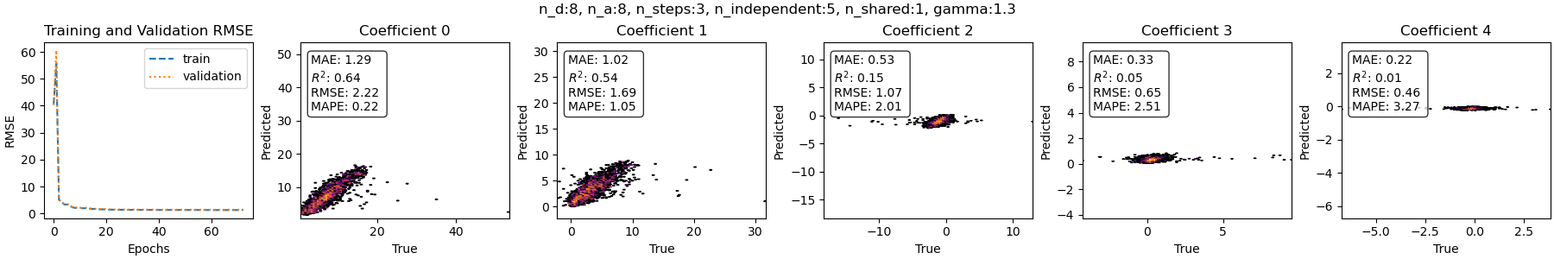
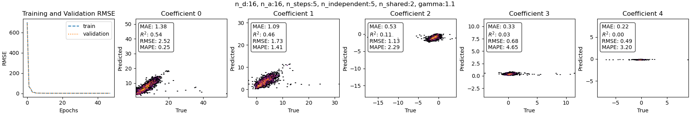
PROF_OWEG
L1 Loss, Ens 5
L1 Loss, Ens 8

Slide 3
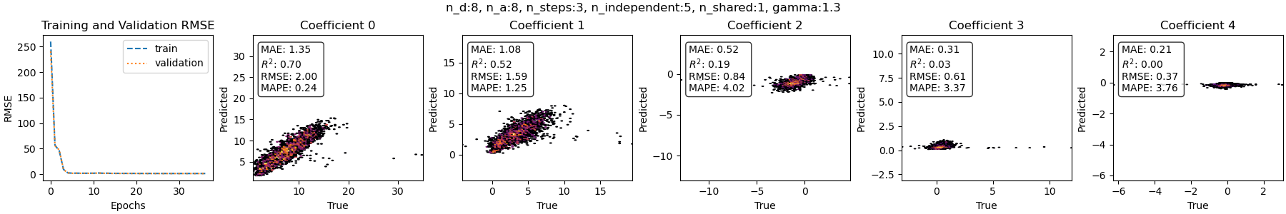
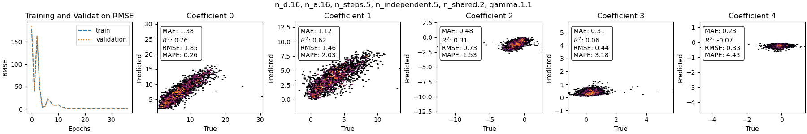
PROF_OWEG
Weighted MSE Loss, Ens 5
Weighted MSE Loss, Ens 8

Slide 4
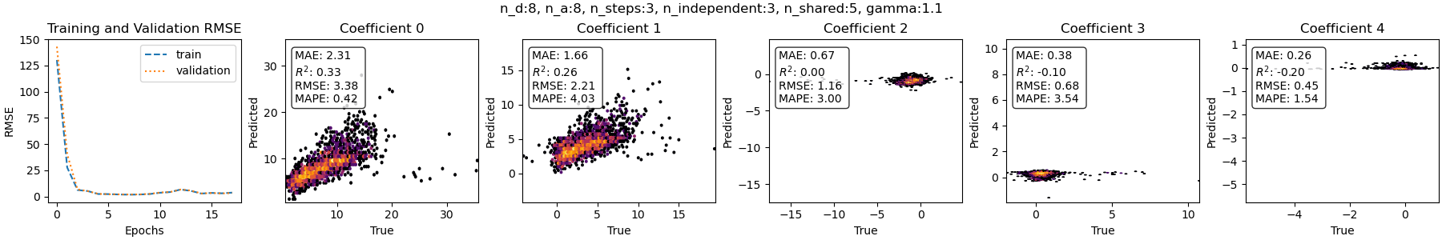
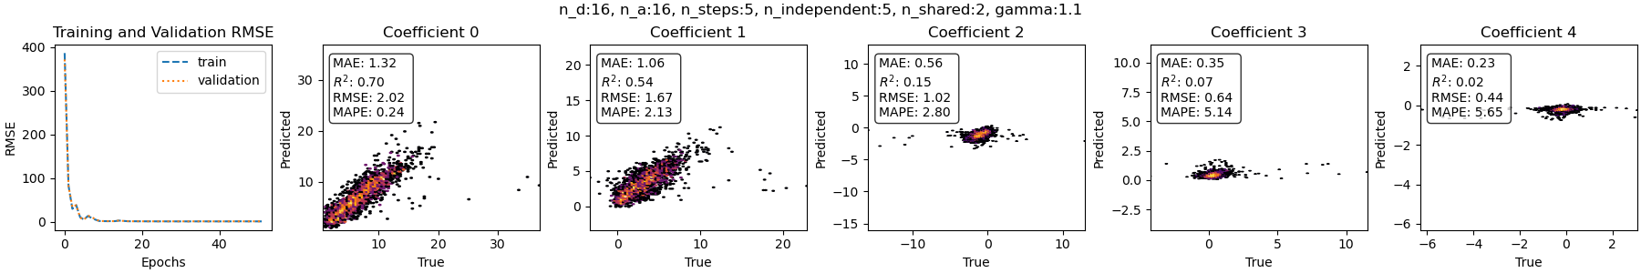
PROF_OWEG
Focal weighted MSE Loss, Ens 5
Focal weighted MSE Loss, Ens 8

Slide 5
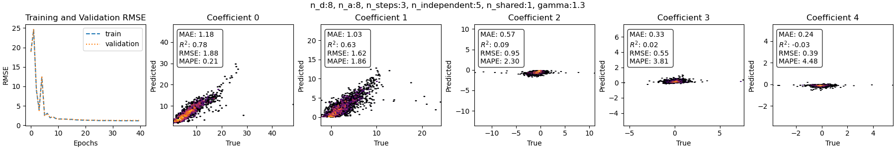
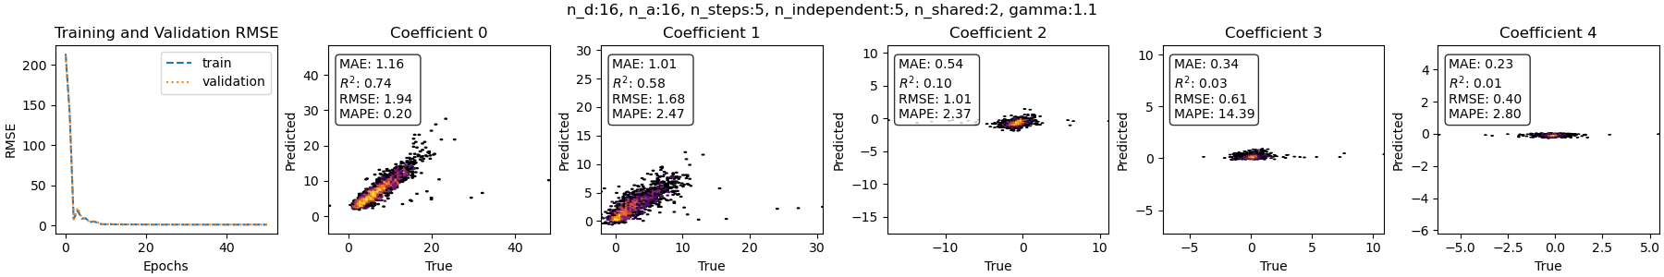
PROF_QUEE
MSE Loss, Ens 5
MSE Loss, Ens 8

Slide 6
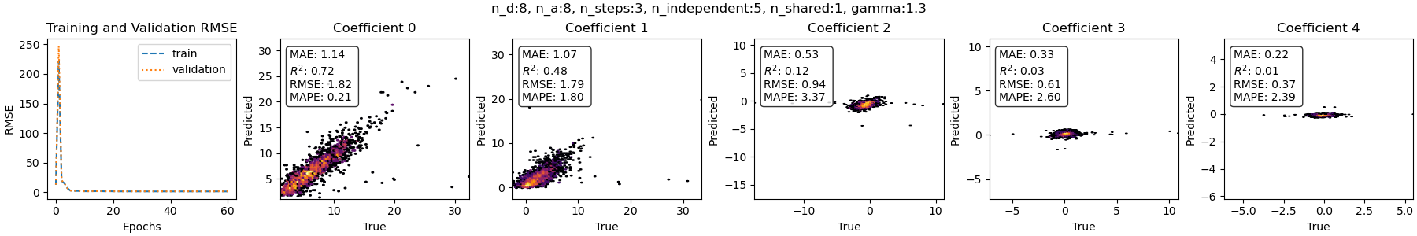
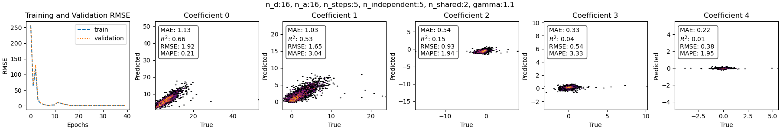
PROF_QUEE
Weighted MSE Loss, Ens 5
Weighted MSE Loss, Ens 8

Slide 7
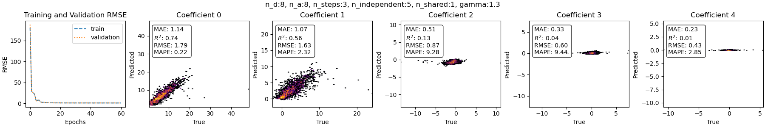
PROF_QUEE
Profiler MSE Loss, Ens 5
Profiler MSE Loss, Ens 8

Slide 8
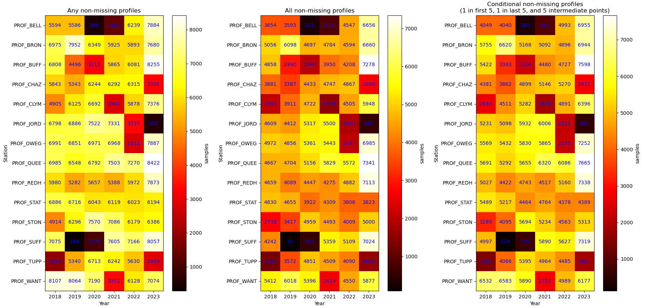
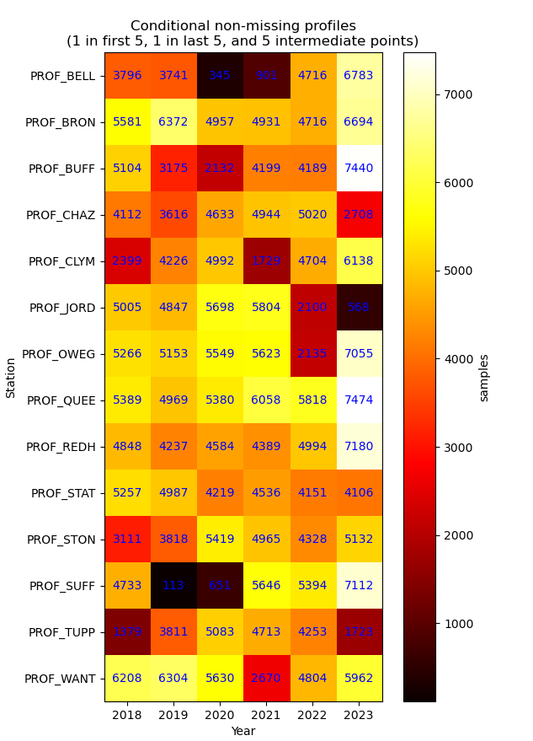
PROF_QUEE
1st method:
nan.mean
from 55th min to 5th min
2nd method:
Time-shifting 5th min data
to 00th min
Profiler MSE Loss, Ens 8

Slide 9
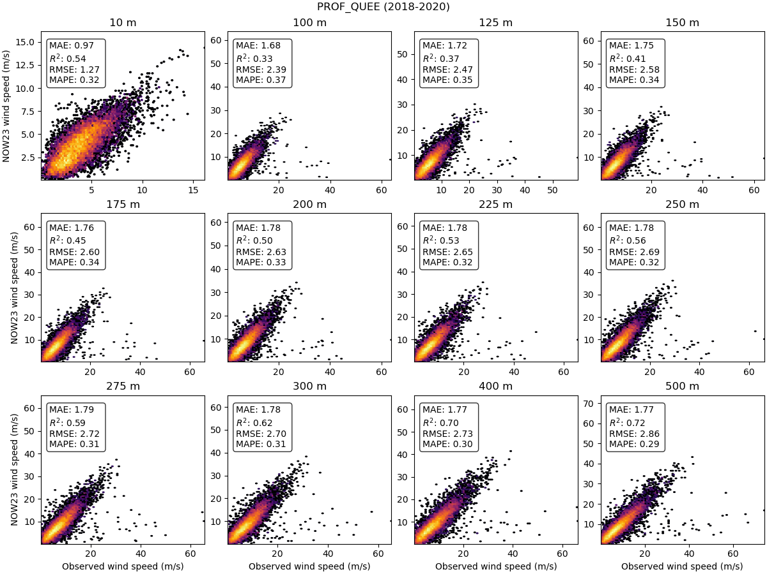
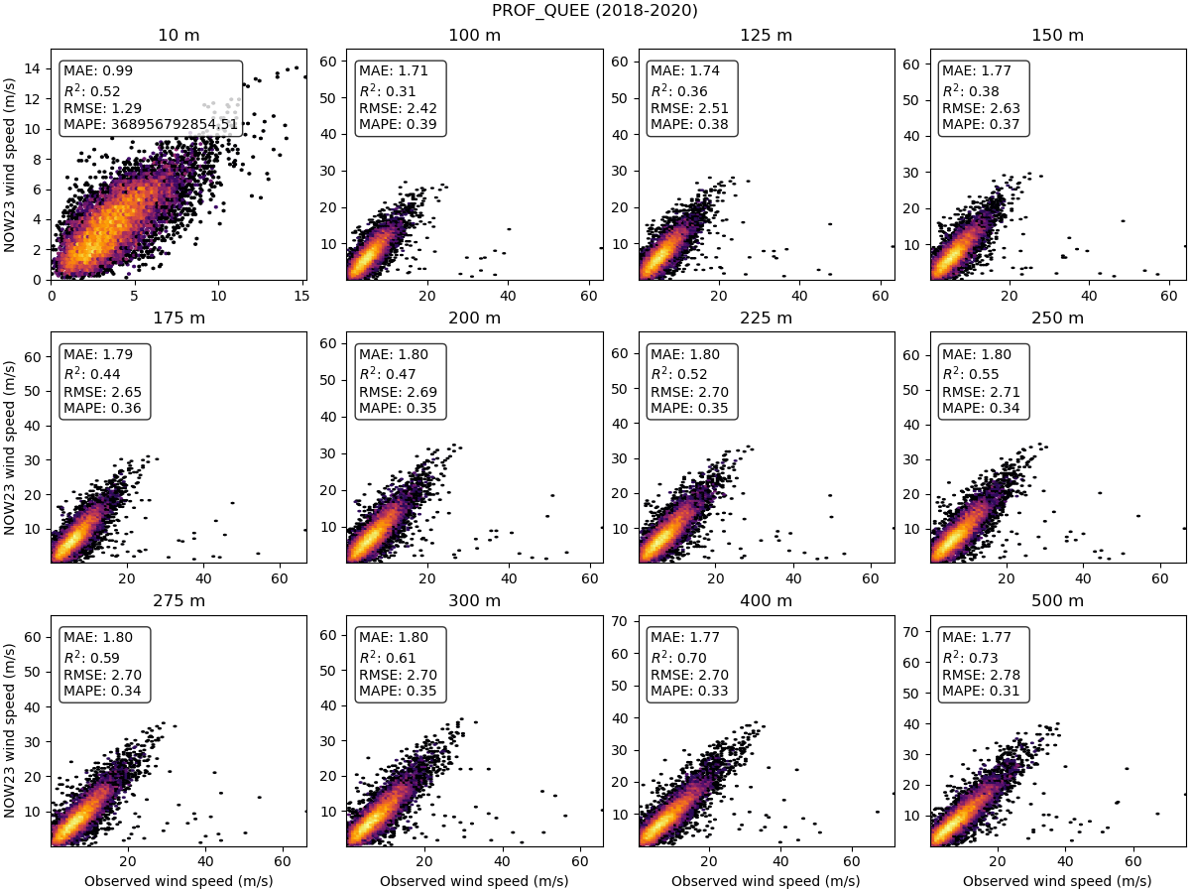
PROF_QUEE
All non-missing
1st method
2nd method

Slide 10
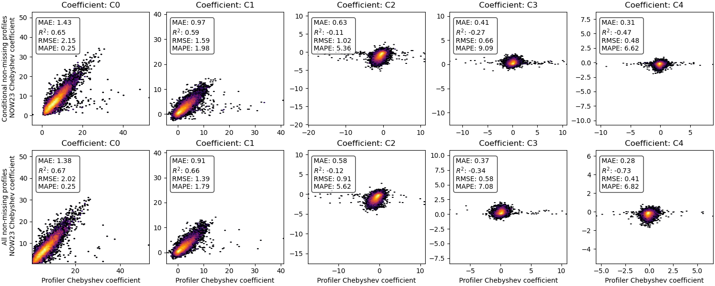
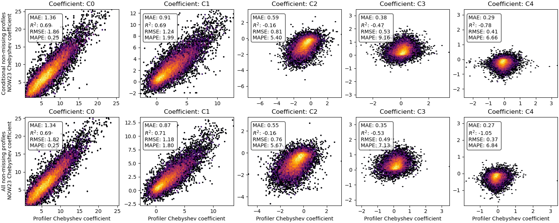
PROF_QUEE
1st method for hourly data processing,
Unsegregated.
1st method for hourly data processing,
Segregated using IsolationForest.

