Slide 1
RETAILIA
Introducing
By:
Harish Inavolu

Slide 2
Agenda
Introduction
Objectives
Motivation
LLM Overview
Core Components
Literature Review
Challenges & Future Directions
Workflow & Results
Conclusion

Slide 3
Motivation
Rapid Digital Transformation
Consumer Expectations
AI Integration in Customer Service
Inefficiencies in Human-Driven Support
Limitations of Rule-Based Chatbots
Lack of Personalization
Improved Efficiency and Automation
Enhanced Understanding and Contextual Responses

Slide 4
Objectives
Chatbot that effectively responds to both product based and user related queries.
Implement dynamic agent selection to automatically route user queries.
Integrate a knowledge base, constructed from manuals and PDF documents and SQL databases
Utilize Generative LLM and Agentic RAG technologies.

Slide 5
Reimagining Customer Interactions with AI
As digital interactions become the norm, the expectations for instant, relevant, and engaging customer service have skyrocketed. Traditional customer service models are struggling to keep pace, creating a pressing need for innovative solutions. This is where Retailia comes in.
It leverages the latest in Large Language Models and Agentic RAG systems to deliver responses that are not just timely but contextually enriched and conversational. Retailia can handle both routine queries and complex requests, providing dynamic, up-to-date information while maintaining a natural conversational flow.

Slide 6
Research and Insights: Literature Review
Our Literature review synthesized AI applications in e-commerce, focusing on evolutions in Retrieval-Augmented Generation (RAG), Natural Language Processing (NLP) in chatbots, and Large Language Models (LLMs) like LLaMA in Retail Industry.
Enhancing International Graduate Student Support: Saha and Saha (2024) developed an AI-driven chatbot using GPT-3.5 turbo and RAG to support international graduate students. This research demonstrates RAG's potential for providing tailored support and highlights the importance of domain-specific data sources for accurate responses.
Improving LLMs for Domain-Specific Tasks: Santos et al. (2024) explored using RAG and fine-tuning techniques to enhance LLM performance in specialized tasks. The research emphasized the importance of data retrieval and demonstrated how combining RAG with fine-tuning leads to better performance in text generation and summarization.
Effective Handling of Sensitive Queries: A study by S. Vakayil et al. (2024) explored using RAG with LLaMA-2 to create an empathetic chatbot for sexual assault victims, demonstrating the capacity of LLMs to provide sensitive and contextually appropriate responses.

Slide 7
Data at work
eCommerce Database
FAQ Knowledge Base
Contains product information and user-specific data such as cart, orders, ratings, and feedback.
Contains FAQs documents which are list of frequently asked questions and corresponding answers.

Slide 8
How Retailia Handles Queries
SQL Agent employs more complex queries requiring real-time data.
The SQL Agent interacts with the MySQL Database housing eCommerce database to retrieve relevant information.
FAQ Agent takes center stage for FAQ related queries.
It utilizes a FAISS index, a powerful tool for efficient similarity search within a vector database.

Slide 9
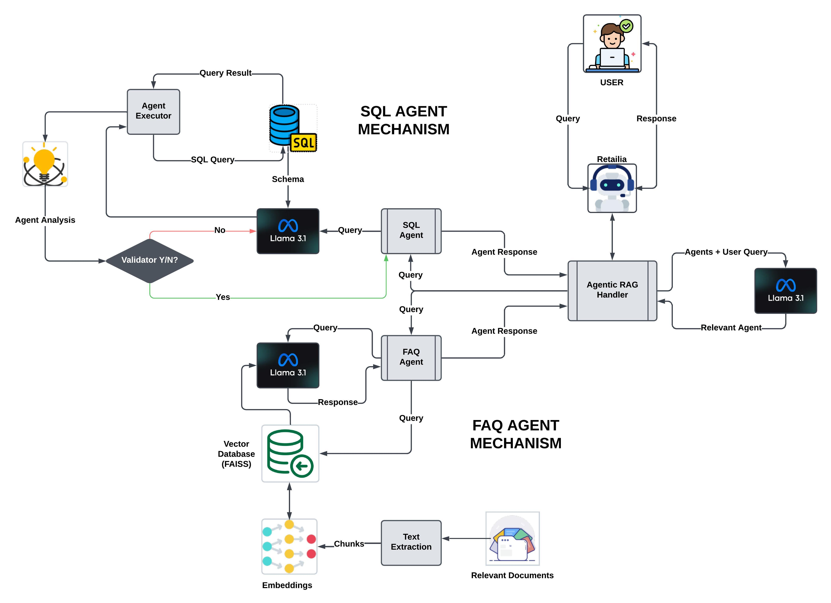
Architecture

Slide 10
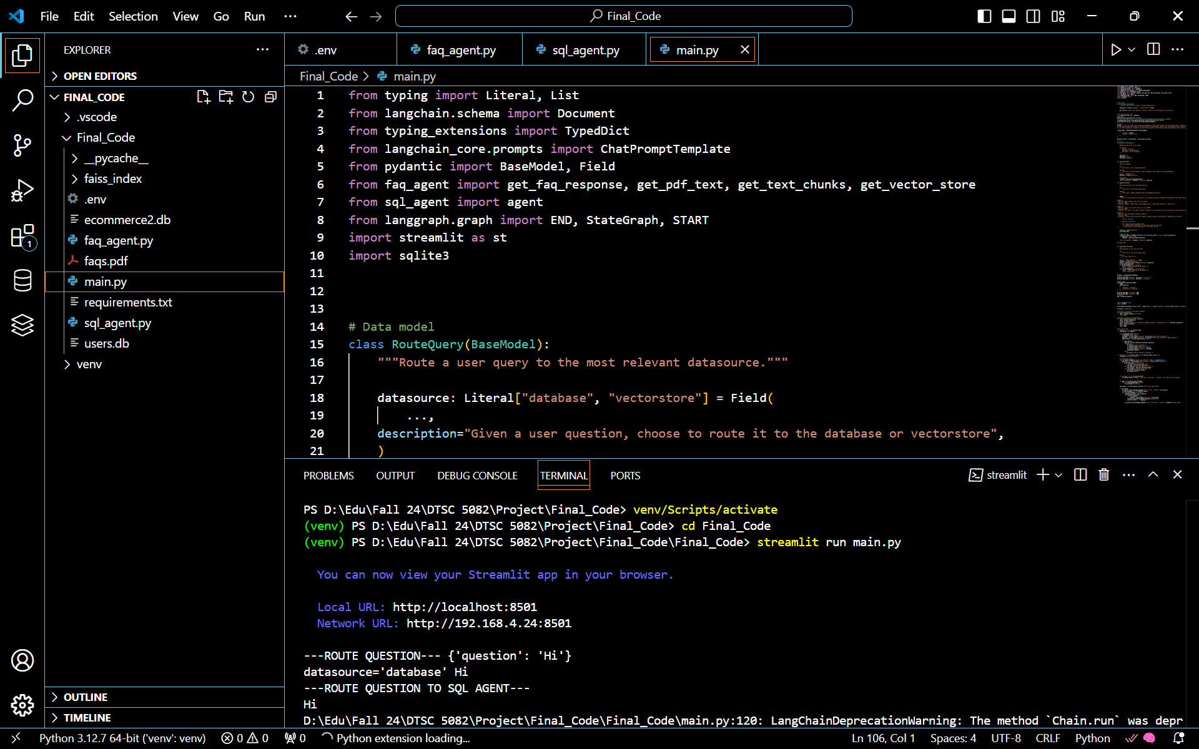
Retailia in Development Environment

Slide 11
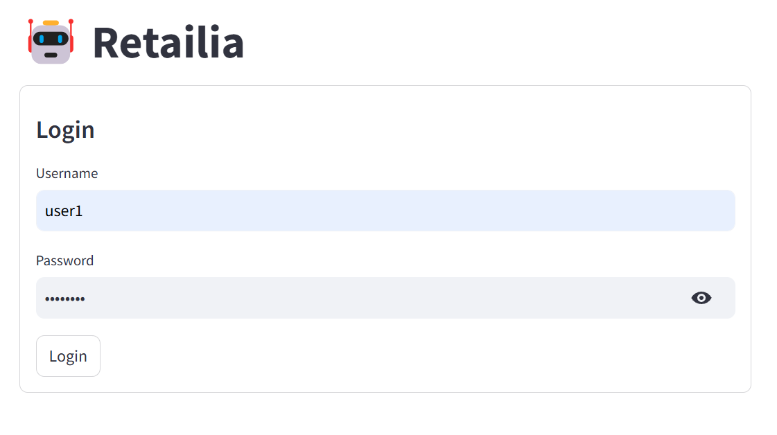
Sneak peek
Interfacing with Retailia: Streamlit’s Role
User Authentication

Slide 12
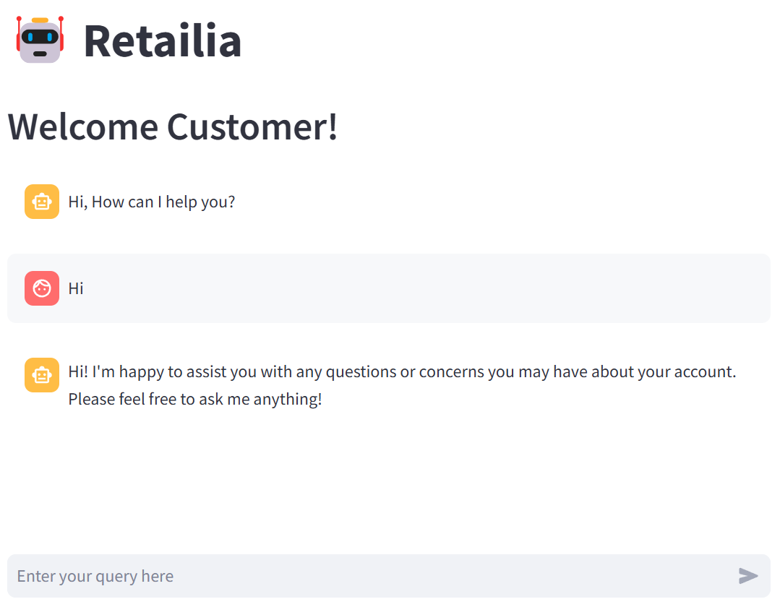
Sneak peek
Interfacing with Retailia: Streamlit’s Role
Chatbot Interface

Slide 13


Routing to FAQ Agent

Slide 14
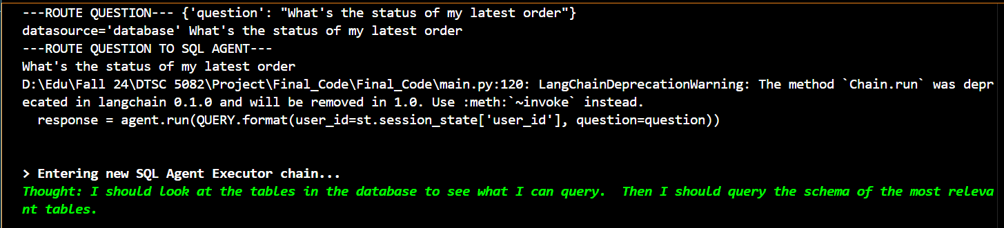
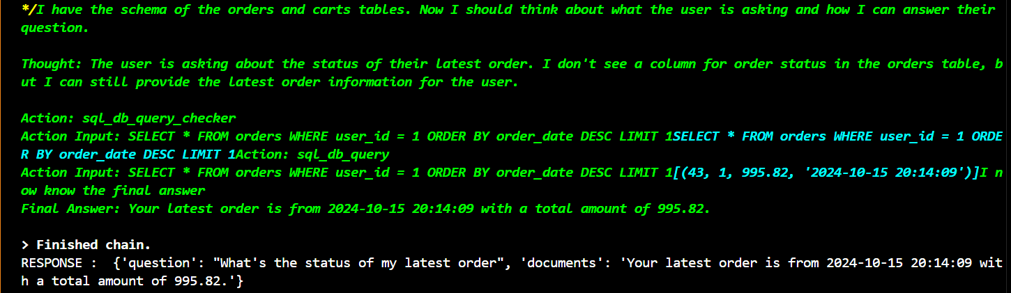
Routing to SQL Agent

Slide 15
Challenges
While developing Retailia;
Addressing Data Bias: AI systems can inherit biases present in their training data.
Efficient Query Routing: As the volume of queries increases, Retailia's ability to efficiently route queries to the appropriate agent (FAQ or SQL) becomes paramount.
In Real world setting;
Privacy and Security: Retailia's access to sensitive customer data necessitates robust security measures and strict adherence to privacy regulations to prevent data breaches or misuse.
Job Displacement: The automation of customer service tasks by Retailia could raise concerns about potential job displacement for human agents.

Slide 16
Growth Potential
Personalized Recommendations: Retailia can be enhanced to provide personalized product recommendations in future by leveraging customer data and purchase history.
Multi-Modal Interactions: Future enhancements could incorporate multi-modal interactions, allowing customers to interact using voice commands and images.
Advanced Sentiment Analysis: Advanced sentiment analysis can be implemented to ensure that chatbot responds based on the emotional tone of user queries.

Slide 17
References
Saha, B., & Saha, U. (2024). Enhancing international graduate student experience through ai-driven support systems: A llm and rag-based approach. 2024 International Conference on Data Science and Its Applications (ICoDSA), 300–304. https://doi.org/10.1109/ICoDSA62899.2024.10651944
Santos, H., & Khalil, A. (2024). Unleashing the potential of llm in ml: Techniques for fine-tuning, adaptation, and practical deployment with chatgpt. Baltic Multidisciplinary Journal, 2(2), 179–184. https://balticjournals.com/index.php/baltic/article/view/49
Vakayil, S., Juliet, D. S., J, Anitha., & Vakayil, S. (2024). Rag-based llm chatbot using llama-2. 2024 7th International Conference on Devices, Circuits and Systems (ICDCS), 1–5. https://doi.org/10.1109/ICDCS59278.2024.10561020
Agents. (n.d.). Retrieved November 21, 2024, from https://www.kaggle.com/whitepaper-agents
Embeddings & vector stores. (n.d.). Retrieved November 21, 2024, from https://www.kaggle.com/whitepaper-embeddings-and-vector-stores
Foundational large language models & text generation. (n.d.). Retrieved November 21, 2024, from https://www.kaggle.com/whitepaper-foundational-llm-and-text-generation

Slide 18
THANK YOU!

