Slide 1


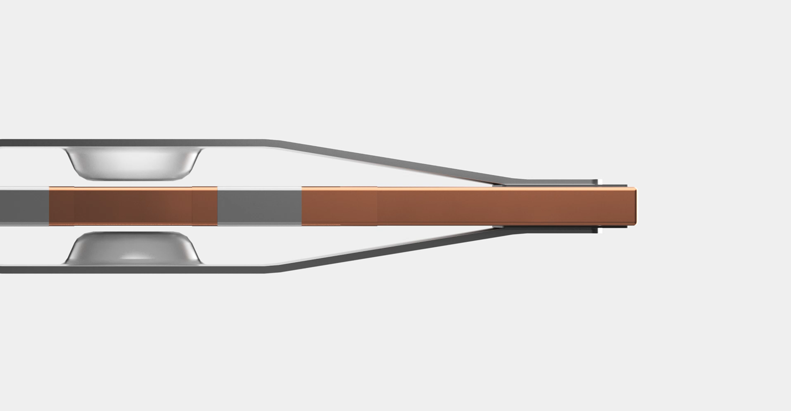





PowerHap enables best-in-class haptic systems PowerHap enables best-in-class haptic systems
PowerHap combines the essential characteristics to deliver a high-definition haptic feedback in various applications, from ICT to automotive systems
Configurability: PowerHap is capable to achieve a wide range of haptic feedbacks thanks to its high bandwidth operation with various signals and amplitudes.
PowerHap 6005
PowerHap 1919/1313
Speed & Power: Piezo materials are renowned for their rapid and precise movements. PowerHap translates this advantage to crisp and sharp haptic feedbacks.
Patented Technology: The piezo ceramic in the PowerHap is like no other. Its copper inner electrodes and sophisticated construction ensure top-tier performance and exceptional resistance to humidity.
PowerHap 1313/1204
Cost-effective: In a 15” haptic display, for example, only one PowerHap actuator is needed to uniformly move the entire display, thereby lowering the overall system cost.
PowerHap 1204
PowerHap 0704

