Slide 1
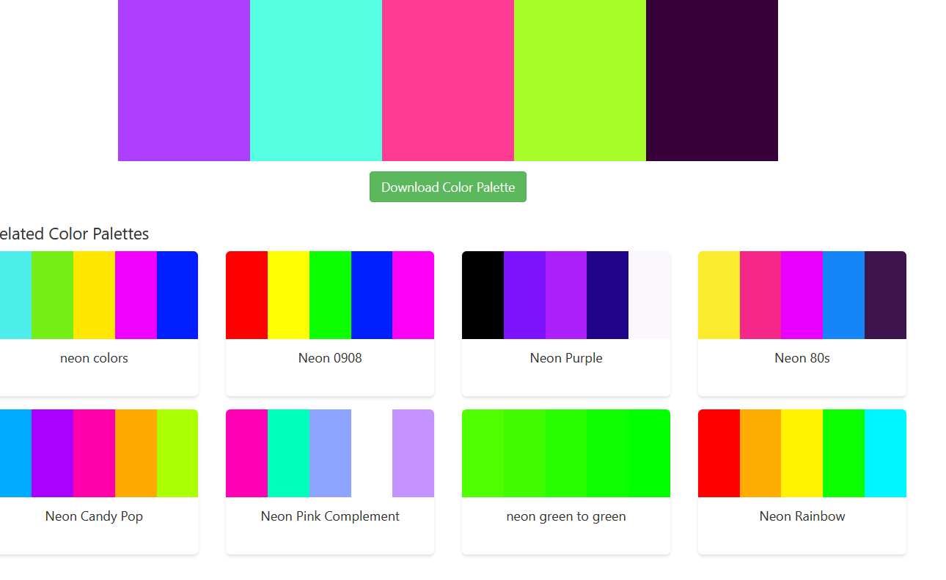
IVM6311 Software flow

Slide 2
DFT Setup
Test Bench
Static Files
Multimeter
PowerSupply
Load
Audio
Instruments
Static Files
Test1
DFT
.excel
Test2
JSON
Data
Test3
\
GUI
Instructions / Test Filter
DFT
Matrix
Driver
Test4
Test5
signalroot
Logs
Manual
Static Files
DFT
DFT
Testgenerate/Test.yaml
Logs
.json
.txt
.png
Instruments
Test Bench
Matrix
Iterative Files
One Time Generate
Static Files

Slide 3
Test-xy Setup
Test Setup
Test Measurements
Test Evaluation
From Test
Bench
Instructions
Configuration files
Setup files
Write Registers
Configure Instruments
Fetch limits/ set limits manually
Init Instrument
objects
Operate DFT matrix switches
Evaluate limits / write respective registers
Collect Variables, Trim, Trim sweep
Sweep/Apply instrument parameters,
Collectvalues
Clean Variables / return log data
Switches
Logger
Instruments
.json, .txt, .png

Slide 4
Test Script Generate
Add test in the IVM6311_Testing_scripts.xlsx matrix
testCreate.py will take dft matrix pages/sheets as input TestCreate(sheets = ['Digital','Reference','Boost'])
Generate the testscript_generate_config.yaml file from TestBecnh/testCreate.py -> dump_test_names('TestBench/testscript_generate_config.yaml’)
testscript_generate_config.yaml contains test names in DFT, each testname created as testscript under the respective directories(test page name)
to generate test script run create_test_scripts('TestBench/testscript_generate_config.yaml’) from testCreate.py
Custom test script template can be written inside each test script
If Test script already exists mean program won’t overwrite the test script until you force manually
Test can be bypassed if you mention the test name in the test_ignore.yaml file with respect to the page, test wont compiled ( bypassed)

Slide 5
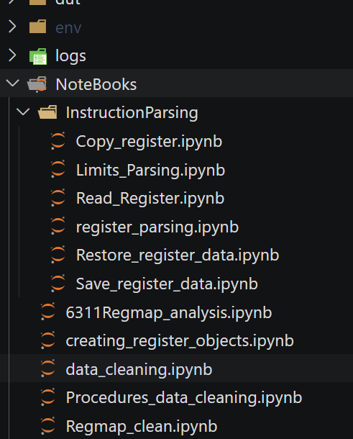
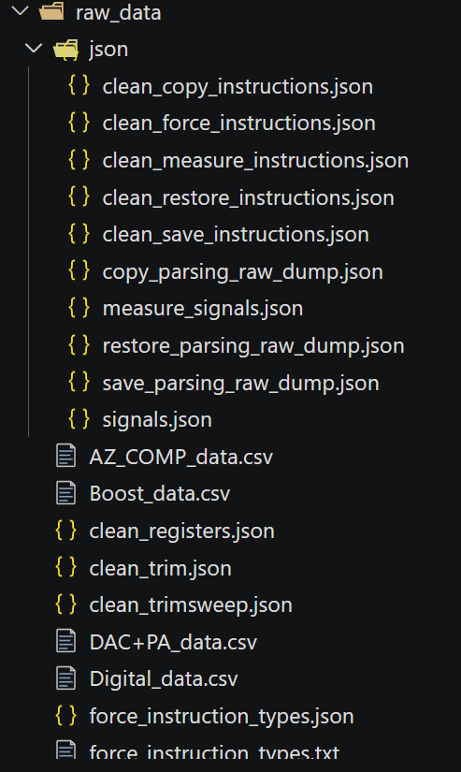
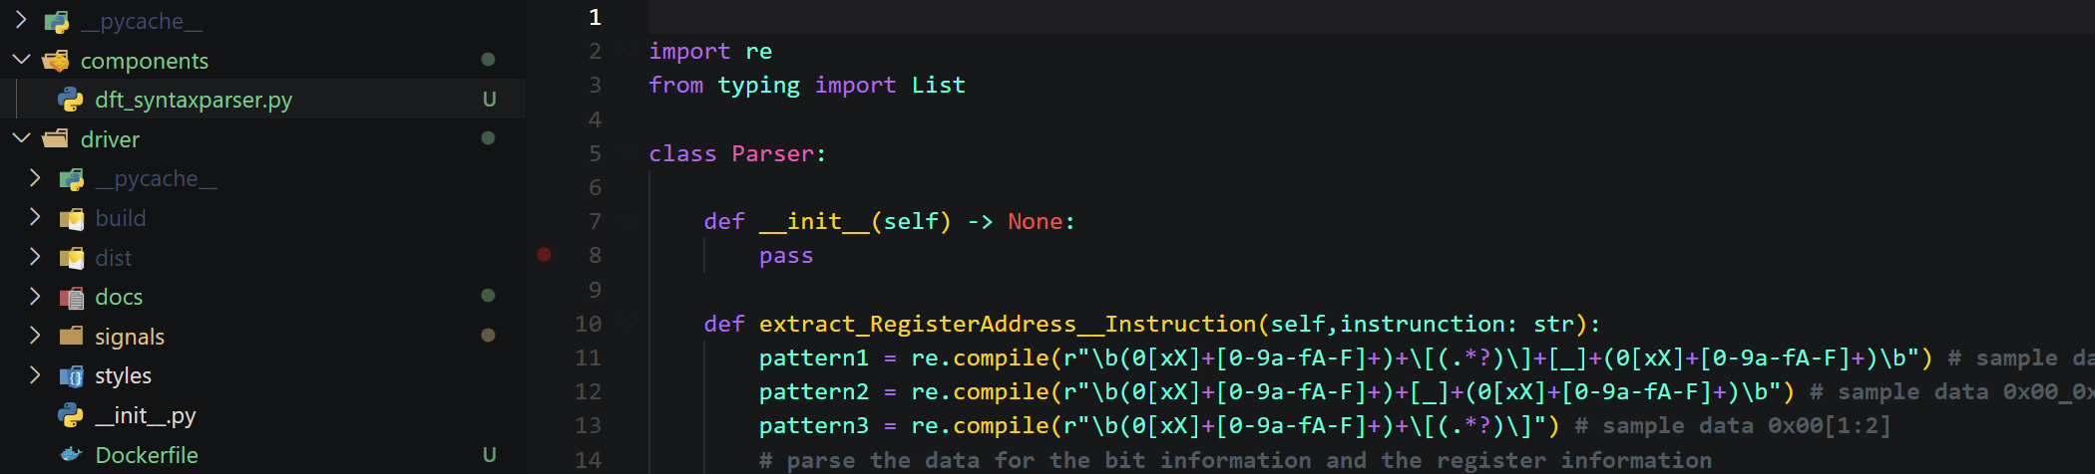
DFT syntax parser
Raw_instruction notebooks
DFT key words extracted and tested ( designated keywords only)
To understand better how the patterns are extracted referee the notebook of the respective instruction
Each Notebook container all forms of instruction exists in the DFT document, parsing the instruction and testing the parsing
All types of instruction raw and clean data available under {repository}/ raw_data/json ( you can see different forms of raw instruction and their respective parsing)
All instructions syntax parser available under component/dft_syntaxparser.py – import the script to parse any DFT instruction in test program ( all the tested instruction under notebook data copied into single class with different methods of respective instruction )
Raw/clean instructions data
Parser object for DFT test program

Slide 6
DFT Matrix

Slide 7
DFT Matrix
 | MCP23017 – 16bit IO Expander
 | 0 | 1 | 0 | 0 | A2 | A1 | A0 | RW | 7 bit | 8 bit
Control rows 1 and 2 | 0 | 1 | 0 | 0 | 0 | 0 | 0 | 0 | 20 | 40
Control rows 3 and 4 | 0 | 1 | 0 | 0 | 0 | 0 | 1 | 0 | 21 | 42
Control rows 5 and 6 | 0 | 1 | 0 | 0 | 0 | 1 | 0 | 0 | 22 | 44
Control rows 7 and 8 | 0 | 1 | 0 | 0 | 0 | 1 | 1 | 0 | 23 | 46
 | 0 | 1 | 0 | 0 | 1 | 0 | 0 | 0 | 24 | 48
 | 0 | 1 | 0 | 0 | 1 | 0 | 1 | 0 | 25 | 4A
 | 0 | 1 | 0 | 0 | 1 | 1 | 0 | 0 | 26 | 4C
 | 0 | 1 | 0 | 0 | 1 | 1 | 1 | 0 | 27 | 4E
board matrix
default
Address
MCP23017
RL11 | RL12 | RL13 | RL14 | RL15 | RL16 | RL17 | RL18
RL21 | RL22 | RL23 | RL24 | RL25 | RL26 | RL27 | RL28
A2 | A1 | A0
0 | 0 | 0
GPA0
:
GPA7
GPA0
GPA1
GPA2
GPA3
GPA4
GPA5
GPA6
GPA7
2nd board matrix
Optional
address
GPB0
:
GPB7
MCP23017
GPB0
GPB1
GPB2
GPB3
GPB4
GPB5
GPB6
GPB7
Vdd
Sda_in
Scl_in
gnd
A2 | A1 | A0
0 | 0 | 1
RL31 | RL32 | RL33 | RL34 | RL35 | RL36 | RL37 | RL38
RL41 | RL42 | RL43 | RL44 | RL45 | RL46 | RL47 | RL48
GPA0
:
LTC4316
GPA7
GPA0
GPA1
GPA2
GPA3
GPA4
GPA5
GPA6
GPA7
SCL_in
SCL_out
GPB0
:
GPB7
USB
MCP2221A
addr_in
addr_out
MCP23017
GPB0
GPB1
GPB2
GPB3
GPB4
GPB5
GPB6
GPB7
A2 | A1 | A0
0 | 1 | 0
RL51 | RL52 | RL53 | RL54 | RL55 | RL56 | RL57 | RL58
RL61 | RL62 | RL63 | RL64 | RL65 | RL66 | RL67 | RL68
GPA0
:
GPA7
GPA0
GPA1
GPA2
GPA3
GPA4
GPA5
GPA6
GPA7
7 bit TRanslation BYTE
MSB |  |  | LSB |  | fixed
a6 | a5 | a4 | a3 | a2 | a1 | a0
addr_out =XOR(ADDR_in,tr_byte)
GPB0
:
GPB7
MCP23017
GPB0
GPB1
GPB2
GPB3
GPB4
GPB5
GPB6
GPB7
Using the translator and 5 bits of the translation byte, it is possible to handle 2⁵ = 32 matrix boards, each one with the default I2C addresses
Using the second matrix board with the optional addresses we can have 2⁴x2=32 matrix boards
A2 | A1 | A0
0 | 1 | 1
RL71 | RL72 | RL73 | RL74 | RL75 | RL76 | RL77 | RL78
RL81 | RL82 | RL83 | RL84 | RL85 | RL86 | RL87 | RL88
GPA0
:
GPA7
GPA0
GPA1
GPA2
GPA3
GPA4
GPA5
GPA6
GPA7
GPB0
:
GPB7
GPB0
GPB1
GPB2
GPB3
GPB4
GPB5
GPB6
GPB7

Slide 8
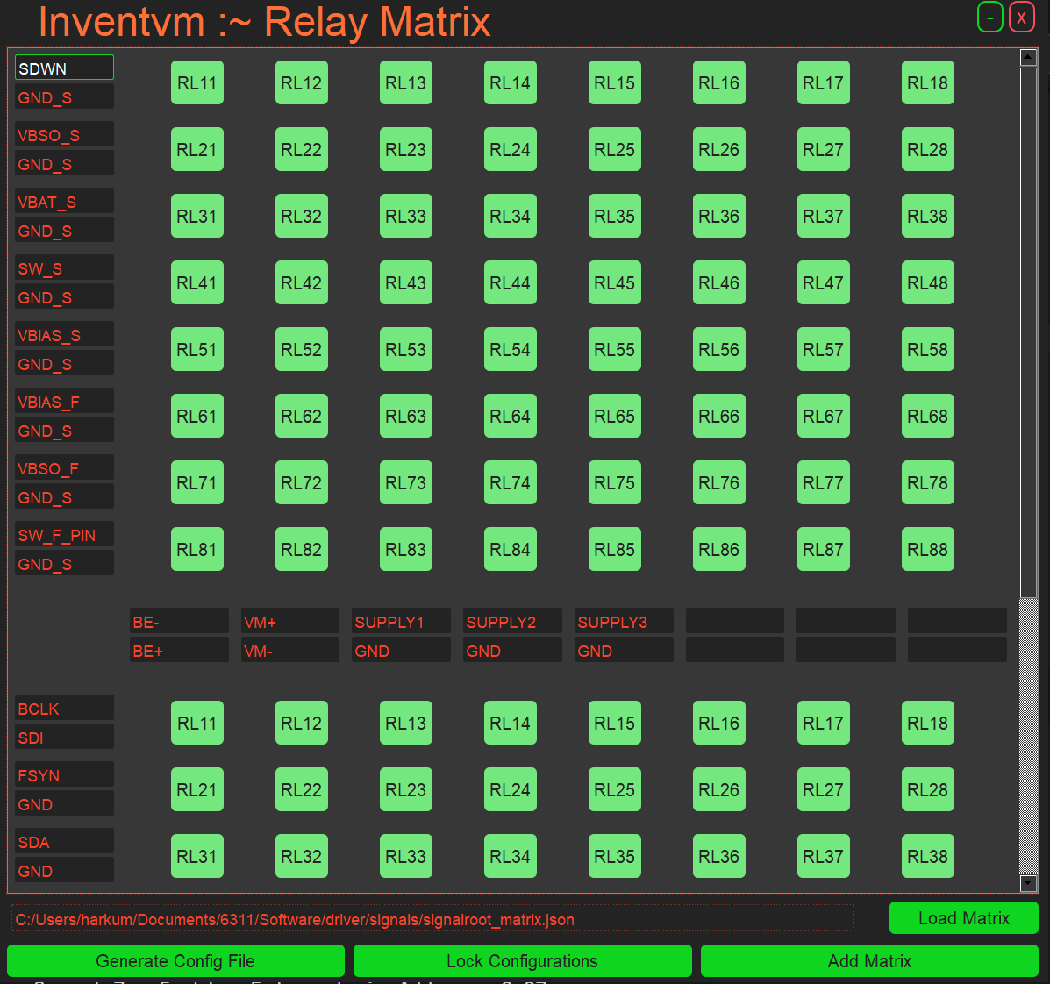
DFT Matrix Software support
mainDriver.py
Add Switch Matrixes
When new matrix added by default switches opened
Configure the row and Columns signals / Instruments
Lock the Configuration to operate Relays
Without locking the configurations relays can’t be operated ( signals /Instruments configurations can’t be changed )
Once the config lock release all the switches opened automatically
If all the configurations works fine, we can generate the configuration file with Generate Config button
To Generate Configurations, lockconfig button needs to be released
New matrix should not be added, when matrix configurations in lock
When lock config button released all the relays and the check in status of the gui relay buttons will be relased
Once the configuration is locked you can no longer edit the signals
We can add N-number of the matrixes, gpio expander address assigned automatically
Matrix configuration can be loaded with pre-configuration file
By default, gui will take preloaded path to generate configuration file
If there is no pre-loaded path, default signalroot.json file saved in the gui source directory
Configurations can be saved with different filename / by default, current configurations saved inside the preloaded file
Configurations can be also saved with custom file name ( if there is only file name, current configurations will be saved inside the gui source directory with given name )
If gui closed abruptly all the relays will be released

Slide 9
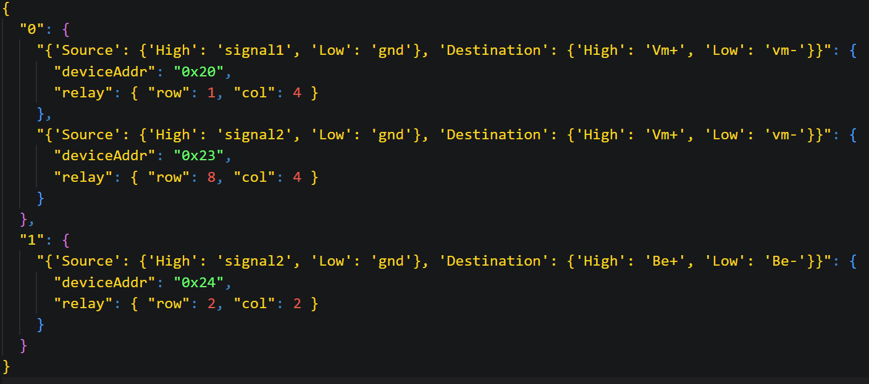
DFT Matrix Configuration file from gui
Matrix Number
GPIO expander device address
Source and Destination configuration

Slide 10
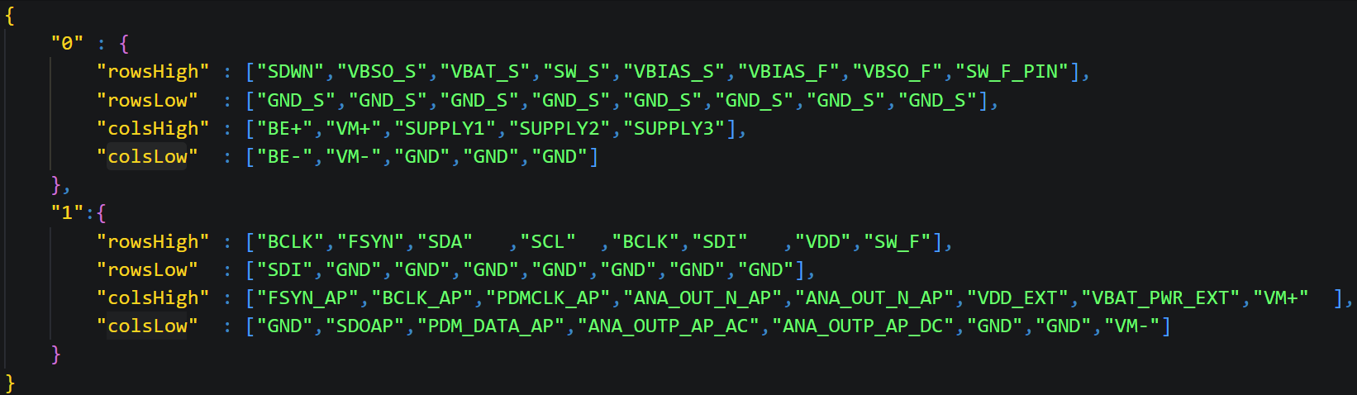
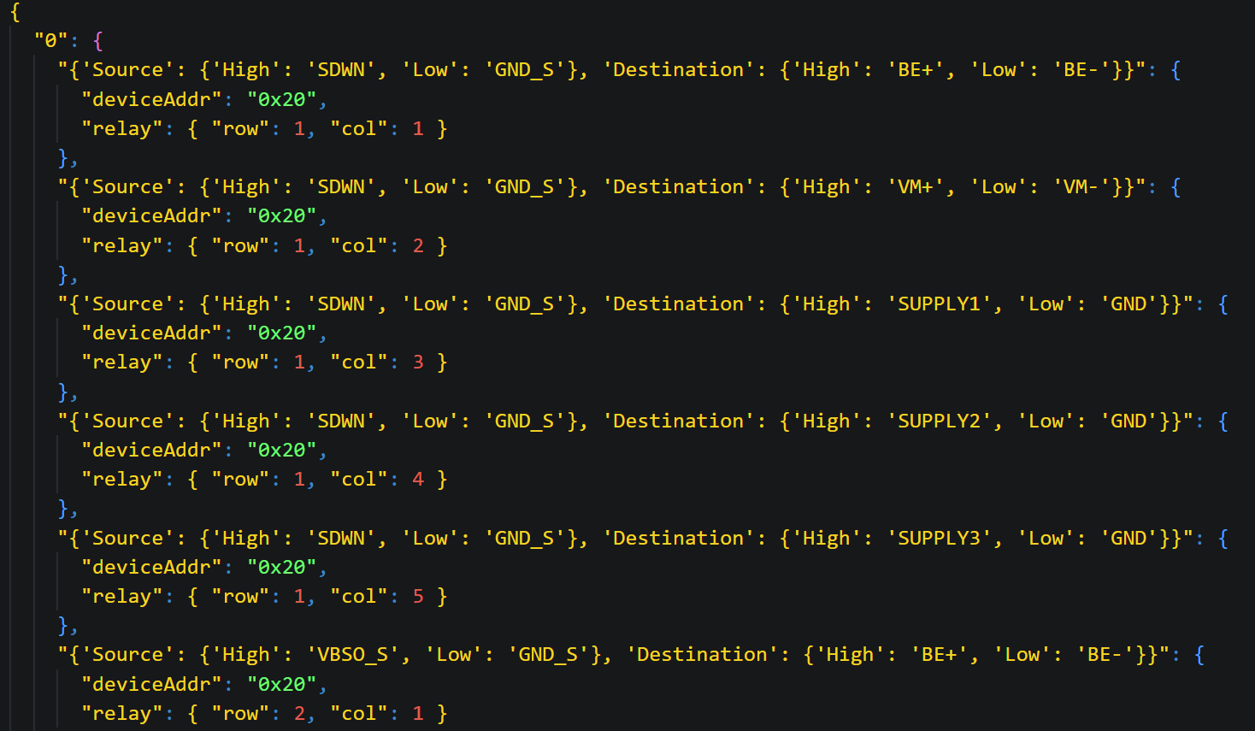
Writing DFT Matrix Configuration file Manually
SignalConfig.json
Write SignalConfig.json under driver/signals in repository
Write signal configuration file with respect to matrix number and row/col highside/lowside signals
Do not miss respective high and low signals ( if row high signal present and low signal missed, that row or column signal not accounted into configurations )
Run signalRoot.py -> signalPathMapping() method to generate low level signalroot_matrix.json file
signalPathMapping(self,signalConfig_path='driver\signals\SignalConfig.json', signalMapfile_path='driver/signals/signalroot_matrix.json’)
Provide signal config/map files paths
Signalroot_matrx.json

