Slide 1

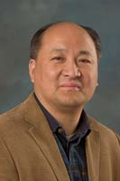

Module #4 – Software Black-Box Testing Methods
Software Testing
Topic #1 – Software Black-Box Testing
Instructor: Jerry Gao, Ph.D., Professor
San Jose State University
Notes:
From this session, we start to Module #4 on Software Black-Box Testing.
In this module, we cover detailed concepts on black-box testing and different black-box testing
methods, including the following the followings:
Topic #1 - Software Black-Box Testing
Topic #2 – Equivalence Partitioning Testing
Topic #3 – Boundary Value Testing
Topic #4 – Category Partition Testing
Topic #5- Decision Based Testing
Topic #6 – State=Based Software Testing

Slide 2
Topic #1 – Software Black-BOX Testing
Software Testing
What Is Black-Box Testing?
Black-Box Testing Focuses
Why Is Black-Box Testing Important?
Who Does Black-Box Testing?
A Black-Box Testing Example
Black-Box Testing Coverage
Notes:
This is the first package in Module 3 for Software Testing Class. It provides an introduction to software white-box testing. It covers the following
What is black-box testing?
Black-box testing focuses
Why Is black-box testing important?
Who does white-box testing?
A Black-box testing example
Black-box testing coverage

Slide 3


Topic #1 – Software Black-BOX testing
Software Testing
What is software black-box testing?
Black-box testing, also known as requirement-based testing
Definition: Software black-box testing refers to test design based on program requirements specifications to validate software functions, external behaviors, and external visible QoS requirements.
What do you need for black-box testing?
Black-box testing models and test criteria
Black-box test design and generation methods
Software requirements specification and product specification

Slide 4

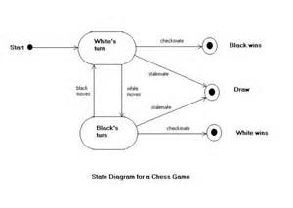



Topic #1 – Software Black-BOX Testing
Software Testing
Black-Box Testing Focuses
System QoS
Requirements
System Behaviors
Software
System Functions
Check system QoS Requirements
Software GUI
System Functions
System Behaviors
Software GUI

Slide 5
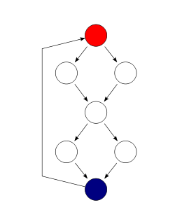
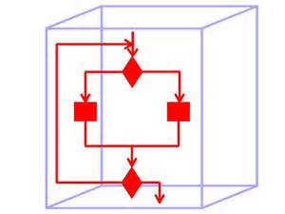

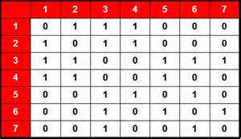

Topic #1 – Software WHITE-BOX Testing
Software Testing
Why Is Black-Box Testing Important?
Answer: - Assure the quality of software functions, behaviors and QoS parameters.
- Achieve adequate system requirement validation criteria.
Incorrect program
implementations
Software
Incorrect software
designs
Incorrect system
Intelligence
Incorrect requirements

Slide 6
Topic #1 – Software Black-BOX Testing
Software Testing
Who Does Black-Box Testing?
Several engineer groups perform black-box program testing:
Function validation engineers
– Perform function testing
System test engineers
– Conduct system testing for QoS parameters
Quality assurance engineers
– Performance system testing based on QA standards
System users – Acceptance testing

Slide 7
Topic #1 – Software Black-BOX Testing
Software Testing
A Black-Box Testing Example - Triangle Analyzer
Program specification:
Input: 3 numbers separated by commas or spaces
Processing:
Determine if three numbers make a valid triangle; if not, print
message NOT A TRIANGLE.
If it is a triangle, classify it according to the length of the sides as scalene
(no sides equal), isosceles (two sides equal), or equilateral (all sides equal).
If it is a triangle, classify it according to the largest angle as acute (less than
90 degree), obtuse (greater than 90 degree), or right (exactly 90 degree).
Output: One line listing the three numbers provided as input and the classification
or the not a triangle message.
Jerry Gao Ph.D.
Notes:
White-box software testing focuses on the following areas:
– Program control/execution paths → to make sure that executable program control flows
can be correctly executed.
Program data → to make sure that program data parameters and values are properly set-up and
accessed.
-

Slide 8
Topic #1 – Software Black-BOX Testing
Software Testing
A Black-Box Testing Example - Triangle Analyzer
inputs
outputs
a
a, b, c
b
a
b
Triangle Analyzer
Analysis
Result
c
c
Output: One line listing the three numbers provided as input and the classification or the not a triangle message.
Test Example: Inputs Outputs
3,4,5 3,4,5 Scalene Right
6,1,6 6,1,6 Isosceles Acute
5,1,2 5,1,2 Not a triangle
Jerry Gao Ph.D.
Notes:
White-box software testing focuses on the following areas:
– Program control/execution paths → to make sure that executable program control flows
can be correctly executed.
Program data → to make sure that program data parameters and values are properly set-up and
accessed.
-

Slide 9
Topic #1 – Software Black-BOX Testing
Software Testing
A Black-Box Testing Example - Triangle Analyzer
inputs
outputs
a
b
a
Analysis
Result
b
Triangle Analyzer
c
c
Inputs Expected Results
--------------------------------------------------------------
4,4,4 4,4,4 Equilateral acute
6,5,3 6,5,3 Scalene acute
5,6,10 5,6,10 Scalene obtuse
3,4,5 3,4,5 Scalene right
6,1,6 6,1,6 Isosceles acute
7,4,4 7,4,4 Isosceles obtuse
1,2,2 1,2,2 Isosceles right
Test Set #1
Jerry Gao Ph.D.

Slide 10
Topic #1 – Software Black-BOX Testing
Software Testing
A Black-Box Testing Example - Triangle Analyzer
inputs
b
a
outputs
a
b
Triangle Analyzer
Analysis
Result
c
c
Test cases for special inputs and invalid formats:
Inputs Descriptions
3,4,5,6 Four sides
646 Three-digit single number
3,,4,5 Two commas
3 4,5 Missing comma
3.14.6,4,5 Two decimal points
4,6 Two sides
5,5,A Character as a side
6,-4,6 Negative number as a side
-3,-3,-3 All negative numbers
Empty input
Test Set #2
Jerry Gao Ph.D.

Slide 11
Topic #1 – Software Black-BOX Testing
Software Testing
A Black-Box Testing Example - Triangle Analyzer
inputs
b
a
outputs
a
b
Triangle Analyzer
Analysis
Result
c
c
Boundary conditions for legitimate triangles:
Inputs Descriptions
-----------------------------------------------------------------------------------------------------
1,1,2 Makes a straight line, not a triangle
0,0,0 Makes a point, not a triangle
4,0,3 A zero side, not a triangle
1,2,3.00001 Close to a triangle but still not a triangle
9170,9168,3 Very small angle (scalene, acute)
.0001,.0001,.0001 Very small triangle (equilateral, acute)
83127168,74326166,96652988 Very large triangle, scalene, obtuse
Test Set #3
Jerry Gao Ph.D.

Slide 12
Topic #1 – Software Black-BOX Testing
Software Testing
A Black-Box Testing Example - Triangle Analyzer
inputs
b
a
outputs
a
b
Triangle Analyzer
Analysis
Result
c
c
Boundary conditions for sides classification:
Inputs Descriptions
-------------------------------------------------------------------------------------------------
3.0000001,3,3 Very close to equilateral (isosceles, acute)
2.999999,4,5 Very close to isosceles (scalene, acute)
Boundary conditions for angles classification:
Inputs Descriptions
----------------------------------------------------------------------------------------------------
3,4,5.000000001 Near right triangle (scalene, obtuse)
1,1,1.41141414141414 Near right triangle (isosceles, acute)
Test Set #3
Jerry Gao Ph.D.

Slide 13
Topic #1 – Software Black-BOX Testing
Software Testing
Software Testing Principles
A set of testing principles listed below:
All tests should be traceable to customer requirements.
Tests should be planned long before testing begins.
- Testing should begin “in the small” and progress toward testing “in the large”.
- Exhaustive testing is not possible.
- Testing should be conducted by an independent third party.

Slide 14

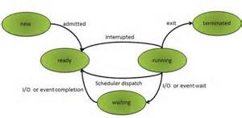


Topic #1 – Software Black-BOX Testing
Software Testing
Black-Box Software Testing Coverage
System
Function
Requirement
Coverage
Under-test
System
System Behavior
Coverage
System QoS
Parameter Coverage
Business Roles
& Intelligence
Coverage
System GUI
Coverage

