Slide 1



Module #4 – Software Black-Box Testing Methods
Software Testing
Topic #4 – Decision Table Testing Method
Instructor: Jerry Gao, Ph.D., Professor
San Jose State University
Notes:
From this session, we start to Module #2 on Software Testing Fundamentals.
In this module, we cover the basics of software testing, including the following subjects:
Topic #1 - Software Problem Management
Topic #2 - Software Test Design
Topic #3 - Software Test Management

Slide 2
Topic #4 – Decision Table Testing METHOD
Software Testing
What is Decision Table Testing Method?
Why Do We Need Decision Table Testing?
How to Use Decision Table Testing?
Decision Table Testing Examples
Decision Table Testing Summary
Notes:
This is the first package in Module 3 for Software Testing Class. It provides an introduction to software white-box testing. It covers the following
What is white-box testing?
Why Is white-box testing important?
Who does white-box testing?
White-box testing focuses
White-box testing coverage

Slide 3
Topic #4 – Decision TABLE TEST METHOD
Software Testing
What is decision table testing method?
A decision table is a good way to deal with combinations of things (e.g. inputs). This technique is sometimes also referred to as a ’cause-effect’ table.
Definition:
Decision table testing is black box test design technique to determine the test scenarios for complex business logic. In decision table testing the test cases are designed to execute the combinations of inputs and/or stimuli (causes) from the decision table.
A decision table is a table of rows and columns separated into four quadrants .
Decision Stub
Rules Stub
Action Stub
Entries Stub

Slide 4
Topic #4 – Decision TABLE TEST METHOD
Software Testing
Importance of Decision Table Test Method
It helps testers to search the effects of combinations of different inputs and other software states that must correctly implement business rules.
Provides a regular way of stating complex business rules, that’s helpful for developers as well as for testers.
It is a structured exercise to prepare requirements when dealing with complex business rules.

Slide 5
Topic #4– DECISION TABLE TEST METHOD
Software Testing
Number of Rules
Each condition generally has two possible outcomes either YES or NO
Total number of rules is equal to
2 ^ no. of conditions
For example, if there are four conditions then, there will be sixteen possible rules.

Slide 6
Topic #4– DECISION TABLE TEST METHOD
Software Testing
Creating a Decision Table
Steps on how to create a simple decision table using the Triangle Problem.
1. Step One – List All Stub Conditions
In this example we take three inputs, and from those inputs we perform conditional checks to calculate if it’s a triangle, if so then what type of triangle it is.
2. Step Two – Calculate the Number of Possible Combinations (Rules)
So in our table we have 4 condition stubs and we are developing a limited entry decision table so we use the following formula:
Number of Rules = 2 (power) Number of Condition stubs, So therefore
Number of Rules = 2^4 = 16
So we have 16 possible combinations in our decision table.

Slide 7
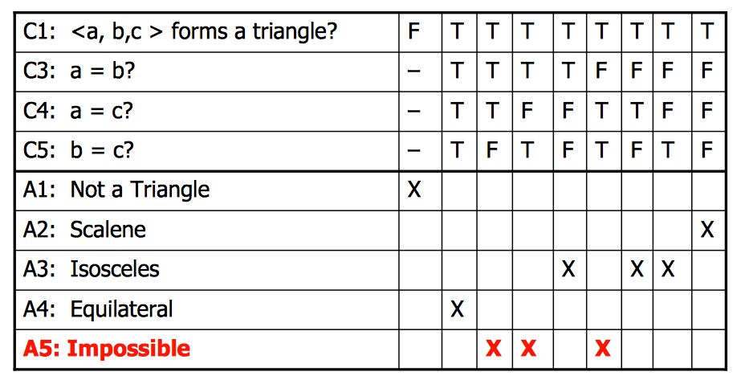
Topic #4– DECISION TABLE TEST METHOD
Software Testing
Creating a Decision Table
Place all the combinations in the decision table
Rules
R1
R1
R1
R1
R1
R1
R1
R1
R1
Conditions :
Actions :
Entries

Slide 8
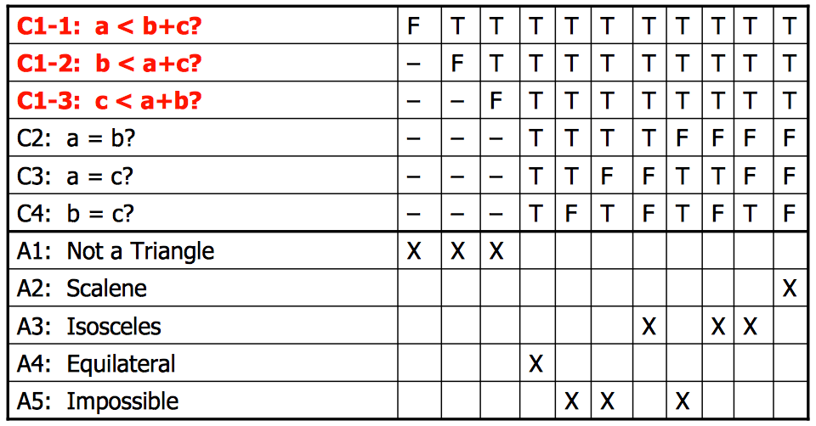
Topic #4 – DECISION TABLE TEST METHOD
Software Testing
Few more conditions added to the decision table.
Rules
Conditions :
Actions:
Entries
Notes:
White-box software testing focuses on the following areas:
– Program control/execution paths → to make sure that executable program control flows
can be correctly executed.
Program data → to make sure that program data parameters and values are properly set-up and
accessed.
-

Slide 9
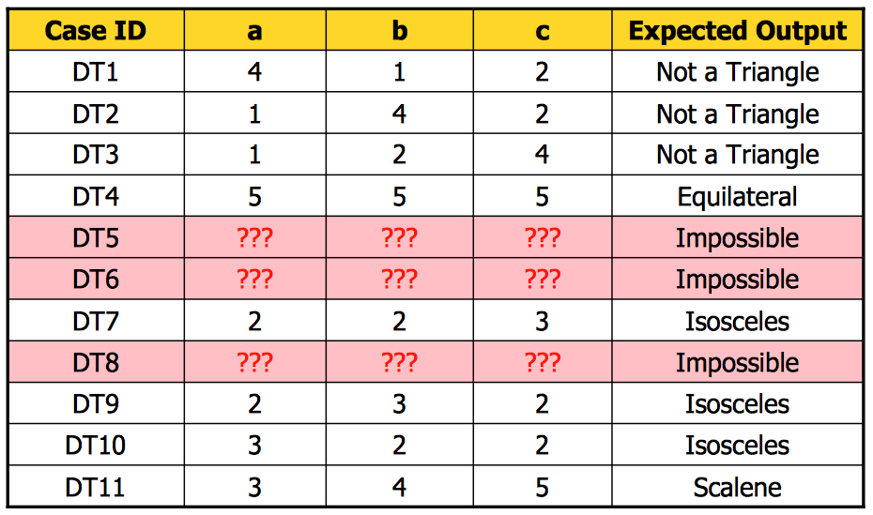
Topic #4 – DECISION TABLE TEST METHOD
Software Testing
Test cases from Decision Table
Notes:
White-box software testing focuses on the following areas:
– Program control/execution paths → to make sure that executable program control flows
can be correctly executed.
Program data → to make sure that program data parameters and values are properly set-up and
accessed.
-

Slide 10
Topic #4 – DECISION TABLE TEST METHOD
Software Testing
Creating a Decision Table
Example 2 : Credit Card
If you are a new customer and you want to open a credit card account then there are three conditions first you will get a 15% discount on all your purchases today, second if you are an existing customer and you hold a loyalty card, you get a 10% discount and third if you have a coupon, you can get 20% off today (but it can’t be used with the ‘new customer’ discount).
Question :
Create a decision table for the above scenario with the list of possible conditions and actions.
Calculate the number of possible rules for the decision table.
Derive test cases from the table constructed.
Notes:
Why white-box software testing is important?
The major purpose is to achieve pre-defined program code coverage for white-box testing. Here are the typical objectives and reasons:
– Cover different program control flows and execution paths
Cover different program data and their value set-up and usage
Cover various program branches and logics
Uncover the deadlock program codes and cases in software

Slide 11
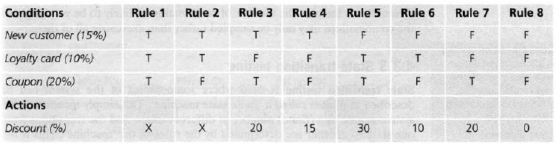
Topic #4 – DECISION TABLE TEST METHOD
Software Testing
Creating a Decision Table
Example 2 : Credit Card
Notes:
Why white-box software testing is important?
The major purpose is to achieve pre-defined program code coverage for white-box testing. Here are the typical objectives and reasons:
– Cover different program control flows and execution paths
Cover different program data and their value set-up and usage
Cover various program branches and logics
Uncover the deadlock program codes and cases in software

Slide 12
Topic #4 – DECISION TABLE TEST METHOD
Software Testing
Decision Table Testing Summary
Advantage:
Easy to understand
Map nicely to a set of business rules
Applied to real problems
Able to process both numerical and categorical data
Test Coverage:
The decision table value method assures the decision table test coverage.
For each rule in the table, there is a test case derived.
Limitations:
Limited to one output attribute
Decision tree algorithms are unstable
Trees created from numeric datasets can be complex.
Challenges:
- It is difficult to identify all the conditions in a given scenario.
Notes:
White-box software testing focuses on the following areas:
– Program control/execution paths → to make sure that executable program control flows
can be correctly executed.
Program data → to make sure that program data parameters and values are properly set-up and
accessed.
-

