Slide 1



AI Testing – A Tutorial
Presented by: Jerry Gao, Professor, and Director
San Jose State University – Excellence Research Center on
Smart Technology, Computing, and Complex Systems
Date: 6/4/2018

Slide 2
Test Automation Market
The report "Automation Testing Market by Technology (IoT, AI, and Big Data), Testing Type (Functional, Performance, Compatibility, and Security), Service (Advisory & Consulting, Managed, and Implementation), Endpoint Interface, and Region - Global Forecast to 2023"
https://www.marketsandmarkets.com/Market-Reports/automation-testing-market-113583451.html
The automation testing market size is expected to grow from USD 8.52 Billion in 2018 to USD 19.27 Billion by 2023, at a Compound Annual Growth Rate (CAGR) of 17.7% during the forecast period (2018–2023).
Global Test Automation Market Set For Rapid Growth, To Reach Around USD 54.98 Billion by 2022
https://www.zionmarketresearch.com/news/test-automation-market
As per a report by Transparency Market Research, the global test automation market will likely expand at a robust CAGR of 15.4% from 2017 to 2025 to become worth US$ 109.69 bn by 2025 from US$ 30.45 bn in 2016.
https://www.transparencymarketresearch.com/test-automation-market.html

Slide 3
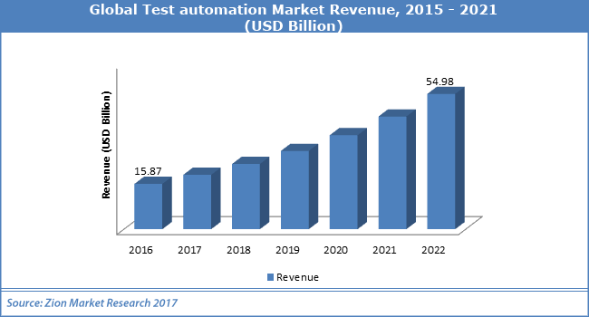

Slide 4
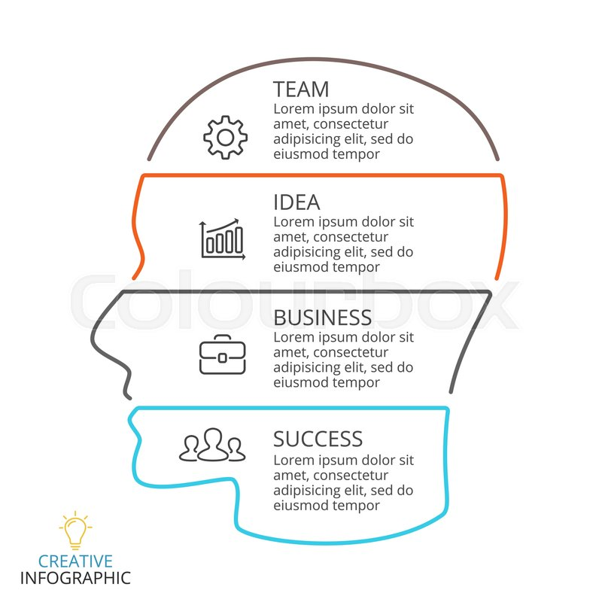
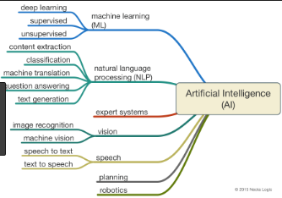
AI Classification

Slide 5


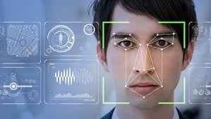
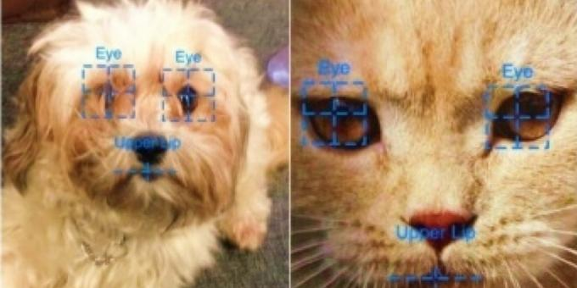

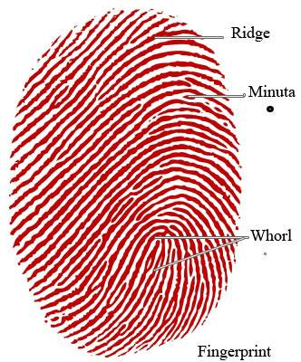
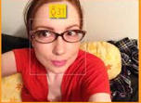
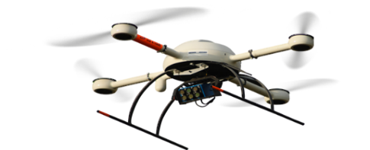



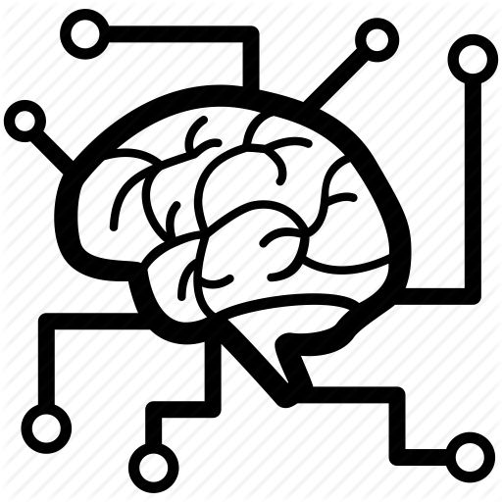
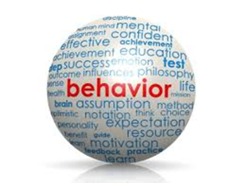





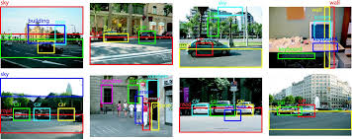




AI Software Classification
Expert System
Recommendation
System
animal profiling
& classification
human profiling
& classification
Identification & recognition system
Unmanned vehicle system
weather
Translation system
air/water/soil quality
disaster
transportation
…………………..
Behavior detection
& classification
Learning-Based System
Q&A system
Business Intelligent system
object detection & classification
context identification & classification
Command control & action

Slide 6
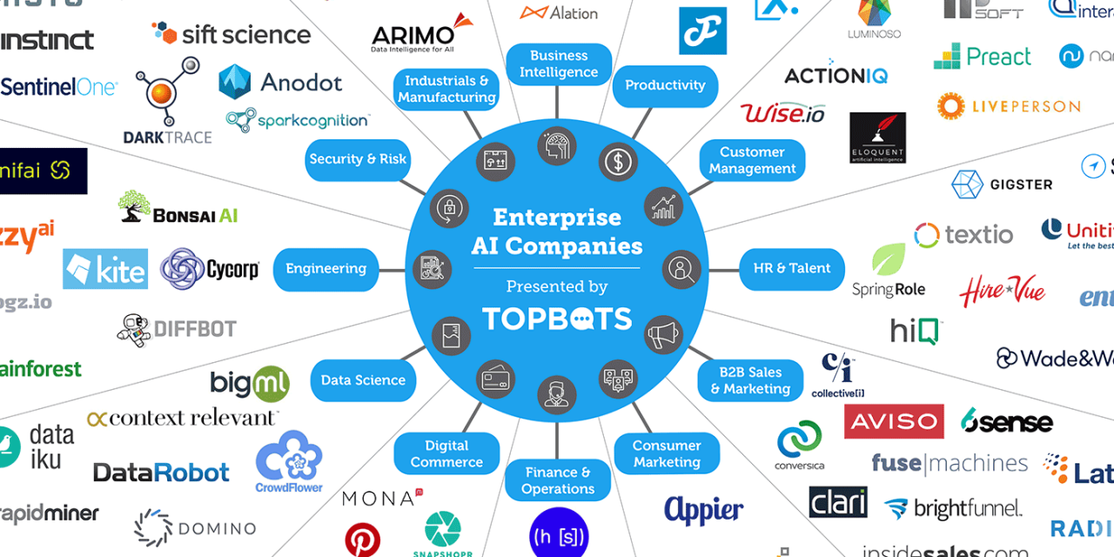
AI Enterprise Companies

Slide 7


Current AI System Testing Special Features
Test cases based on
Input Data from Big Data with 6V
Change Based-On Learning
Learning-Based System Evolution
Example-Based
Learning System
Limited Knowledge Scope
Real-Time Based Application
Limited Training/Test Dataset
Uncertainty
Incorrect Decision
Incorrect Behavior & Actions

Slide 8
Common AI Testing Questions
What is AI software testing?
How to test AI functions in a mobile app?
How to identify and establish well-defined test requirements for AI functions in a mobile app?
What and where are the cost-effective testing models and methods for testing AI functions?
What and where are the adequate quality assessment criteria for AI functions?
How to evaluate the training and test data sets?
Where are the automatic tools supporting AI software testing?
In addition, we also found following common facts and features of current AI mobile software apps after validating numerous ones.
Limited data training and validation – Most of our tested mobile apps with AI features are built based on machine learning models and techniques, and trained and validated with limited input data sets under ad-hoc contexts.
Data-driven learning features – Many mobile apps with learning features provide static and/or dynamic learning capabilities that affect the under-test software outcomes, results and actions.
Uncertainty in system outputs, responses, or actions – Since existing AI-based models are dependent on statistics algorithms, this brings the outcome uncertainty of AI software. We experienced many mobile apps with AI functions generated inconsistent outcomes for the same input test data when context conditions are changed.

Slide 9
What is AI Software Testing?
What Is AI Software Testing?
Intuitively, AI software testing refers to diverse quality testing activities for AI-based software systems using well-defined quality validation models, methods, and tools.
Its major objective is to validate system functions and features developed based machine learning models, techniques and technologies.
AI software testing includes the following primary goals:
Establish AI function quality testing requirements and assessment criteria
Detect AI function issues, limitations, and quantitative and quality problems
Gain the quality confidence of AI functional features developed based on AI techniques and machine learning models.
Evaluate AI system quality against well-established quality requirements and standards.

Slide 10
Major Testing Focuses and Scope
In the past two years, we have validated different types of AI mobile apps with diverse AI capabilities and features. Figure 1 shows the scope of AI software testing, which covers different types of artificial intelligent features and capabilities. Our students have tested numerous mobile apps powered with diverse machine learning models and AI algorithms. Here are some typical examples.
Figure 1. AI Software Testing Scope
Apple Siri - It is a built-in, voice-controlled personal assistant for Apple users. The idea isthat you talk to her as you would a friend and she aims to help you get things done, whether that be making a dinner reservation or sending a message.
Calorie MAMA – It is a smart camera app that uses deep learning to track nutrition from food images.
Seeing AI – It is a free app that narrates the world around you. Designed for the blind and low vision community, this ongoing research project with powered AI techniques. Its goal is to open up the visual world for users by describing nearby people, text and objects. - Check
My Age - It is a biometric face detection and age estimation application. It uses world best Neurotechnology face recognition algorithms to find the age from the look of the face

Slide 11
Data quality validation:
Issue #1 - Domain-specific training data quality checking could be very costly and time consuming. For example, training data for medical machine learning projects require the quality validation and confirmation from medical doctors. This is not only costly but very time consuming.
Issue #2 - There is a lack of automatic unstructured data quality validation tools. Although some existing tools (such as AAAA, BBB) are available for raw data quality checking, we could not find automatic tools for validating annotated rich media training data (i.e. video, audio and images). This becomes a serious issue in training data quality validation.
Issue #3 – There is a lack of well-defined data quality evaluation models and assessment metrics for unstructured training data, including images, videos, and audios

Slide 12
Why Do We Need AI Software Testing?
Step #1: AI function test planning
In this step, testers need to perform several tasks:
Task partitions and scheduling – In our project experience, students found that this is not easy task due to the complexity of AI function testing as well as the lack of AI knowledge and understanding.
AI function identification, understanding and partitioning
For many selected AI mobile APPs, students have difficulties in identifying and partitioning AI functions due to the lack of well-defined AI function requirements given by vendors. In many cases, several AI functions are aggregated together to generate system outcomes. ‘
AI function test requirement analysis – Many CMPE 287 class students have encountered the difficulty in generate AI function test requirements in a system approach although most of them have used the scenario analysis approach. One of the major reasons is the lack of effective test requirement analysis approaches to assist testers to perform AI function test requirement analysis from data and context perspectives.
Tool selection – Although many existing software testing tools are available for white-box testing, and system GUI and performance testing, students have problems to find any useful and practical tools for AI function validation

Slide 13
Step #2: AI function test modeling
– In this step, testers need to perform test modeling based on the established test requirements.
Although many of student groups have selected existing test models, such as decision tables, state diagram or event-based GUI models, for their AI software testing, they have found that they are not suitable or adequate for them to come out sound and effective test models for their selected AI functions.
Step #3: AI function test design
- This step focuses on AI function test design and test case generation in terms of system input and expected system outcomes. In conventional function testing, test design is performed by applying existing testing methods, test cases are generated by identifying input test data and expected output data.
Step #4: AI function test execution
– In this step, testers need to perform and execute their test cases with input data to detect AI function quality issues by checking the actual outcomes and results. In addition, they need to report the detected problems (bugs) during their testing. One major difficulty in their bug reporting and analysis is to identify and locate the causes of AI function quality issues, such as correctness, consistency, and accuracy. Data scientist and AI software engineers may have encountered the same problem in identifying the isolating the cause of AI function quality issues.
Step #5: AI function test quality evaluation
– In this step, testers need to evaluate their testing quality and decide if they have done enough in function validation. Since AI software has special features such as non-oracles, timeliness and learning capability, here function test quality evaluation is added particularly as the final step of AI software testing process. In this step, different quality parameters are measured using the pre-defined quality metrics based on testing result analysis. If the evaluation results.

Slide 14
AI-Based Software Testing
Test selection and reduction using AI techniques
Now, let’s summarize the major causes to conduct AI testing:
Cause #1 - Current existing software testing models and methods have limits to address AI software testing needs in supporting multi-models with unstructured input data, addressing large-scale classified inputs, and considering oracle problems, and quality accuracy, consistency, and correctness as well as relevance.
Cause #2 – Most current AI software are built-in with machine learning models developed by data scientists through large-scale data training using scientific algorithmically approaches instead of engineering approaches. Hence, there is a big gap in considering quality validation and quality assurance from engineering perspectives. Hence, AI testing research is needed to study and develop new and effective quality standards and evaluation methods.
Cause #3 – Building powerful AI software needs to use largescale training and test data sets. The current train methods and data generation lack of quality consideration, quality assessment, and certification. Hence, how to come out quality training data models, develop large-scale quality test data generation methods will be needed.
Therefore, AI function testing targets at built-in AI features in AI software applications. It refers to different testing activities to find AI software errors, verify evaluate quality parameters with well-defined testing models and quality assessment methods. The testing goal is to validate well-defined test requirements, meet pre-defined testing criteria, and standards of quality assurance of the under-test AI software.

Slide 15
TEST MODELING FOR AI FUNCTIONS
The basic test modeling procedure for each selected AI function consists of the following steps:
Step #1: AI function context classification modeling
In this step, a tester needs to identify and classified diverse context conditions and parameters, and present the classification results using a context classification model, known as a context classification tree.
A context classification tree is a 3-tuples, denoted as GCT= (NCT, ECT, RCT), where NCT is a finite nonempty set of nodes with a node label. There are three types of nodes in NCT, including a root node (NR), intermediate nodes (NI) and leaf nodes (NL). Figure 5 shows a simple example. ECT consists of a set of edges, and each connects two nodes in the tree (GCT), and represents of different category semantic relations between them. These semantic relations are included in RCT as its elements. There are four types semantic relations: AND, XOR, SELET-1 and SELECTM. The table below shows the detailed descriptions.
Semantic Relations Descriptions
AND (NP, ) NP has an AND relation with its n child nodes when all of its child nodes must be included. XOR (NP, ) NP holds an XOR relation with its two child nodes if only one of its two child nodes could be selected.
SELECT-1 (NP) NP has a SELECT-1 relation with its child nodes when only of its child nodes could be selected.
SELECT-M (NP, ) NP has a SELECT-M relation with its n child nodes if and only if m of n child nodes could be selected.

Slide 16
Step #2: AI function input classification modeling
In this step, a tester needs to focus on input classification to identify and classified diverse input data in terms of its category classes and their sub-classes. When an AI-based function accepts multiple input media formats (such as video, audio, and image, and text), each of them should be examined and classified. To effectively support a tester to conduct input classification, we used an input classification model (known as input classification tree) as our analysis and test model to facilitate and represent diverse input data classes and their sub-class using a category approach.
Step #3: AI function outcome classification modeling
In this step, a tester focuses on the classification of diverse AI function outputs, including texts, audio, video, and images, or events (or actions). Similar to input classification, an output classification tree model is generated as the outcome of this step.
Step #4: Generate a 3D classification decision table
In this step, a tester generates a new decision table for each under-test AI function feature, known as 3D classification decision table, to identify three dimensional mappings among disjoint classified context conditions, disjoint classified inputs, and disjoint classified outputs

Slide 17
AI Testing Approaches and Services
AI software testing could be carried out using the following approaches, shown in Figure 3.
Rule-based AI software testing, in which pre-defined expert-based rules are established and used in AI test generation and validation. This approach has been reported in long time ago.
Classification-based AI software testing, in which classification models for inputs, contexts, and outputs and events are setup for AI software testing to assure the adequate testing coverage of diverse input data classes, classified contexts and conditions, and corresponding outputs and classes.
Model-based AI software testing, in which selected machine learning models are extended to be traceable and testable AI test models to facilitate AI software testing and operations in quality evaluation of training data and test data.
AI-based testing for AI software, in which AI models and data-driven techniques are used to facilitate and optimize AI software testing in different perspective.
Metamorphic (Non-Oracle) testing, in which a property-based software testing technique is used as an effective approach for addressing the test oracle problem and test case generation problem.
Testing robots for AI software, where automatic software test robots are built and used to learn and follow experienced testers to perform user-oriented testing operation using collected user testing scenarios and test data.
Learning-based AI software testing using the crowd-sourced approach, in which selected machine learning models and approaches are used to learn from crowd-sources testers in a service platform

Slide 18
CHALLENGES, ISSUES, AND NEEDS
AI software quality validation has a number of major challenges due to the lack of research work results and engineering experience reports. These challenges are summarized below.
Challenge #1: How to establish the quality assurance requirements and testing coverage criteria for AI systems which are built using machine learning methods based on big data?
Challenge #2: How to use systematic methods to establish and develop quality test models for learning-based AI systems?
Challenge #3: How to use a systematic method to prepare quality training datasets and coverage-oriented test datasets for AI-based functional features in learning-based AI for todays’ AI systems?
Challenge #4: How to define quality assurance standards systems, and develop adequate quality test coverage? - Challenge #5: How to develop automatic solutions and tools to support AI-based system validation? In addition, there are a number of issues in AI software testing. Here are the primary ones summarized below

Slide 19
AI System Validation Problems
Problem #1:
Lack of well-defined and experience-approved AI system validation models and methods addressing the special features of today’s AI systems developed based on big data and using machine learning and deep learning techniques
Problem #2:
Lack of well-defined quality assurance standards and assessment methods for machine learning based AI systems based on big data
Problem #3:
Lack of efficient and cost-effective automatic quality validation tools for machine learning based AI systems

Slide 20
AI System Validation Challenges
Major Challenges:
Challenge #1:
How to establish the quality assurance and testing coverage criteria for AI systems using machine learning methods based on big data?
Challenge #2:
How to use a systematic method to prepare and generate quality training datasets and test datasets for today’s AI systems developed based on big data using machine learning and deep learning techniques?
Challenge #3:
How to use systematic methods and models to develop learning-based quality assurance systems or tools for machine learning based AI systems?

Slide 21
AI System Validation Challenges
Major Challenges:
Challenge #4:
When should we stop testing for big data-based AI systems using machine learning methods? Or How could we know that we have enough testing for AI systems?
Challenge #5:
How to prepare a clear and effective problem/bug report and conduct problem/bug analysis for AI system developers?

Slide 22
AI System Validation Needs
Need #1 – Developing well-defined adequate validation models and criteria to address and present the special features and needs in testing AI-based functional features, such as object detection and classification, recommendation and prediction features, and so on
Need #2 – Establishing well-defined quality assurance programs and standards to address the special quality parameters relating to AI functional features in AI-based systems.
Need #3 –More innovative adequate testing methods and test automation tools to address the special needs and features of AI software and applications to deal with the coverage of big data spaces.
Unlike conventional software test automation tools, these expected test automation solutions must consider AI’s special features and needs listed below:
Large-scale big data inputs with diverse formats, and structured and non-structured data;
Learning-based and knowledge-based system evolutions;
Non-oracles problems and rich oracle functions with uncertainty;
New QoS parameters, such as accuracy, consistency, correctness, accountability, usability, and
Automated quality test data generation and discovery using crow-sourcing approaches and learning-based solutions.

Slide 23
AI Testing – Training Process and Maturity Levels
Presented by: Jerry Gao, Professor, and Director
San Jose State University – Excellence Research Center on
Smart Technology, Computing, and Complex Systems
Date: 6/4/2018

Slide 24
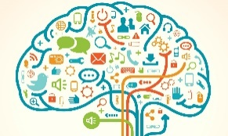











Knowledge-Based AI System Validation
– Validation Modeling, Methods, and Automation
Domain-Based
Knowledge
Training Books
& Resources
Exams & Projects
Training Lectures &
Training Methods
Testing Methods
Exams & Projects
Domain-Based
Knowledge
Test
Dataset
Knowledge-Models
Training Methods
And Tools
Testing
Methods

Slide 25
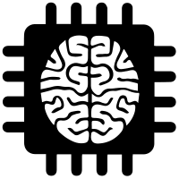



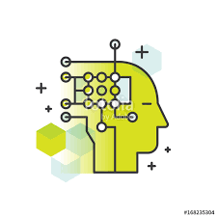





Training Modeling and Data Generation for AI Software
Ad-hoc Data Training
Data Model-based Training
AI Model (s)
AI Model (s)
Trainer
Trainer
AI Software
AI Software
Data-model
Data
Generation
Tool
Ad-hoc
collected
training data
Crowd-
Sourced
Trainer
Crowd-
Sourced
Trainer
Data-model
based training data
Learning
Method(s)
Learning
Method(s)
Ad-hoc training data collection and preparation
Ad-hoc data quality criteria for training data
Trainer: personal-based or crowd-sourced training
Approach: manual ad-hoc training approach
Data model-based training data generation
Ad-hoc data quality standards/criteria
Model-based training data generation and simulation
Trainer: personal-based or crowd-sourced training
Approach: manual training approach
automatic training data simulation

Slide 26

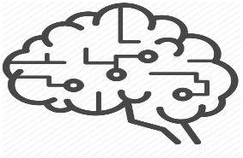






Training Modeling and Data Generation for AI Software
Knowledge-Based Quality Training
Knowledge-Based AI Quality Training
AI Model (s)
AI Model (s)
Trainer
Trainer
Knowledge
model
Knowledge
model
AI Software
AI Software
Knowledge
-based
quality
training data
Knowledge
-based quality
training data
Crowd-
Sourced
Trainers
Crowd-
Sourced
Trainers
Learning
Method(s)
& Tools
Data QA
model
AI
Learning
Tools
Data QA
model
Knowledge-based training data generation
Quality-driven training data generation
Model-based training data generation and simulation
Trainer: personal-based or crowd-sourced training
Approach: manual/automatic training approach
Knowledge-based training data generation
Quality-driven training data generation
Model-based training data generation and simulation
Trainer: personal-based or crowd-sourced training
Approach: AI-based automatic training approach

Slide 27
AI Testing – Test Automation
Presented by: Jerry Gao, Professor, and Director
San Jose State University – Excellence Research Center on
Smart Technology, Computing, and Complex Systems
Date: 6/4/2018

Slide 28

7 Innovative AI Test Automation Tools for the Future: The Third Wave
Applitools
SauceLabs
Testim
Sealights
Test.AI
Mabl
ReTest

Slide 29
 | Applitools | SauceLabs | Testim | Sealights | TestAI | Mabl | ReTest
Objectives | Ai-based automated maintenance |  | Ai-based test authorization and execution |  | Add an Ai brain to Selenium and Appium
Approaches | Automatically understand the changes |  |  |  | Dynamic approach
Test Format |  |  | Reducing flaky tests and test maintenance |  | Similar BDD syntax of Cucumber
Test Execution | Auto visual test execution |  |  |  | Support GUI test execution
Automatic Change Identification | GUI change and test identification |  |  |  | GUI screens and elements
Platform/Tool | Visual Validation Tool | Cloud-Based | Cloud-Based |  | Tool
Dependent Technology |  |  |  |  | Selenium and Appium
Bug detection | find out potential bugs

Slide 30
Automatic Test Planning and Modeling
Automatic or
Semi-Automatic Test Generation
Automatic Test Selection &
Execution
Automatic Test
Quality Assessment
- Automatic test model discovery
- Automatic test model generation
- Automatic test model validation
- Test script generation
- Test case generation
- Test data generation
- Auto test script selection
- Auto test execution control
- Auto test result validation
- Auto problem/bug generation
- Auto model test coverage analysis
- Auto test result quality assessment
- Auto bug/problem quality evaluation
Automatic Code Change Detection and Impact Analysis
Automatic Test Impact Detection and Analysis
Automatic Re-Test Selection &
Generation
Automatic Test Execution and
Quality Assessment
- Auto program change detection
- Auto program change analysis
- Auto program impact analysis
- Test case impact analysis
- Test script impact detection
- Test script impact analysis
- Auto re-test script selection
- Auto re-test script generation
- Auto re-test case generation
- Auto re-test script execution
- Auto re-test overage analysis
- Auto re-test result quality assessment
- Auto bug/problem quality evaluation

Slide 31
A Comparison Between AI Testing and Software Testing
Items | AI Testing | AI-Based Software Testing | Conventional Software Testing
Objectives | Validate and assure the quality of AI software and system by focusing on system AI functions and features | Leverage AI techniques and solutions to optimize a software testing process and its quality | Assure the system function quality for conventional software and its features
Primary AI testing focuses | AI feature quality factors: correctness, accuracy, consistency, timeless, completeness, and performance. | Optimize a test process in product quality increase, testing efficiency, and cost reduction. | Automate test operations for a conventional software process
Common system testing quality | System quality factors: performance, reliability, scalability, availability, security, throughput, | System quality factors: performance, reliability, scalability, availability, security, throughput, | System quality factors: performance, reliability, scalability, availability, security, throughput, …
System function testing | AI system function testing: -Object detection & classification - Recommendation and prediction -Language translation | System functions, behaviors, user interfaces, …. | System functions, behaviors, user interfaces, ….
Test Selection | AI test model based test selection, classification, and recommendation | Test selection, classification, and recommendation using AI techniques | Rule-based and/or experience based test selection
Test Data Generation | AI test model based test data discovery, collection, generation, validation, and | AI-based test data collection, classification, and generation | Model-based and/or pattern based test generation
Bug Detection and Analysis | AI model-based bug detection, analysis, and report | Data-driven analysis for bug classification and detection, as well as prediction | Digital and systematic bug/problem management

Slide 32
A Classification-Based Test Automation
- AI feature context classification model generation
- AI function input classification model generation
- AI function output classification model generation
- AI function output event classification generation
3D decision table entry mappings among three dimensions
Classified test input data discovery and collection
Classified test test input data generation, augmentation, simulation
Automatic classification rule validation for every test input instance
Automatic test mapping for expected outputs and events
Classification Based Test Modeling for
AI Features
3D AI Classification Decision Table (3D AICDT) Generation
Test Generation for 3D AI Classification Decision Table
AI Function Classification Test
Quality Assessment
- Context classification table generation with rules
- Input classification table generation with rules
- Output classification table generation with mappings
Automatic/semi-automatic test script generation
Automatic test script execution control and monitor
Automatic test result validation and quality evaluation
Automatic test 3D AICDT model test coverage analysis
Automatic bug report generation and assessment

Slide 33
A Classification-Based Re-Test Automation
- AI feature context classification model generation
- AI function input classification model generation
- AI function output classification model generation
- AI function output event classification generation
3D decision table entry mappings among three dimensions
Classified test input data discovery and collection
Classified re-test input data generation, augmentation, simulation
Automatic classification rule validation for every re-test input instance
Automatic re-test mapping for expected outputs and events
Classification Based Re-Test Modeling
For AI Features
3D AI Classification Decision Table
Re-Generation
Re-Test Generation for 3D AI Classification Decision Table
AI Function Classification Re-Test
Quality Assessment
Context classification table re-generation with rules
Input classification table re-generation with rules
Output classification table re-generation with mappings
Automatic change detection of 3D AI Classification Decision Table
Automatic/semi-automatic new test script generation
Automatic re-test script execution control and monitor
Automatic re-test result validation and quality evaluation
Automatic updated re-test model coverage analysis
Automatic re-test bug report generation and assessment

