Slide 1

Environment Variable and Set-UID Program
By Harish Marepalli
SJSU ID: 016707314
Professor: Dr. Younghee Park
Teammate: Tirumala Saiteja Goruganthu
Project/Attack Category: Software Security

Slide 2
Introduction
An environment variable is a dynamic value that can be used by programs running in a specific environment.
These variables provide information about the environment in which the program is running and can be accessed by the program through APIs.
They are used by most operating systems since they were introduced to Unix in 1979.
Although environment variables affect program behaviors, how they achieve that is not well understood by many programmers.
As a result, if a program uses environment variables, but the programmer does not know that they are used, the program may have vulnerabilities.

Slide 3
Set-UID
A Set-UID (Set User ID) is a special permission in Unix/Linux operating systems that allows a program to run with the permissions of its owner instead of the user who executed it.
This is often used to allow non-privileged users to execute certain privileged tasks.
However, when these two concepts are combined, they can create a security vulnerability known as an Environment Variable and Set-UID Attack.
This attack occurs when an attacker sets an environment variable that a privileged program uses, and then runs the program with the Set-UID permission.
By doing so, the attacker can execute malicious code with the elevated privileges of the program.

Slide 4
Set-UID Concept
Every process has two User IDs.
Real UID (RUID): Identifies real owner of process.
Effective UID (EUID): Identifies privilege of a process.
Access control is based on EUID
When a normal program is executed, RUID = EUID, they both equal to the ID of the user who runs the program.
When a Set-UID is executed, RUID != EUID. RUID still equal to the user’s ID, but EUID equals to the program owner’s ID.
If the program is owned by the root, the program runs with the root privilege.

Slide 5


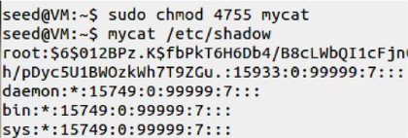
Turn a Program into Set-UID
Change the owner of a file to root:
Before Enabling Set-UID bit:
After Enabling the Set-UID bit:

Slide 6

How it works?
A Set-UID program is just like any other program, except that it has a special marking, which is a single bit called Set-UID bit.

Slide 7
How is Set-UID Secure?
Allows normal users to escalate privileges
This is different from directly giving the privilege (sudo command)
Restricted behavior
Unsafe to turn all programs into Set-UID
Example: /bin/sh
Example: vi

Slide 8
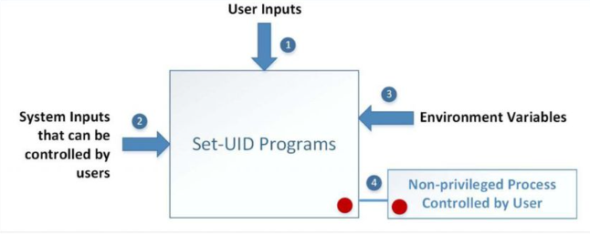
Attack Surfaces of Set-UID Programs

Slide 9
Objective
The objective of this project is to understand what risks such privileged programs face and how they can be attacked if there are mistakes in the code.
We also understand how environment variables work, how they are propagated from parent process to child, and how they affect system/program behaviors.
We are particularly interested in how environment variables affect the behavior of Set-UID programs, which are usually privileged programs.

Slide 10
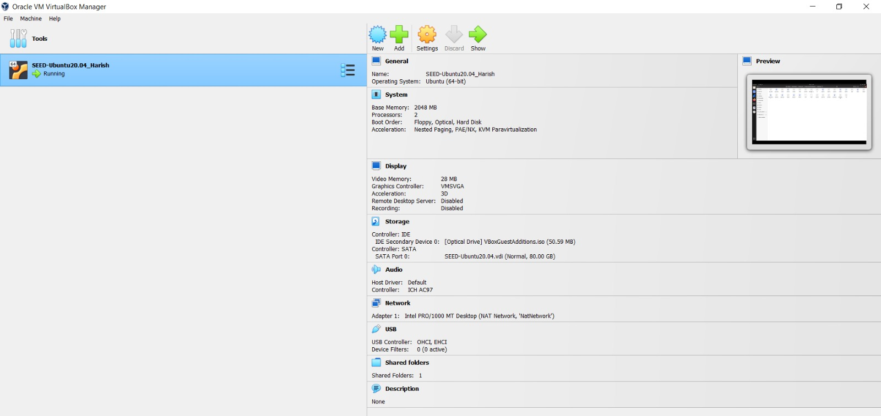
Lab Environment
This lab has been tested on the SEED Ubuntu 20.04 VM.
We can download a pre-built image from the SEED website and run the SEED VM on our own computer.

Slide 11
Tasks
Task 1: Manipulating Environment Variables
Task 2: Passing Environment Variables from Parent Process to Child Process
Task 3: Environment Variables and execve ()
Task 4: Environment Variables and system ()
Task 5: Environment Variable and Set-UID Programs
Task 6: The PATH Environment Variable and Set-UID Programs
Task 7: The LD_PRELOAD Environment Variable and Set-UID Programs
Task 8: Invoking External Programs Using system () versus execve ()
Task 9: Capability Leaking

Slide 12
Defense Methods
To defend against these attacks, there are some measures that can be taken:
Avoid using environment variables in set-UID programs: This is the most effective defense measure. By avoiding the use of environment variables in set-UID programs, you eliminate the risk of an attacker manipulating them.
Validate input: It is important to validate all input to set-UID programs, including environment variables. This can help prevent attackers from exploiting vulnerabilities in the program.
Use secure coding practices: Set-UID programs should be designed and coded with security in mind. This includes practices such as input validation, error checking, and boundary checking.

Slide 13
Thank you ☺

