Slide 1

Amazon QA Automation
Harish Kumar Marthi
22,July 2020

Slide 2
Agenda
Problem Definition
Idea Generation and Tools Used
Steps for this Framework
Task Code Execution
Challenges faced during automation
Reports

Slide 3
Problem Definition
To Review the below three use cases and automate them using any web automation tool.
Search a phone on Amazon
Print out average stars of a product
Validate the pin code change workflow

Slide 4
Idea Generation and Tools Used
The idea was to use the below mentioned tools and applications to work on this assignment.
Programming Language : Java(can be use the JDK 8 and above)
Automation Tool : Selenium WebDriver 3.141.59
Framework Used : Hybrid Framework(BDD Cucumber, POM with Page Factory, Junit, Cucumber JVM Reports)
Reports : Custom HTML reports
Build Tool : Maven

Slide 5
Steps for this Framework
Once you run the project through TestRunner.java or pom.xml file then the control will move to feature file to read the steps.
After that control will move to step definitions package to read the glue code.
From step definitions the control moves to Page files to do the actual test execution.
In the test base class, we are maintaining the driver details and launching the browser.
“Utils” contains the utility method for the project.
Configuration file consists of all the config details for the drivers, driver keys and app url etc..
Finally reports will be stored under "AmazonAutomation/target/cucumber-jvm-report/cucumber-html-report" folder.
Here we are using the cucumber JVM reports
After every test case or test scenario is completed the browser will close and open again for next test case or test scenario

Slide 6
Task Code Execution
The code can be executed in two ways as shown below:
Run through Junit file : In the project root node there is a "TestRunner.java" file. Right click on it and choose run as then click on "JUnit Test" Option.
Run through POM file : In the project root node there is a "pom.xml" file. Right click on it and choose run configuration for maven build as "mvn clean verify".

Slide 7
Challenges faced during Automation
The scenario where challenge was faced is during the development of the below test case:
Validate the pin code change workflow: When we click the “Deliver to” icon at the initial stage, it did not prompt any screen to change the address.
So, I have set up the initial address and then changed the pin code according to the test case description.

Slide 8
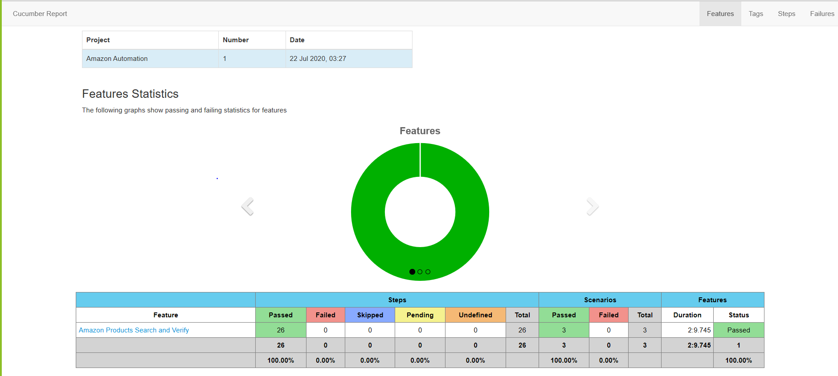
Reports
The Report shows the scenarios covered when you click on the Feature link.
It also displays the screenshots for each test step.
The Test Results show Passed/Failed/Skipped/Pending/Undefined/Total and the duration.
The report will capture the timestamp.
Reports will be saved in "AmazonAutomation/target/cucumber-jvm-report/cucumber-html-report" folder.

Slide 9


