Slide 1
CSE302: Computer Networks Project
Title: Live Audio Streaming From Server to Client with Message box
Presented By
Pallamala Harish
124003420
Guide Name: Dr. Kannan Balasubramanian, CSE/SoC, SASTRA University
Date of Presentation: 13.12.2022
1

Slide 2
Points to be discussed
Aim & Objective
Problem Statement
Literature Survey
Work Flow Diagram
Proposed Work Flow and Methodology
System Configuration : Software, Hardware, Network type, Protocols used
Work Done (Implementation code link)
Sample I/O (screen shots)
References

Slide 3
AIM & OBJECTIVES
Aim : Implementing the Live audio streaming using UDP protocol in wireless network to simulate the application on Client-Server environment.
Objective 1: Understanding User Datagram Protocol
Objective 2: Applying LAN and various types of networks concepts
Objective 3: Connecting Multiple clients to single server through MulticastSocket
Objective 4: Benefits to the end users who are listening to live commentary or live audio.

Slide 4

Problem Statement & Solution
Sample problem statement :
How to join Multiple clients while live audio is being sent from the server to them?
The Solutions is :
Using MulticastSocket to implement a client-server program and grouping all clients connected to the server

Slide 5
Existing Solutions- LITERATURE SURVEY
S.No | Title of the paper | year | Comments on base and reference papers
1 | Audio Streaming | 2018 | Audio response received by client is played for visually impaired person

Slide 6
System configuration
Client
Hardware used: Speakers
Server
Hardware used: Microphone
Software used: JDK 16.0.1
Network : wireless
Protocol: UDP
Platform used : IntelliJ

Slide 7
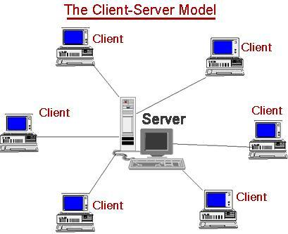
Network Architecture
Clients connects to the server and receives audio.

Slide 8
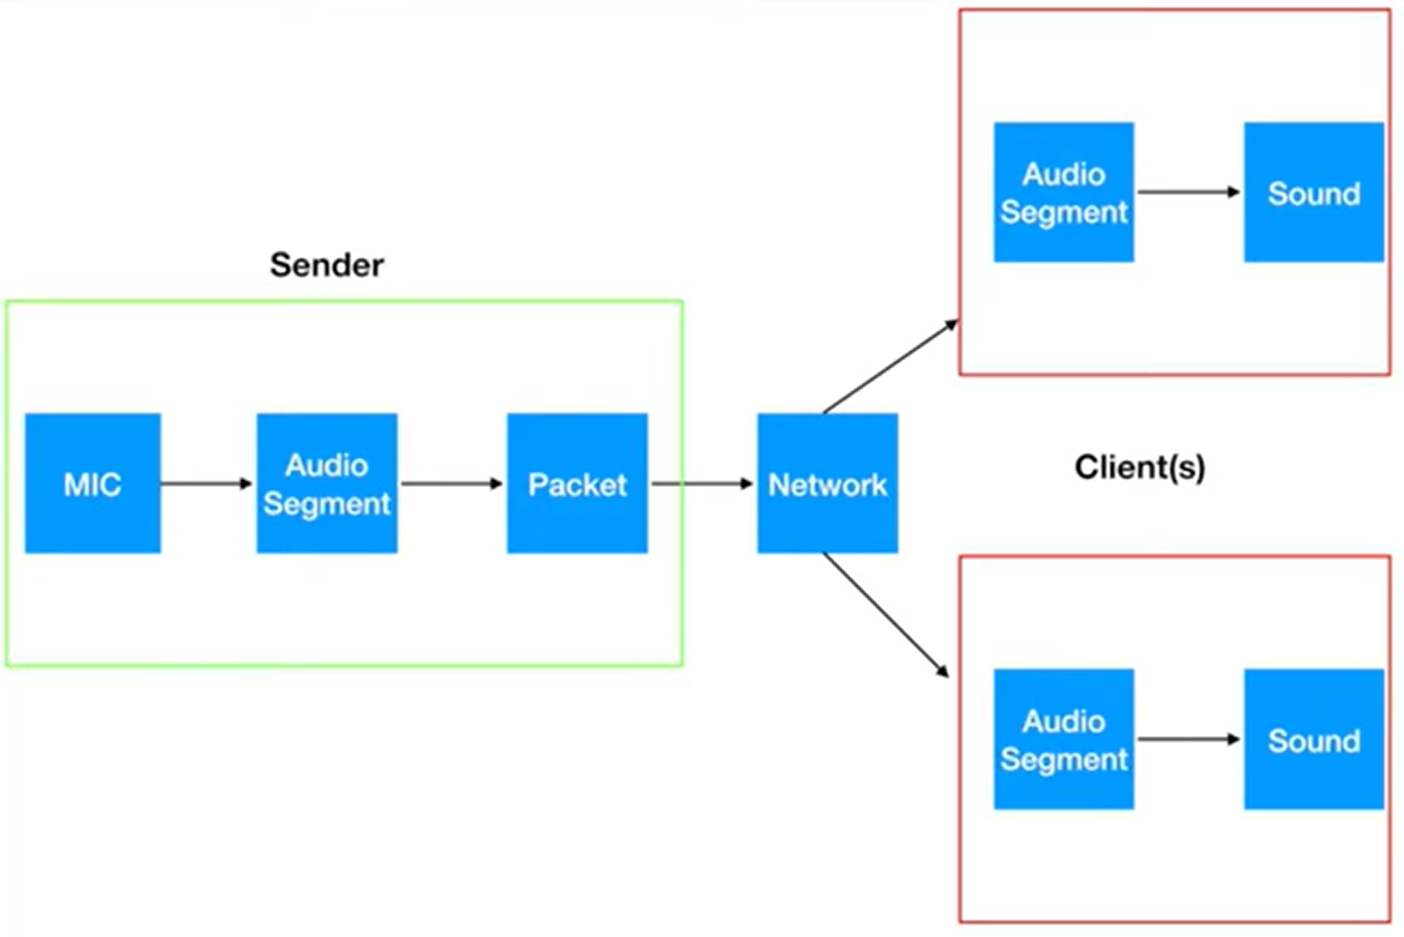
Working Flowchart

Slide 9
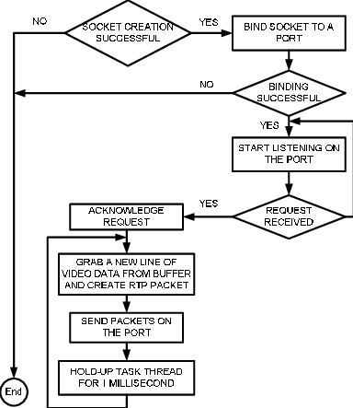
Technical Implementation & Methodology Flowchart

Slide 10
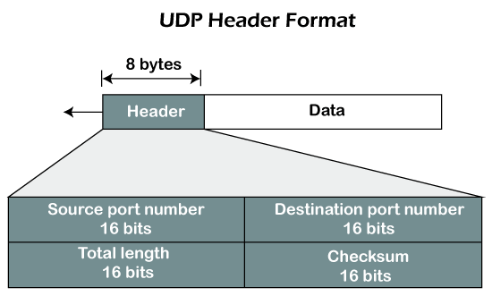
Proposed Protocol Description
RFC number:____ UDP Header format
Features of the protocol : Connectionless, Faster transmission
Limitation of the protocol : Unreliable, No Flow control, No Acknowledgement

Slide 11
Work done
Link of the implementation code:
https://github.com/HarishPallamala/LiveAudioStreaming

Slide 12
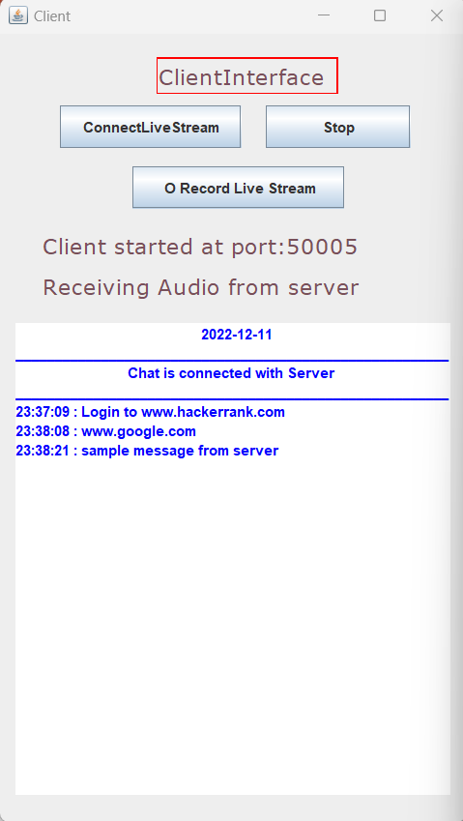
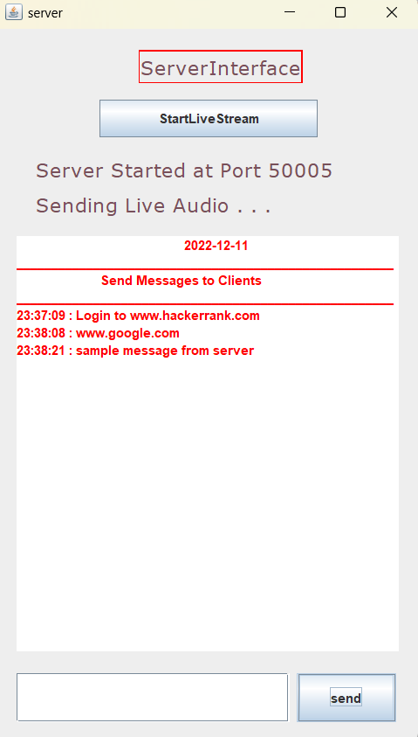
Sample Output snapshots
Status of the audio & connection
Date
Messages from server along with time
Message Box

Slide 13
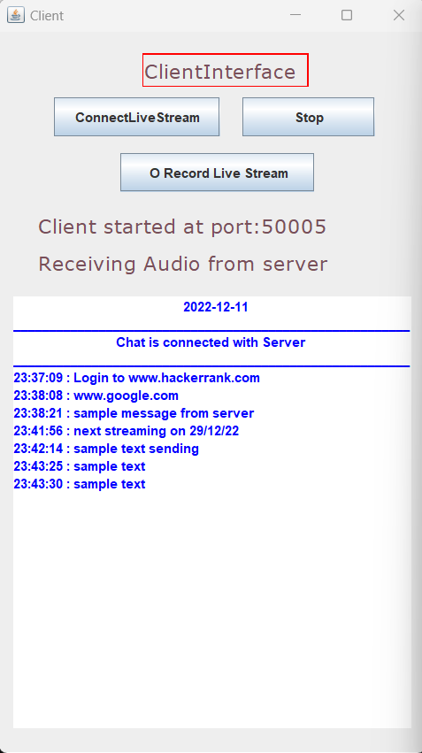
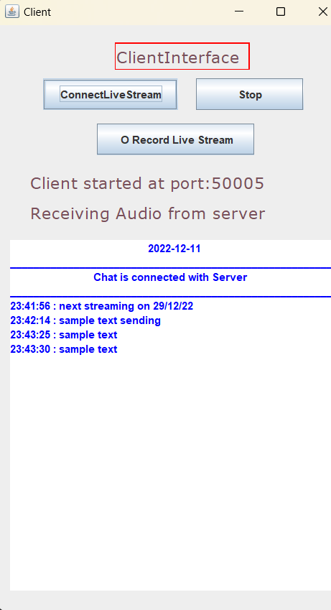
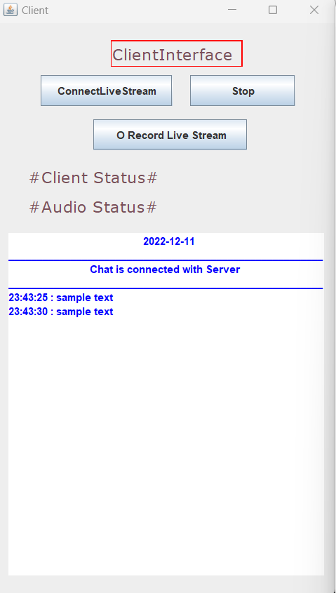
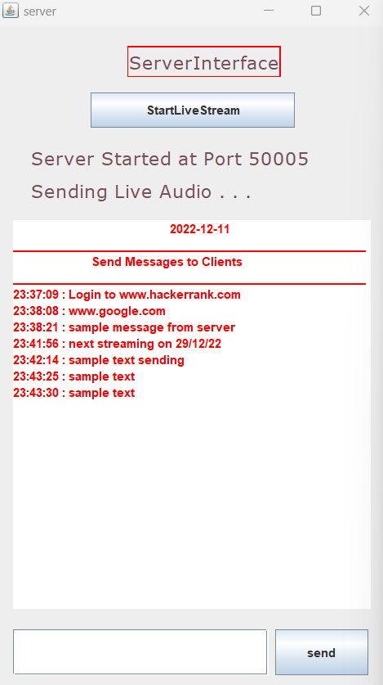
Multiple clients connected in the middle of the streaming

Slide 14
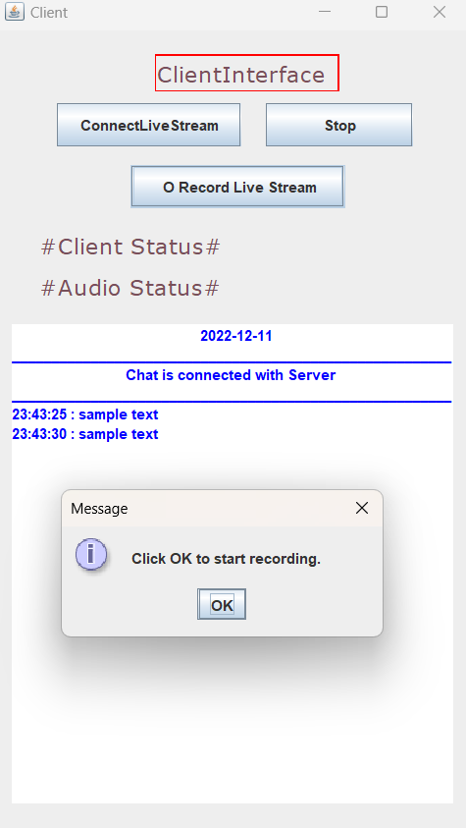
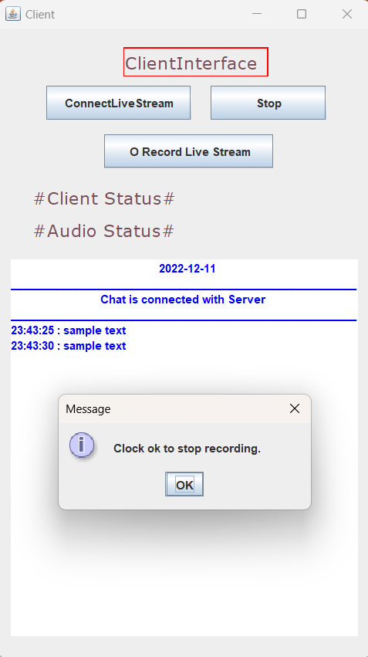
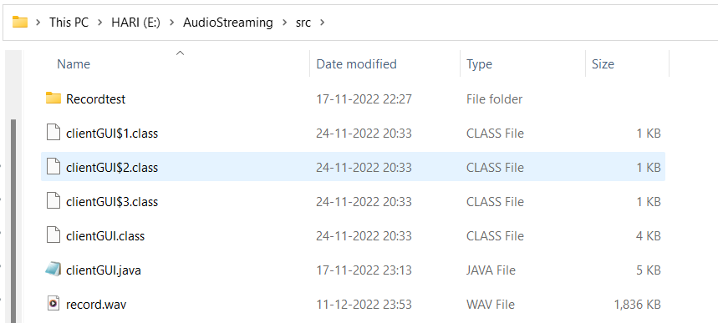
Client is Recording the audio
The audio from the server is recorded into the record.wav when the client starts recording. After recording is finished, this wav file is saved in the client file directory.

Slide 15
References
15
Hernandez C. I. (February 24, 2017). Abstraction Layers: From Atoms to Apps
Herbert Schildt (July 29, 2015) JAVA: The Complete Reference
Anonymous, Transport Layer Protocols, Transport Layer, en.wikipedia.org/wiki/Transport layer
Jim Kurose, Keith Ross Authors’ website, Differences in TCP and UDP, Computer Networking: A Top-down Approach - 8th Edition, http://gaia.cs.umass.edu/kurose_ross/online_lectures.htm
https://stackoverflow.com

Slide 16
17
Thank You

