Slide 1
PROJECT EXECUTION METHODOLOGIES

Slide 2
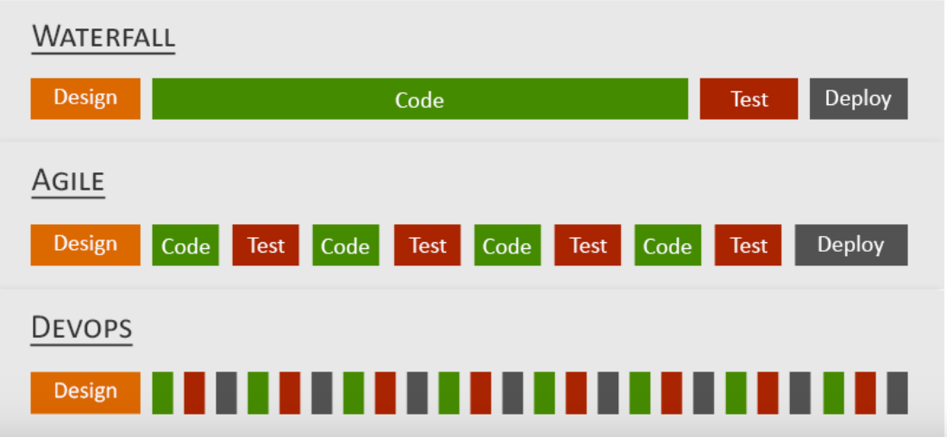
WATERFALL vs AGILE vs DEVOPS

Slide 3
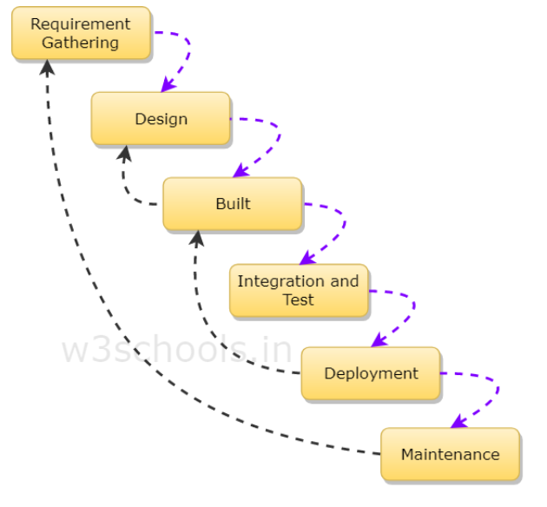
WATERFALL MODEL PHASES

Slide 4
Advantage's of waterfall model
This model is simple and easy to understand and use.
It is easy to manage due to the rigidity of the model – each phase has specific deliverables and a review process.
In this model phases are processed and completed one at a time. Phases do not overlap.
Waterfall model works well for smaller projects where requirements are clearly defined and very well understood.

Slide 5
WHEN TO USE WATERFALL MODEL
This model is used only when the requirements are very well known, clear and fixed.
Product definition is stable.
Technology is understood.
There are no ambiguous requirements
Ample resources with required expertise are available freely
The project is short.

Slide 6
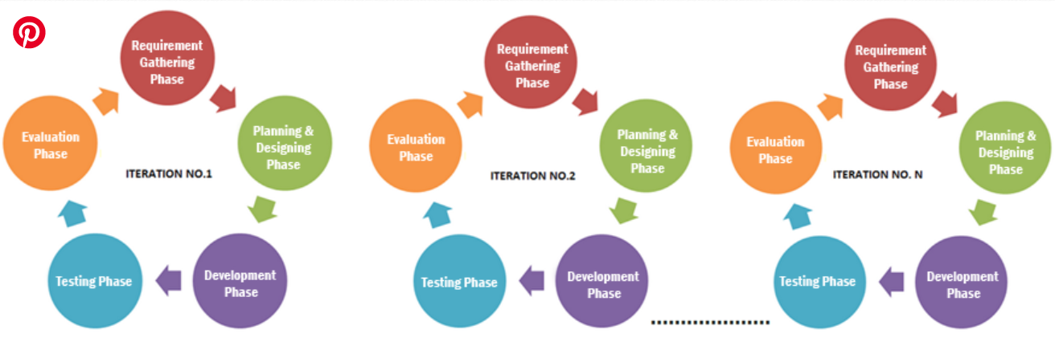
AGILE MODEL PHASES

Slide 7
ADVANTAGES OF AGILE
Customer satisfaction by rapid, continuous delivery of useful software.
People and interactions are emphasized rather than process and tools. Customers, developers and testers constantly interact with each other.
Working software is delivered frequently (weeks rather than months).
Face-to-face conversation is the best form of communication.
Close, daily cooperation between business people and developers.
Continuous attention to technical excellence and good design.

Slide 8
WHEN TO USE AGILE
When new changes need to be implemented. The freedom agile gives to change is very important. New changes can be implemented at very little cost because of the frequency of new increments that are produced.
To implement a new feature the developers need to lose only the work of a few days, or even only hours, to roll back and implement it.
Unlike the waterfall model in agile model very limited planning is required to get started with the project. Agile assumes that the end users’ needs are ever changing in a dynamic business and IT world.
Both system developers and stakeholders alike, find they also get more freedom of time and options than if the software was developed in a more rigid sequential way.

Slide 9
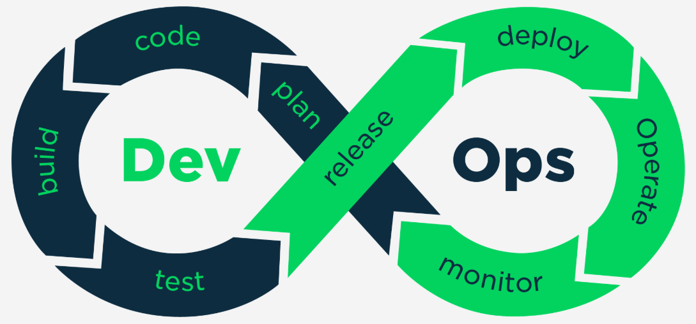
DEVOPS PHASES

Slide 10
Advantages of devops
Swifter time to market
Ensured stability and less risk of failures post-deployment
Quicker recovery time after unforeseen circumstances
Enhanced efficiency and productivity
Increased scalability and robustness of processes

Slide 11
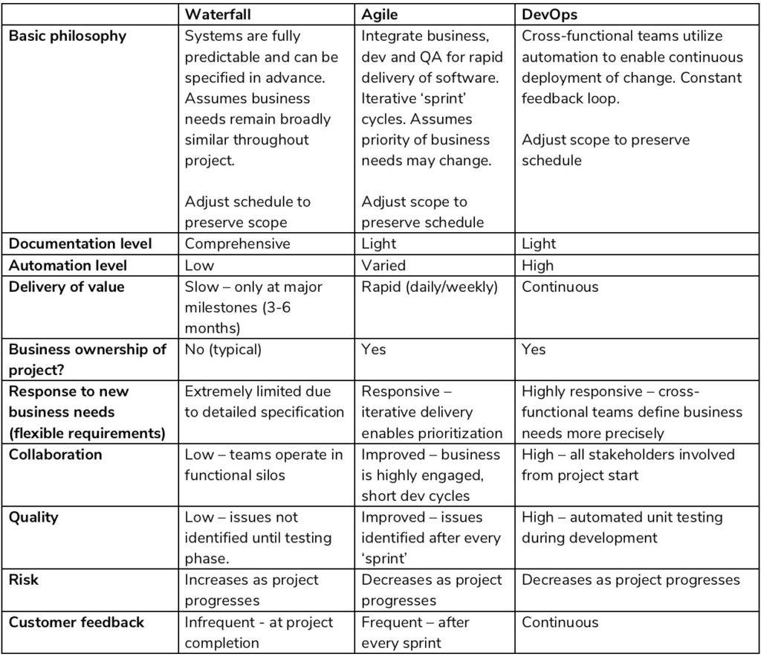
DIFFERENCES

Slide 12

THANK YOU!!

