Slide 1

CRYPTOGRAPHY

Slide 2
WHAT IS CRYPTOGRAPHY
Cryptography is often associated with the process where an ordinary plain text is converted to cipher text which is the text made such that intended receiver of the text can only decode it.
Cryptography is also known as cryptology.

Slide 3
FEATURES OF CRYPTOGRAPHY
Confidentiality: Information can only be accessed by the person for whom it is intended and no other person except him can access it.
Integrity: Information cannot be modified in storage or transition between sender and intended receiver without any addition to information being detected.
Non-repudiation: The creator/sender of information cannot deny his or her intention to send information at later stage.
Authentication: The identities of sender and receiver are confirmed. As well as destination/origin of information is confirmed.

Slide 4
TYPES OF CRYPTOGRAPHY
Symmetric Key Cryptography: It is an encryption system where the sender and receiver of message use a single common key to encrypt and encrypt messages. Symmetric Key Systems are faster and simpler but the problem is that sender and receiver have to somehow exchange key is a secure manner.
Hash Functions: There is no usage of any key in this algorithm. A hash value with fixed length is calculated as per the plain text which makes it impossible for contents of plain text to be recovered.
Asymmetric Key Cryptography: Under this system a pair of keys is used to encrypt and decrypt information. A public key is used for encryption and a private key is used for decryption. Public key and Private Key are different.

Slide 5
PUBLIC vs PRIVATE KEYS
S.No | PRIVATE KEY | PUBLIC KEY
1. | Private key is faster than public key. | It is slower than private key.
2. | In this, the same key (secret key) and algorithm is used to encrypt and decrypt the message. | Two keys are used, one key is used for encryption(public key) and while the other is used for decryption(private key).
3 | In private key cryptography, the key is kept as a secret. | One of the two keys is kept as a secret
4 | Private key is Symmetrical because there is only one key that is called secret key. | Public key is asymmetrical because one is kept secret and another key is made public
5 | The sender and receiver has to share the same key. | The sender and receiver does not need to share the same key.

Slide 6
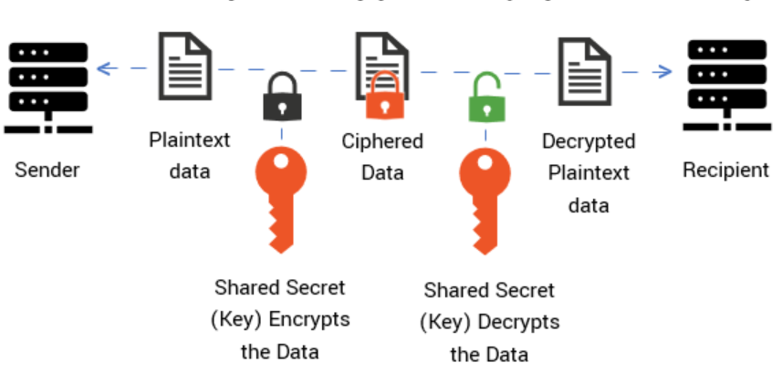
PRIVATE KEY ENCRYPTION (SYMMETRIC)

Slide 7
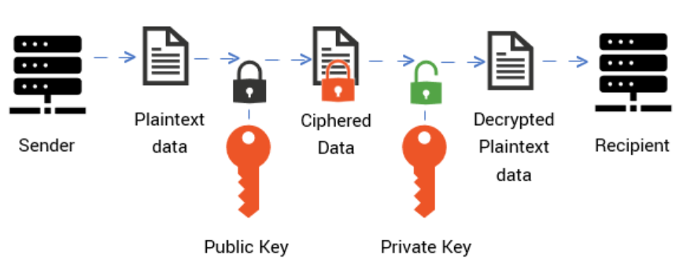
PUBLIC KEY ENCRYPTION (ASYMMETRIC)

Slide 8

THANK YOU!!

