Slide 1
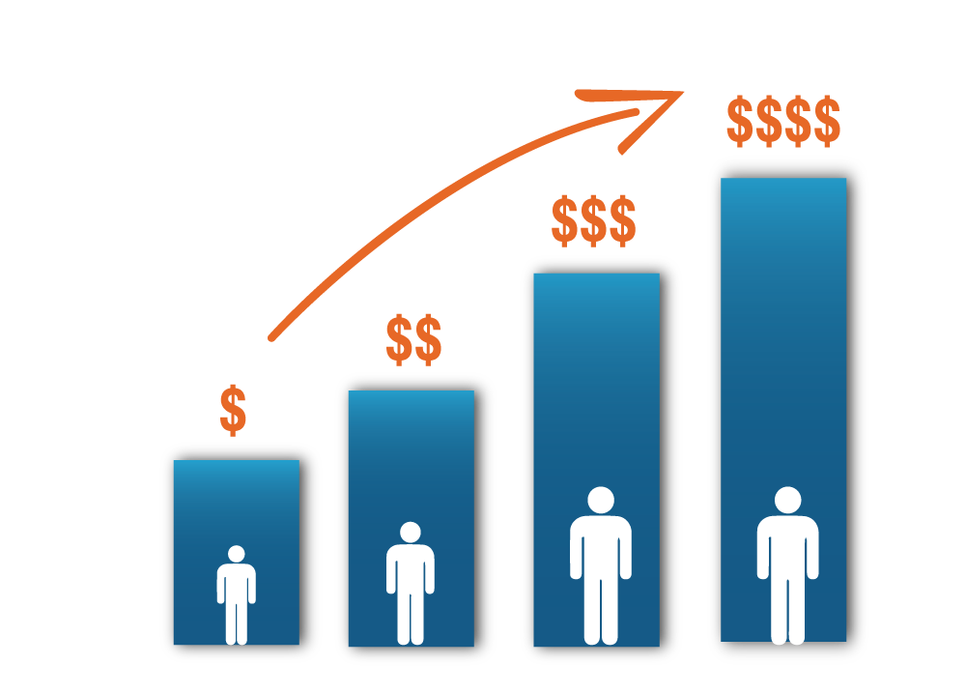
Customer Future Value Analysis
By
Elite Consulting

Slide 2






Elite Consulting
Yash Prakash
Alvi Mahmud
Asish Pamu
Harish Patlolla
Gopi Govindarajula
Thu Dinh

Slide 3
Outline
Approach
Output & Insights
Recommendations

Slide 4
Approach

Slide 5
When it comes to growing your business, there are essentially two tactics at your disposal…

Slide 6


Acquiring new customers
Retaining existing customers and increasing CLV
More customers = More Sales = More Revenue = More Profits = Good times ahead
Old wisdom that it’s cheaper to keep a customer than to find a new one

Slide 7
“
The purpose of a business is to create a customer and grow that customer
– Peter Drucker
”

Slide 8
Acquisition Vs. Retention
16%
Just of companies focused more on retention than acquisition.
82%
companies surveyed agreed that retention was cheaper than acquisition.
Source: Econsultancy’s 2014 Cross-Channel Marketing Report

Slide 9
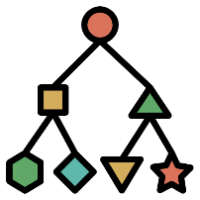


Business Objectives
Expand Sales Margin
Increase Customer Future Value (CFV)
Improve Customer Retention

Slide 10



Data Description
Age
Length of Residence (LOR)
Number of Generations
Value of Home Residence
Total Household Income
Own/ Rent the Residence
Number of months since last transactions
Number of purchases
Amount of purchases
Responses to marketing contacts
Current Tier
Revenue
Cost

Slide 11
Outputs & Insights

Slide 12
Findings from Churn Model
Variable Importance

Slide 13


Findings from Margin Model
Diamond tier, both this year and previous year; had the highest positive association; meaning whether a customer is or was in diamond tier is the best predictor for their margin
Purchase amount of past 36 months was the most important indicator for predicting the margin of a customer

Slide 14
CFV Calculation
Churn Model
Margin Model
Calculate CFV
Underdogs
Cash-cows
Wild cats
Stars

Slide 15
Customer Profiling
High
Medium CFV
High CFV
Underdogs : Low Retention, Low Margin
Cash-cows : Low Retention, High Margin
Wildcats : High Retention, Low Margin
Stars : High Retention, High Margin
Wildcats
Stars
Retention Likelihood
Low CFV
Medium CFV
Underdogs
Cash-cows
Low
High
Margin $

Slide 16


Call - Ins
High
11
6
For Wildcat and Underdog groups:
Resolve issues faster to decrease call-ins
Wildcats
Stars
Retention Likelihood
9
4
Upsell to increase margins
Underdogs
Cash-cows
Low
High
Margin $

Slide 17
Call - Outs
High
2
3
For the low Call-Outs groups:
More engagement with customers
Wildcats
Stars
Retention Likelihood
1
2
Targeted marketing with discounts
Underdogs
Cash-cows
Low
High
Margin $

Slide 18

Home Value
High
$145,753
$160,258
For Cash-Cows:
High net worth, but low retention
Wildcats
Stars
Retention Likelihood
$140,784
$172,104
A loyalty points program to increase retention
Underdogs
Cash-cows
Low
High
Margin $

Slide 19

Mails Sent to Customer
High
20
31
For Cash-Cows:
Wildcats
Stars
Send mails with promotional offers
Retention Likelihood
9
13
Underdogs
Cash-cows
Low
High
Margin $

Slide 20
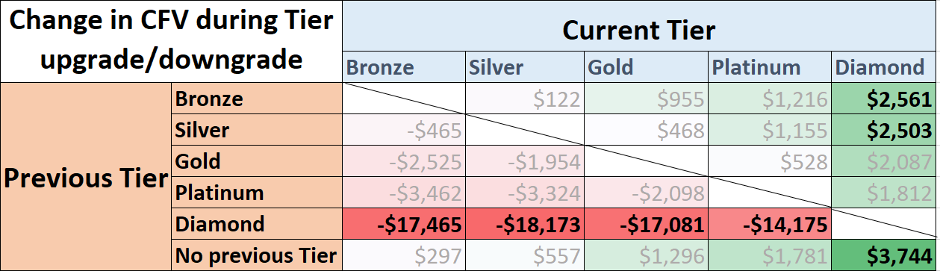
Tier – CFV Relationship

Slide 21



Strategy
High
Engage Stars
Wildcats
Stars
Reach out to Wildcats & Cash-cows
Retention Likelihood
Underdogs
Cash-cows
Identify Detractors
Margin $
High
Notes:
Engage Promoters and use their love for your brand to spread positive word-of-mouth and thus bring in more business
Reach out to passives before they churn and delight them with excellent customer service to convert them into Promoters
Identify Detractors and trade their dissatisfaction for a positive experience by fixing and following-up with reported issues

Slide 22
Recommendations

Slide 23



Recommendations
Focus on Customer Experience : Decrease call ins, increase satisfaction
Build Relationship: Increase call outs, try other options like social media, chat, blogs etc.
Customize Product : Upsell, Cross sell based on past purchasing behavior
Notes:
Make an effort to improve your processes over time, and don’t be shy or quiet about it. Customers like to see companies put in effort to improve. It shows humility and a concern for customers’ happiness. Review reordering processes, website functionality, and more to ensure everything is up to par.
Ask for feedback. Follow up if there are any issues. Don’t cloak pricing, value propositions, or contract terms. Coax customers into signing up for a long-term relationship with discounts or value additions to the deal. Then, if you can’t persuade them to stay, treat the conversation like an exit interview to try and learn from the situation.
Study what products customer is interested in. Suggest related options that are new in the market. Upsell, cross sell other products based on his interests.

Slide 24



Recommendations (Contd.)
Define most valuable and most risky customers : targeted marketing
Competitors : Monitor their strategies, sales, and learn
Loyalty Programs : To offer benefits, upgrade tier, and thereby increasing retention
Notes:
4) The best way to avoid churn is to prevent them from happening in the first place, right ? There is alwaysa grp of customers who are more likely to churn than others. By identifying them, you can reach out to them to make them stay. Similarly, it’s good if you can separate your most valuable customers too. You can go an extra mile to make sure they are atleast receiving what they signed up for. This group has to be taken care of because they bring in the biggest margins for you
5) Know what you’re up against. Keep an eye on competitors’ strategy and offering developments, so you can focus on maintaining an advantage over them. Don’t give your customers an opportunity to leave for something better. At the same time, make sure your customers know what you are better at, and what makes you unique.
6) Offer benefits. They don’t have to be costly. They just have to provide value. Freebies, gift cards, and other gifts can go a long way in making customers feel valued and want to stick around for more. Also, upgrade tiers of customers for extra benefits with more loyalty reward points.

Slide 25
“
“
Thank you

Slide 26
“
“
Q/A

Slide 27
Appendix

Slide 28
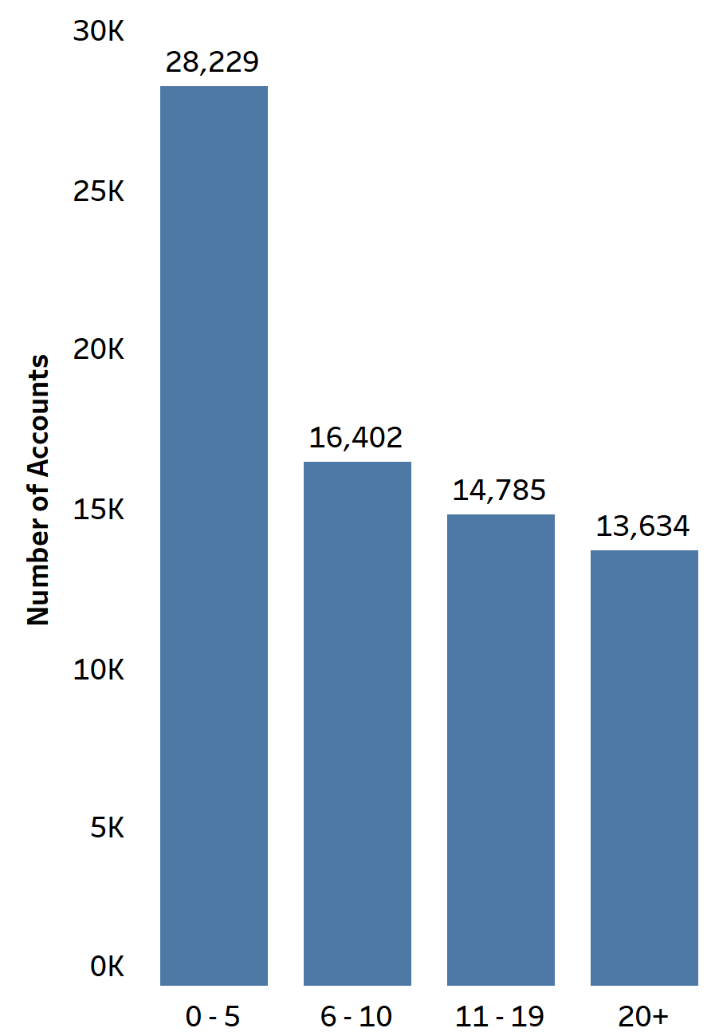
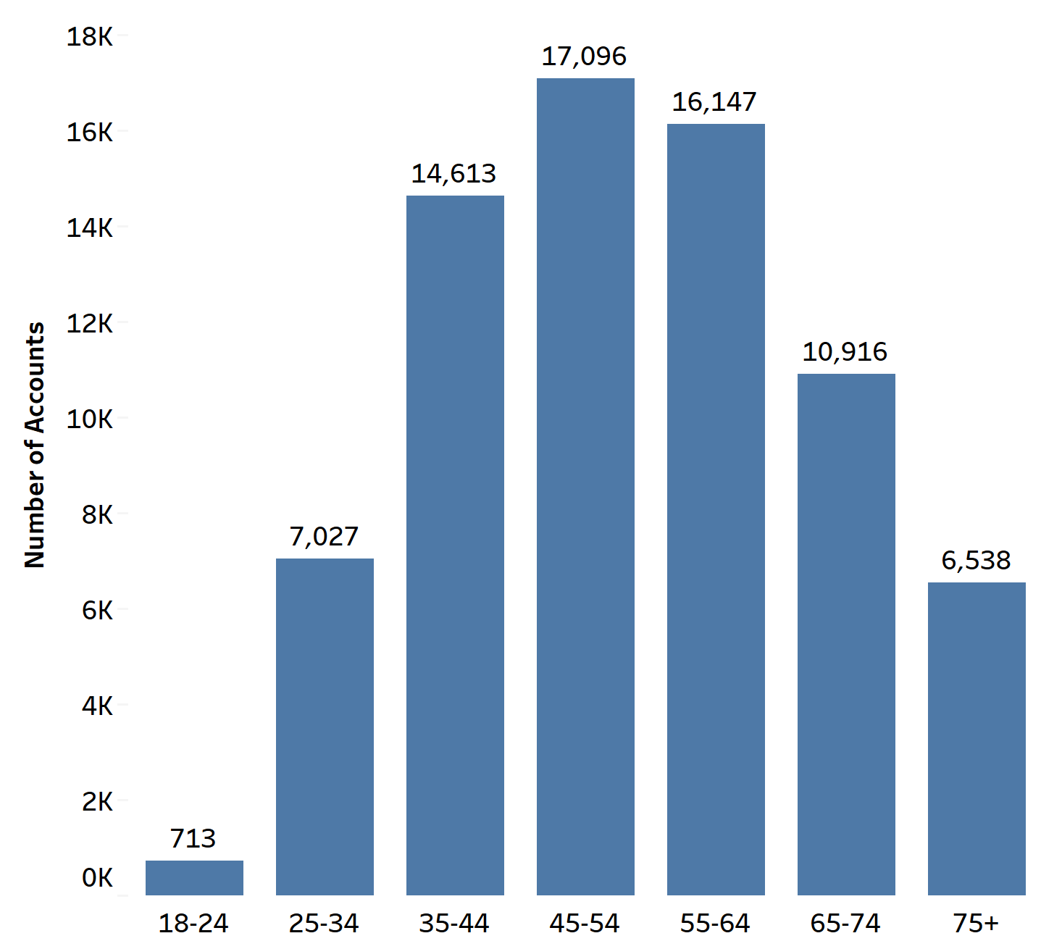
Underdogs– Low CFV
Length of Residence (years)
Age group(years)

Slide 29
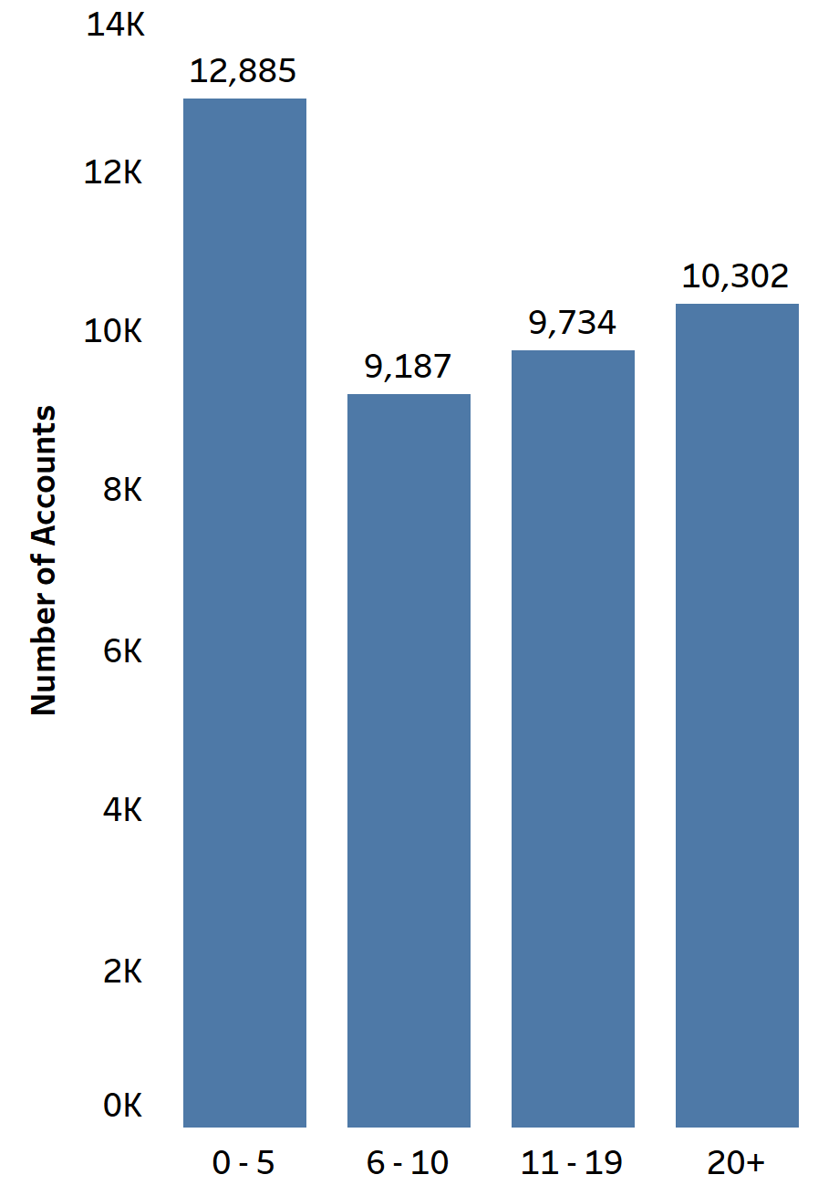
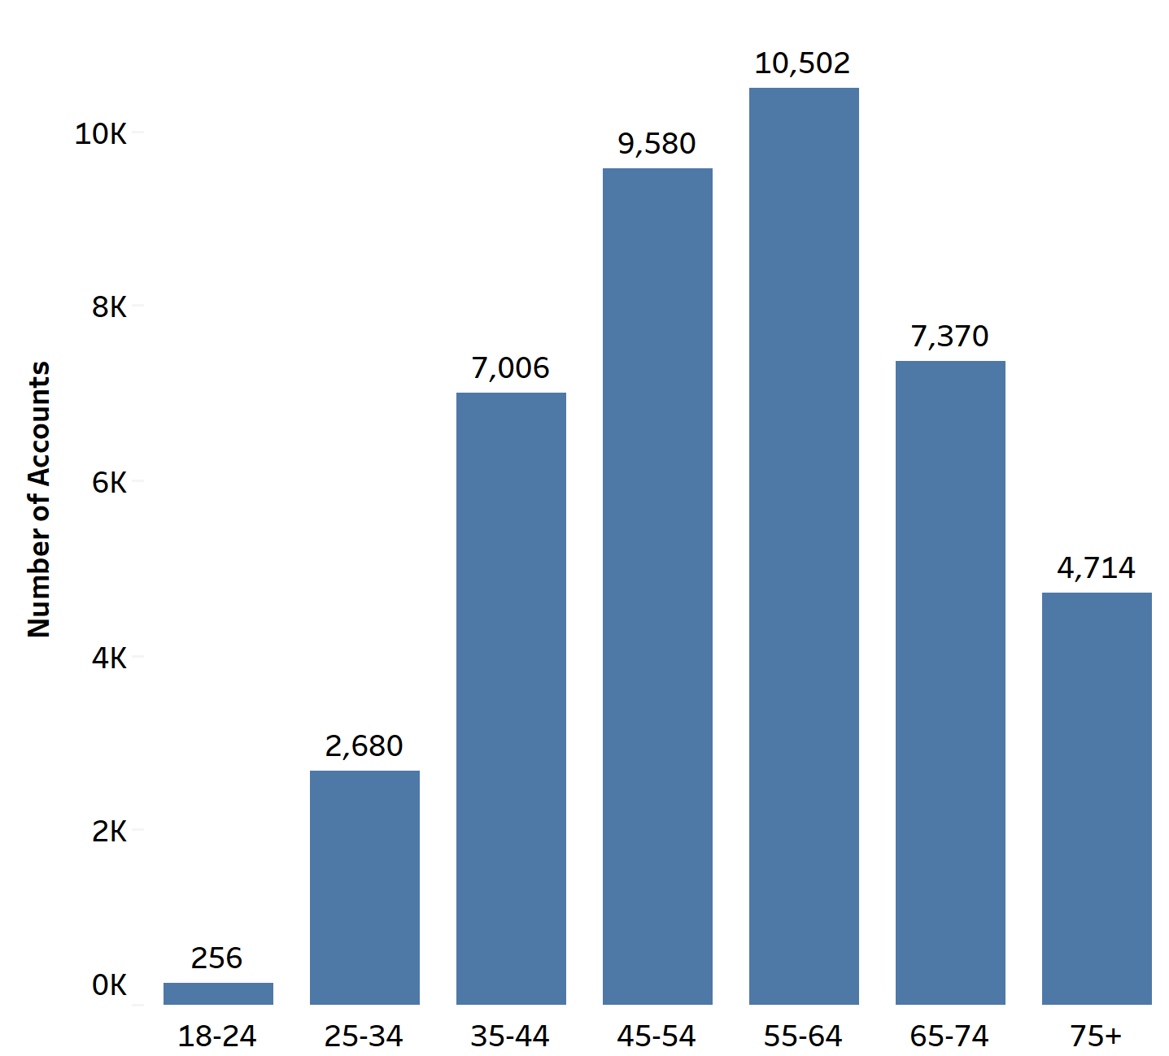
Cash cows– Medium CFV
Length of Residence (years)
Age group(years)

Slide 30
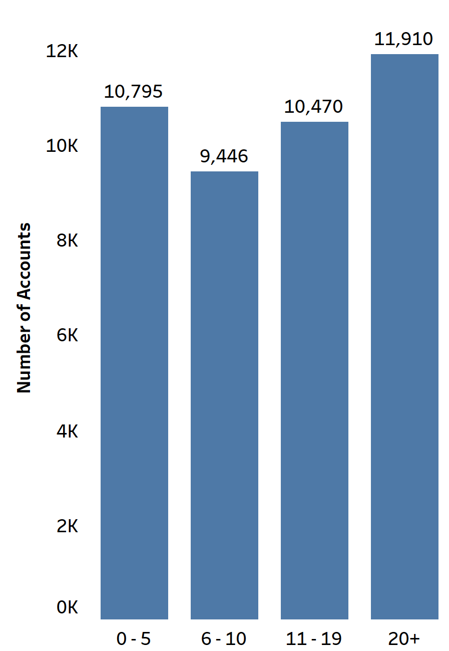
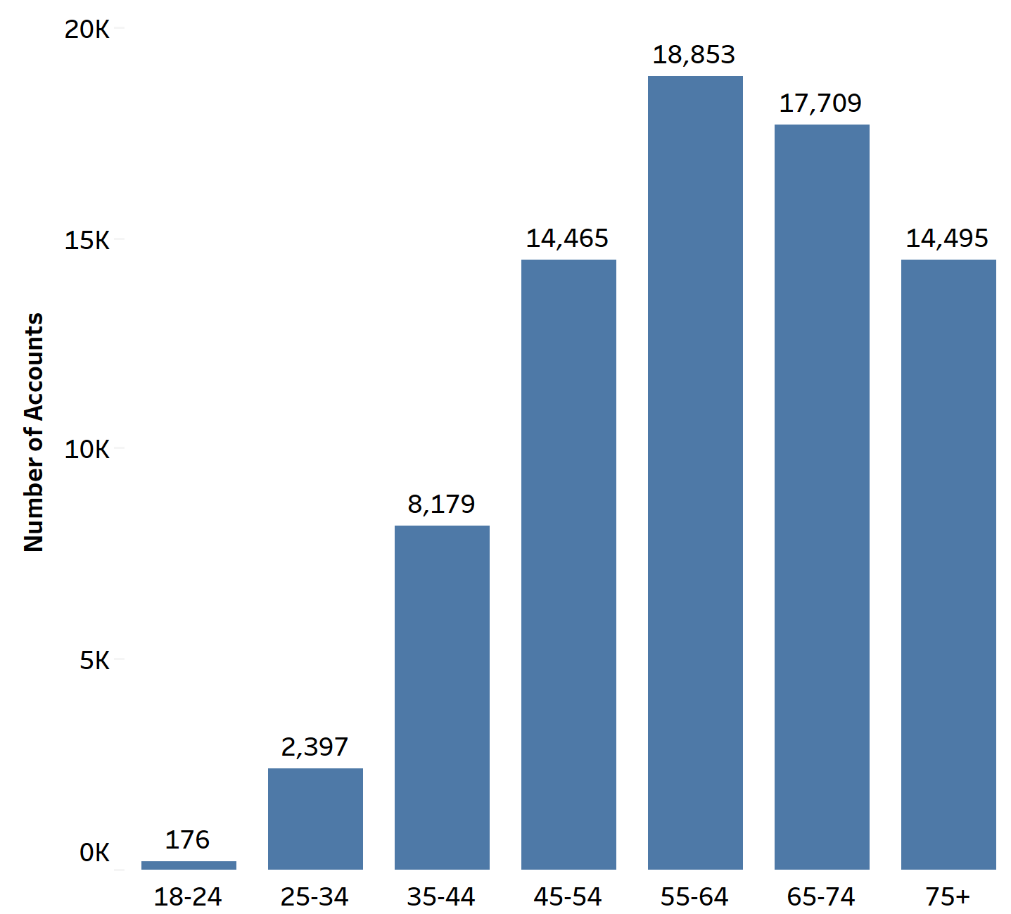
Wild cats– Medium CFV
Length of Residence (years)
Age group(years)

Slide 31
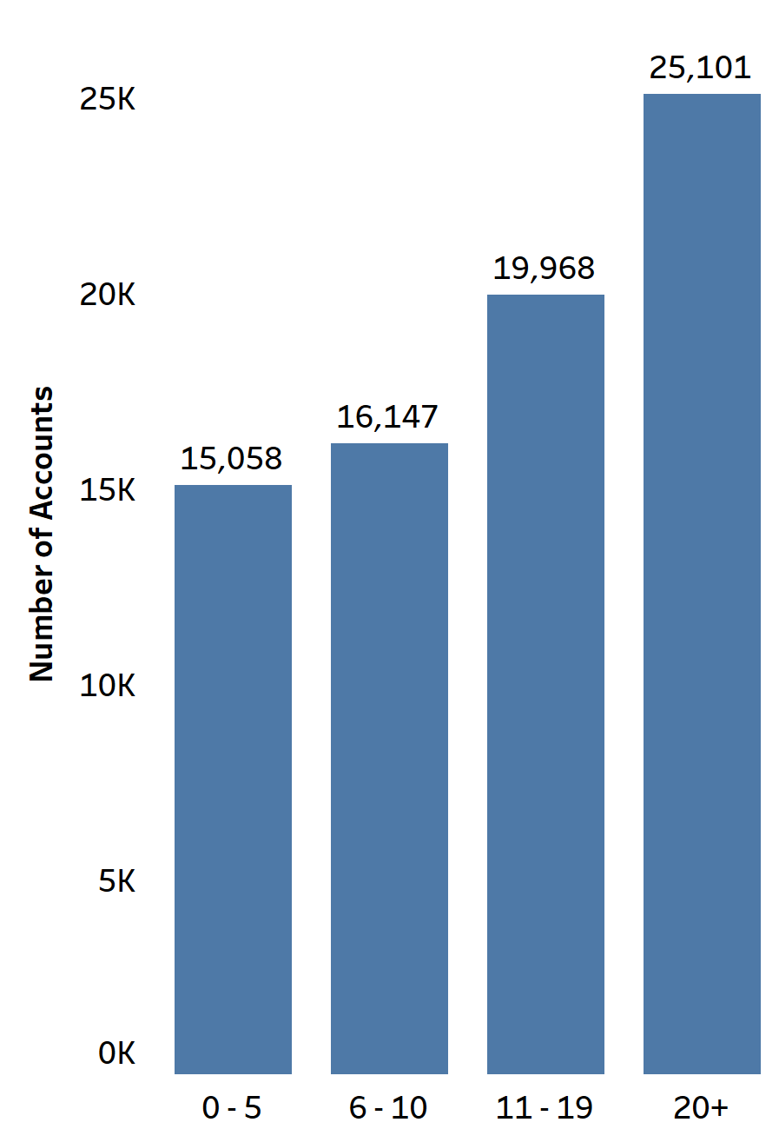
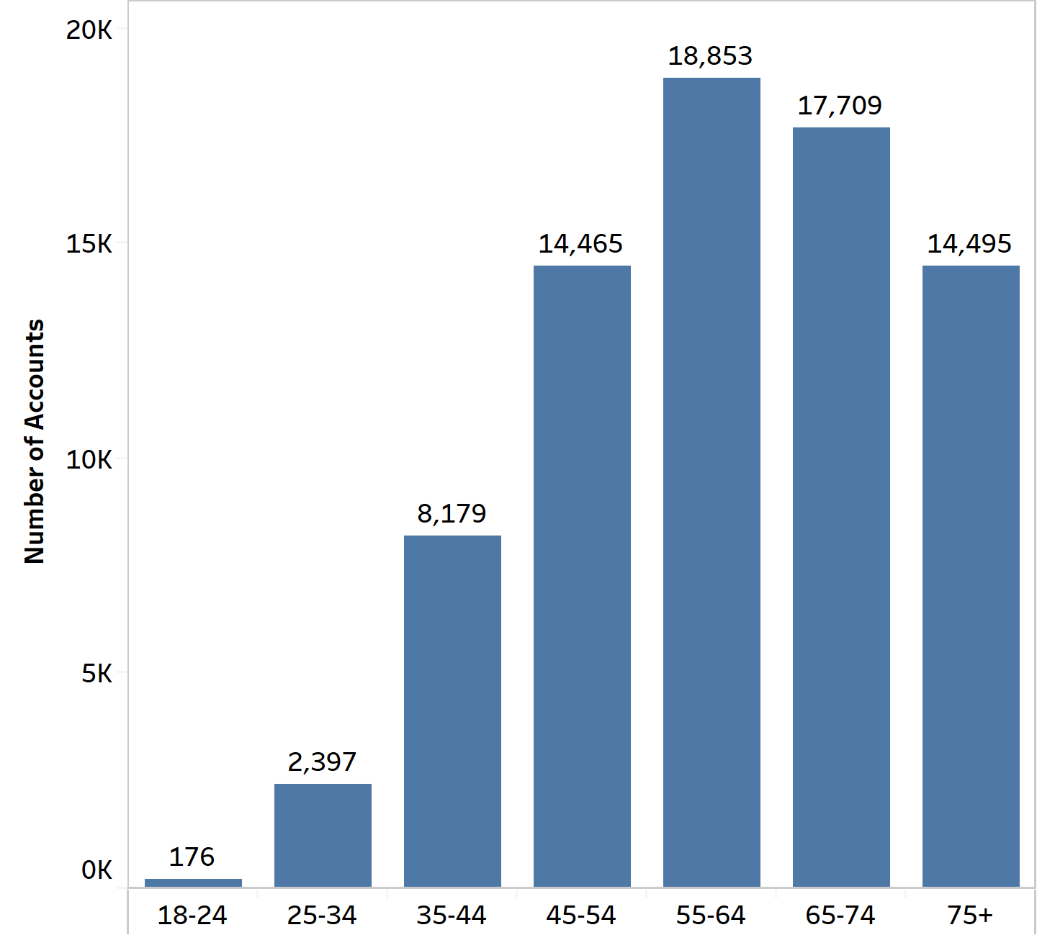
Stars– High CFV
Length of Residence (years)
Age group(years)

Slide 32
Variables dropped during modelling
Dropped 'Demo_inc_crs' because its redundant variable
Changed 'demog_homevalue' to numeric by replacing with mean in each class
Merged demographic data to both churn_data and margin_data
Dropped 'demog_homevalue' 46% missing values
Imputed below mentioned variables demog_generations(14783 missing values)
demog_adults(19236 missing values)
demog_assets_num (1431 missing values)
demog_inc_num(18880 missing values)

Slide 33
Model Outputs
Model Name | Churn | Margin
Logistic | AROC train = 0.92 AROC test = 0.92 | MSE train = 9.52x10^-5 MSE test = 6x10^-6
Margin | AROC train = 0.941 AROC test = 0.937 | MSE train = 2.51x10^-5 MSE test = 3.45x10^-5

