Slide 1
TRAVEL PLANNER AGENT
CAPSTONE PROJECT
Presented By:
1. PUPPALA HARISH-KHATRIYA COLLEGE OF ENGINEERING-CIVIL ENGINEERING

Slide 2
OUTLINE
Problem Statement (Should not include solution)
Proposed System/Solution
System Development Approach (Technology Used)
Algorithm & Deployment
Result (Output Image)
Conclusion
Future Scope
References

Slide 3
Problem Statement
A Travel Planner Agent is an AI-powered assistant that helps users plan trips efficiently and intelligently. It uses real-time data to suggest destinations, build itineraries, and recommend transport and accommodation options. By understanding user preferences, budgets, and constraints, it tailors personalized travel plans. Integrated with maps, weather updates, and local guides, it ensures a smooth travel experience. The agent can also manage bookings, alert users to changes, and optimize schedules on the go. This smart assistant transforms complex travel planning into a seamless, enjoyable process.

Slide 4
Proposed Solution
it uses real-time data suggest destinations,build itineraries,and transport and accomdation options. By understanding user preferences ,budgets. Integrated with maps ,weather updates.it ensures a smoth travel experience.This smart assistant transforms complex travel planning into a seamless, enjoyable process.
Deployment:
Travel Agent Ai –powered assistant that helps users plan trips efficiently and intelligently.
Evaluation:
This Travel Agent collect and process large amounts of data from various sources to identify challenges.

Slide 5
System Approach
The "System Approach" section outlines the overall strategy and methodology for developing and implementing the Travel Planner Agent. Here's a suggested structure for this section:
System requirements :
IBM Cloud(Mandatory)
IBM Cloud object storage for dataset handling
IBM Watsonx.ai for model development and deployment

Slide 6
Algorithm & Deployment
Algorithm Selection:
Algorithms for collecting and preparing data from various sources.This inclide data cleaning,transformation,and feature extraction.
Data Input:
Users can directly interact with the agent through text and providing instruction or asking questions.This is a common input type for conversational agents or those designed for user assistance.
Training Process:
Overtime, AI agents learn and improve by creating data flywheel,where data generated through interactions is feedback into the system,refining models and increasing their effectiveness.

Slide 7
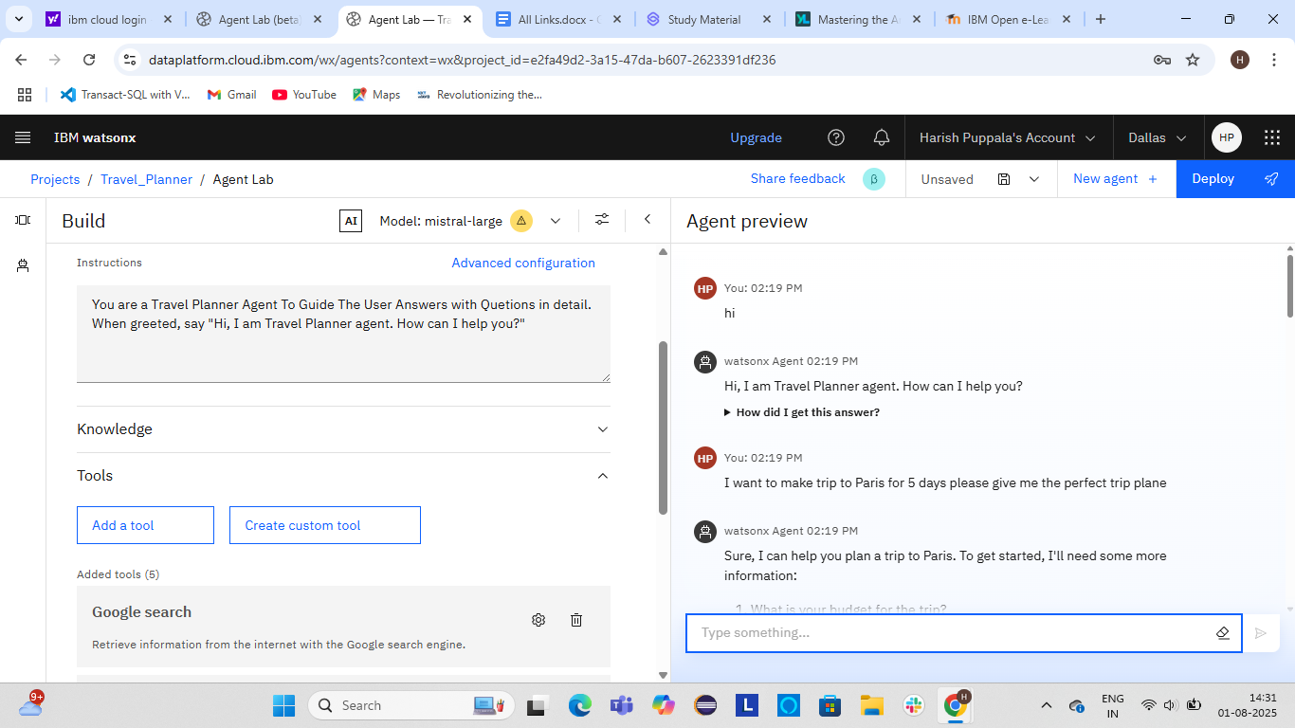
Result

Slide 8
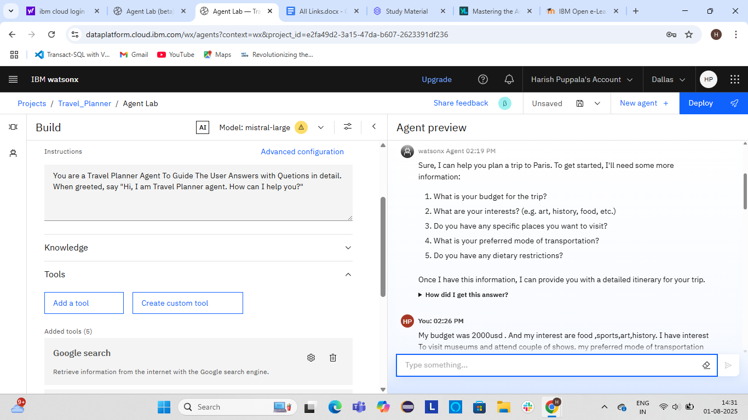
Result

Slide 9
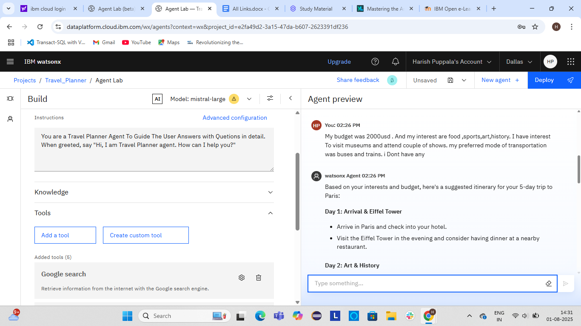
Result

Slide 10
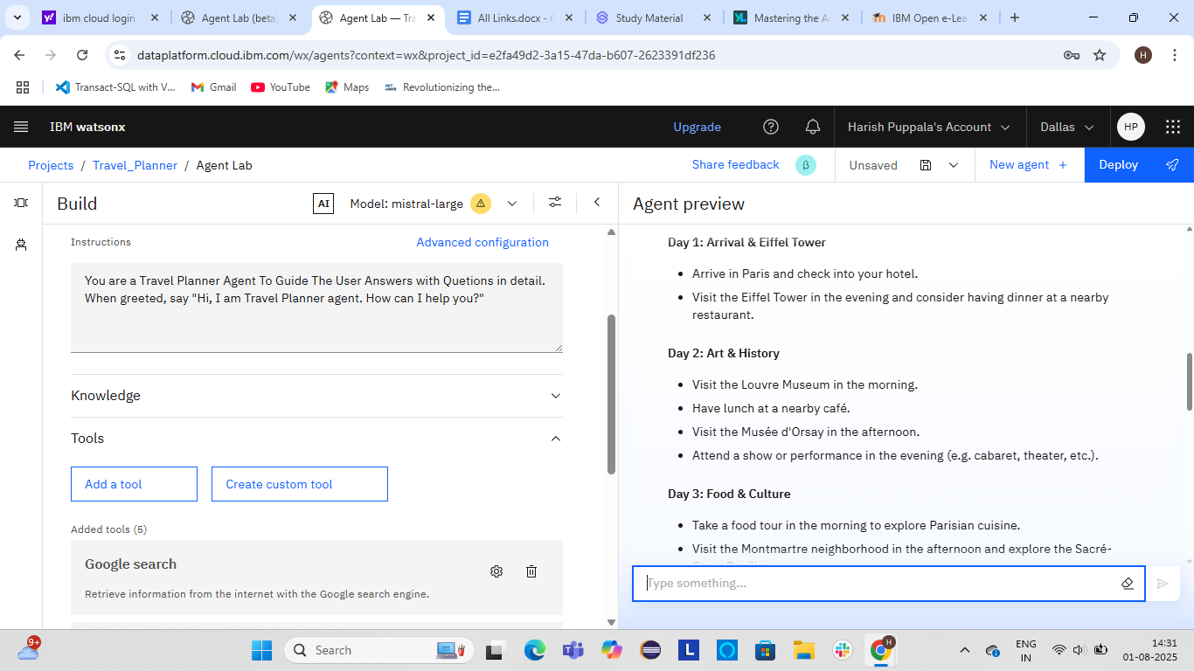
Result

Slide 11
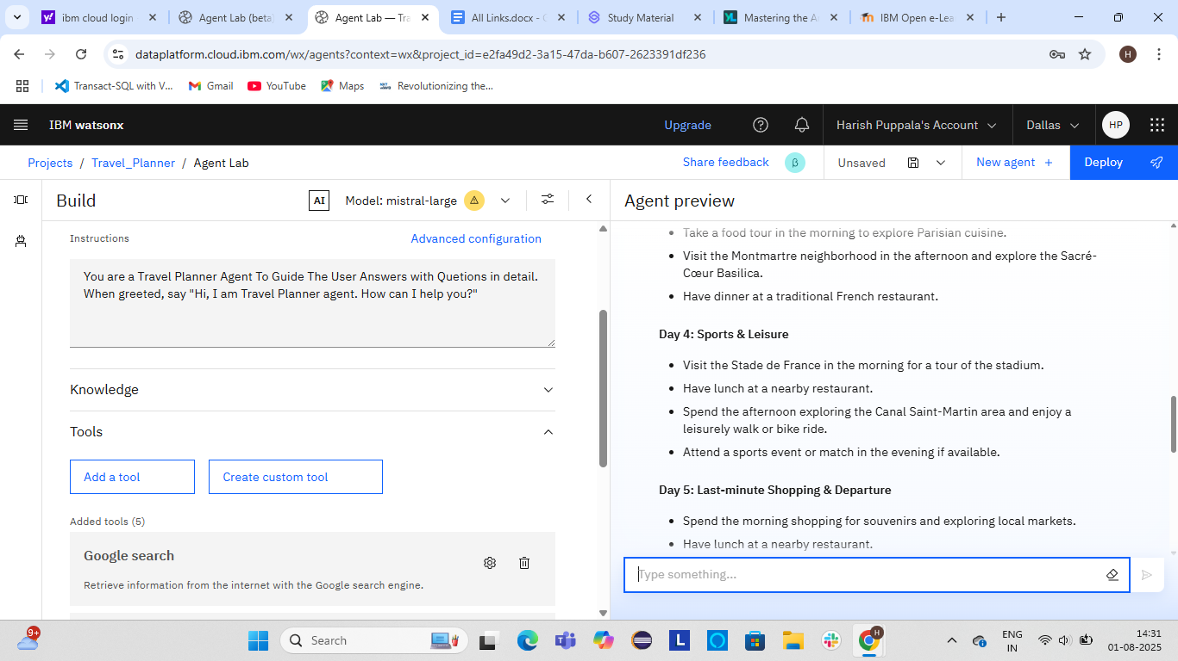
Result

Slide 12
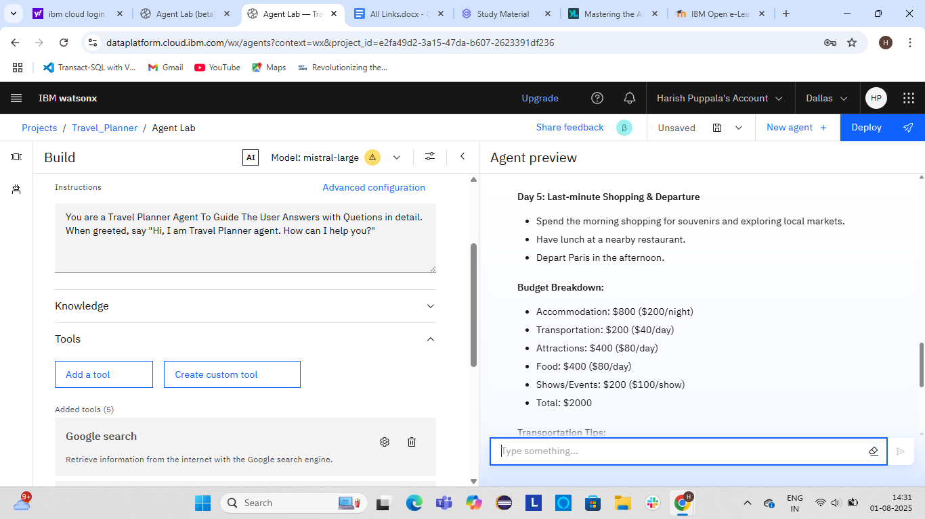
Result

Slide 13
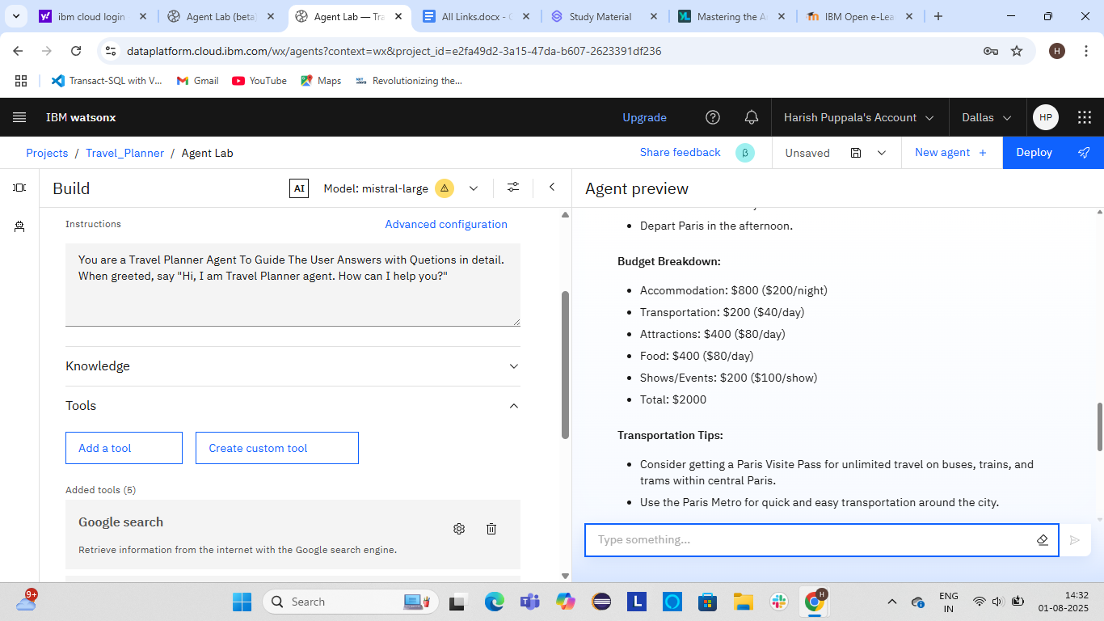
Result

Slide 14
Conclusion
A Travel Planner Agent is a assistant that helps users plan trips Preferences and budget free.it tailors personalized travel plans. It smooth travel experience.This smart assistant transforms complex travel planning into a seamless,enjoyable process.

Slide 15
Future scope
The future scope of the “Travel Planner Agent” Real time data sources for dynamic updates, enhancing natural language interaction for more intuitive user input, and supporting personalized, multi model, and group travel planning, Expanding agent capabilities, improving explanability,and adding user profiling will increase trust and usability. Long-term, the system can evolve into a fully autonomous travel assistant that proactively manages and optimizes trip with minimal user intervention.

Slide 16
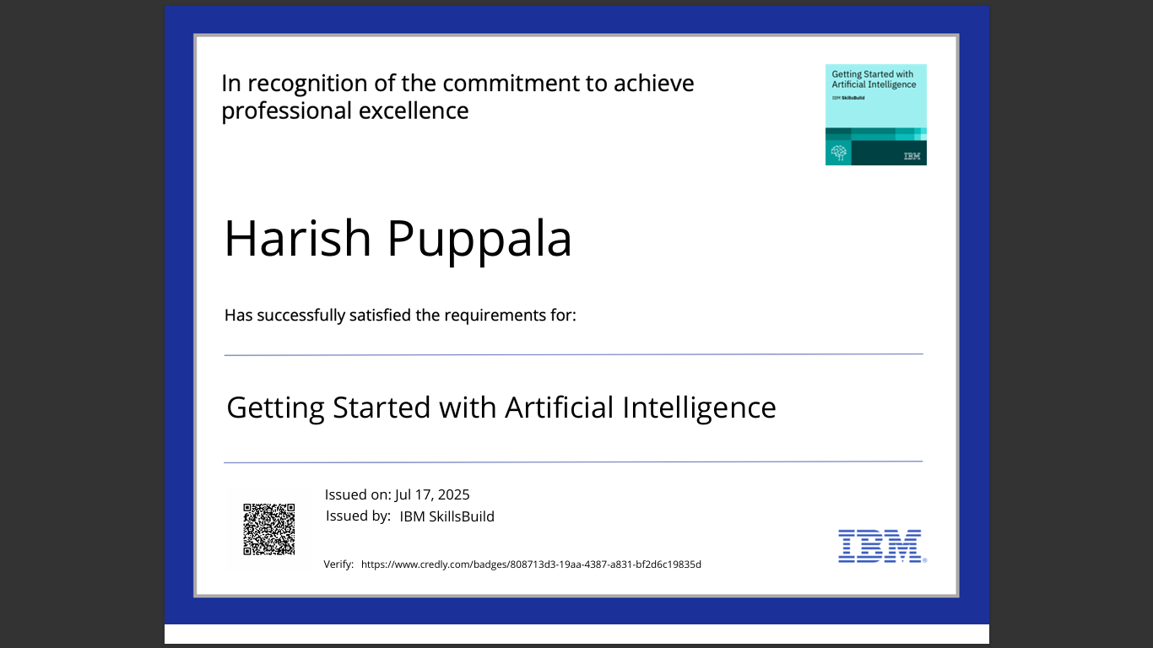
IBM Certifications

Slide 17
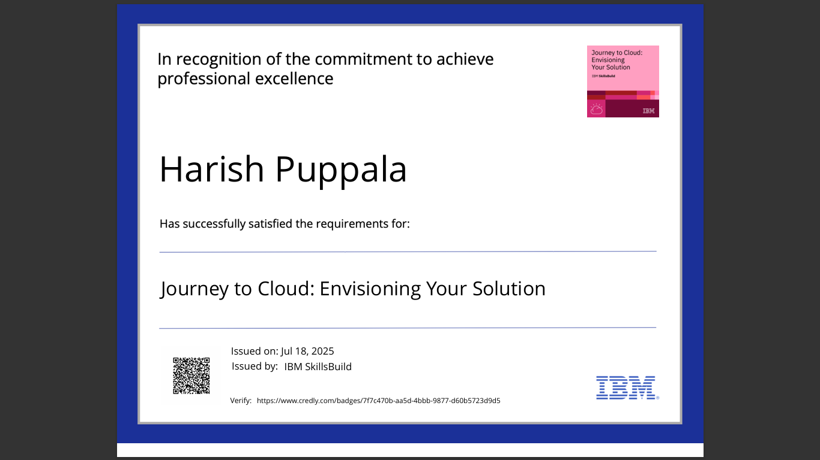
IBM Certifications

Slide 18
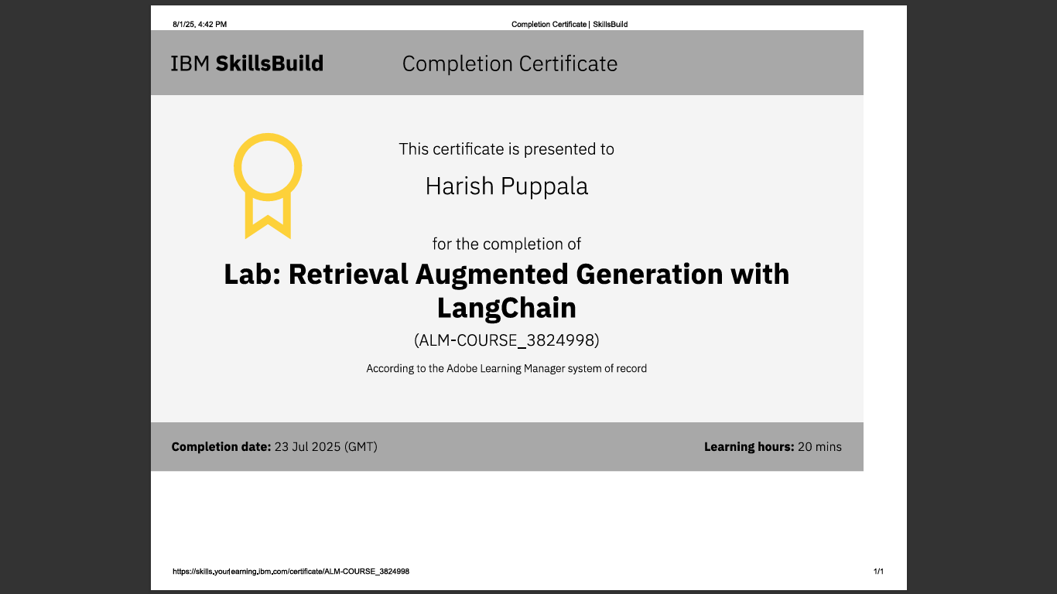
IBM Certifications

Slide 19
THANK YOU

