Slide 1









Driving Strategic Impact: Tech Transformation Program Overview
This program is designed to empower innovation, agility, and growth across our organization through a comprehensive technological overhaul. We aim to address current challenges, leverage market opportunities, and deliver significant benefits to all stakeholders. Understanding the core components of this transformation is crucial for our collective success.
Vision & Mission
Empower innovation, agility & growth through technology.
Current Challenges
Siloed data, slow processes, rising costs.
Market Context
Competitors accelerating digital adoption; risk of falling behind.
Stakeholder Benefits
Faster decisions, improved customer experience, cost efficiency.
Program Scope
Cloud migration, AI integration, process automation.
Key Metrics
Target 30% cost reduction, 40% faster time-to-market.
Timeline
Phased rollout over 18 months.
Governance Model
Executive sponsorship + agile squads.
Call to Action
Align now to lead transformation.

Slide 2
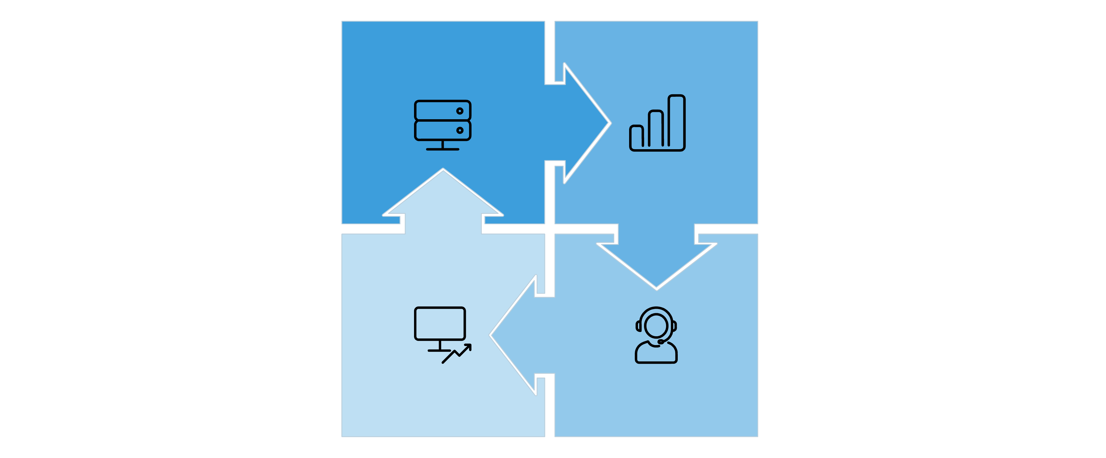




Interconnected Pillars of Transformation
Our tech transformation is built upon a foundation of interconnected pillars, each crucial for success. These elements work in concert, with progress in one area often enabling breakthroughs in others. Understanding their relationships is key to a holistic and effective transformation.
Modernization
Data Analytics
Automation & Security
Customer Experience
This integrated approach ensures that no single area operates in isolation, fostering synergy and accelerating our overall strategic objectives. Each pillar strengthens the others, leading to a robust and future-proof digital infrastructure.

Slide 3
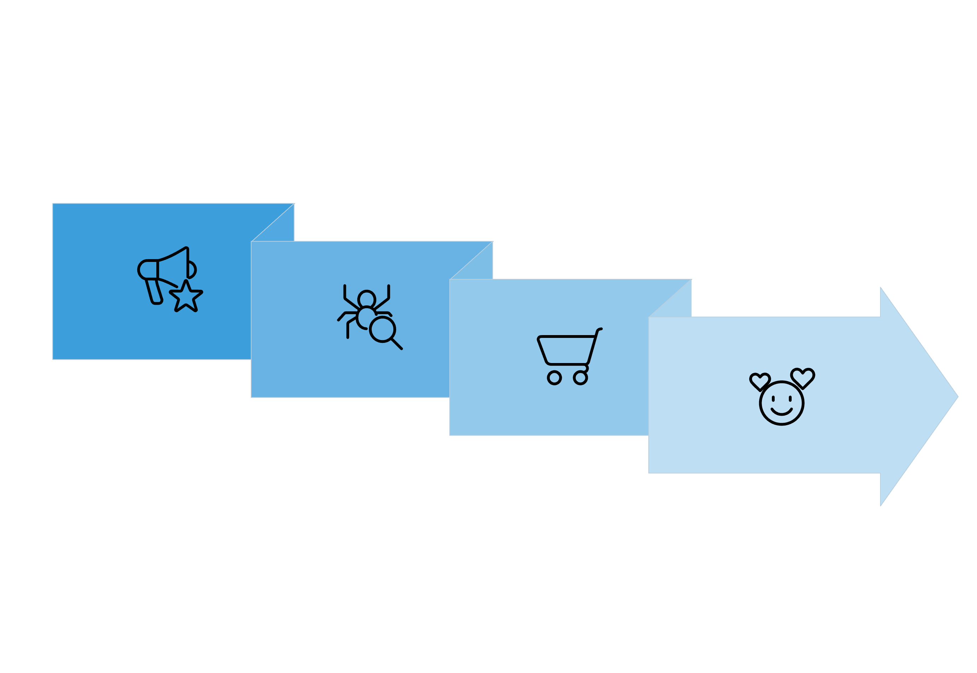




Customer Journey Transformation: From Fragmented to Seamless
The ultimate goal of our tech transformation is to revolutionize the customer journey. By leveraging new technologies, we aim to eliminate friction points, personalize interactions, and create a truly seamless and delightful experience from initial awareness to loyal advocacy.
Consideration
Advocacy
Awareness
Purchase
By optimizing each stage of the customer journey, we not only enhance customer satisfaction but also drive increased retention, higher lifetime value, and stronger brand advocacy. This customer-centric approach is at the heart of our digital strategy.

Slide 4






Risk Mitigation & Success Enablers
Successfully navigating a large-scale tech transformation requires proactive identification and mitigation of potential risks. Simultaneously, we must cultivate key enablers that will accelerate our progress and ensure the program's long-term success. This dual focus is critical for maintaining momentum and achieving desired outcomes.
Legacy System Complexity
Data Privacy Concerns
Change Resistance
Mitigation: Incremental migration & API layering.
Mitigation: End-to-end encryption & compliance audits.
Mitigation: Executive sponsorship & targeted training.
Budget Overruns
Talent Gaps
Vendor Lock-in
Mitigation: Agile budgeting & phased funding.
Mitigation: Upskilling & strategic hiring.
Mitigation: Open standards & multi-vendor strategy.
Cybersecurity Threats
Integration Failures
Success Enablers
Mitigation: Continuous monitoring & incident response.
Mitigation: Robust testing & middleware platforms.
Strong leadership, clear KPIs, cross-team collaboration.
By diligently addressing these risks and fostering these enablers, we build a resilient and adaptable transformation program, capable of delivering its promises and exceeding expectations.

Slide 5









Your Role in Leading the Transformation
The success of this tech transformation hinges on the active leadership and commitment of every director. Your role extends beyond oversight; it involves championing the vision, empowering your teams, and ensuring resources are aligned to drive meaningful change. This is a collective effort to secure our future.
Champion the Vision
Drive Alignment
Empower Teams
Communicate clear purpose & benefits to your teams and stakeholders.
Unite stakeholders across functions to ensure cohesive execution.
Support agile squads & foster an environment for innovation.
Allocate Resources
Monitor Progress
Foster Culture
Ensure appropriate funding and tools are available for project needs.
Track Key Performance Indicators (KPIs) and course-correct swiftly as needed.
Promote a digital mindset and continuous learning throughout the organization.
Mitigate Risks
Celebrate Wins
Commit to Future
Anticipate challenges and act proactively to address potential roadblocks.
Recognize milestones and team efforts to maintain morale and momentum.
Lead us into a sustainable digital future, leveraging technology for competitive advantage.
Your leadership is indispensable in making this transformation a resounding success. Together, we can build a more agile, innovative, and resilient organization.

