Slide 1
EMBEDDED SYTEM INTERSHIP PROJECT
PRESENTATION
EV DASHBOARD SYSTEM
Presenting by :
Harish Rajoli
Harish Patil

Slide 2
CONTENTS :
Introduction
Objectives
Hardware and Software Tools
STM32 Configuration
Integration of Ultrasonic sensor and ADAS feature
VSPE Configuration
Picsimlab
Python Dashboard
Results

Slide 3
INTRODUCTION :
This project aims to create a low-cost simulation platform using:
STM32 Blue Pill (STM32F103C8T6)
PICSimLab
Python Dashboard
without requiring a real electric vehicle.

Slide 4
OBJECTIVES :
Simulate EV behavior
Calculate speed
Estimate battery SOC
Estimate range
Detect obstacles
Display data on Python dashboard Simulate ADAS

Slide 5
Hardware and Software Used :
Hardware | Purpose
STM32F103C8T6 | Main Controller
Blue Pill | Development Board
LED | CLS,BSD_L,BSD_R,FLT
BUZZER | 1
HC-SR04 | Obstacle Detection
Potentiometer | Acce,brk,SOC,temp_motor
Software | Purpose
STM32CubeIDE | Embedded Programming
PICSimLab | Hardware Simulation
Python | Dashboard
VSPE | COM Port
VIRTUAL TERMINAL | OUTPUT

Slide 6
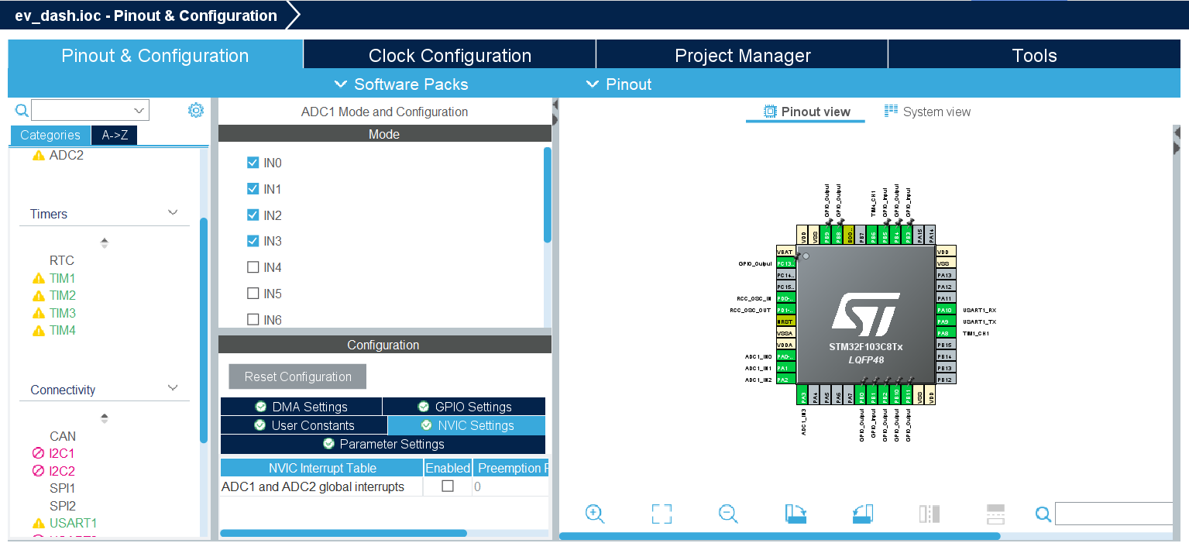
STM32 Configuration :
Open STM32CubeIDE
Select STM32F103C8T6
Create New Project
Configure Clock
Configure GPIO
Configured
ADC
UART
TIM1
TIM2
TIM3
TIM4
Generate the code and add all the header file and source

Slide 7
Integration of Ultrasonic Sensor ADAS Feature:
Trigger pulse generation
Echo measurement Distance
calculation Obstacle detection
Implemented
Front Collision Warning
Left Detection
Right Detection
Safe Distance Monitoring

Slide 8
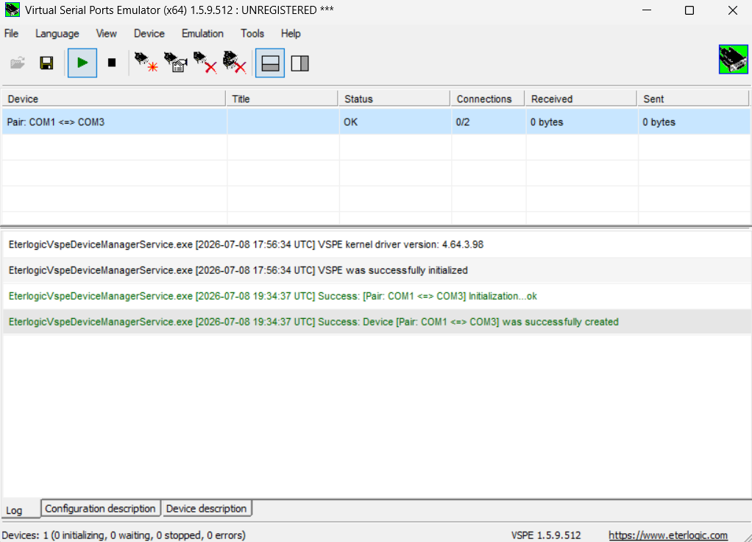
VSPE Configuration :
Why VSPE?
Because Python cannot directly communicate with PICSimLab.
STM32
↓
COM3
↓
VSPE
↓
COM1
↓
Python Dashboard

Slide 9
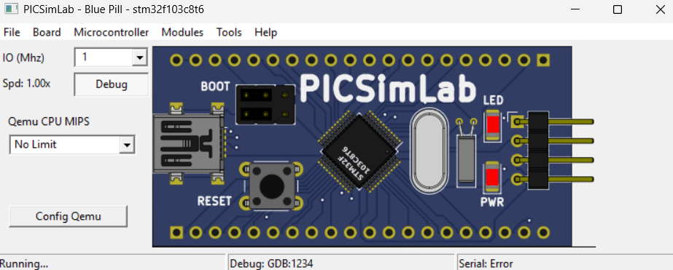
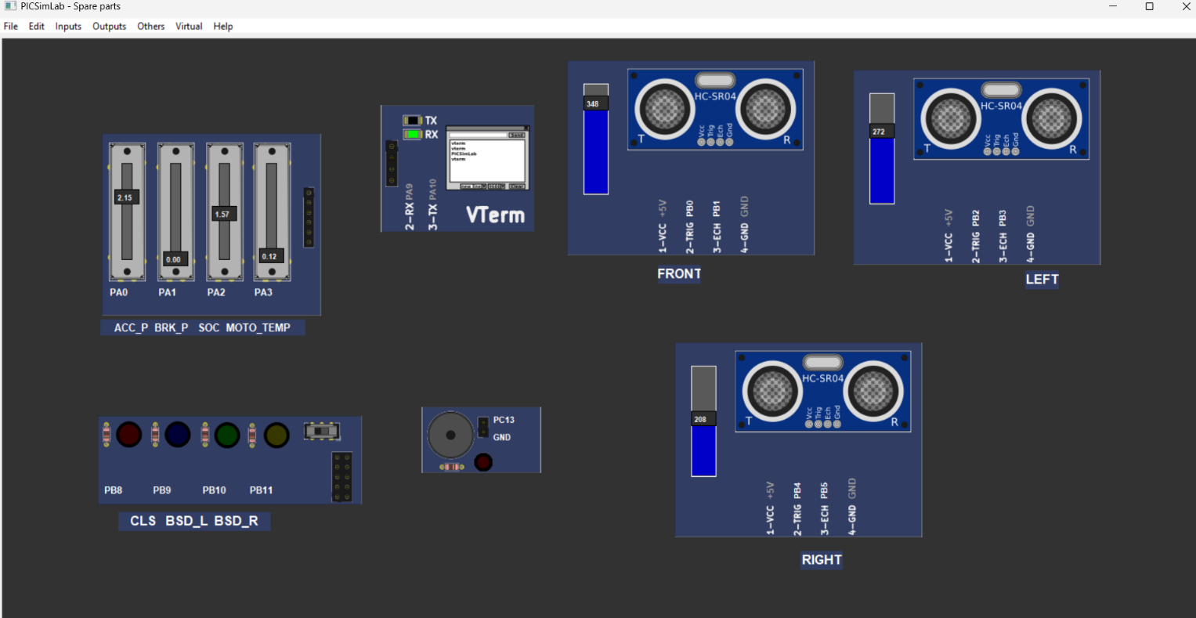
PICSimLab :
PICSimLab simulates
Blue Pill Board
ADC Inputs
Sensors
UART

Slide 10
Python Dashboard :
Python receives UART data.
Displays
Speedometer
Battery
Power
Range
Motor Temperature
ADAS Alerts

Slide 11
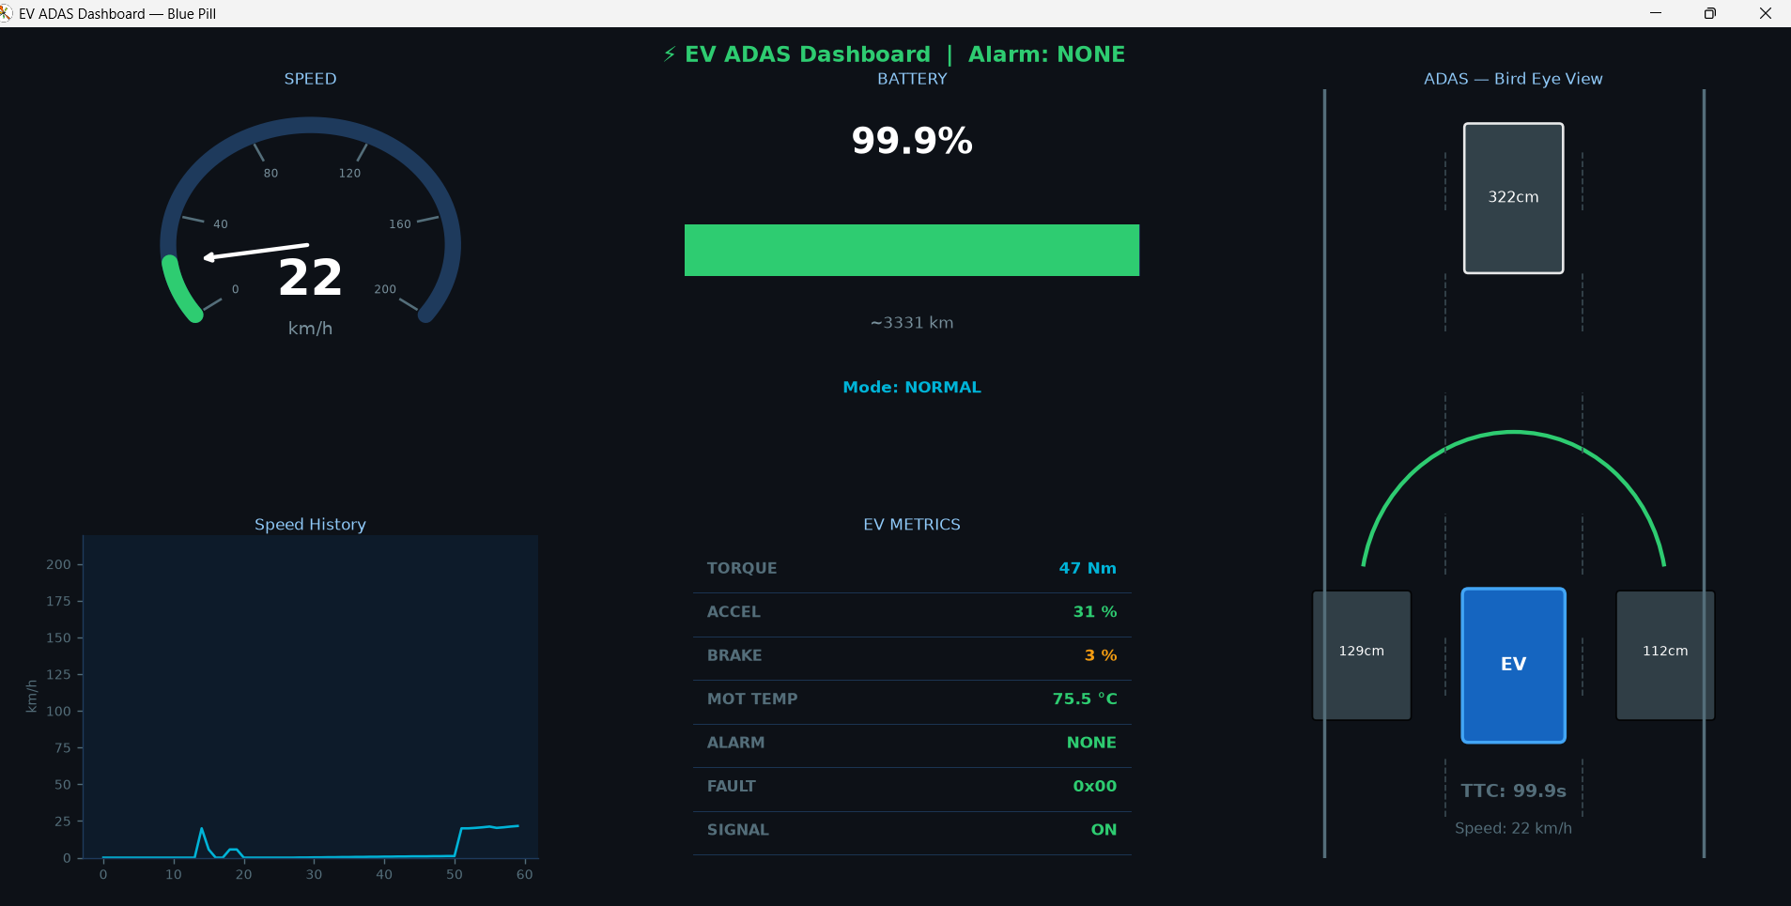
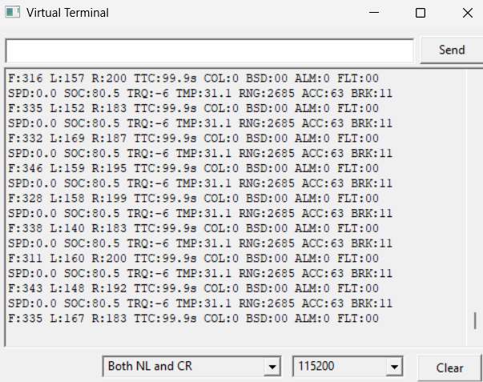
Results :
STM32CubeIDE
PICSimLab
Python Dashboard
Serial Output

Slide 12
Thank You

