Slide 1

Mini-Project 2025-26
A PROJECT IDEA PRESENTATION ON
“Smart Greenhouse Monitoring System”
Presented By:
Guided by:
Prof.Chandramouli Joshi
Channabasu .A.Nelagudd USN:2KA23EC007
Harish.M.Patil USN:2KA23EC015
Harish.V.Rajoli USN:2KA23EC016
Mohammed Ayaz Khatib USN:2KA23EC029

Slide 2
Contents:
Introduction
Objectives
Literature Survey
Methodology
Hardware and Software requirements
Advantages and Disadvantages
Applications
Conclusion
Reference

Slide 3
Introduction:
Traditional greenhouse farming relies heavily on manual monitoring, which is time-consuming and prone to error.
Environmental parameters like temperature, humidity, soil moisture, and light intensity must be constantly monitored for optimal crop growth.
Our project offers an automated, real-time monitoring system for greenhouses using IoT technologies.
And it continuously tracks temperature, humidity, soil moisture, and light intensity using low-cost sensors.
It also transmits the live data wirelessly to a mobile application using ESP32’s built-in Wi-Fi, allowing users to monitor from anywhere.

Slide 4
Objectives:
To monitor key environmental parameters such as:
  Temperature, Humidity, Soil moisture and Light intensity
To automate greenhouse control systems based on sensor data by:
  Turning on/off a fan to regulate temperature and humidity
  Turning on/off a water sprayer based on soil moisture.
  Controlling LED grow lights based on ambient light conditions
To implement real-time data transmission from the greenhouse to a mobile application using Wi-Fi (ESP32).
To design an energy-efficient and cost-effective embedded system for sustainable greenhouse management.
To enhance remote monitoring and control capabilities by integrating IoT features.
To provide a user-friendly mobile interface for:
  Live data viewing
  System alerts or notifications
  Manual override of automation (if needed)

Slide 5
Literature Survey:
AUTHOR | TITLE | TYPE/YEAR | SUMMARY / KEY CONTRIBUTION
1. Bhagyashree 2. Pandurangi*1, 3. Sachin G Teradal*2 | Next-generation iot-powered smart greenhouse | International Research Journal of Modernization in Engineering Technology and Science Volume:07/Issue:06/June-2025 e-ISSN: 2582-5208 | The IoT-based greenhouse system enables efficient crop management by monitoring temperature, humidity, soil moisture, and light intensity. Color sensors detect plant stress through leaf pigmentation, adjusting light for better growth. Real-time cloud connectivity supports remote control, while automated irrigation and lighting conserve energy, water, and labor.

Slide 6
AUTHOR | TITLE | TYPE/YEAR | SUMMARY / KEY CONTRIBUTION
1. A.Simo 2. S. Dzitac 3. G. E. Badea 4. D. Meianu | Smart Agriculture: IoT-based Greenhouse Monitoring System | International journal of computers communications & control Online ISSN 1841-9844, ISSN-L 1841-9836, Volume: 17, Issue: 6, Month: December, Year: 2022 | Smart agriculture applies IoT, cloud, and big data to enhance farming. A low-cost monitoring device is proposed to track environmental and electrical parameters. Findings show IoT enables data-driven decisions, reduces costs, and supports efficient, sustainable agricultural practices.
1.Israr Ullah 2.Muhammad Fayaz 3.Muhammad Aman 4.DohyeunKim | Toward autonomous farming—a novel scheme based on learning to prediction and optimization for smart greenhouse environment control | IEEE Internet of things journal, Volume:9, NO. 24, 15 December 2022 | The IoT-based ANN greenhouse model integrates prediction, optimization, and control, ensuring adaptive climate management, higher yield, and reduced energy consumption by 61.97% compared to baseline and 11.73% over standard optimization.

Slide 7
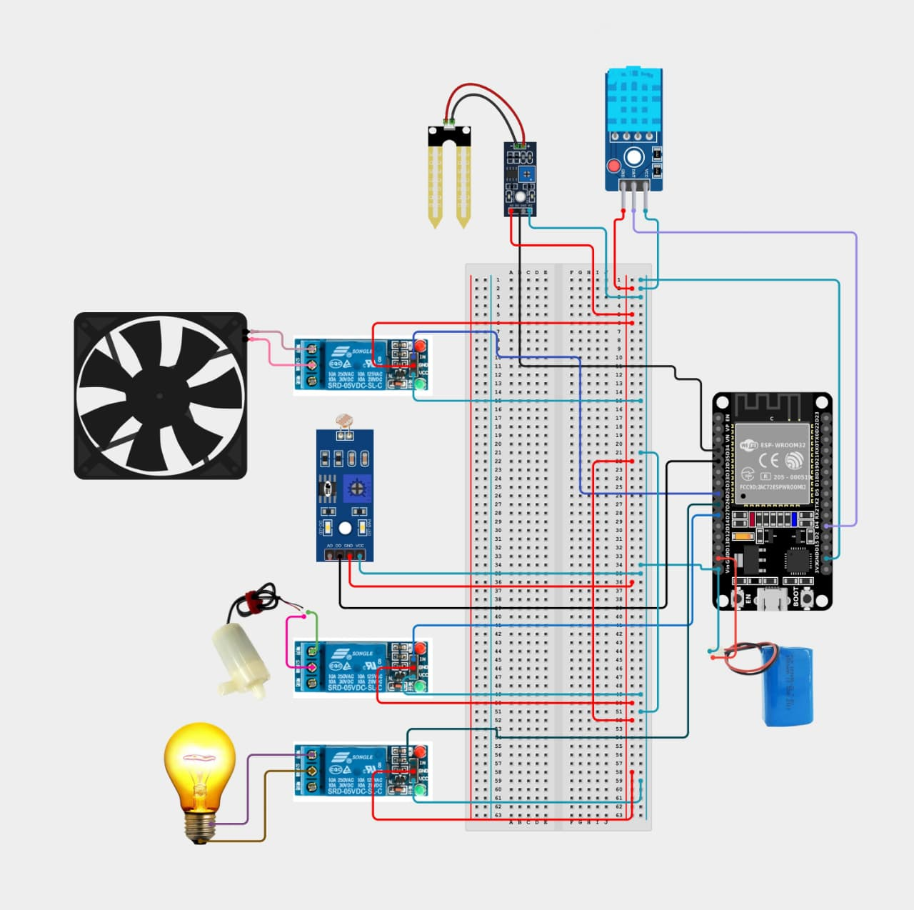
Methodology :

Slide 8
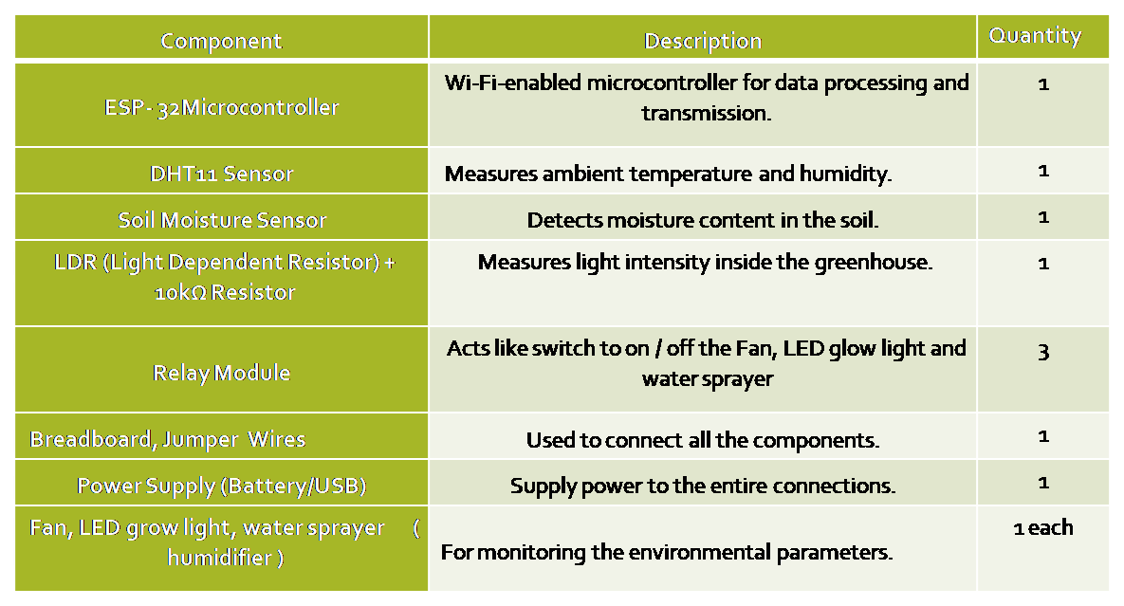
Hardware Requirements:
Software Requirements:
Arduino IDE.
Blynk App.
IoT Dashboard.

Slide 9
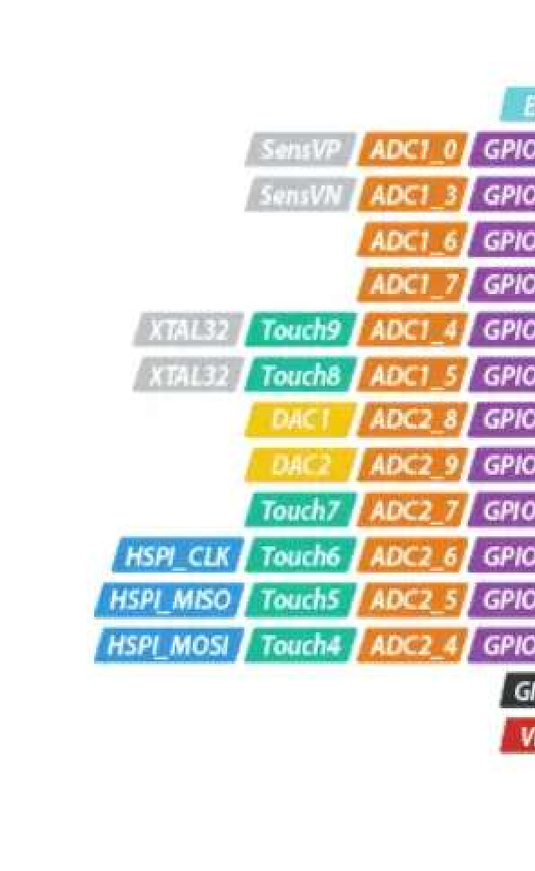
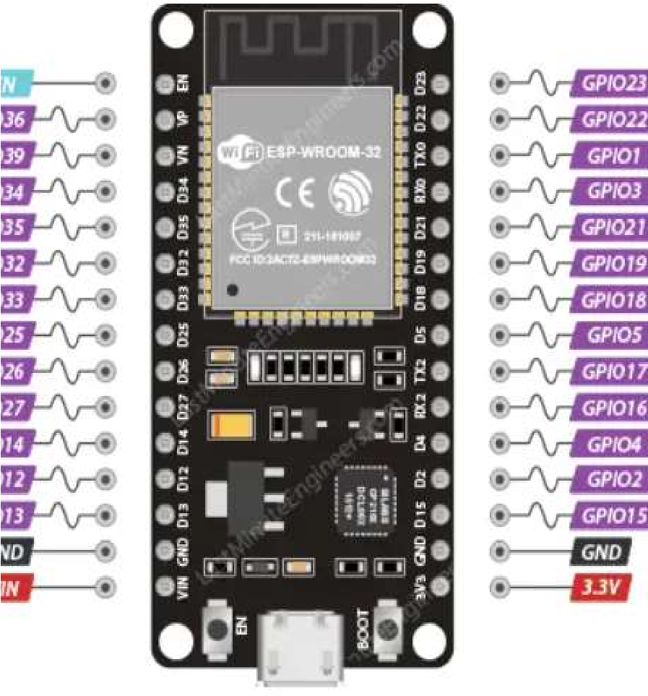
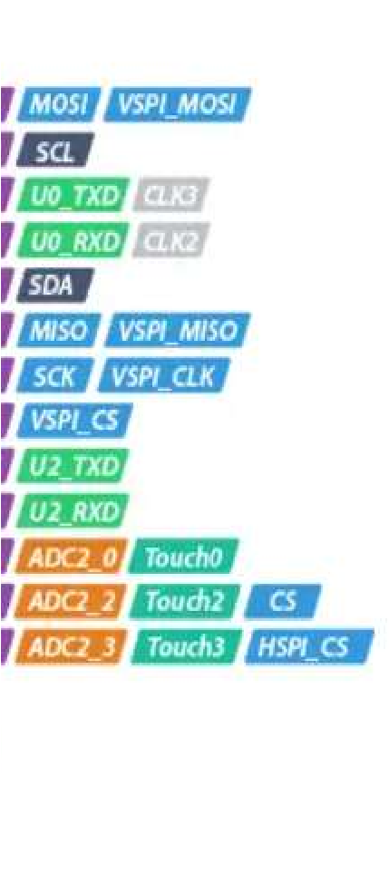

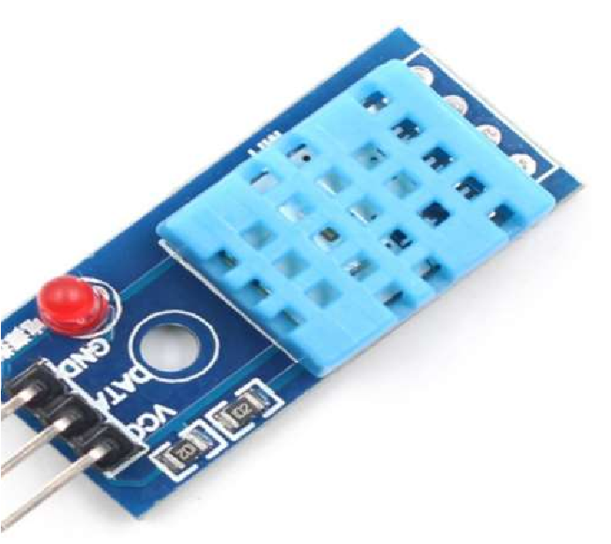
ESP 32: | ESP32 Dev Kit is a powerful microcontroller board with integrated Wi-Fi and Bluetooth. It features a dual-core 32-bit processor for high-performance applications. The board operates at 3.3V logic with multiple GPIO pins. It comes with 4 MB flash memory for code and data storage. It includes built-in support for SPI, I2C, UART, ADC, and PWM. It includes built-in sensors like a hall sensor and touch sensors. The board supports deep sleep mode for low-power applications.
DHT 11 SENSOR: | DHT11 is a digital sensor that measures temperature and humidity. It provides calibrated output through a single digital pin. It operates within a temperature range of 0°C to 50°C and humidity range of 20% to 90%. It requires a 3.5V to 5.5V power supply for proper operation.

Slide 10
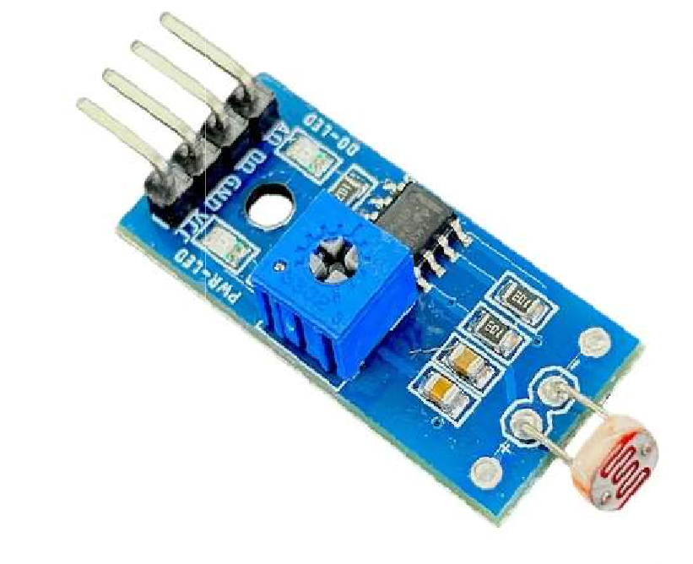
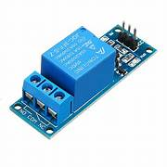

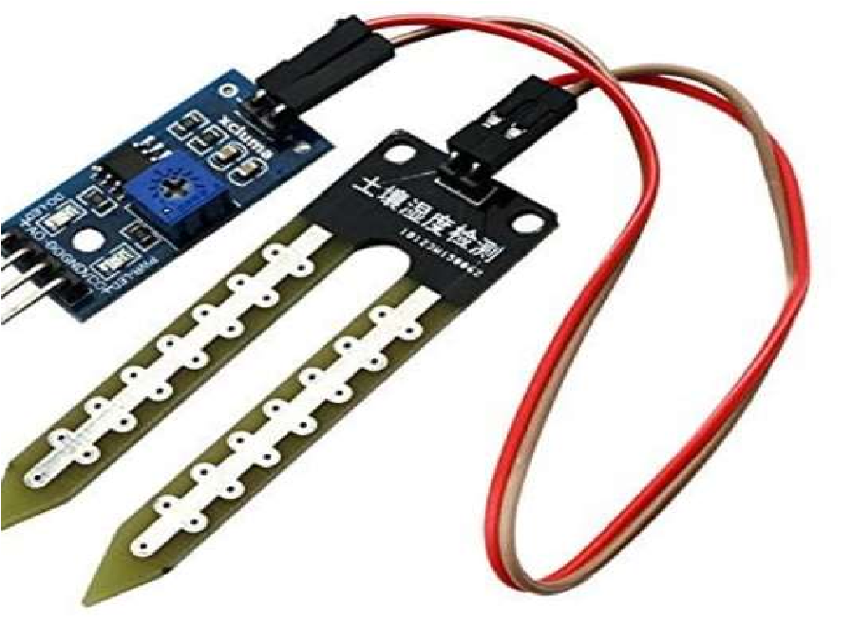
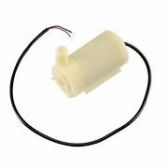
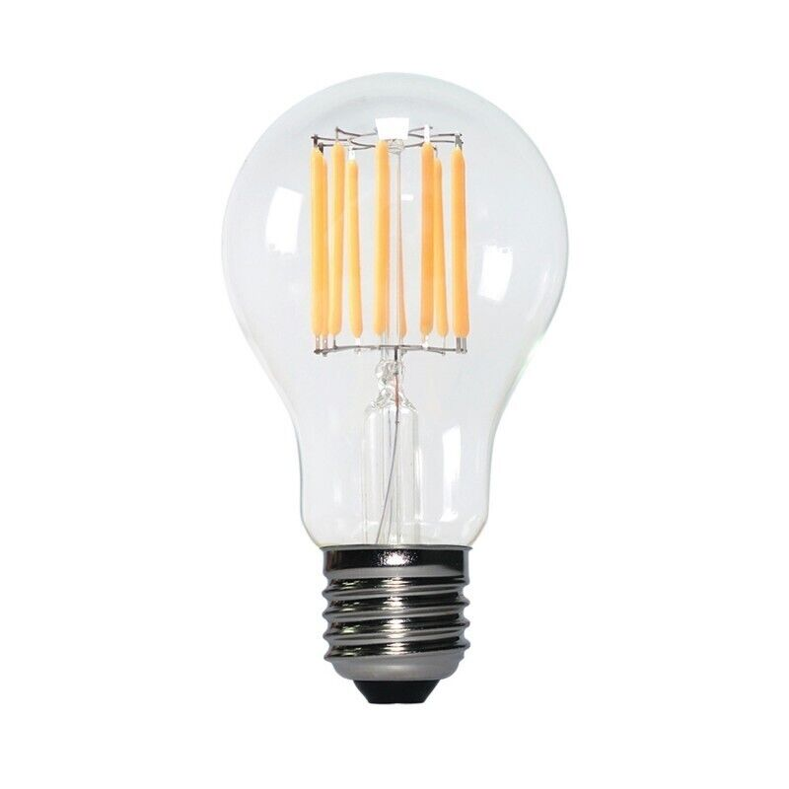
LDR MODULE: RELAY MODULE: | LDR (Light Dependent Resistor) module detects light intensity based on resistance changes. It is commonly used in automatic lighting and smart greenhouse systems. A relay module acts as a switch that allows a microcontroller to control high-voltage devices
SOIL MOISTURE SENSOR: | A soil moisture sensor measures the water content in the soil. It outputs analog or digital signals based on moisture levels. It helps automate irrigation in smart farming and greenhouse systems.
WATER PUMP : LIGHT: | A water pump is used to move or circulate water in irrigation systems. It can be controlled automatically using microcontrollers and relays in IoT projects. A light in a smart greenhouse provides artificial illumination to support plant growth when natural light is insufficient.

Slide 11
Advantages:
Real-Time Monitoring and Alerts
Automated Environmental Control
Dual Control Modes
Energy and Resource Efficiency
Disadvantages :
  Internet Dependency
  Limited Sensor Accuracy
  Initial Setup Complexity
  Maintenance and Calibration Needs

Slide 12
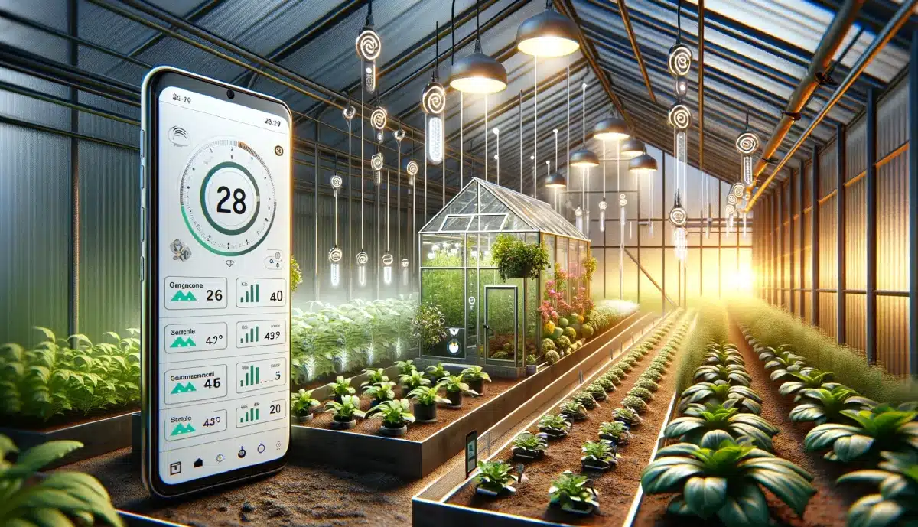
Applications:
Real-Time Environmental Monitoring and Control.
Automated Smart Farming.
Dual-Mode Operation (Manual and Automatic Control).
Enhanced Resource Efficiency and Crop Yield.
Water Management
Remote monitoring and control
Increased crop yield and quality
Energy efficiency

Slide 13
Conclusion :
A smart greenhouse integrates sensors, actuators, and IoT technology to monitor and control environmental parameters like temperature, humidity, soil moisture, and light, ensuring optimal plant growth, efficient resource usage, and reduced manual intervention, making agriculture more sustainable and productive.

Slide 14
Reference:
[1] Bhagyashree ,Pandurangi*1, Sachin G Teradal*2 , Next-generation iot-powered smart greenhouse International
Research Journal of Modernization in Engineering Technology and Science Volume:07/Issue:06/June-2025
e-ISSN: 2582-5208
[2] A.Simo,S. Dzitac,G. E. Badea,D. Meianu, Smart Agriculture: IoT-based Greenhouse Monitoring System International
journal of computers communications & control Online ISSN 1841-9844, ISSN-L 1841-9836,
Volume: 17, Issue: 6, Month: December, Year: 2022
[3] Israr Ullah,Muhammad Fayaz,Muhammad Aman,DohyeunKim, Toward autonomous farming—a novel scheme based
on learning to prediction and optimization for smart greenhouse environment control IEEE Internet of things journal,
Volume:9, NO. 24, 15 December 2022

Slide 15
COST OF PROJECT :
Budget | Amount
Materials Miscellaneous | 1000.00 500.00
Total | 1500.00

Slide 16
Thank you

