Slide 1
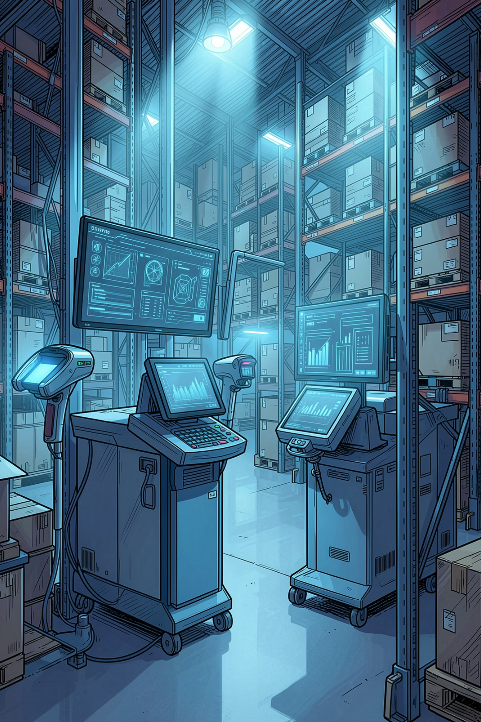
AI-Powered Dealer Parts Return Inspection
Automating Manual Inspection Using Document AI and Generative AI
Created by : Harish Reddy (TE202)
Date: May 2026

Slide 2

Manual Inspection = Time, Errors, and Delays
Every returned parts order processed by Cummins warehouses today relies entirely on handwriting and manual re-entry. There is no automation, no consistency, and no digital audit trail.
Step 1 — Handwritten Inspection
Step 2 — Manual BMS Re-Entry
Step 3 — Days of Delay
Warehouse staff physically inspect returned dealer parts and handwrite findings — quantities approved, quantities rejected, and rejection reasons — directly onto paper RGA documents that travel with the physical parts from the dealer.
A second person manually re-types every quantity, accepted count, rejected count, and rejection reason line by line into BMS DRET orders. This is slow, error-prone, and entirely repetitive — every single line, every single time.
The entire process takes days. Dealers are left waiting for credit while paper documents move between the warehouse and back office. Volume spikes require additional headcount and still result in backlogs.
Request Logged
Warehouse Inspect
Handwritten RGA
Dealer Return
OEQT Order

Slide 3

Two Paper Documents. Dozens of Lines. All Typed Manually.
The warehouse inspector makes every decision on paper across two separate forms. Both documents must then be manually transcribed into BMS — a process the AI eliminates entirely.
Document 1 — RGA Sheet
Document 2 — Rejected Parts List
Generated by BMS and travels physically with the returned parts from the dealer. Pre-printed with Part Number, Item Description, Price Group, and Qty Shipped.
A separate monthly form completed by the inspector for all rejected lines. Contains Part Number, Quantity, Rejection Code (A–T), and free-text comments.
Inspector handwrites the Qty Approved column:
19 standardized rejection codes already defined:
A cross (X) = entire quantity rejected
A circled number = that many units approved
A plain number = partial approval quantity
H = Used / Not in New Condition
N = Superseded Part
B = Damaged
A = Rusty / Corroded
R = Packaging Not in Salable Condition
This handwritten column is what gets manually re-typed into BMS DRET today — line by line, order by order.
Inspector also writes free-text comments per code. This form is then used as reference while manually entering reasons into BMS.
The inspector has already made every decision on paper. The only problem is someone has to re-type it all into BMS. That is exactly what the AI removes.

Slide 4
Digitize First. Automate Second.
The solution operates in two connected phases. Phase 1 captures the paper inspection digitally in seconds. Phase 2 uses that data to auto-populate BMS DRET with zero manual entry.
Phase 1 — Document Digitization
Phase 2 — BMS DRET Auto-Population
Trigger: Warehouse completes physical inspection and fills in paper documents.
Trigger: DRET order cloned from OEQT in BMS.
AI reads digitized inspection data from the staging table
Accepted and rejected quantities auto-populated per DRET line
Rejection codes A–T mapped to BMS codes via lookup table
GPT-4o generates a professional, BMS-compliant rejection reason per line
Overall confidence score calculated per line based on OCR accuracy
Lines ≥80% confidence: auto-applied directly to DRET
Lines <80% confidence: routed to human review queue in Cumpas
Warehouse scans or photographs the RGA sheet and Rejected Parts List using a phone camera or flatbed scanner
Images uploaded to Cumpas via a new Upload Inspection Documents button
Azure Document Intelligence reads both documents simultaneously
Handwriting interpreted: X = rejected, circled number = approved quantity, partial notation = partial split
Rejection codes A–T extracted; inspector free-text comments captured per line
All extracted data stored in BMS staging table instantly
Result: DRET order fully populated — zero manual data entry required.
Result: Entire paper inspection digitized in seconds — no manual typing.

Slide 5

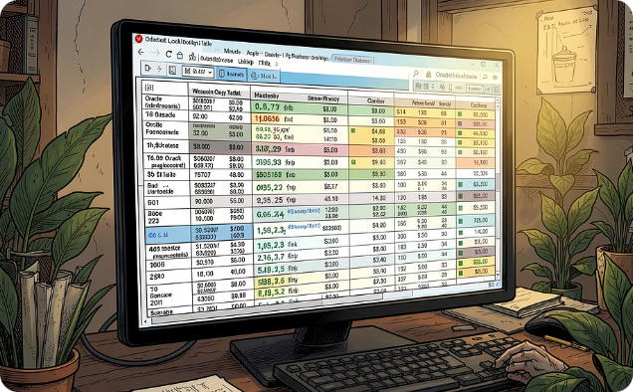

Three AI Components Working Together
The solution integrates three purpose-built AI components, each handling a distinct part of the automation chain — from reading handwriting to generating professional rejection language.
Azure Document Intelligence
Rejection Code Mapping Engine
GPT-4o Rejection Reason Generator
Microsoft Azure's pre-trained form recognition service reads scanned RGA sheets and Rejected Parts Lists. It interprets handwritten notation including crosses and circled numbers, extracts structured data per field, and returns a confidence score so low-quality scans are automatically flagged. Works with standard phone camera photos — no special scanner required.
Maps all 19 standardized inspector codes (A–T) directly to BMS rejection codes via an Oracle lookup table. Zero ambiguity — the inspector's original decision is preserved exactly. Examples: Code A (Rusty/Corroded) → BMS Code 3; Code N (Superseded Part) → BMS Code 1; Code O (Part Not Authorized) → BMS Code 2. No machine learning prediction needed — the inspector already decided.
Azure OpenAI GPT-4o is called per rejected line, combining the rejection code description with the inspector's handwritten comment to produce a professional, consistent, BMS-compliant rejection reason. Example output: "Item rejected — evidence of use, not in new or unused condition. Inspector notes: Used parts — signs of installation on all 5 units." Every reason is auditable and compliant.

Slide 6
19 Lines. 2 Documents. 100% Automated. Zero Manual Entry.
The POC was tested against a real RGA document from GPM Pump and Truck Parts LLC (RGA #11717-RTN0825-8235). All 19 lines were auto-applied with confidence scores between 84% and 93%, saving 95 minutes of manual work with zero human review required.
Part Number
Description
Shipped
Accepted
Rejected
Code
Confidence
Result
5320949
Heater, Engine
8
8
0
—
92%
AUTO
5418426
Tube, Pressure Sensing
24
24
0
—
90%
AUTO
5295882
Housing, Rocker Lever
5
0
5
H
93%
AUTO
5324121RX
Kit, ICP Turbocharger
5
0
5
N
92%
AUTO
5332563
Gasket, Oil Pan
3
1
2
A
91%
AUTO
5362273
Pump, Fuel Transfer
3
1
2
B
90%
AUTO
5398680
Tube, Tur Oil Supply
5
2
3
S
84%
AUTO
5406130
Kit, Fuel Pump Repair
5
2
3
D
90%
AUTO
5415562
Sensor, Oxygen
3
2
1
I
85%
AUTO
Sample AI-Generated Rejection Reason
19
95min
Part 5295882 — Housing, Rocker Lever (Code H, 93.4%):
"Item rejected — evidence of use, not in new or unused condition. Inspector notes: Used parts — signs of installation on all 5 units."
Lines Processed
Time Saved
Part 5324121RX — Kit, ICP Turbocharger (Code N, 92.4%):
"Item rejected — superseded part not approved for return. Inspector notes: Superseded — no prior distributor approval obtained."
All auto-applied
Single RGA document
0
Manual Reviews
Zero lines flagged

Slide 7
What Changes for the Business
BEFORE — TODAY
AFTER — WITH AI
Every line on every return order typed manually into BMS DRET — approx. 5 minutes per line
Quantities and rejection reasons auto-populated from scanned documents in seconds
Rejection reasons vary by person — inconsistent wording causes dealer disputes and re-work
Every rejection reason is professionally worded, consistent, and BMS-compliant
Delays between inspection and credit damage dealer relationships and satisfaction scores
Dealers receive credit faster with clear, consistent communication every time
Volume spikes require additional headcount — no ability to scale without cost
Scales to any return volume with no additional headcount required
No digital audit trail — paper documents can be lost, misread, or disputed
Confidence scores create a complete, auditable digital trail for every inspection decision
80%
95min
Reduction in Manual Entry
Saved Per RGA Doc
Data entry effort eliminated
Proven in POC results
0
100%
Extra Headcount Needed
Audit Coverage
Scales without staffing
Every decision traceable

Slide 8

Low Risk. Phased Delivery. Value from Month One.
The implementation roadmap is designed for zero disruption to current operations. Each phase builds confidence before advancing, with the business retaining full control at every stage.
Phase 1 — Shadow Mode
1
Months 1–2
AI runs in parallel — no auto-apply to BMS
Output compared against human entry for accuracy
10 real RGA documents validated through Azure
Accuracy report produced at end of Month 2
2
Phase 2 — Assisted Mode
Months 3–4
AI suggestions displayed in Cumpas for human confirmation
One-click confirm or easy edit before applying to BMS
Override available on every line
Feedback loop captures corrections to improve model
Phase 3 — Autonomous Mode
3
Months 5–6
Lines ≥80% confidence auto-applied to DRET
Lines below threshold routed to review queue
60–80% automation rate target achieved
Monthly accuracy reports to management
4
Phase 4 — Optimise & Expand
Month 7+
Model retrained quarterly on real inspection data
Expand from CECO to all product codes
Full ROI realized across all dealer return orders
Continuous improvement as more data is processed
Starting Point: Begin with CECO product code only — highest volume, best-defined codes, and lowest risk entry point for Phase 1 validation.

Slide 9
Four Business Decisions. Four IT Approvals. Then We Start.
The POC is built, the scripts are tested, and the results are proven. All that remains are eight decisions to move from proof of concept to production.
Business Decisions Required
IT Approvals Required
Approve the 80% confidence threshold as the auto-apply boundary for DRET lines
Azure Document Intelligence subscription — handwriting and form recognition
Name the owner of the human review queue in Cumpas for sub-threshold lines
Azure OpenAI GPT-4o subscription — rejection reason generation
Confirm starting scope — CECO product code only for Phase 1 shadow mode
Oracle UTL_HTTP HTTPS access approved to call Azure API endpoints from BMS
Nominate two warehouse staff to validate AI output during shadow mode
Deploy new BMS staging table and lookup table to UAT environment
Weeks 1–2
Azure infrastructure provisioned and tested
Weeks 3–4
Real RGA documents scanned and processed through Azure
Weeks 5–6
Shadow mode running alongside manual process
Week 7–8
First accuracy report delivered to business
Month 3
Assisted mode live in Cumpas
Month 5
Autonomous mode active — manual hours saved daily

Slide 10

AI-Powered Dealer Return Inspection — The Case for Acting Now
Every returned parts order results in hours of manual re-typing into BMS — slow, inconsistent, and error-prone. AI reads the paper inspection documents, interprets the handwriting, and auto-populates BMS DRET. No manual typing required.
Strategic Value
POC Proof
AI-Driven Ops
Scalable
A real 19-line RGA document from GPM Pump and Truck Parts LLC was processed with 100% automation rate, 95 minutes saved, and confidence scores between 84–93% — with zero errors and zero manual intervention.
Inspection decisions digitized and applied to BMS automatically
Handles any return volume without increasing headcount
Dealer Experience
Future Ready
Faster credit, consistent communication, fewer disputes
Foundation for broader AI automation across BMS workflows
The Ask: Four business decisions. Four IT approvals. A phased roadmap that starts with zero risk. The technology is ready. The POC is proven. The business case is clear.

