Slide 1
Security By and For Deep Learning Models
Capstone Project Review 2
Harish Senthilkumaran Dharani - 22011103017
M K Lokesh Kumar - 22011103026
Dr. Dhivya S
Shiv Nadar University Chennai

Slide 2
MOVING FORWARD
Why we moved on from MNIST to CIFAR-10?
  MNIST is simple, grayscale digits and not complex real-world images
  CIFAR-10 is more realistic (32x32 colour images)
  To test if our defense method generalizes
Why we chose ResNet-18?
  Powerful standard model
  Capable of handling complex features better than CNN
  Stronger baseline which is needed to properly test against attacks with our proposed defense

Slide 3
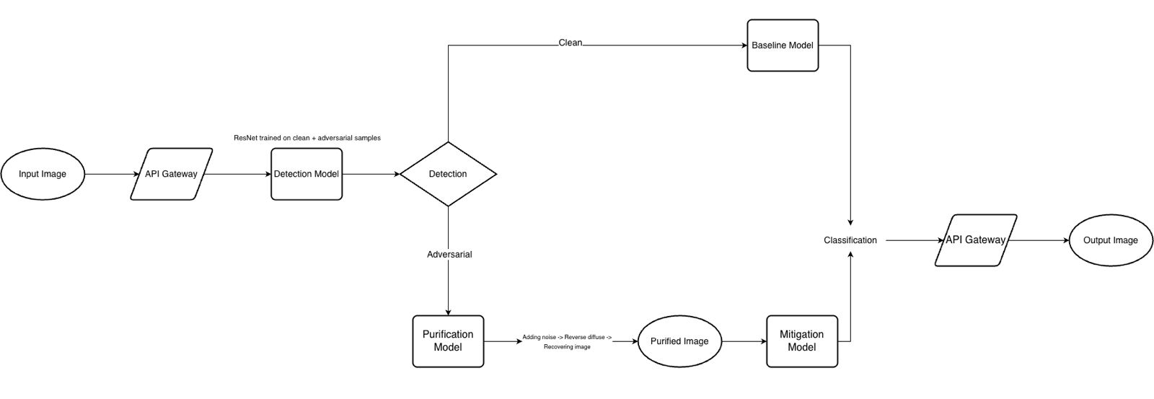
ARCHITECTURE OVERVIEW

Slide 4
OUR RESNET-18 ARCHITECTURE
Input Layer: 3 x 32 x 32 Colour Images
Initial Convolutional Layer: 3 channel -> 64 channel with a Stride = 1 + Batch Normalization + ReLU
Residual Stage 1: 2 BasicBlocks
  64 channels -> 64 channels and Uses Skip Connections
Residual Stage 2: 2 BasicBlocks
  64 channels -> 128 channels and Stride = 2
Residual Stage 3: 2 BasicBlocks
  128 channels -> 256 channels and Stride = 2
Residual Stage 4: 2 BasicBlocks
  256 channels -> 512 channels and Stride = 2
Pooling: Averages each 4x4 feature map down to a single 1x1 value
Flattening Layer
Final Layer
  Baseline/Mitigation – 10 Output Neurons
  Detection – 2 Output Neurons

Slide 5
THE MITIGATION MODEL
Trained the Mitigation Model on the CIFAR-10 images
MART + AWP training offered a greater accuracy on adversarial samples, although it compromised on the balance between clean and robust accuracy
Training Method | Clean Accuracy | PGD-20 Robust Accuracy
Standard Adversarial Training (ART) | ~80% | ~30%
TRADES | ~84% | ~38%
MART | ~82% | ~50%
MART + AWP | ~81% | ~59%

Slide 6
USING A DIFFUSION MODEL FOR PURIFICATION
Used a Denoising Diffusion Probabilistic Model (DDPM) trained specifically on CIFAR-10 images
Uses Exponential Moving Average (EMA) weights for more stable reconstruction
  Chosen due to its lightweight size and strong denoising quality for natural images
Generate and Restore images through 2-way noise process
  Forward Process – Gradually add Gaussian Noise to clean images at timestamps till they become pure noise
  Reverse Process – Learns to remove noise step-by-step by reconstructing clean image from noisy
  Learns structure of natural images and what the “real data” looks like
Uses this knowledge to denoise or purify corrupted images and revert back to clean data

Slide 7
THE PURIFICATION PROCESS
Diffusion Models are trained to remove Gaussian Noise, not Adversarial Perturbations
Forward Pass
  Add controlled amount of Gaussian Noise to ”trump” the adversarial noise
  Model now knows how to remove the noise as it is no longer small perturbations
Backward Pass
  Reverse Diffusion Process gradually removes the noise and restores to a clean image
Amount of Noise added was controlled using PURIFICATION_TIMESTAMP t
  Higher the t value, stronger the cleaning process and less detailed the image becomes
Adversarial Image (Small Perturbation) -> (+) Gaussian Noise -> Noisy Image -> (+) Diffusion Denoise -> Clean Image

Slide 8
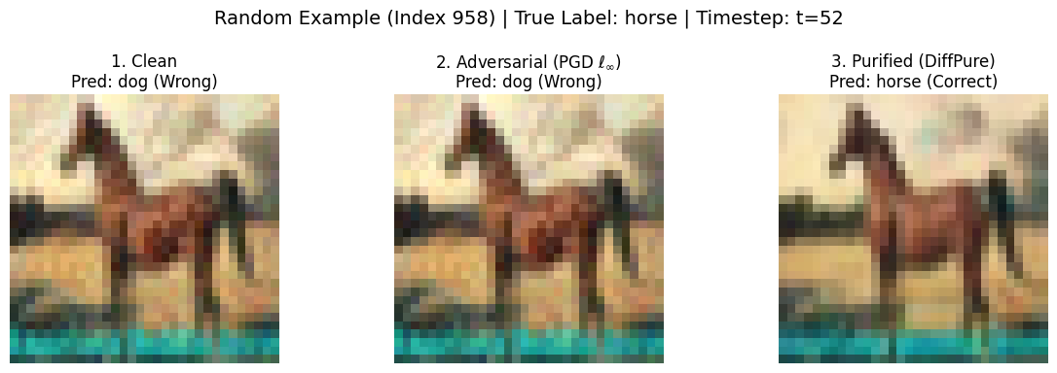
UNITING THE PURIFICATION AND MITIGATION MODELS
With both the Purification and the Mitigation models, two purification strategies are performed:
  Single-stage purification: Applies diffusion-based purification using a single, fixed timestep
  Ensemble purification: Aggregates predictions by averaging the Mitigation model’s logits from multiple diffusion timesteps, effectively combining varied purification strengths into a single, more robust final decision
Images purified via Ensemble Purification consistently achieve higher classification accuracy when evaluated by the Mitigation model

Slide 9
RESULTS
Method | Accuracy on Adversarial Samples
No purification + Mitigation model | ~59%
Single-step purification | ~88%
Ensemble purification | ~91%

Slide 10
FUTURE SCOPE
Implement adaptive diffusion purification where timesteps are dynamically adjusted based on model confidence for efficient and robust defense.
Extend the framework to handle higher-resolution RGB datasets for broader applicability.

Slide 11
References
Publications
  Nie W, Lin B, Narodytska N, Patel A, “Purifying Diffusion Models Improves Out-of-Distribution Robustness”, arXiv:2205.07460, May 2022.
  Hongyang Zhang, Yaodong Yu, Jiantao Jiao, Eric P. Xing, Laurent El Ghaoui, Michael I. Jordan “Theoretically Principled Trade-off between Robustness and Accuracy”, arXiv:1901.08573, June 2019
  Yisen Wang, Difan Zou, Jinfeng Yi, James Bailey, Xingjun Ma, Quanquan Gu “Improving Adversarial Robustness Requires Revisiting Misclassified Examples”, Apr 2024
Code and Data Sources
  Guided Diffusion Model. Retrieved from https://github.com/pesser/pytorch_diffusion

