Slide 1
Adversarial Attack Detection and Mitigation Framework for Deep Learning Models
Capstone Project Review – Phase 1
Harish Senthilkumaran Dharani - 22011103017
M K Lokesh Kumar - 22011103026
Dr. Dhivya S
Shiv Nadar University Chennai

Slide 2
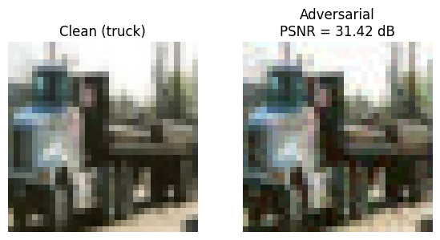
PROBLEM DEFINITION
Deep learning models achieve high accuracy but are vulnerable to adversarial perturbations – small, human-imperceptible noise that causes misclassification.
Such vulnerabilities can be exploited in autonomous systems, medical imaging, and security-critical applications.
AIM: To develop a robust framework capable of detecting and mitigating adversarial attacks.
Notes:
Explain a scenario with autonomous vehicle systems
Explain how the PSNR metric works

Slide 3
OBJECTIVES
Design a detection model to distinguish clean and adversarial samples.
Implement a diffusion-based purification module to remove adversarial perturbations.
Employ a robust ResNet-18 mitigation model trained using MART + AWP for improved resilience.
Integrate all three into a unified pipeline that ensures high performance on both clean and adversarial samples.

Slide 4
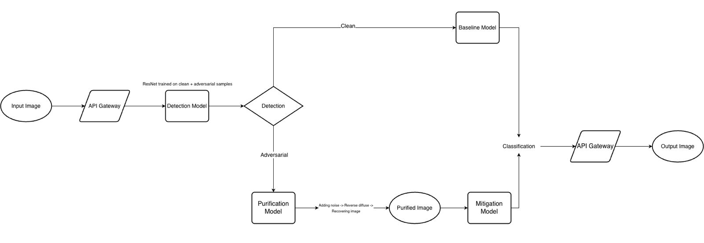
ARCHITECTURE OVERVIEW
Notes:
Emphasize on the importance of layered defense here

Slide 5
DATASET AND ATTACK SCENARIOS
Dataset
  CIFAR-10 (60,000 32 x 32 RGB images, 10 classes)
Purpose
  Evaluate robustness of framework under white-box attacks.
Attack used
  PGD (Projected Gradient Descent) – ε = 8/255, steps = 10
Notes:
Explain why focus is on defending against white-box attacks here than black-box attacks
Justify the use of CIFAR-10 here

Slide 6
PROJECTED GRADIENT DESCENT (PGD) ATTACK
Iterative, white-box attack – has full knowledge of the model parameters and gradients.
Repeatedly adjusts pixel values in the same direction as the gradient of the loss to increase the likelihood of misclassification.
Each small step modifies the image just enough to confuse the model while remaining imperceptible to the human eye.
Keeps total perturbation with a small bound so that the attack remains subtle.
Effectiveness
  Stronger than one-step attacks like FGSM.
Parameters used
  Perturbation limit (ε): 8/255
  Steps: 10 iterations
Notes:
Explain why PGD is used over other adversarial attacks (like FGSM) here

Slide 7
ResNet-18 ARCHITECTURE
Input Layer: 3 x 32 x 32 Colour Images
Initial Convolutional Layer: 3 channel -> 64 channel with a Stride = 1 + Batch Normalization + ReLU
Residual Stage 1: 2 BasicBlocks
  64 channels -> 64 channels and Uses Skip Connections
Residual Stage 2: 2 BasicBlocks
  64 channels -> 128 channels and Stride = 2
Residual Stage 3: 2 BasicBlocks
  128 channels -> 256 channels and Stride = 2
Residual Stage 4: 2 BasicBlocks
  256 channels -> 512 channels and Stride = 2
Pooling: Averages each 4x4 feature map down to a single 1x1 value
Flattening Layer
Final Layer
  Baseline/Mitigation – 10 Output Neurons
  Detection – 2 Output Neurons
Notes:
- Explain rationale for ResNet-18

Slide 8
DETECTION MODEL
Based on ResNet-18 architecture trained on CIFAR-10.
Binary classifier trained on equal mix of clean and adversarial images.
Optimized using Binary Cross-Entropy Loss.
Output layer: 2 neurons corresponding to either “clean” or “adversarial”.
Performance metrics:
  Accuracy: 97%
Effectively filters adversarial inputs before they reach the classifier.

Slide 9
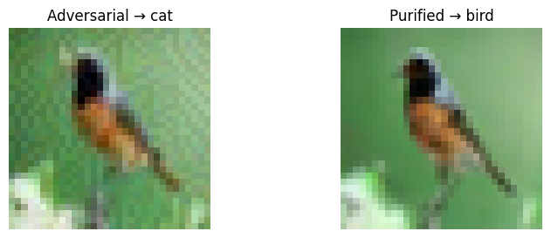
DIFFUSION-BASED PURIFICATION
Built using Denoising Diffusion Probabilistic Model (DDPM) trained on CIFAR-10.
Forward Process: Gradually adds Gaussian noise and converts adversarial noise to random noise.
Reverse Process: Denoises step-by-step and reconstructs clean image.
Exponential Moving Average (EMA) weights stabilize image generation.
Controlled using Purification Timestep (t) – higher t = stronger cleaning, lower detail.
Notes:
Explain single-step vs ensemble purification
EMA
Forward + backward pass

Slide 10
MITIGATION MODEL
Based on ResNet-18 architecture trained on CIFAR-10.
Uses MART (Misclassification Aware aDversarial Training) combined with AWP (Adversarial Weight Perturbation) for enhanced robustness.
MART focuses on difficult (near-boundary) samples, improving defense against adaptive attacks.
AWP regularizes model weights by introducing small perturbations in weight space to prevent overfitting to specific attacks.
Output layer: 10 neurons corresponding to CIFAR-10 classes.
Balances clean sample accuracy and robustness.
Notes:
Accuracy-robustness tradeoff
MART and AWP in detail

Slide 11
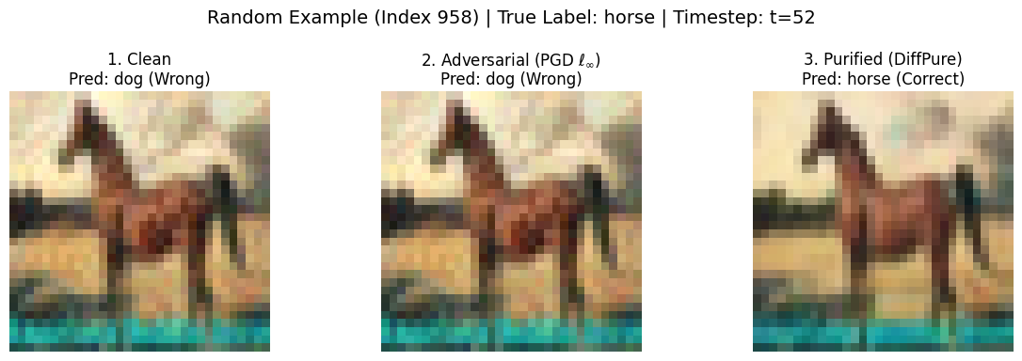
UNITING THE PURIFICATION AND MITIGATION MODELS
With both the Purification and the Mitigation models, two purification strategies are performed:
  Single-stage purification: Applies diffusion-based purification using a single, fixed timestep.
  Ensemble purification: Aggregates predictions by averaging the Mitigation model’s logits from multiple diffusion timesteps, effectively combining varied purification strengths into a single, more robust final decision.
Images processed through Ensemble Purification consistently demonstrate higher classification accuracy under the Mitigation Model compared to both unpurified inputs and those purified using the Single-stage approach.
Notes:
Ensemble purification captures both fine and coarse purification levels.

Slide 12
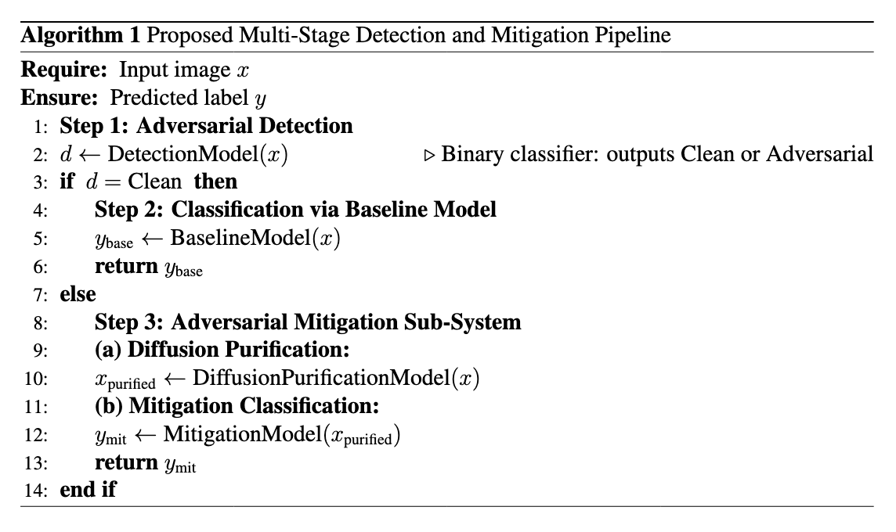
PIPELINE

Slide 13
RESULTS
Overall system accuracy (on a corpus of clean + adversarial samples): 91.6%
Method | Accuracy on Adversarial Samples
No purification | ~59%
Single-step purification | ~88%
Ensemble purification | ~91%

Slide 14
FUTURE SCOPE
Adaptive purification: Dynamic timestep control based on model confidence.
Scalability: Extend to higher-resolution datasets (CIFAR-100, ImageNet).
Efficiency: Explore lighter diffusion models for faster inference.
Notes:
- Look into diffusion backbone alternatives that could potentially be faster and why they haven’t been explored yet

Slide 15
References
Publications
  Nie W, Lin B, Narodytska N, Patel A, “Purifying Diffusion Models Improves Out-of-Distribution Robustness”, arXiv:2205.07460, May 2022.
  Hongyang Zhang, Yaodong Yu, Jiantao Jiao, Eric P. Xing, Laurent El Ghaoui, Michael I. Jordan “Theoretically Principled Trade-off between Robustness and Accuracy”, arXiv:1901.08573, June 2019
  Yisen Wang, Difan Zou, Jinfeng Yi, James Bailey, Xingjun Ma, Quanquan Gu “Improving Adversarial Robustness Requires Revisiting Misclassified Examples”, Apr 2024
  Madry A, Makelov A, Schmidt L, Tsipras D, Vladu A, “Towards Deep Learning Models Resistant to Adversarial Attacks”, arXiv:1706.06083, 2018.
  Eric Wong, Leslie Rice, J. Zico Kolter, “Fast is Better than Free: Revisiting Adversarial Training”, arXiv:2001.03994, Jan 2020.
Code and Data Sources
  Diffusion Model. Retrieved from https://github.com/pesser/pytorch_diffusion
  Trusted AI’s Adversarial Robustness Toolbox. Retrieved from https://github.com/Trusted-AI/adversarial-robustness-toolbox

