Slide 1
Adversarial Attack Detection and Mitigation Framework for Deep Learning Models
Capstone Project Review 1 – Phase 2
Harish Senthilkumaran Dharani - 22011103017
M K Lokesh Kumar - 22011103026
Dr. Dhivya S
Shiv Nadar University Chennai

Slide 2
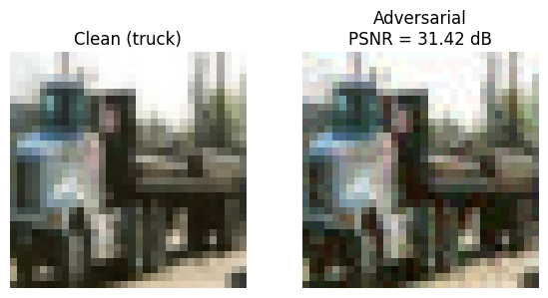
PROBLEM DEFINITION
Deep learning models achieve high accuracy but are vulnerable to adversarial perturbations – small, human-imperceptible noise that causes misclassification.
Such vulnerabilities can be exploited in autonomous systems, medical imaging, and security-critical applications.
AIM: To develop a robust framework capable of detecting and mitigating adversarial attacks.
Notes:
Explain a scenario with autonomous vehicle systems
Explain how the PSNR metric works

Slide 3
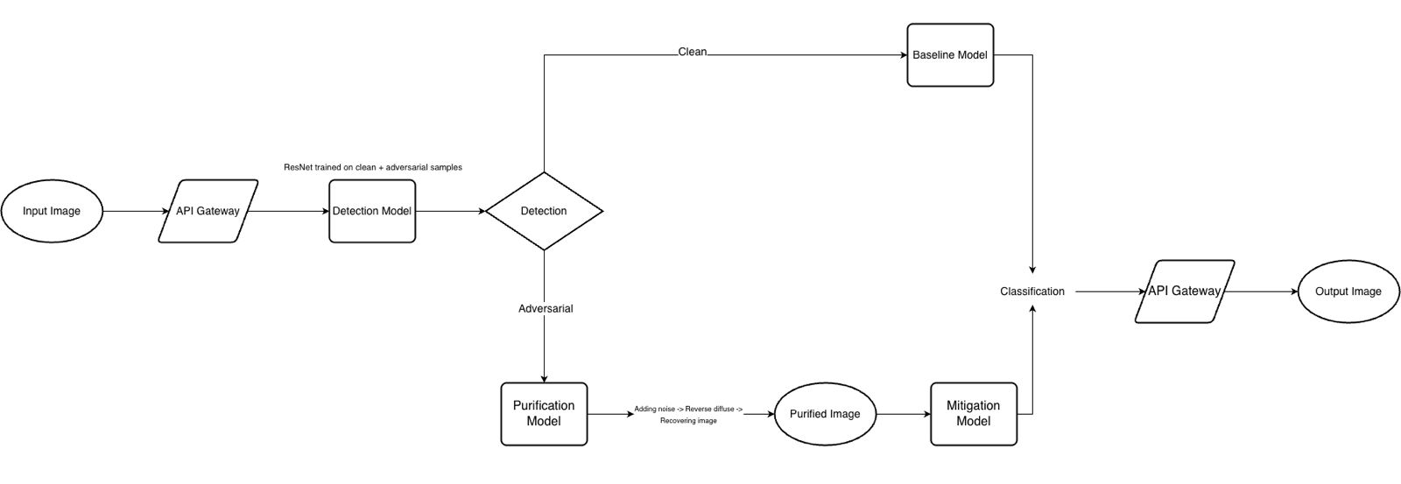
PIPELINE OVERVIEW
Notes:
Emphasize on the importance of layered defense here

Slide 4
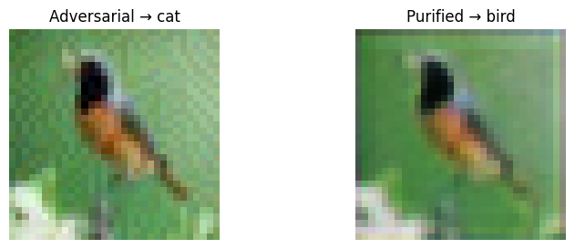
CIFAR-10 UNet-BASED PURIFIER
Trained UNet-based image purifier using PGD adversarial examples (ε = 8/255, 10 steps) generated on-the-fly against a fixed ResNet-18 classifier.
Optimization objective combines pixel-level reconstruction with classifier-guided loss, ensuring purified outputs remain both visually clean and semantically correct.
Classifier weights are frozen during purifier training, enforcing true purification rather than co-adaptation.
Achieved 93% classification accuracy on adversarial CIFAR-10 samples.
Notes:
Explain why U-Net works well here (limited semantic complexity)
Explain difference between using pre-processed images and those that are attacked-on-the-fly
Justify the use of CIFAR-10 here

Slide 5
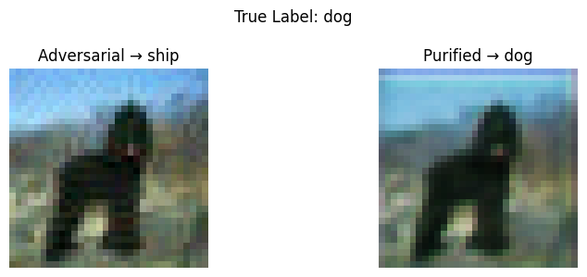
OBSERVATIONS FROM CIFAR-10
Adversarial perturbations on CIFAR-10 are predominantly low-frequency and spatially-localized.
UNet skip connections preserve class-discriminative features while removing noise.
Single-pass purification achieves results comparable to iterative diffusion at significantly lower computational cost.
Notes:
Explain how perturbations are low-frequency and spatially-localized
Explain how lower computational cost
Explain how skip connections help here
Clarify that the result should not be over-generalized
Transition into motivation for ImageNet

Slide 6
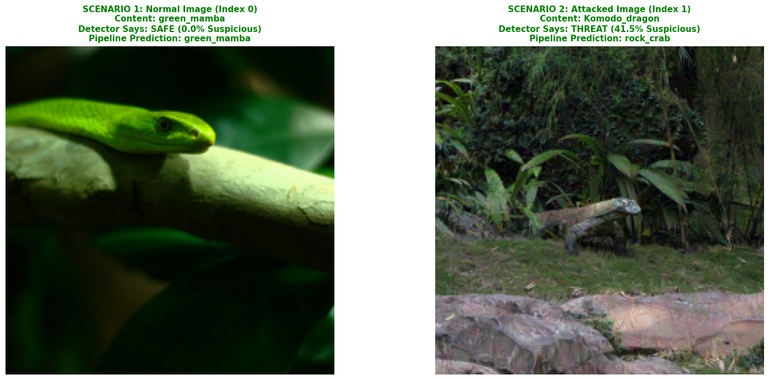
ImageNet DIFFUSION-BASED PURIFICATION
Built using Denoising Diffusion Probabilistic Model (DDPM) trained on ImageNet.
Forward Process: Gradually adds Gaussian noise and converts adversarial noise to random noise.
Reverse Process: Denoises step-by-step and reconstructs clean image.
Exponential Moving Average (EMA) weights stabilize image generation.
Controlled using Purification Timestep (t) – higher t = stronger cleaning, lower detail.
Achieved 66% classification accuracy on adversarial CIFAR-10 samples.
Notes:
Explain single-step vs ensemble purification
EMA
Forward + backward pass

Slide 7
ImageNet UNet-BASED PURIFIER
Same UNet-style purification applied to ImageNet.
Purification introduces over-smoothing, removing class discriminative features
Local convolutional inductive-bias limits global context modeling
Achieved 44% classification accuracy on adversarial ImageNet samples.
Notes:
Explain why over-smoothing occurs
Why didn’t this issue occur with CIFAR-10
High-res datasets require global coherence across objects
Accuracy drop is due to representation loss, not attack strength
“local convolutional inductive-bias”
“global context modeling”

Slide 8
RESULTS
Diffusion models scale better with data complexity.
U-Net is more effective for low-resolution regimes.
Dataset | Purifier | Accuracy on Adversarial Samples
CIFAR-10 | UNet | 94%
ImageNet | Diffusion (Ensemble Purification) | 66.4%
ImageNet | UNet | 44%

Slide 9
FUTURE DIRECTIONS
Architecture enhancements
  Hybrid UNet-diffusion pipelines for semantic preservation.
Domain-specific training
  Train purifiers on modality-specific distributions (X-ray, CT).
Robustness-oriented objectives
  Feature-space purification and confidence-aware denoising.
  Joint training with adversarial and realistic noise models.
Notes:
Medical images require “modality-aware training”, not generic natural-image priors
Anatomy and physics constraints are key advantages over the complex nature of ImageNet
Hybrid methods could balance both robustness with clinical efficiency
Path toward deployable adversarial defense in healthcare
Explain ”feature-space purification” and “confidence-aware denoising”
Explain how joint training could help
Explain semantic preservation

Slide 10
References
Publications
Code and Data Sources

