Slide 1
Presentation on
Hospital management system
Presented By: Santosh Bohara
: Jagdish Dhami
: Harish Samant
: Anushesh K.K.tharu

Slide 2
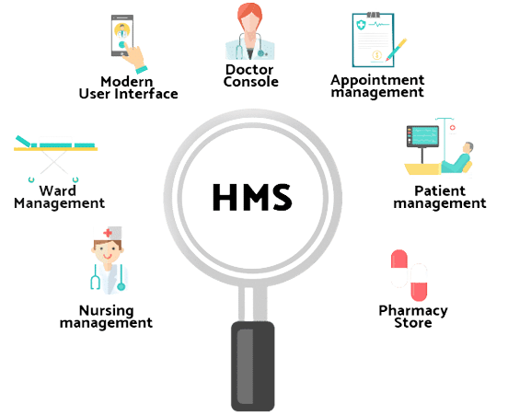
Introduction
A hospital management system (HMS) is a tool that collects data about patients, doctors, and hospital administrative details in one software to automate internal activities.

Slide 3
Objective
A standardized and user-friendly data storage system:
A standardized and user-friendly data storage system is essential for a
Hospital Management System (HMS) to ensure efficient operations, accurate
record-keeping, and easy retrieval of information.
Comprehensive doctor and patient information:
Doctor information including his or her name ,gender ,Address ,id and
specialty.
Patient Information including his or her Name ,gender ,address, date and
Medical history.
Eliminate data redundancy and improve speed:
Database Normalization:
Organize the database tables to minimize redundant data and reduce
the potential for data inconsistencies. This involves breaking down large
tables into smaller, related tables, and establishing relationships between
them.

Slide 4
streamlined operation and paperwork reduction:
Electronic Health Records (EHRs):
Transition from paper-based records to electronic health records. EHRs
allow for seamless data entry, retrieval, and sharing among healthcare
providers.
Automated Patient Registration:
Use digital forms for patient registration and admission. This eliminates the
need for manual data entry and reduces paper forms.
Electronic Billing and Invoicing:
Utilize electronic billing and invoicing systems to generate and send bills to
patients and insurance providers, reducing paper-based billing processes.

Slide 5
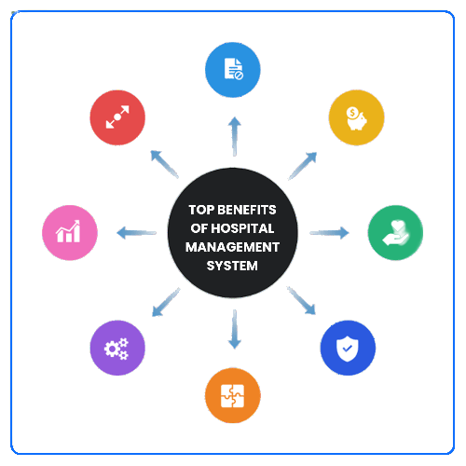
Advantages
Better Diagnosis and Treatment.
Easy Patient data retrieval.
Better Communication between Hospital Departments.
Increased Data security.
Cost-Effective.

Slide 6
Cocept uses
We used the following concept and features of c programming to develop this program
File handeling .
Array
Structure
String
Switch Case
Loop

Slide 7
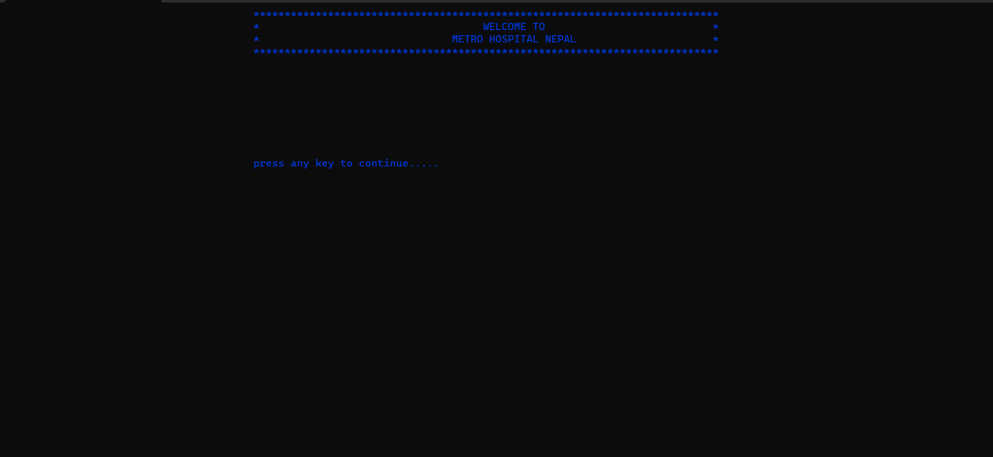
SNAPSHOTS OF THE SYSTEM
Welcome Screen

Slide 8
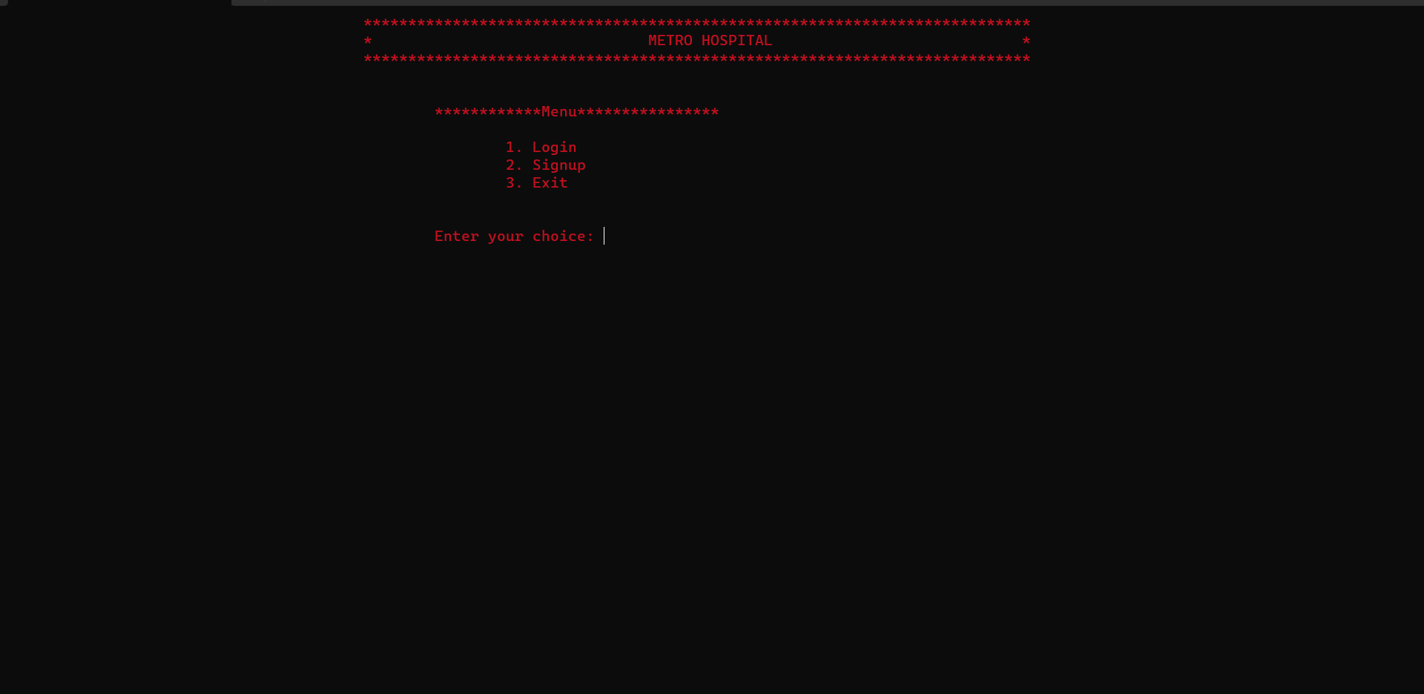
Login And Signup Screen

Slide 9
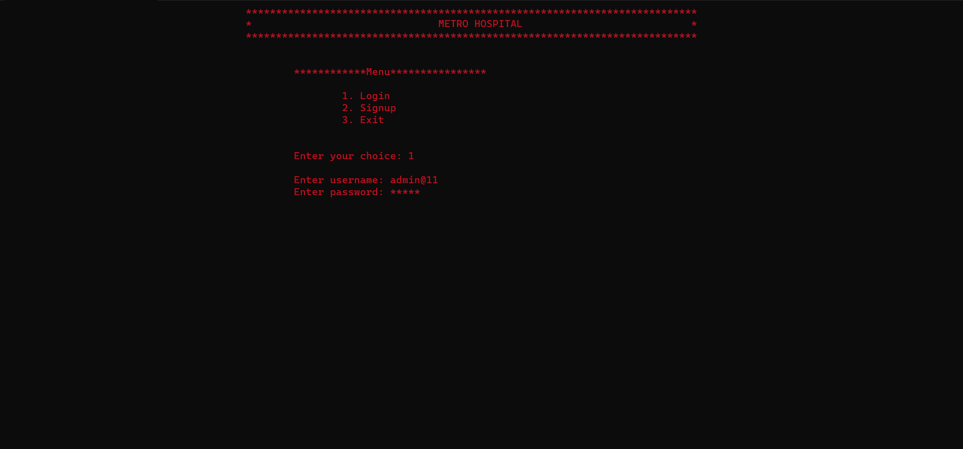
Login screen

Slide 10
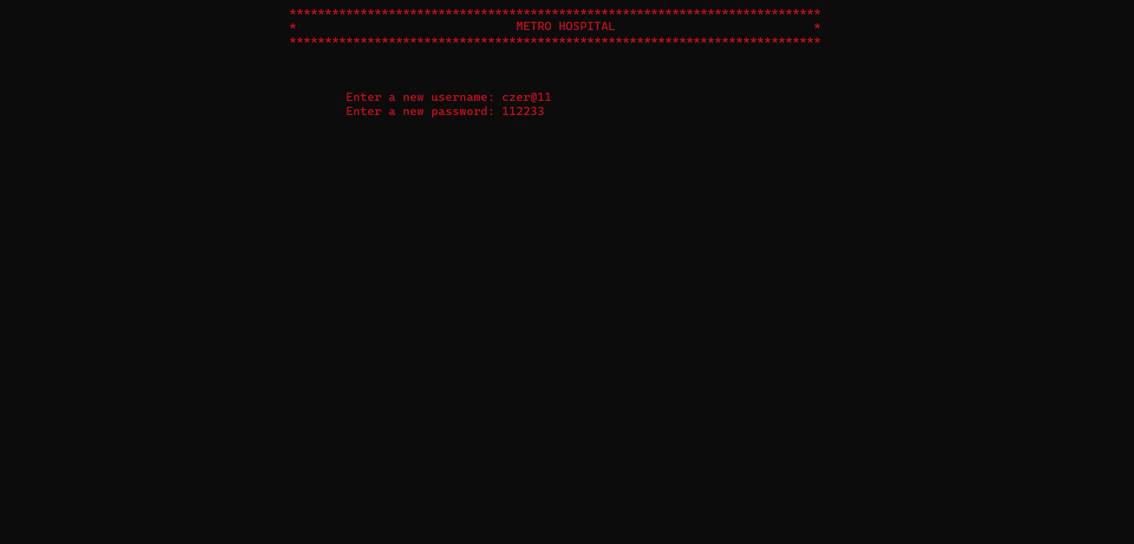
Signup screen

Slide 11
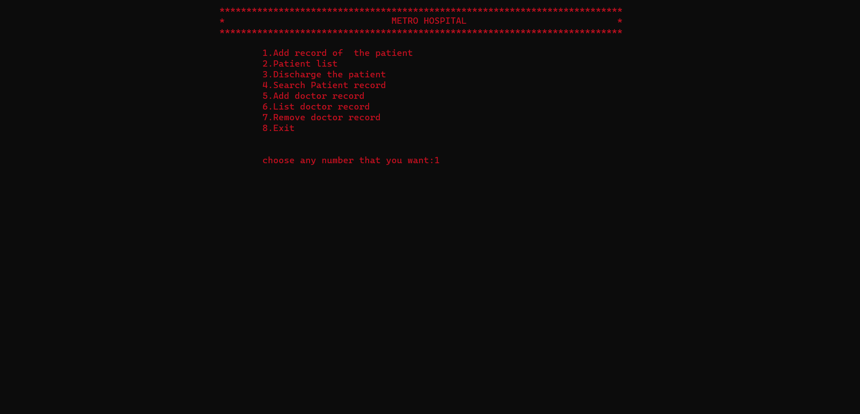
Main Menu

Slide 12
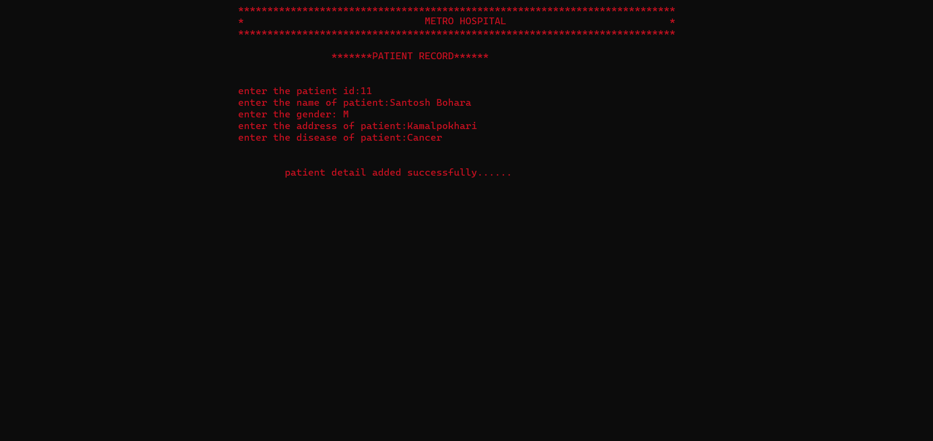
Add Patient Record screen

Slide 13
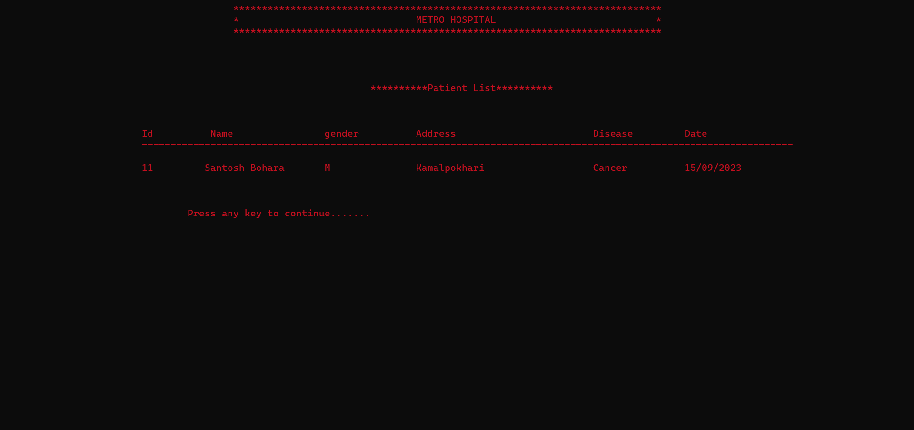
Patient List Screen

Slide 14
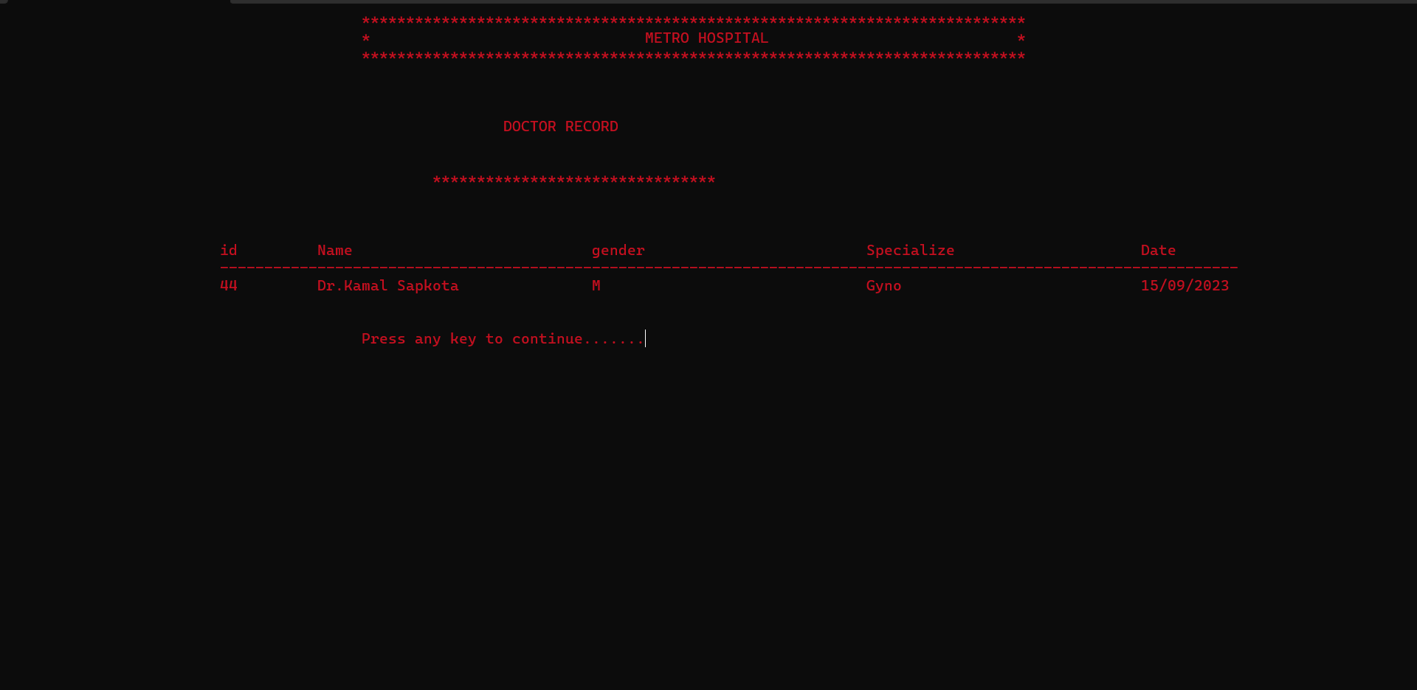
Doctor Record Screen

Slide 15
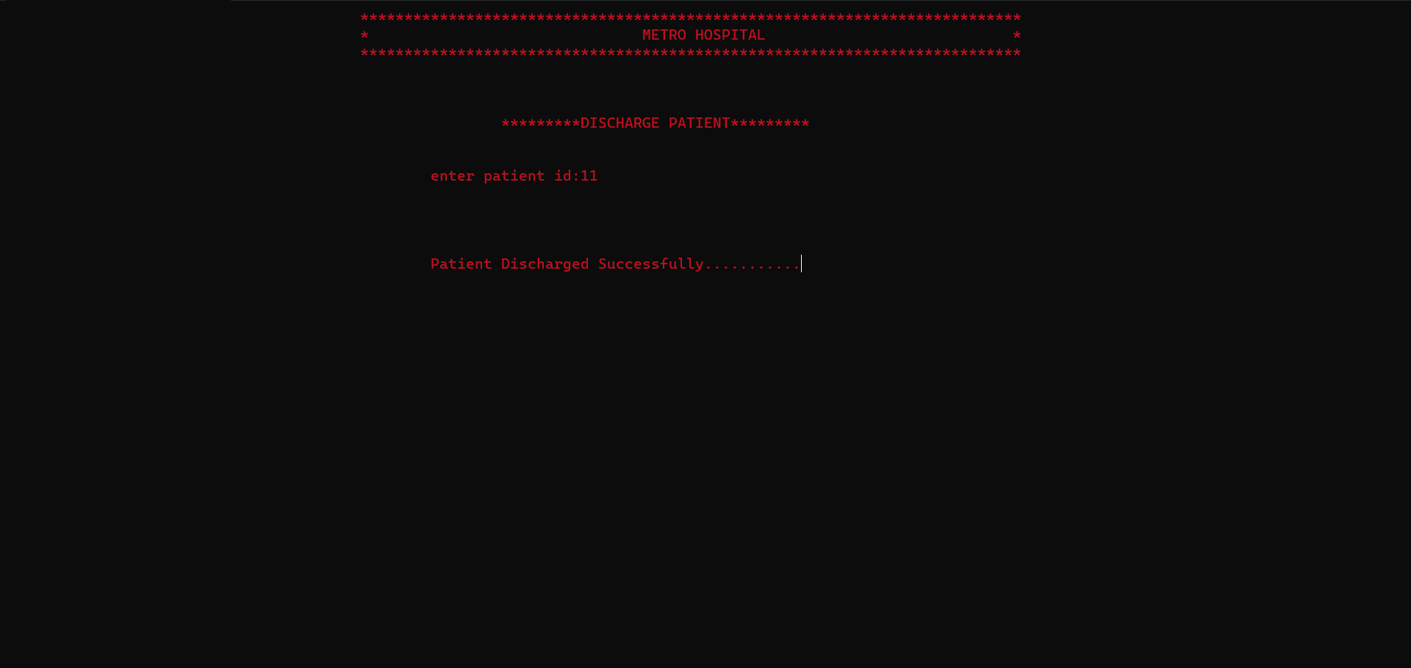
Discharge Patient Screen

Slide 16
Conclusion
In conclusion, this project has provided us with a remarkable opportunity to delve into the realm of C programming. Collaborating as a group has imparted valuable lessons in teamwork and cooperation. It has been an enriching experience, and we are sincerely grateful for the unwavering support from our friends and teachers throughout this journey. Additionally, this project has broadened our knowledge in diverse areas, as it required us to synthesize concepts such as file handling, arrays, structures, functions, and loops into a cohesive, functional system. We eagerly anticipate the positive impact this system will have on our hospital's operational efficiency and patient satisfaction. We extend our heartfelt appreciation to our dedicated team for their contributions. Our commitment remains steadfast in ensuring ongoing support and continuous improvements for the future.

