Slide 1
Embarking on Conversations: Crafting Chatbots with NLP
Building a Conversational Agent with Natural Language Processing
Group 4
Harigovind Padmarajan
Harish Sathiyanarayanan
Harshita Temburu
Bhargavi Vippala

Slide 2
Why Chatbots?
Definition:
A chatbot is a computer program designed to simulate conversation with human users, especially over the internet.
Why Chatbots?
Enhanced User Engagement: providing 24/7 support and personalized user experience
Efficient Customer Service: with instant support and helps automating routine tasks
Accessibility: available anywhere anytime
Scalability and Cost-Efficiency: by handling large volumes of queries parallelly

Slide 3
Project Overview
Objective:
Develop a chatbot capable of understanding and responding to user queries.

Slide 4
Steps
Data Pre-Processing
Create Training Data
Pytorch Model and training
Save and load model and implement the chatbot

Slide 5
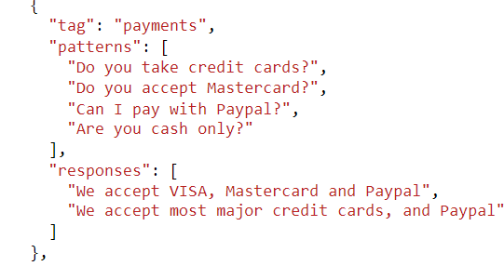
Intendation
Enables chatbot recognition of user intentions through predefined patterns.
Associates specific responses with recognized intents.

Slide 6
Data Preprocessing and Preparation
1. Tokenization
Utilized NLTK library for sentence tokenization.
2. Stemming
Applied Porter Stemmer for word stemming.
3. Bag of Words
Assigns 1 to positions corresponding to words present in the tokenized sentence

Slide 7
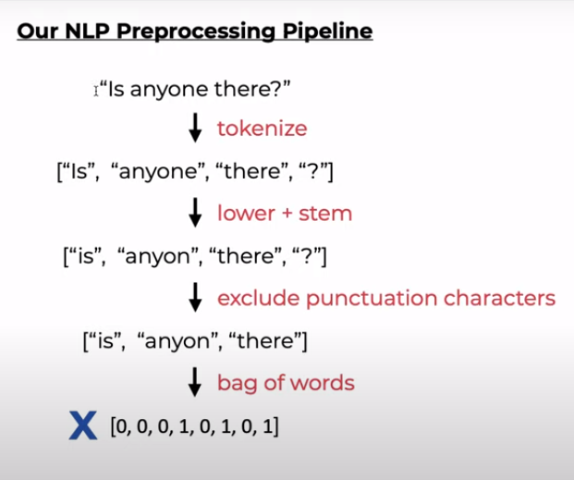

Slide 8
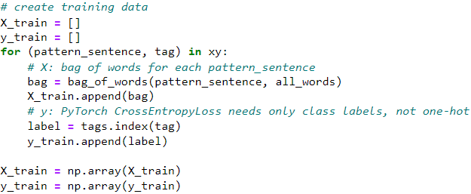
Model Training
X_train is a bag-of-words representation of pattern sentences, and y_train is the corresponding tag index.

Slide 9
Model Training
Hyperparameter Tuning: Set parameters like epochs, batch size, and learning rate for control
Train the network using cross-entropy loss and the Adam optimizer.
The goal is to minimize the cross-entropy loss, improving the model's ability to correctly classify input patterns into the appropriate intents.
The optimal model is saved and employed for the chatbot.

Slide 10

Neural Network Architecture
Three linear layers with ReLU activation
Takes bag-of-words representation as input
Produces unnormalized scores for each intent
Introduces non-linearity for learning complex patterns

Slide 11
Workflow
Take user input and tokenize it.
Use the bag-of-words representation to get a prediction from the trained model.
Check the confidence of the prediction and generate response if confidence is above threshold
Continue the chat until the user types "quit."

Slide 12
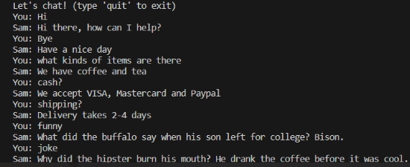
Chatting with the Bot

Slide 13

Reference
https://www.youtube.com/watch?v=k1SzvvFtl4w&list=PLqnslRFeH2UrFW4AUgn-eY37qOAWQpJyg&index=4
https://www.youtube.com/@patloeber

Slide 14
Thankyou

