Slide 1
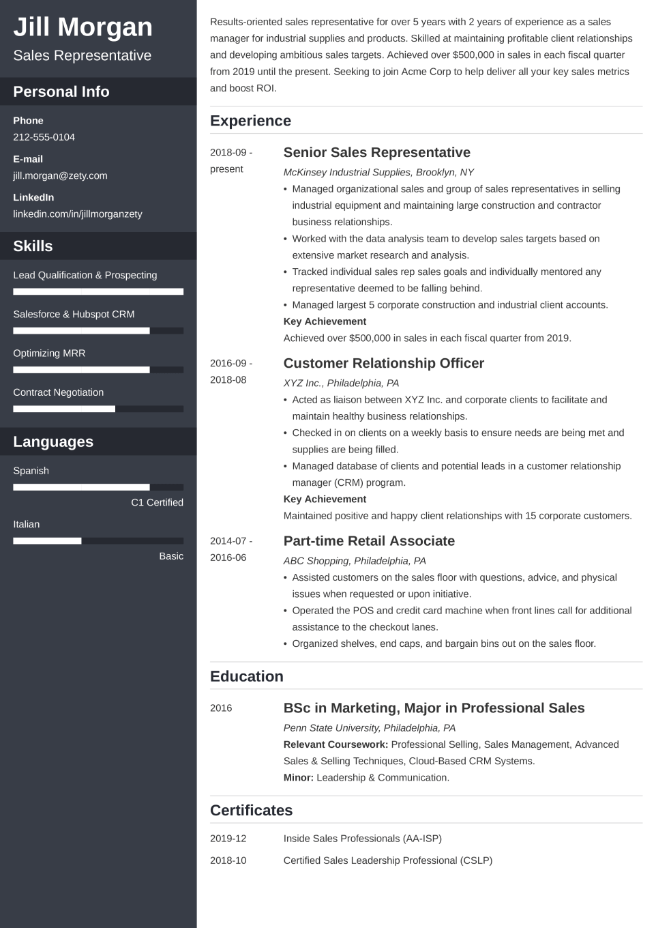
Automatic Resume Builder
PRESENTED BY : HARISHANKAR KUMAR YADAV
UNIVERSITY ROLL NO.: 191500314
GLA UNIVERSITY, MATHURA

Slide 2
CONTENTS
INTRODUCTION
MODULE AND DESCRIPTION
HARDWARE AND SOFTWARE SPECIFICATION
FRONT END
DFD
SCREEN SHOTS
CONCLUSION
FUTURE REFERANCE

Slide 3
INTRODUCTION
The "Online Resume Builder" has been developed to override the problems prevailing in the practicing manual system. This software is supported to eliminate and in some cases reduce the hardships faced by this existing system. Moreover this system is designed for the particular need of the company to carry out operations in a smooth and effective manner.
The application is reduced as much as possible to avoid errors while entering the data. It also provides error message while entering invalid data. No formal knowledge is needed for the user to use this system. Thus by this all it proves it is user-friendly. Online Resume Builder, as described above, can lead to error free, secure, reliable and fast management system. It can assist the user to concentrate on their other activities rather to concentrate on the record keeping. Thus it will help organization in better utilization of resources.

Slide 4
MODULES
Resume Management Module: Used for managing the Resume details.
Jobseeker Module: Used for managing the details of Jobseeker
Individual Module: Used for managing the details of Individual Job
Management Module: Used for managing the information and details of theJob.
Qualification Module: Used for managing the Qualification details Skill Module: Used for managing the Skill information

Slide 5
HARDWARE SPECIFICATION
RAM-2GB
HARD DISK-5GB
PROCESSER-INTEL PENTIUM 4
KEYBOARD-104 KEYS

Slide 6
SOFTWRE REQUIREMENT
MICROSOFT VISUAL CODE
CHROME BROWSER
WINDOWS 7 OR HIGHER

Slide 7
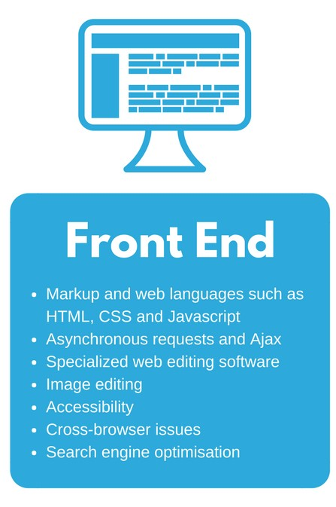
FRONT END
HTML
CSS
JAVASCRIPT

Slide 8
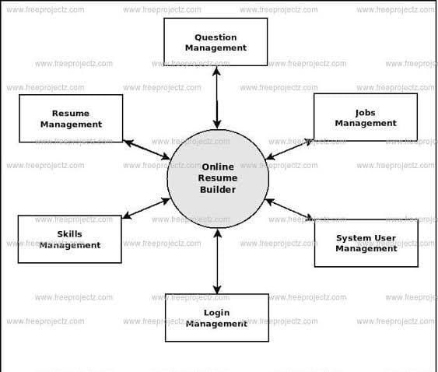
DFD
0 Level DFD

Slide 9
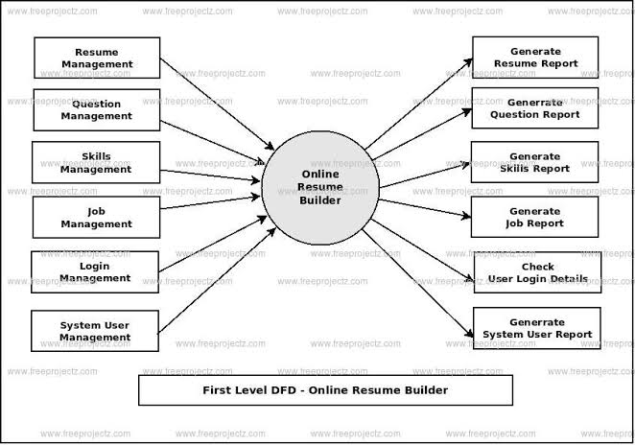
DFD

Slide 10
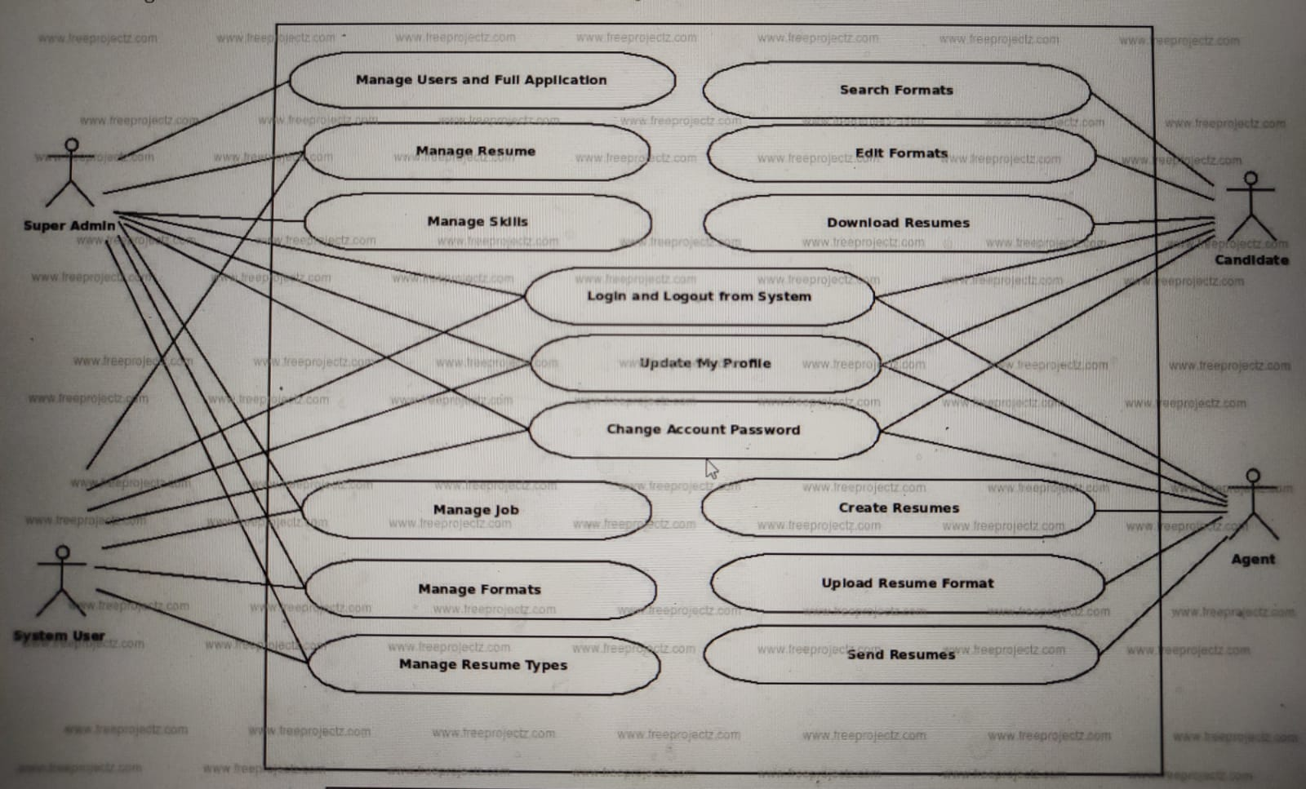
USE CASE DIAGRAM

Slide 11
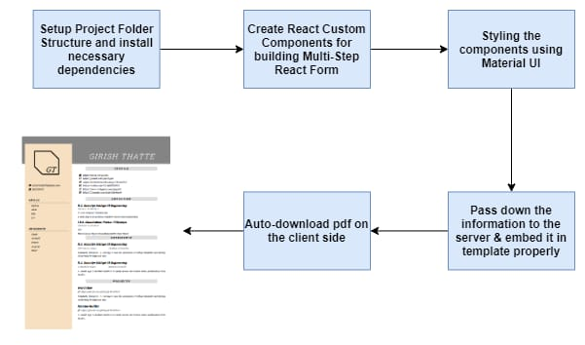
Resume Builder

Slide 12
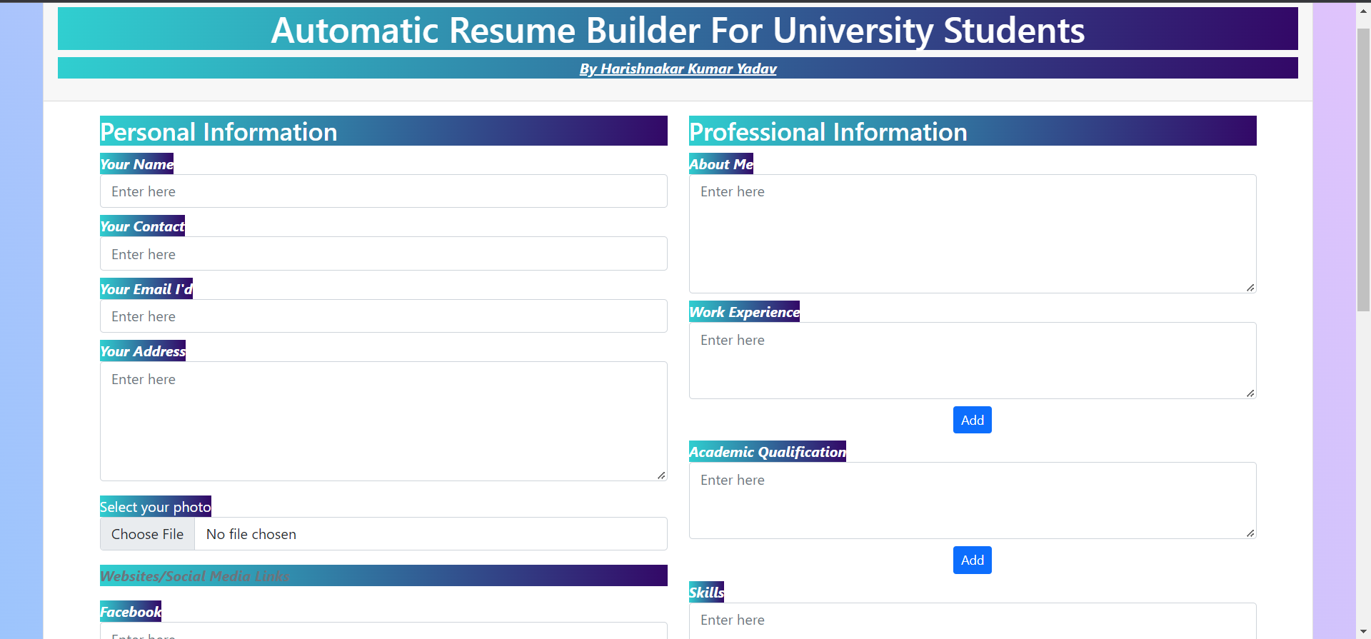
SCREEN SHOTS
FORM PAGE

Slide 13
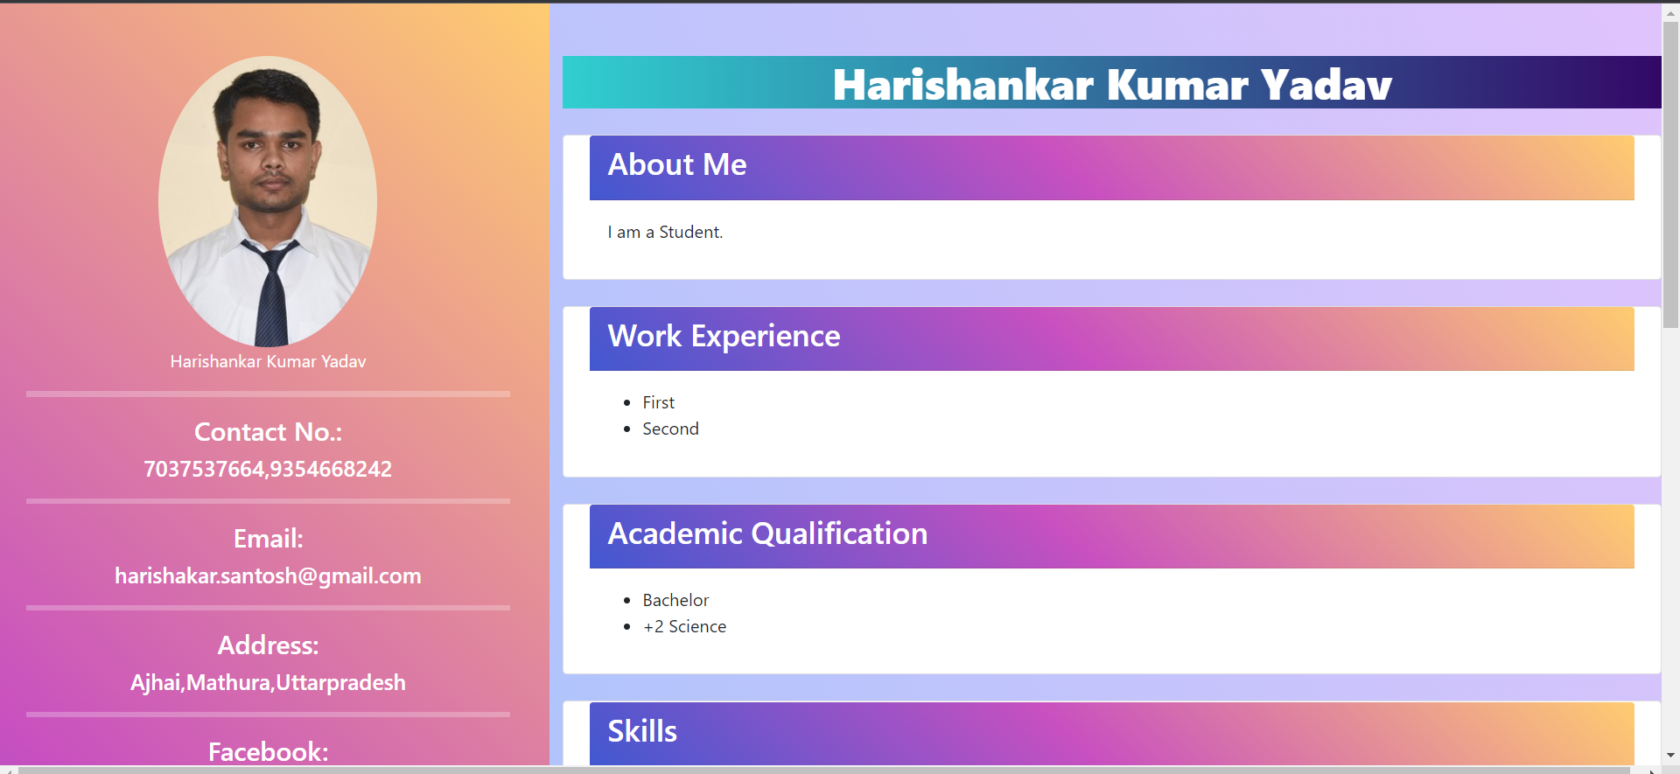
Automatic Resume Build Page

Slide 14
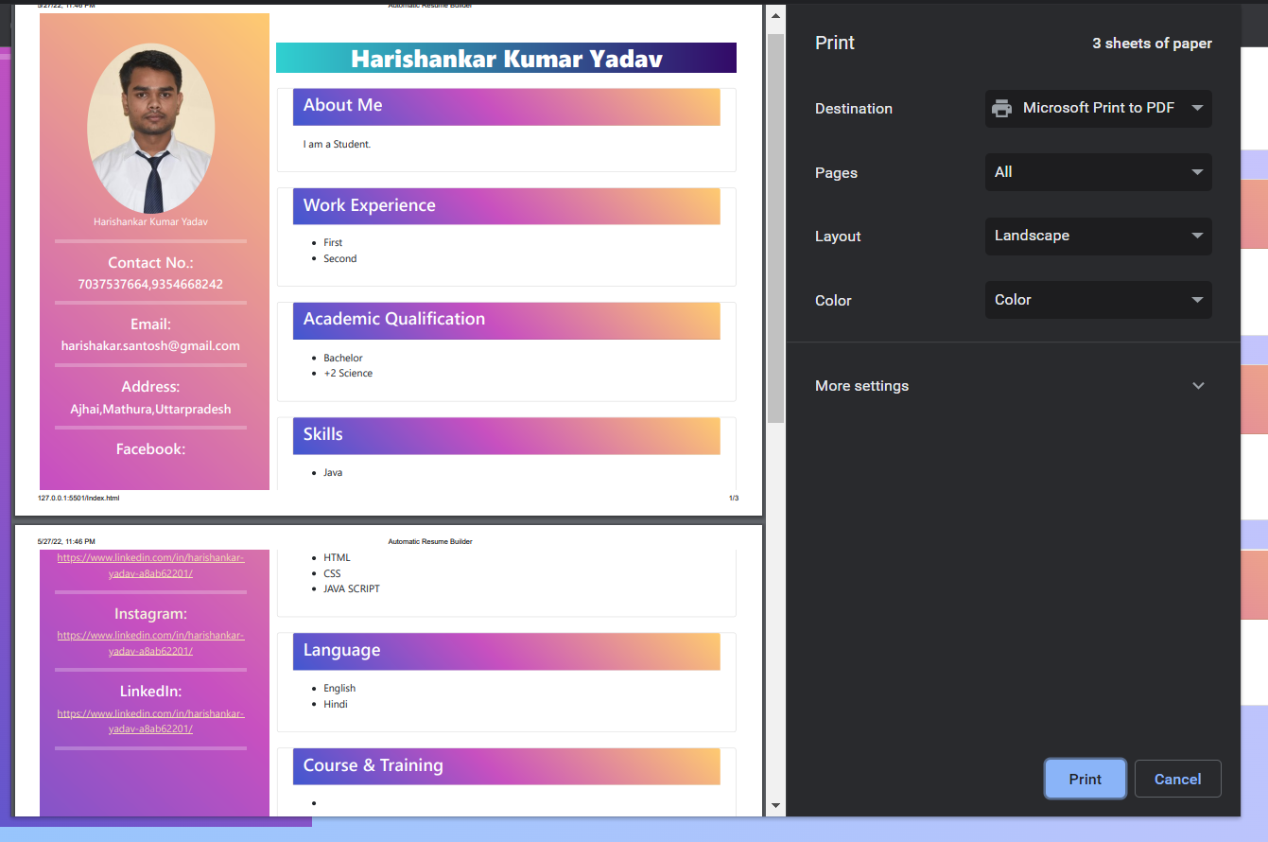
PRINT OUT PAGE

Slide 15
CONCLUSION AND SCOPE
Our project is only a humble venture to satisfy the needs to manage their project work. Several user friendly coding have also adopted. This package shall prove to be a powerful package in satisfying all the requirements of the school. The objective of software planning is to provide a frame work that enables the manger to make reasonable estimates made within a limited time frame at the beginning of the software project and should be updated regularly as the project progresses.
We can give more advance software for Online Resume Builder including morefacilitiesWe will host the platform on online servers to make it accessible worldwideIntegrate multiple load balancers to distribute the loads of the system. Create the master and slave database structure to reduce the overload of the database queriesImplement the backup mechanism for taking backup of codebase and database on regular basis on different servers

Slide 16
THANK YOU

