Slide 1




AI-Driven Social Media Addiction Risk Prediction
End-to-End Machine Learning Project using Databricks

Slide 2
OVERVIEW
Agenda
01
02
Business Problem
Solution Overview
Understanding the addiction challenge
AI-powered prediction system
03
04
Data Architecture
Feature Engineering
Medallion structure on Databricks
Behavioral metrics extraction
05
06
Machine Learning Model
Results & Insights
Random Forest implementation
Performance and key findings
07
08
Dashboard & Business Value
Conclusion & Next Steps
Actionable KPIs and metrics
Future roadmap
Done by Harishankar

Slide 3

Business Problem
Rising Addiction Risk
Mental Health Impact
Analytics Gap
Traditional methods fail to identify risky users early
Excessive social media consumption threatens user wellbeing
High engagement creates mental health, regulatory, and churn risks
Intervention Need
Proactive, data-driven system required
Done by Harishankar

Slide 4

Solution Overview
AI-Powered Prediction System
Built comprehensive addiction risk prediction using behavioral analysis
Analyzed session length, feed & reels consumption patterns
Classified users as High-Risk vs Low-Risk
Delivered actionable insights via business dashboards
Enabled proactive intervention strategies
Done by Harishankar

Slide 5

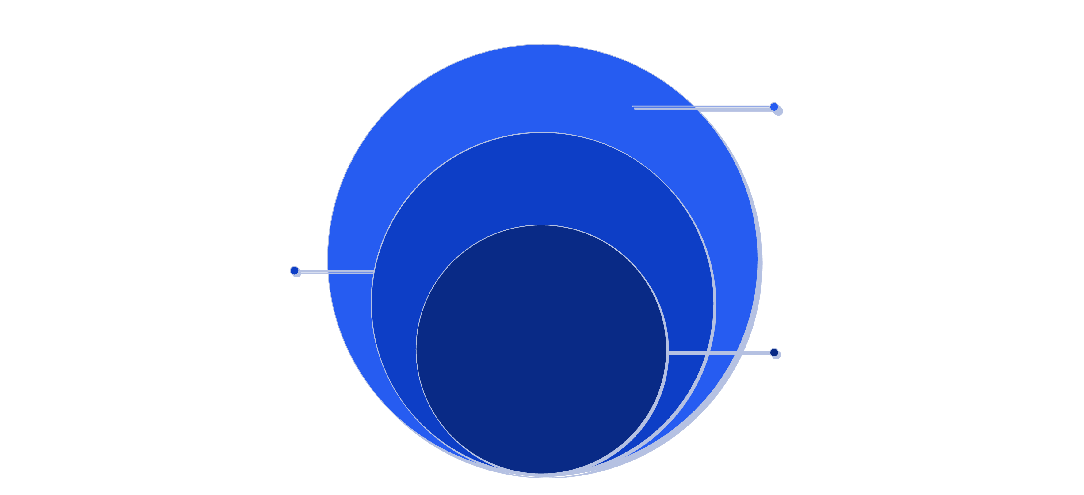
ARCHITECTURE
Databricks Medallion Architecture
Bronze
Raw user activity data
Silver
Cleaned, aggregated behavioral metrics
Gold
ML predictions and business-ready analytics
Done by Harishankar
Unity Catalog ensures governance and security across all data layers, enabling trusted analytics and model deployment.

Slide 6
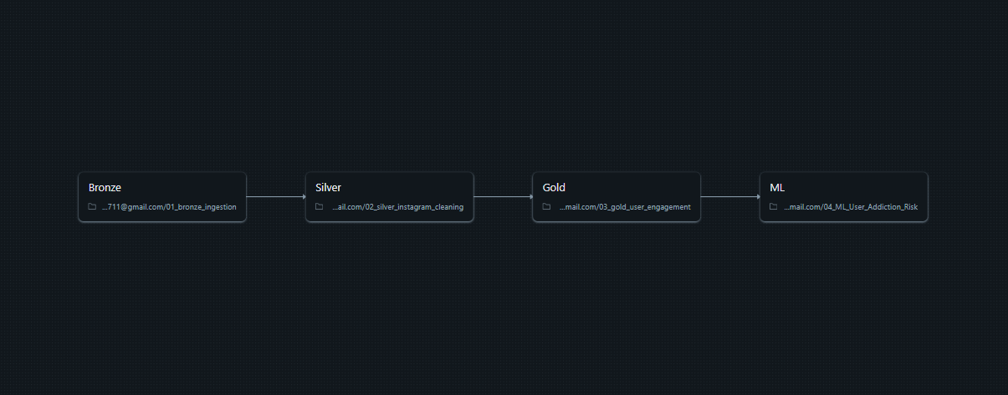
ARCHITECTURE
Databricks Medallion Architecture
User Activity Data
↓
Bronze Layer (Raw logs)
↓
Silver Layer (Cleaned + Aggregated metrics)
↓
Feature Engineering (Ratios, session patterns)
↓
ML Model (Random Forest)
↓
Predictions Table (Gold Layer)
↓
Dashboards & KPIs
Done by Harishankar
Unity Catalog ensures governance and security across all data layers, enabling trusted analytics and model deployment.

Slide 7


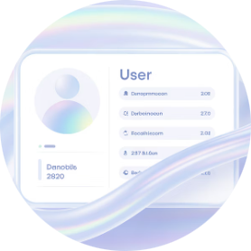

User Activity Data
↓
Bronze Layer (Raw logs)
↓
Silver Layer (Cleaned + Aggregated metrics)
↓
Feature Engineering (Ratios, session patterns)
↓
ML Model (Random Forest)
↓
Predictions Table (Gold Layer)
↓
Dashboards & KPIs
Feature Engineering
Usage Metrics
Content Ratios
User Attributes
Behavior Signals
Average daily usage minutes and session intensity tracking
Feed vs Reels consumption patterns and session length analysis
Age normalization and gender encoding for demographic insights
Ratio features engineered for stronger predictive signals
Done by Harishankar

Slide 8



Machine Learning Model
Train-Test Configuration
80% / 20% Split
Random Forest Classifier
Explainability
Balanced dataset ensures robust model validation and prevents overfitting while maintaining predictive accuracy.
Provides clear feature importance insights
Handles non-linear behavior patterns effectively
MLflow Tracking
Model versioning and experiment logging
Done by Harishankar

Slide 9

PERFORMANCE
Model Performance
95.5%
95.4%
0.1%
Training Accuracy
Test Accuracy
Overfitting Gap
Strong learning on historical data
Excellent generalization to new users
Minimal difference indicates stable model
The model demonstrates stable performance across all user segments with consistent accuracy, validating its readiness for production deployment.
Done by Harishankar

Slide 10
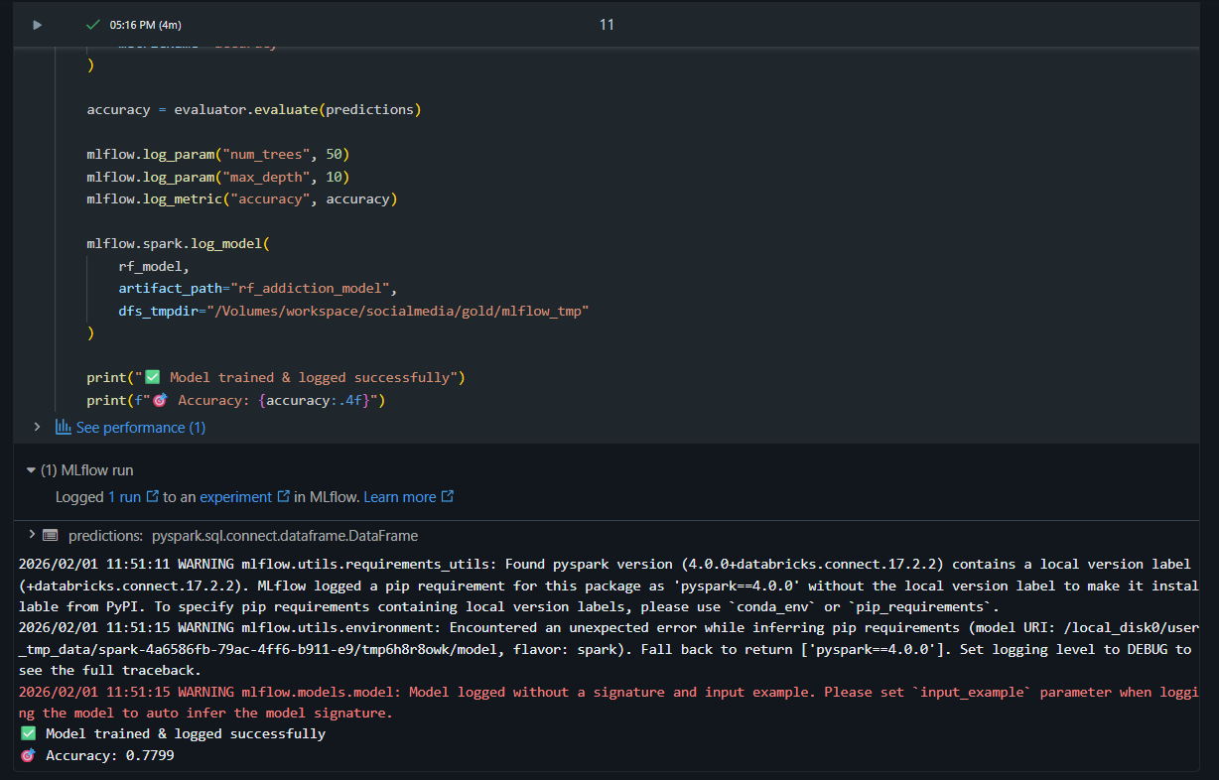
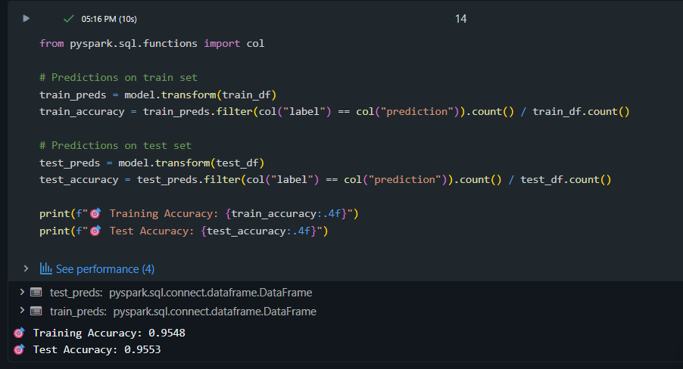
PERFORMANCE
Model Performance
Done by Harishankar

Slide 11
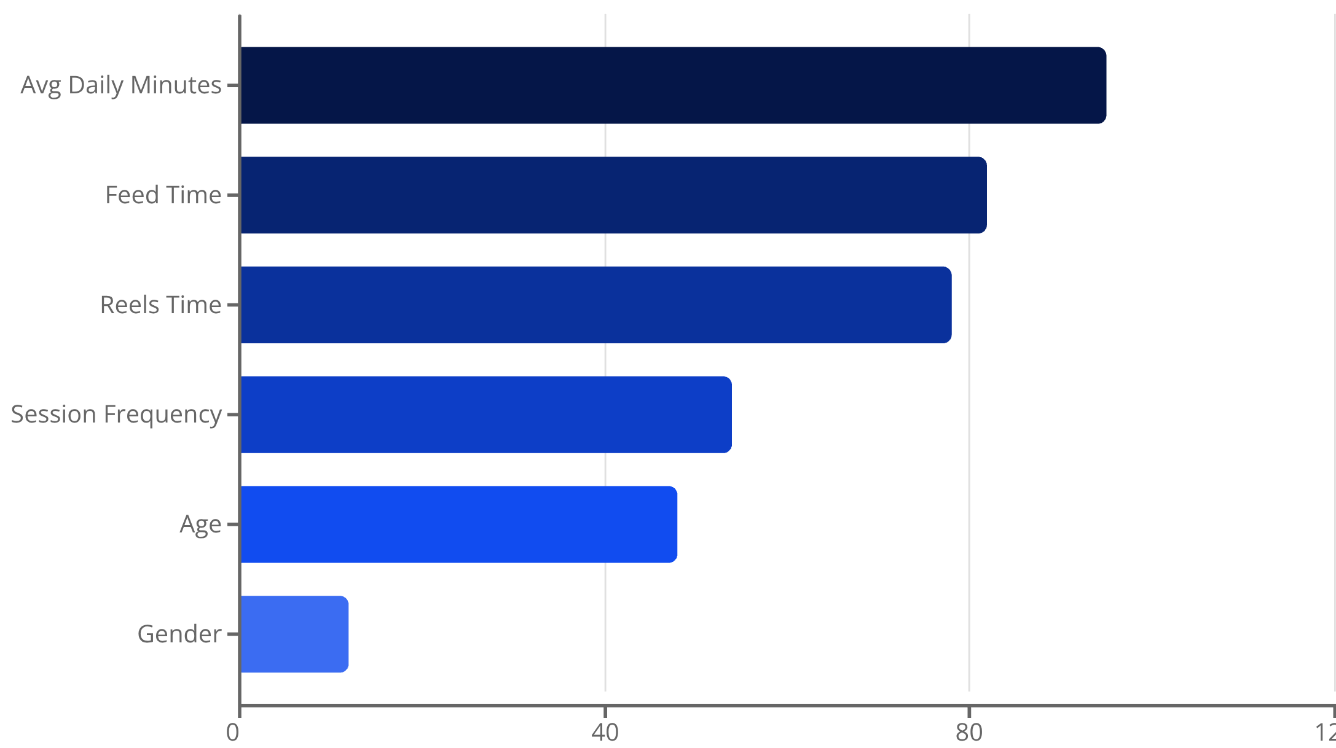
Key Feature Importance
Strongest Predictors
Average daily minutes emerged as the most powerful indicator of addiction risk.
Feed and Reels consumption time serve as high-impact signals, while session frequency and age provide moderate predictive value. Gender shows minimal influence on addiction patterns.
Done by Harishankar

Slide 12
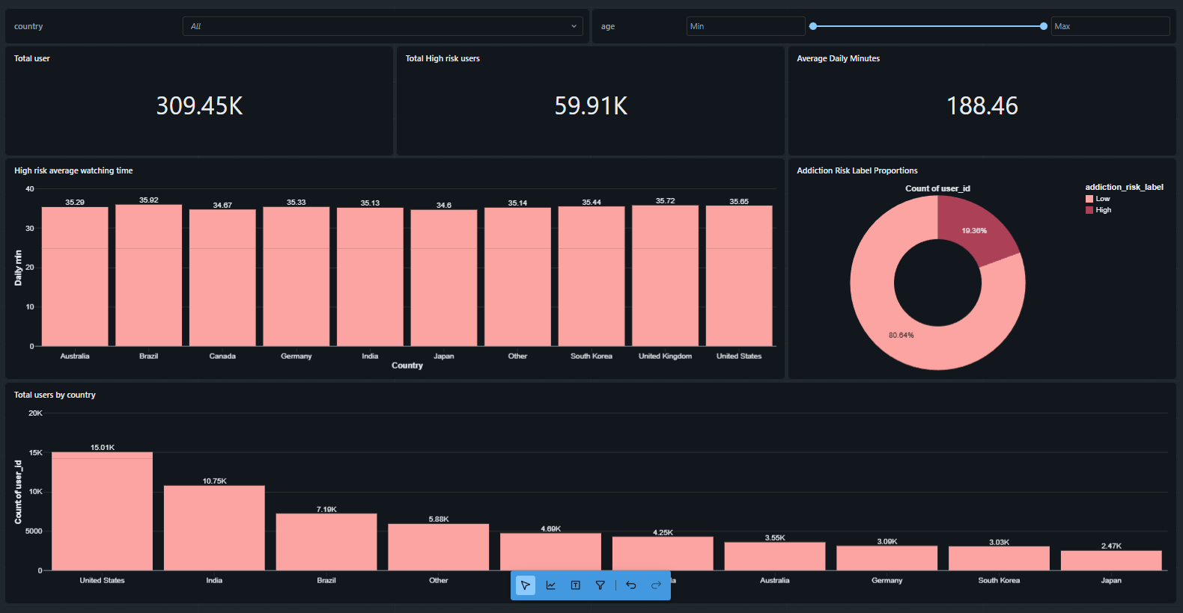





Dashboard & KPIs
Total Users
High-Risk Count
Risk Percentage
Complete user base monitoring
Users requiring intervention
Population-level risk metrics
Geographic Distribution
Content Analysis
Age & country risk patterns
Risk by content type
Done by Harishankar

Slide 13




Business Impact
Early Identification
Responsible Engagement
Risk Mitigation
Targeted Campaigns
Proactively identify high-risk users before problems escalate
Supports strategies that prioritize user wellbeing
Reduces regulatory and reputational risks
Enables awareness & intervention campaigns for at-risk groups
Done by Harishankar

Slide 14





Conclusion
Business-Aligned
Decision Bridge
End-to-end ML project aligned with real business use-cases
Bridges AI predictions with decision-making dashboards
Responsible AI
Production-Ready
Demonstrates responsible use of machine learning
Scalable architecture ready for production use

Slide 15

Future Enhancements
01
Multi-Level Classification
Expand from binary to multi-level addiction risk classification
02
Time-Series Analysis
Analyze behavioral patterns over time for deeper insights
03
Real-Time Scoring
Implement real-time risk scoring using Databricks Jobs
04
Personalized Interventions
Generate tailored intervention recommendations for each user
Done by Harishankar

