Slide 1





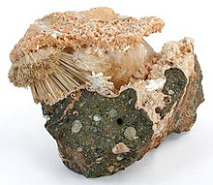

Catalysis with Zeolites and Production of Iso-Butene
Date: 01/04/2025
CL-304 : Chemical Process Technology
Presented by:
Harishankar Yadav- 220107043
Aditya Kanglekar-220107016
Sachin Tiwari-220107073

Slide 2
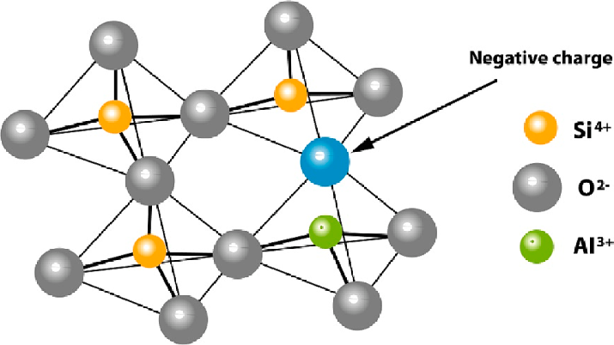

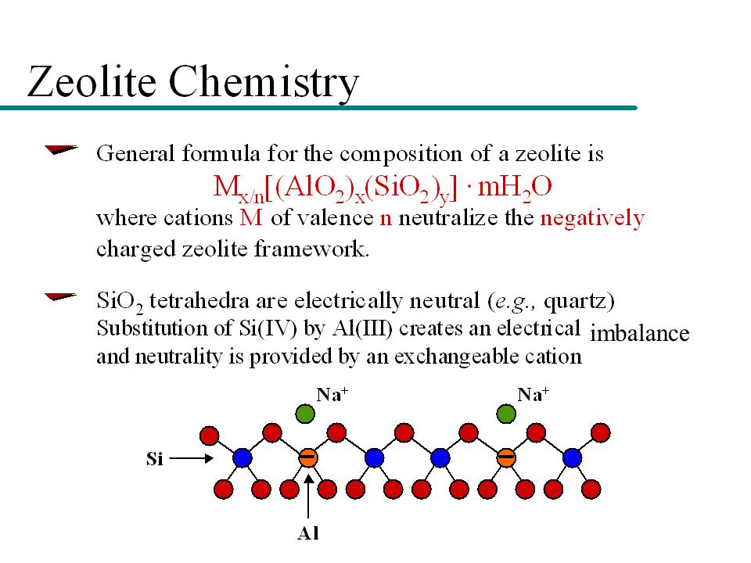
INTRODUCTION
Zeolites are crystalline, aluminosilicates characterized by their porous structure and high surface area.
They consist of a framework of silicon, aluminum, and oxygen atoms.
They have a porous structure (Allows molecules to enter and react within their cavity).
Chemical Structure -
[here, M is either a metal ion or H+]

Slide 3
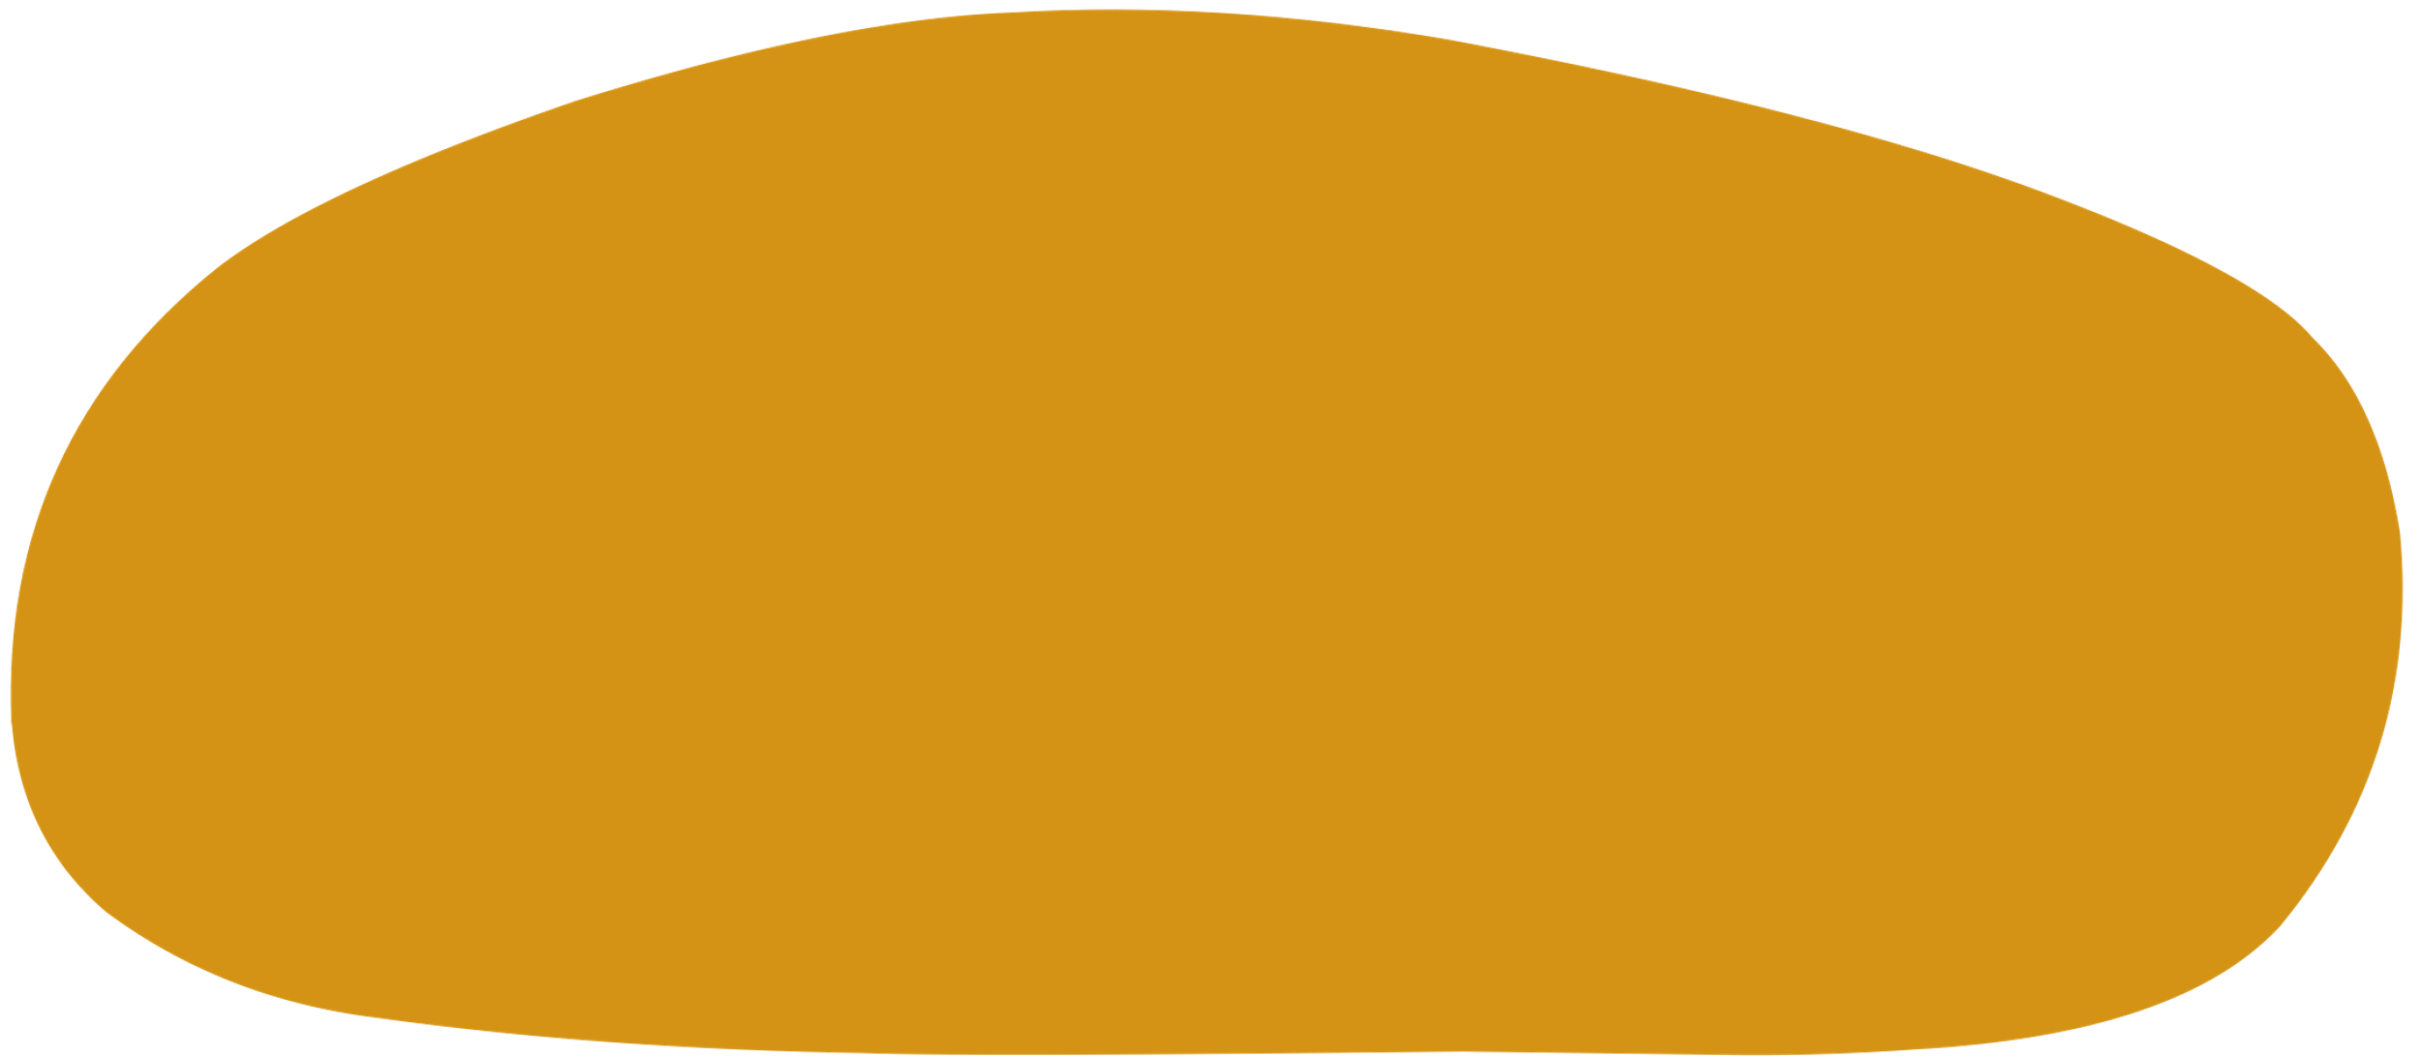
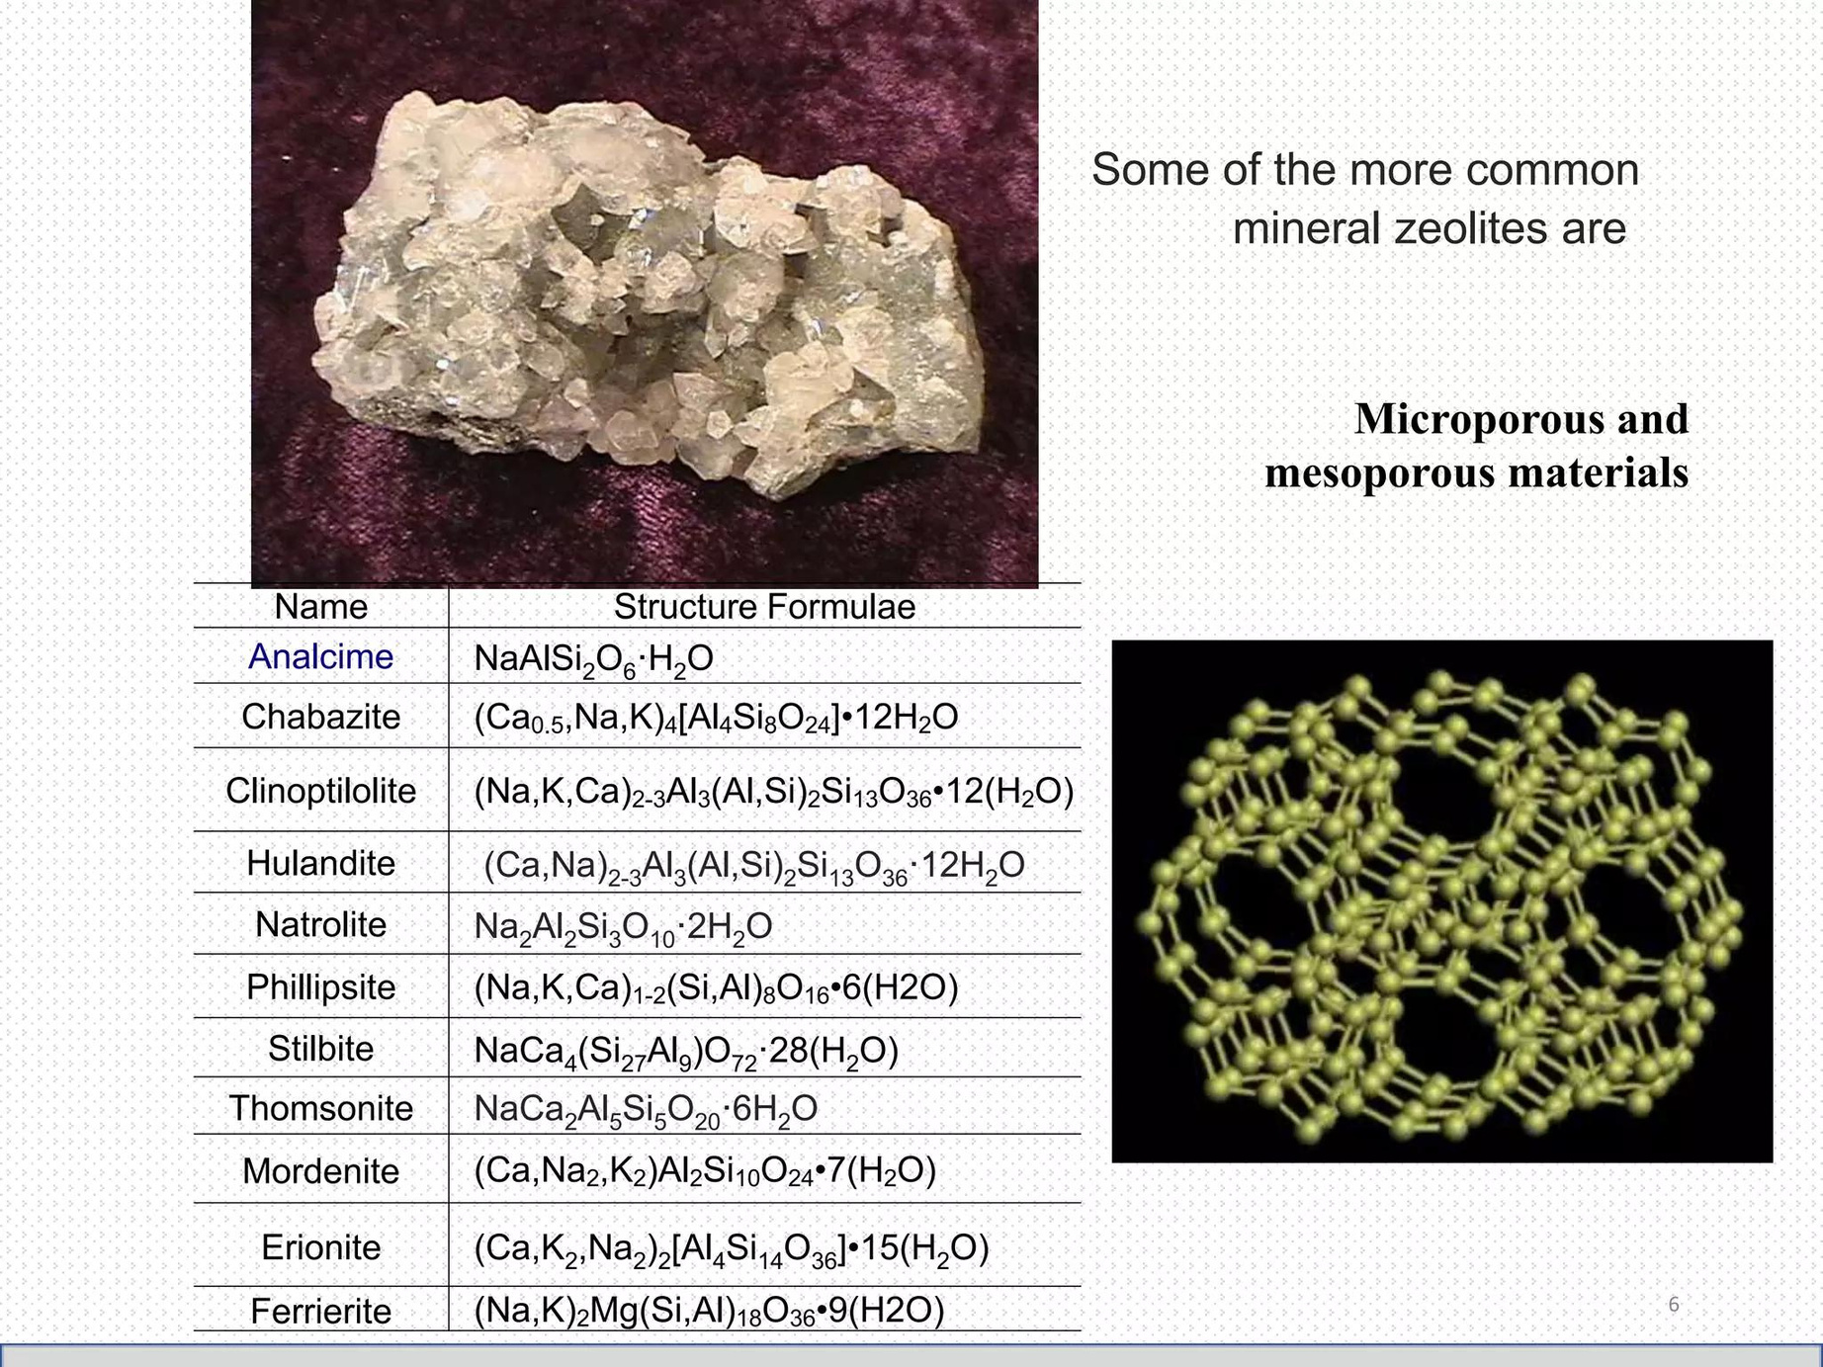
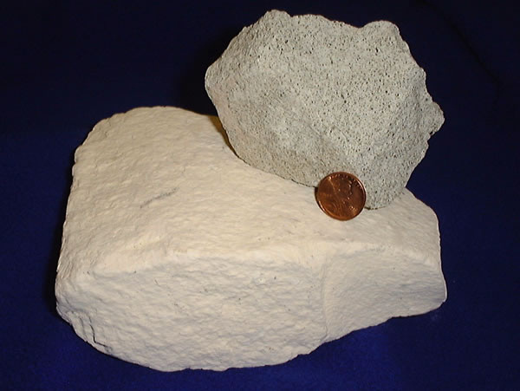


COMMON ZEOLITES
Zeolites are either formed naturally or can be synthesised or produced industrially.
There are nearly 50 different types of zeolites which are available.
some of the most common mineral zeolites are-

Slide 4
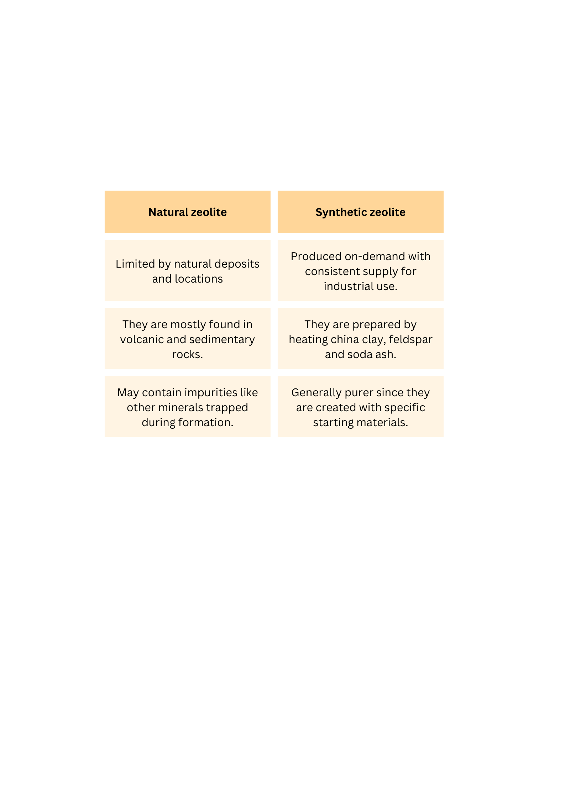

TYPES OF ZEOLITES
{ NATURAL V/S SYNTHETIC }
Zeolites are of two types :

Slide 5

CLASSIFICATION OF ZEOLITES
Based on Pore Size and Shape:
Microporous Zeolites:
Mesoporous Zeolites:
Macroporous Zeolites:
Zeolites with pore sizes less than 2 nanometers, ideal for molecular sieving applications due to their small pore size.
Zeolites featuring pore sizes ranging from 2 to 50 nanometers, suitable for adsorption and catalysis of medium-sized molecules.
Zeolites characterized by pore sizes greater than 50 nanometers, utilized in larger-scale separations and industrial processes.

Slide 6
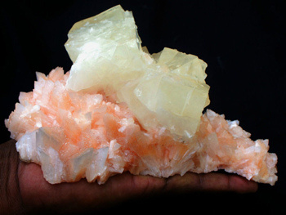
CLASSIFICATION OF ZEOLITES
Low Si/Al Ratio Zeolites:
Si/Al ratio of less than 2.
They are typically less acidic compared to their high Si/Al ratio counterparts.
Examples include Zeolite X and Zeolite L (Linnaeite).
Intermediate Si/Al Ratio Zeolites:
Based on Si/Al Ratio:
They have Si/Al ratios ranging between 2 and 10, offering moderate acidity and framework rigidity.
Zeolite A (Linde Type A) and ZSM-11 are common examples.
High Si/Al Ratio Zeolites:
Characterized by a Si/Al ratio greater than 10, typically acidic in nature.
Zeolite Y, ZSM-5, and Beta Zeolite are prominent examples

Slide 7


PROPERTIES OF ZEOLITES
porous structure
Allows molecules to enter and react within their cavity
high surface area provide ample active sites for catalytic reactions.
Selective Adsorption
Precise pore sizes allows for selective adsorption based on size and shape.
Ion-Exchange capability
Enables modification of catalytic property

Slide 8
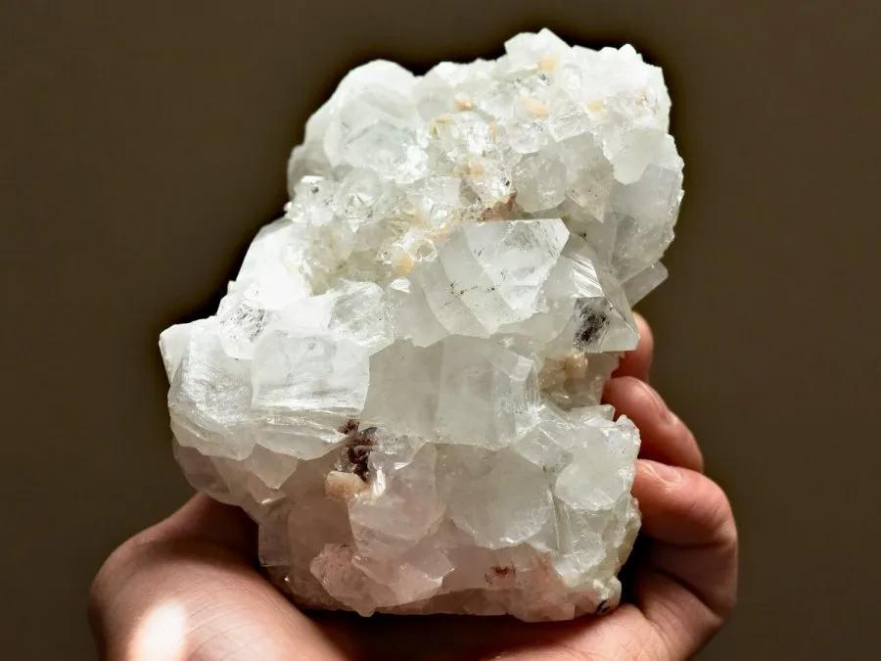



CATALYSIS WITH ZEOLITES
OVERVIEW
Shape Selectivity:
Zeolites have channels of specific sizes, allowing only certain molecules to react.
Enables precise control over product distribution in catalytic reactions.
Acidic Sites for Reactions:
Zeolites contain acid sites crucial for various chemical transformations.
These sites catalyze reactions like cracking, isomerization, and alkylation.

Slide 9
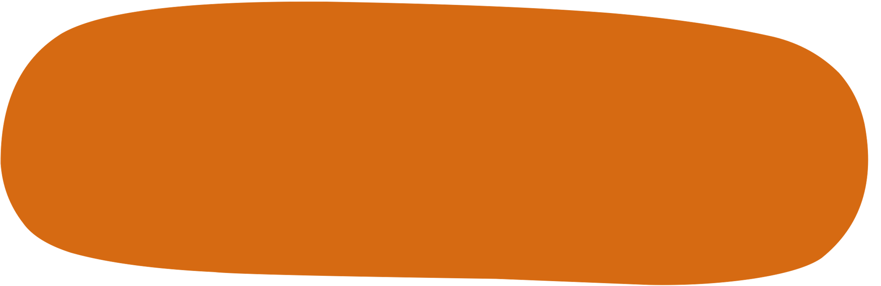
ADVANTAGES OF ZEOLITES IN CATALYSIS
High Surface Area:
Porous structure provides a large active surface area and thereby accelerate the reactions.
Specific Pore Sizes
Different zeolite structures offer pores of specific sizes and shapes , selectively admitting molecules based on size.
Thermal and Chemical Stability:
Zeolites are stable under high temperatures and harsh chemical conditions.

Slide 10
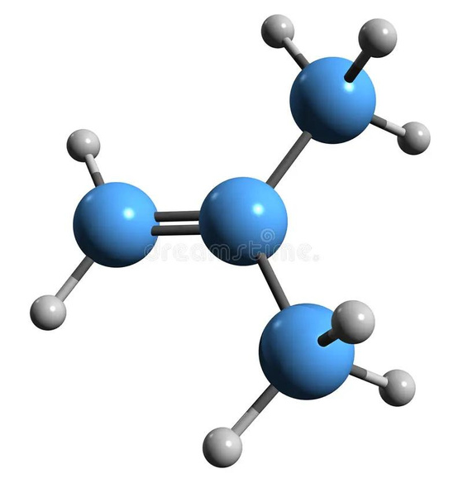

ISOBUTENE
Chemical formula: C4H8
Applications:
Butyl Rubber Production:
Primary component for manufacturing butyl rubber, used in tires and seals.
Fuel Additives:
Blended into gasoline to improve octane ratings and combustion efficiency.
Polymer Manufacturing:
Essential for creating polymers used in plastics, adhesives, and synthetic fibers.

Slide 11


CATALYTIC PROCESSES WITH ZEOLITES FOR ISO-BUTENE PRODUCTION
1.Catalytic Cracking of Butanes
Catalytic cracking of butanes is a primary method for iso-butene production.
Zeolites act as catalysts by providing active sites within their porous structure.
Long-chain hydrocarbons in butane feedstocks are broken down into smaller molecules, including iso-butene.
Shape-selective properties of zeolites ensure specific molecular sizes can access catalytic sites, favoring iso-butene formation.
Zeolite catalysts offer high activity and selectivity, minimizing undesired byproducts.

Slide 12
CATALYTIC PROCESSES WITH ZEOLITES FOR ISO-BUTENE PRODUCTION
2.Catalytic Dehydrogenation of Iso-Butane
Catalytic dehydrogenation of iso-butane is another common method for iso-butene production.
Zeolite catalysts facilitate this reaction by providing active sites for dehydrogenation.
Iso-butane molecules adsorb onto the surface of zeolite catalysts, where they undergo dehydrogenation reactions.
The acidic nature of zeolites enhances activation of iso-butane molecules, promoting hydrogen removal.
Zeolite catalysts offer high stability under reaction conditions, ensuring continuous performance.

Slide 13
CATALYTIC PROCESSES WITH ZEOLITES FOR ISO-BUTENE PRODUCTION
3.Catalytic Dehydration of Tertiary Butanol:
Zeolite catalysts facilitate the removal of water molecules from tertiary butanol.
Tertiary butanol molecules adsorb onto the surface of zeolite catalysts, where dehydration reactions occur.
The porous structure of zeolites provides an ideal environment for efficient conversion of tertiary butanol into iso-butene.
Zeolite catalysts offer advantages such as high activity and selectivity, making them preferred for this process.

Slide 14


ADVANTAGES OF ZEOLITE CATALYSTS IN ISO-BUTENE PRODUCTION
High Activity:
Zeolite catalysts exhibit high catalytic activity, accelerating conversion at low temperatures and pressures.
Porous structure provides ample active sites for efficient mass transfer and reaction kinetics.
Selectivity:
Zeolites offer excellent selectivity towards iso-butene, minimizing undesired byproducts.
Shape-selective properties ensure only appropriate molecules access catalytic sites, favoring desired pathways.
Stability:
Zeolite catalysts are thermally and chemically stable, maintaining performance under harsh conditions.
Stability ensures continuous performance and longevity in iso-butene production processes.

Slide 15

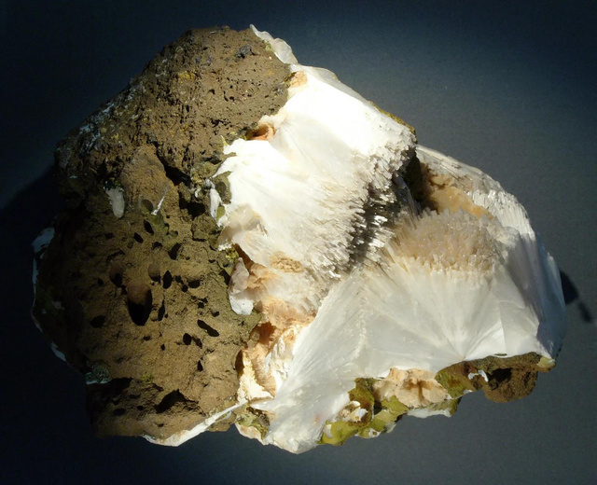
CONCLUSION
In conclusion, zeolites serve as invaluable catalysts in the production of iso-butene, offering significant advantages over traditional methods. By providing:
Improved Selectivity
Higher Activity
Higher Yields
More Stablity
The utilization of zeolites in the production of iso-butene not only enhances process efficiency but also contributes to greener and more sustainable industrial practices. This innovation exemplifies the potential of zeolites in revolutionizing petrochemical processes for a more efficient and environmentally conscious future.

Slide 16

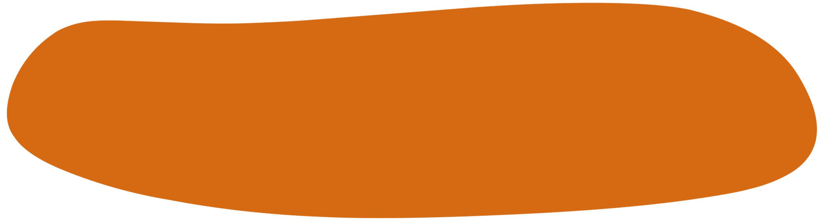

REFERENCES
https://www.researchgate.net/figure/General-classification-of-zeolites_fig1_363591305
https://comptes-rendus.academie-sciences.fr/chimie/articles/10.5802/crchim.149/#article-div
https://www.slideshare.net/hzharraz/zeolite-and-its-uses

Slide 17


