Slide 1

Design and Simulation of a Josephson Parametric Amplifier (JPA)
Internship Project Report
By: Harishankar V B
Guided by: Mr. Aashay Pandharpatte

Slide 2

Agenda
Background: Quantum Amplification & JPAs
Josephson Junction Physics & Three-Wave Mixing
Circuit Topology: SNAIL Architecture
General operating principles
Baseline Design (9.75 GHz) & Flux Tuning
Re-tuning for 7 GHz Operation
Automated Parameter Optimization
Final Results & Performance
Future Work & Applications

Slide 3
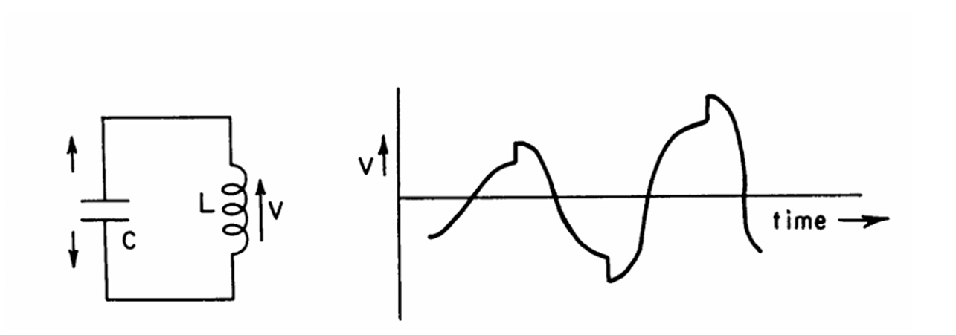
Parametric Amplification
How energy from a strong pump signal amplifies a weak input signal
A parametric amplifier uses a strong pump signal to modulate a nonlinear reactive element (like a Josephson junction), transferring energy to a weak input signal and amplifying it.
Unlike conventional amplifiers that use resistive gain (and add noise), parametric amplifiers use reactive (lossless) energy transfer, enabling near-quantum-limited noise performance.
Analogy: Like pushing a child on a swing at the right frequency — a well-timed pump transfers energy to amplify the oscillation without adding random noise.
Energy conservation: ω_pump = ω_signal + ω_idler. In our degenerate mode: 14 GHz pump → 7 GHz signal + 7 GHz idler.

Slide 4
Why Quantum Amplification?
The Challenge: Amplification of Single-Photon Signals with minimum noise
Information in these systems is carried by extremely faint microwave signals — typically at the level of a single photon (~10⁻ ²⁴ joules per cycle).
❌ Conventional Amplifiers (HEMTs):
✓ Josephson Parametric Amplifier:
Add 5–10 photons of noise.
Destroys quantum information.
Cannot preserve quantum state
Operates near quantum limit
Can exceed SQL (Phase-sensitive) and amplify a specific part of the signal.
Preserves quantum information

Slide 5
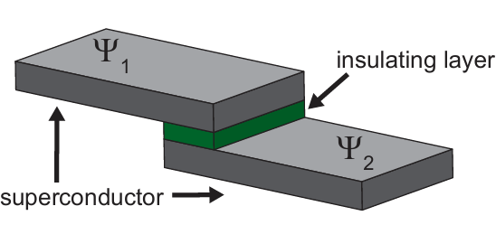
Josephson Junction & Three-Wave Mixing
What is a Josephson Junction?
What is Three-Wave Mixing?
Two superconductors separated by a thin insulating barrier (few nm thick)
Cooper pairs tunnel across the barrier without resistance
Current-Phase Relation: I = I_c × sin(φ)
Acts as a nonlinear inductor — its inductance depends on the current flowing through it
Taylor expansion of sin(φ) reveals the key φ³ nonlinearity needed for parametric amplification.
A nonlinear process where three photons interact via the φ³ term
Energy conservation: ω_pump = ω_signal + ω_idler
One pump photon splits into a signal photon + idler photon, amplifying the signal
In degenerate mode: signal = idler frequency, so 14 GHz = 7 GHz + 7 GHz
Requires broken symmetry (SNAIL) — a symmetric SQUID only has φ⁴ (four-wave mixing, less efficient)
Advantage: Only 1 pump photon needed per amplification event (vs. 2 for four-wave mixing)

Slide 6

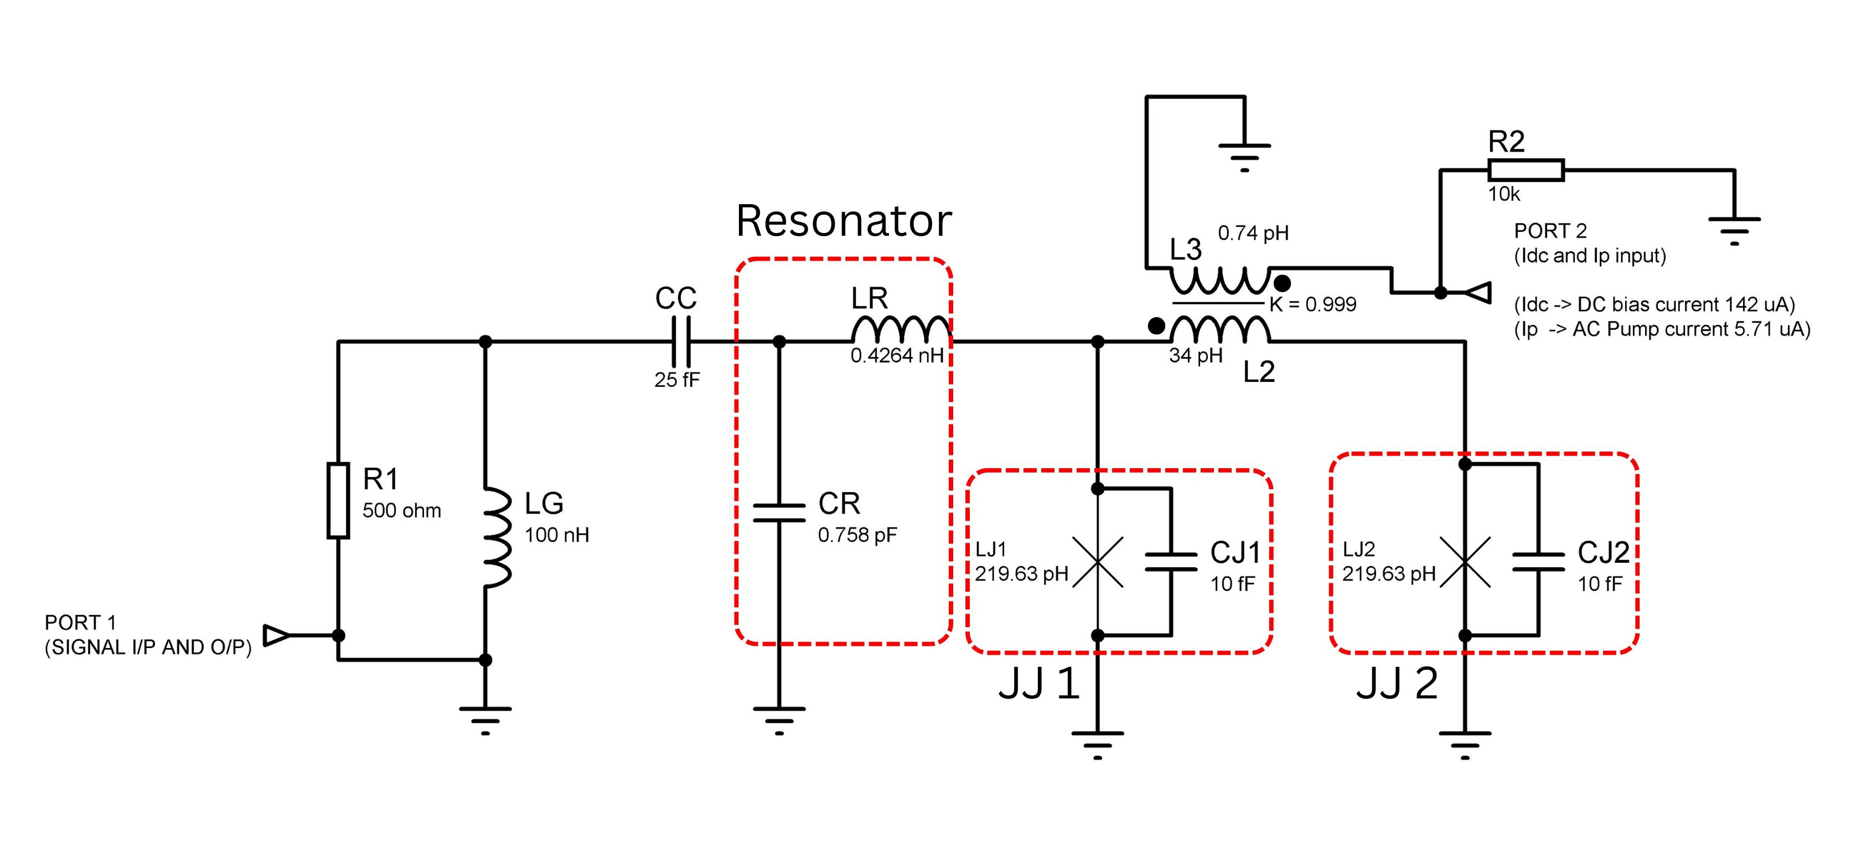
Circuit Topology: SNAIL Architecture
Signal port (P1): 50 Ω termination with DC-blocking inductor
Coupling capacitor (Cc): Controls loaded Q and bandwidth
LC Resonator (Lr, Cr): Resonates at ~7 GHz
Two Josephson junctions (Lj1, Lj2): Nonlinear φ³ source
Inter-junction inductor (L2 = 34 pH): BREAKS SYMMETRY → enables φ³
Bias coil (Ldc): Injects DC flux and pump signal via mutual coupling K ≈ 0.999
Why asymmetry matters: Symmetric SQUID only has φ⁴ (needs 2 pump photons). SNAIL has φ³ (needs only 1)!

Slide 7

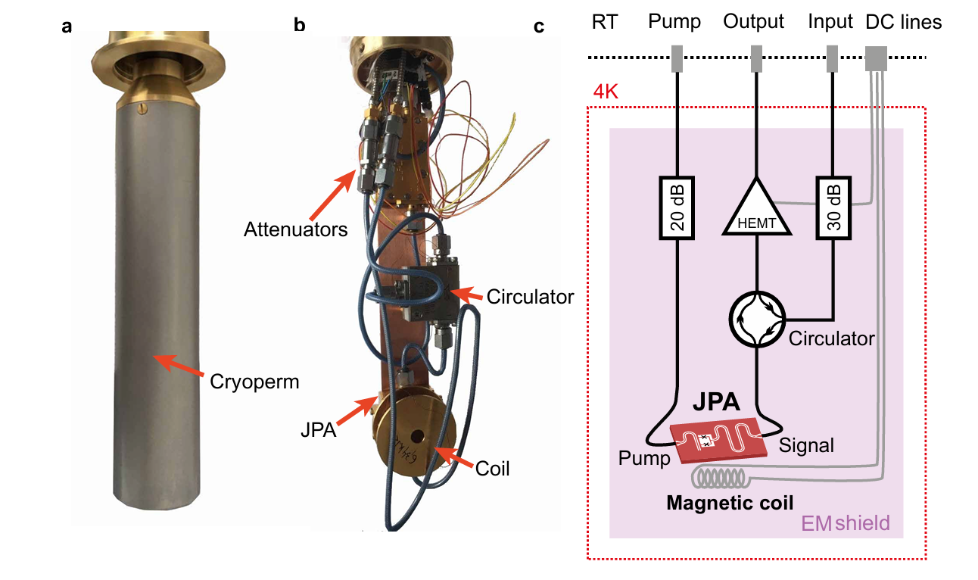
General operating principles
Josephson junctions require cryogenic temperatures (~4 K) to maintain superconductivity and minimize thermal noise
Dilution refrigerator (Cryoperm): A 1-meter tall vessel containing liquid helium-3/helium-4 mixture. The circulators pump helium through the system to absorb heat and maintain temperature
Attenuators (20 dB input, 30 dB output) reduce thermal radiation noise from warm stages (RT) before entering the 4 K stage
Circulator at 4 K: Routes signal bidirectionally without loss; placed immediately after JPA to isolate reflected signal
HEMT (High Electron Mobility Transistor): Amplifies the cryogenically cooled output signal from the JPA for further processing
EM shield: Encloses the entire 4 K stage to block external electromagnetic interference and reduce noise floor
Magnetic coil: Provides DC flux bias and RF pump current to the JPA via mutual coupling; operability depends on cryogenic cooling

Slide 8
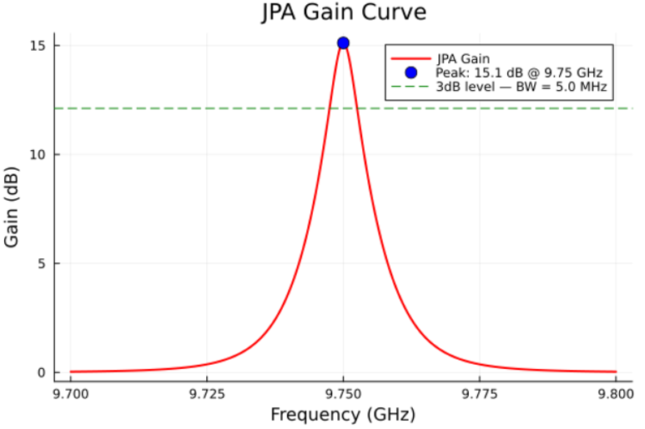
Baseline Design: 9.75 GHz
First phase: Set up simulation environment & reproduce known JPA design of peak gain at 9.75 GHz.
What Was Done:
Defined symbolic netlist in JosephsonCircuits.jl (5-node circuit)
Called hbsolve() with pump tone, DC bias, 3-wave & 4-wave mixing
Extracted S₁₁ reflection gain in dB
Verified circuit schematic in Proteus
Confirmed ~15 dB gain at 9.75 GHz with ~5 MHz bandwidth

Slide 9
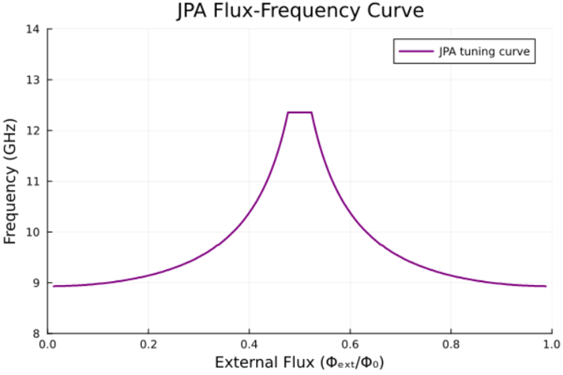
Flux Tuning Curve Characterization
Second phase: Measured how resonant frequency depends on external magnetic flux
What Was Done:
Idc swept from 5 µA to 260 µA (150 points)
Flux: Φ = M·Idc, where M ≈ 5 pH (mutual inductance)
Normalized to flux quantum: Φ/Φ₀ using Φ₀ = 2.068 × 10⁻¹⁵ Wb
Solver unreliable above 0.48 Φ₀ → mirrored right half around 0.5 Φ₀
Result: Arch-shaped curve (9 → 12 GHz) — characteristic of SNAIL
Key: This arch shape (not V-shaped) proves asymmetry is working!

Slide 10
Re-tuning for 7 GHz Operation
Third phase: Shift JPA from 9.75 GHz to 7 GHz
Key Scaling Relation:
Cr_new = Cr_old × (f_old/f_new)² = 0.4 pF × (9.75/7.0)² = 0.758 pF
Design Modifications:
Cr: 0.4 → 0.758 pF (shifts resonance down)
wp: 19.5 → 14 GHz (maintain 3-wave mixing: wp = 2×ws) (Found out by the autotune feature)
Idc: ≈142 µA (0.34 Φ₀ — preserves asymmetry)
Cc: 16 → 25 fF (widen bandwidth per Abdo et al).
Ip: 0.7 µA → 5.71 µA (Found out by the autotune feature)
Note: JPA extremely sensitive to pump frequency & current!

Slide 11

Automated Parameter Optimization
The problem: Manual tuning is impractical (extreme sensitivity to wp & Ip)
Solution: Iterative Grid Search
Search Grid: 25 pump frequencies (13.60–14.00 GHz) × 15 pump currents (5–15 µA)
Total: 375 combinations tested
For each combination:
• Run hbsolve() with coarse signal sweep (5–7.5 GHz, Δf = 5 MHz)
• Extract peak gain
• Track maximum → save optimal (wp, Ip) pair
• Catch convergence failures via try/catch (skip bifurcation zone)

Slide 12
Final Results: 7 GHz Design
Target Achieved: 7.0 GHz with practical 20 dB gain & 18 MHz bandwidth
Parameter
Value
Resonator Capacitance Cr
0.758 pF
Coupling Capacitor Cc
25 fF
DC Bias Current Idc
142.0 µA (≈ 0.34 Φ₀)
Pump Frequency wp
14.00 GHz
Pump Current Ip
5.71 µA
Peak Gain
21.3 dB
Peak Frequency
6.9989 GHz (≈ 7.0 GHz)
3 dB Bandwidth
18 MHz
Flux Tuning Range
6.2 – 8.7 GHz
✓ Matches Abdo et al. (Yale): 19.1 dB gain, 11.3 MHz bandwidth

Slide 13
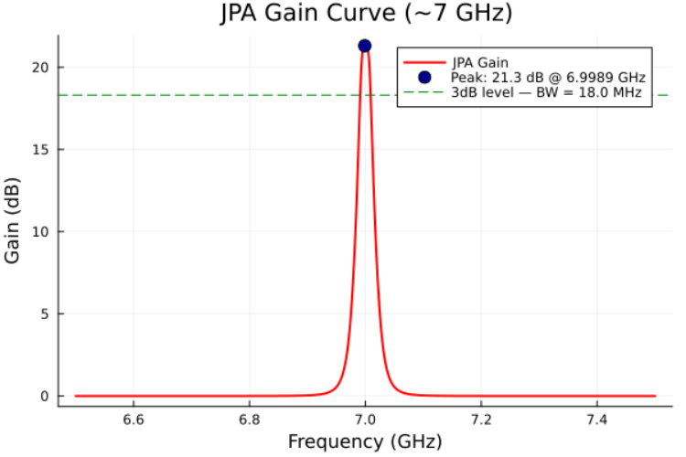
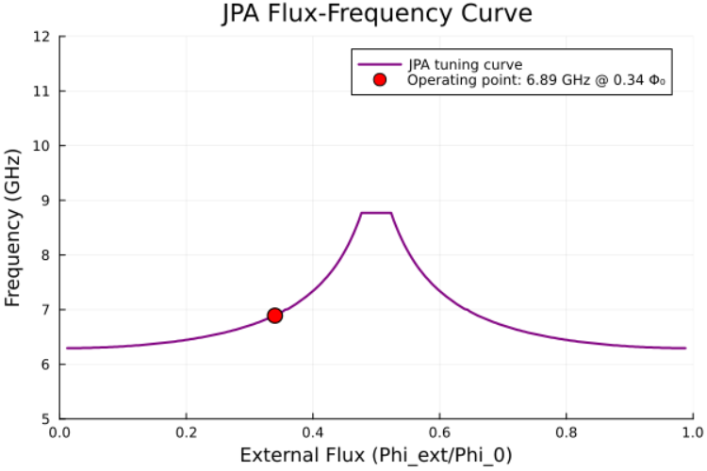
Final Results: 7 GHz Design
Gain Curve
Flux Curve

Slide 14
Simulation Tools & Environment
Julia 1.12: Scientific computing language for numerical analysis
JosephsonCircuits.jl: Harmonic-balance solver for nonlinear superconducting circuits
Plots.jl: Visualization of gain curves and tuning characteristics
VS Code with Julia extension: Development and debugging environment
Proteus: Schematic capture and circuit verification

Slide 15
Future Work: Physical Chip Layout
Translate simulation → fabrication-ready GDS design
The next phase of the project could involve translating the simulated circuit into a physical chip layout suitable for fabrication.
Tools like DeviceLayout.jl can assist in parametrically exploring layout geometries.
The final design must be validated through full-wave electromagnetic simulation and ultimately through experimental measurements.

Slide 16
Further Simulation Studies
Noise Analysis: Quantum efficiency via adjoint method → verify quantum-limited operation
Saturation Power: P₁dB characterization → determine dynamic range for qubit readout
Idler-Mode Analysis: Signal-to-idler transfer → complete parametric picture
Bifurcation Mapping: Fine sweep near critical Ip → gain–bandwidth–saturation trade-off
Performance Optimization: Parallelize with Threads.@threads (i7-13650HX: 14 cores/20 threads) → ~10× speedup

Slide 17
Applications
7 GHz JPA with ~20 dB gain & 18 MHz bandwidth:
Superconducting Qubit Readout: Near-quantum-limited amplification for dispersive readout (transmon qubits)
Quantum-Limited Measurement Chains: First amplifier stage in dilution fridge before cryogenic HEMT
Quantum Sensing: Low-noise microwave detection (axion searches, precision measurements)
Microwave Squeezing: Generate squeezed vacuum states → sub-shot-noise measurements
Quantum Networks: Microwave-to-optical conversion, entanglement distribution between distant qubits

Slide 18
Acknowledgement
I would like to thank my supervisors:
Mr. Aashay Pandharpatte & Mr. Amit Saxena
and the entire C-DAC team for their continuous guidance throughout this internship.
Key Learnings:
✓ Emphasis on practical bandwidth over peak gain (following Abdo et al.)
✓ Gain–bandwidth trade-off: B = const / √G
✓ Importance of state-of-the-art reference designs
✓ Systematic parameter optimization (avoid manual tuning)

Slide 19
Key Takeaways
✓ Successful 7 GHz JPA Design: 21.3 dB gain, 18 MHz bandwidth
✓ Automated parameter search (375 combinations) replaced manual tuning
✓ SNAIL architecture enables efficient 3-wave mixing via φ³ nonlinearity
✓ Validated against Abdo et al. (Yale, 2011) state-of-the-art reference
✓ Code & simulation data publicly available on GitHub

Slide 20
References
Research Papers
Abdo et al., IEEE Trans. Appl. Supercond. (2011)
The IEEE state-of-the-art review of JPAs (2020)
Development of a Josephson Parametric Amplifier for the Preparation and Detection of Nonclassical States of Microwave Fields by Manuel Angel Castellanos Beltran (2002)
Fortgeschrittenenpraktikum: The Josephson Parametric Amplifier by Philipp Kr¨uger and Kirill G. Fedorov (2021)
A Study of Parametric Amplification by Matthew James Quinn Jr.(1961)
Superconducting Parametric Amplifier Design by Kyle Woodworth, Chandrashekhar Gaikwad, Davide Braga, Kater Murch, Farah Fahim (2024)
Simulation Software
JosephsonCircuits.jl (Version 0.5.1)
O’Brien, K. P., & Contributors. (2024). Computer software.
GitHub: github.com/kpobrien/JosephsonCircuits.jl

Slide 21
Thank You
Questions & Discussion

