Slide 1
RADIO LAYER
By- Guthula Harish Aryan

Slide 2
Radio Layer
The Radio Layer is the lowest defined layer of Bluetooth specification.
It defines air interface, frequency bands, frequency hopping specifications, and modulation techniques.

Slide 3
FREQUENCY
Bluetooth operates in the 2.4 GHz unlicensed ISM band.
It uses 79 channels, each of 1 MHz bandwidth.
The frequency range is from 2400 MHz to 2483.5 MHz.

Slide 4
GUARD BAND
Guard bands prevent interference with nearby technologies like Wi-Fi and microwave ovens.
At 2.400 MHz - 2.402 MHz and 2.480 MHz – 2.483.5 MHz
Total of 5.5Mhz of guard band has been used in Bluetooth.

Slide 5
FHSS and AFH
Bluetooth uses FHSS and AFH to avoid interference in the ISM band.
1600 hops per second are used, with a time slot of 625 µs per channel.
AFH dynamically skips channels affected by other RF signals.

Slide 6
Antenna Height and Wavelength
The height of antenna is typically a fraction of wavelength of signal, it is designed to transmit or receive.
Wavelength for Bluetooth is:
λ= c/ f
λ= (3*10^8)/(2.4*10^9)
λ= 12.5cm
If the device uses the quarter wave antenna, then the height of antenna is 3.125cm. If it uses the halfwave antenna, then the height of antenna is 6.25cm.

Slide 7
MODULATIONS USED
GFSK
π/4-QPSK
8DPSK

Slide 8
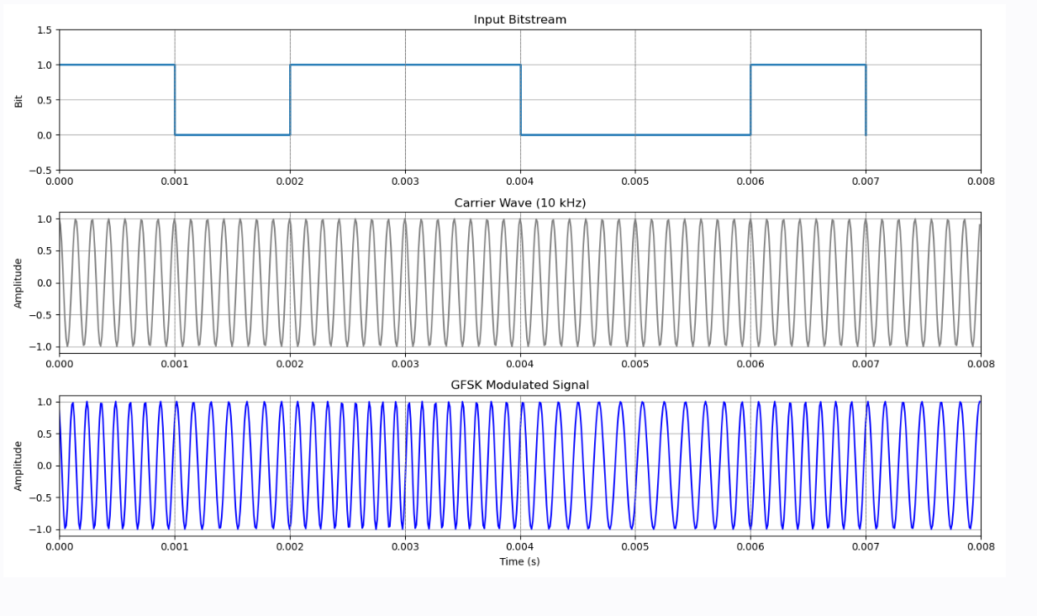
GFSK
During access code and packet header transmission the Basic Rate GFSK modulation mode shall be used.
1
1
1
1
0
0
0
0

Slide 9
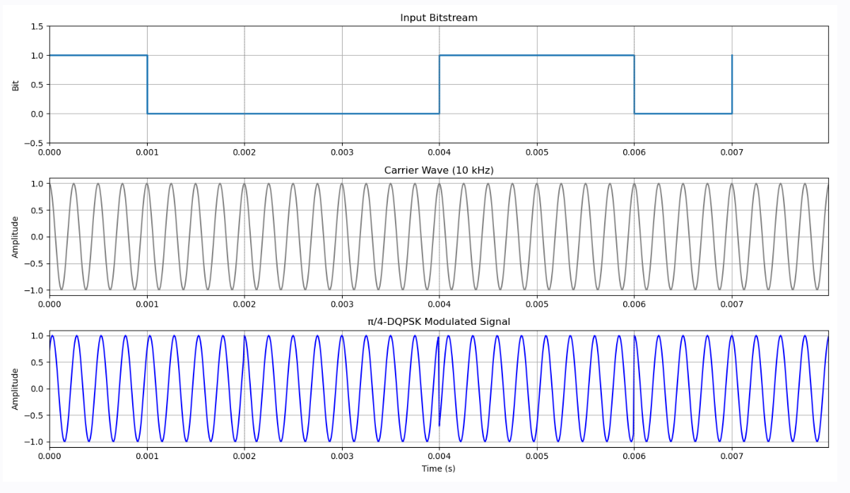
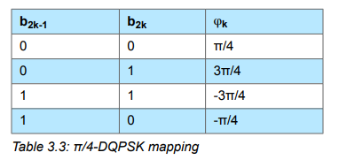
π/4-DQPSK
The PSK modulation format defined for the 2 Mb/s transmission shall be π/4 rotated differential encoded quaternary phase shift keying (π/4-DQPSK).
1
1
1
0
0
0
0

Slide 10
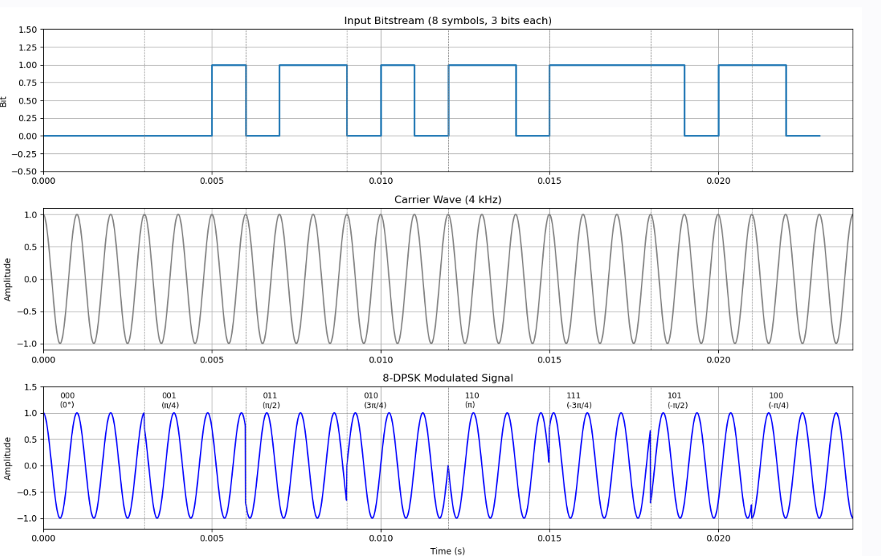
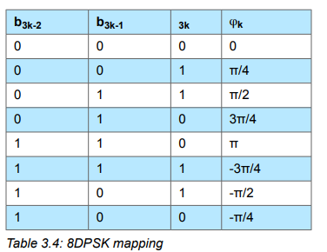
8DPSK
The PSK modulation format defined for the 3 Mb/s transmission shall be differential encoded 8-ary phase shift keying (8DPSK).

Slide 11
SLOTS
🔹 1-Slot
Duration: 68–426 µs
Supports: GFSK, π/4-DQPSK (≤248 symbols), 8DPSK (≤246 symbols)
🔹 3-Slot
Duration: 68–1686 µs
EDR payload: up to 1500 symbols
🔹 5-Slot
Duration: 68–2916 µs
EDR payload: up to 2748 symbols

Slide 12
Thank You

