Slide 1
A Micro Controllers and Embedded Systems Project
PROJECT NAME : INTELLIGENT LIGHT SYSTEM

Slide 2
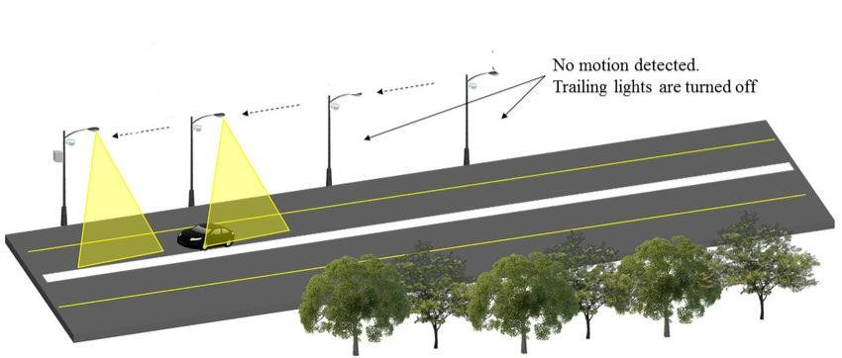
INTRODUCTION:
Intelligent street lighting systems have gained popularity in recent years due to their energy-saving and cost-effective capabilities. These systems use sensors and other smart technologies to automatically adjust lighting levels based on factors such as traffic density, time of day, and weather conditions. The integration of microcontrollers, such as the 8051, has further enhanced the capabilities of intelligent street lighting systems by allowing for greater control and flexibility in programming.

Slide 3
Aim of the project:
The aim of implementing an intelligent street lighting system with 8051 microcontroller is to provide an efficient and cost-effective solution for urban lighting. This system uses sensors and smart technologies to automatically switch on and off lighting based on various factors such as traffic density, time of day, and weather conditions.

Slide 4
Software required:
Keil μ Vision-5:
The µVision IDE combines project management, run-time environment, build facilities, source code editing, and program debugging in a single powerful environment. µVision is easy-to-use and accelerates your embedded software development. µVision supports multiple screens and allows you to create individual window layouts anywhere on the visual surface
Proteus software:
The proteus design suite combines each of use with a powerful feature set to enable the rapid, design, test and layout of professional printed circuit board.

Slide 5
Overview of 8051 Micro Controller:
The 8051 microcontroller is a popular 8-bit microcontroller architecture developed by Intel in the 1980s. It has since become a widely used architecture in embedded systems and has been adopted by many other manufacturers, such as Atmel, Philips, and Texas Instruments. The 8051 microcontroller has a simple and compact design, making it suitable for low-power, high-speed applications with limited memory and I/O requirements.
4K bytes internal ROM.
128 bytes internal RAM.
Four 8-bit I/O ports (PO - P3).
Two 16-bit timers/counters.
One serial interface.
64k external memory for code.
64k external memory for data Microcontroller.
210 bit addressable

Slide 6
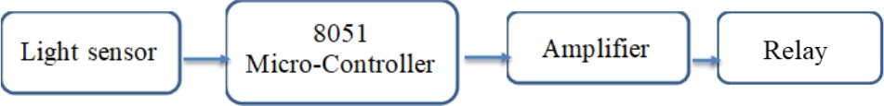
Block Diagram:

Slide 7
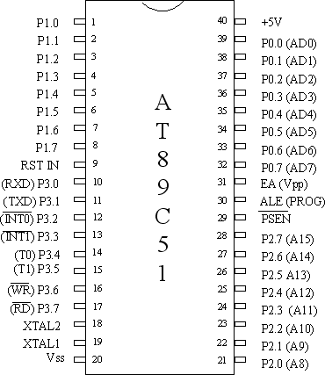
Ports Representation Port 0 - external memory access low address byte/data. Port 1 - general purpose I/O. Port 2 - external memory access high address byte. Pins 0, 1 for timer/counter 2. Port 3 - Special features. 0 - RxD: Serial input 1 - TxD: Serial output 2 - INTO: External interrupt 3- INT1: External interrupt 4 - TO: Timer/counter 0 external input 5 - T1: Timer/counter 1 external input 6 - WR: External data memory write strobe 7- RD: External data memory read strob
PIN DIAGRAM:

Slide 8
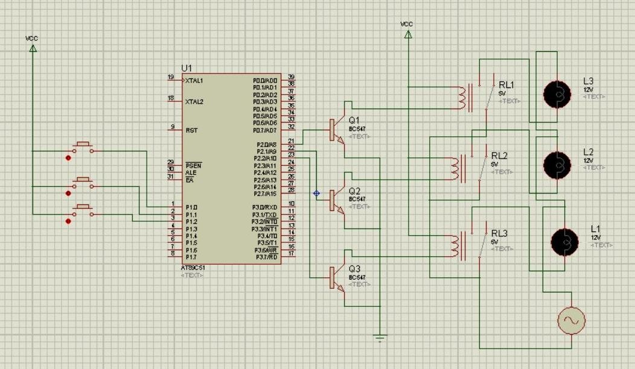
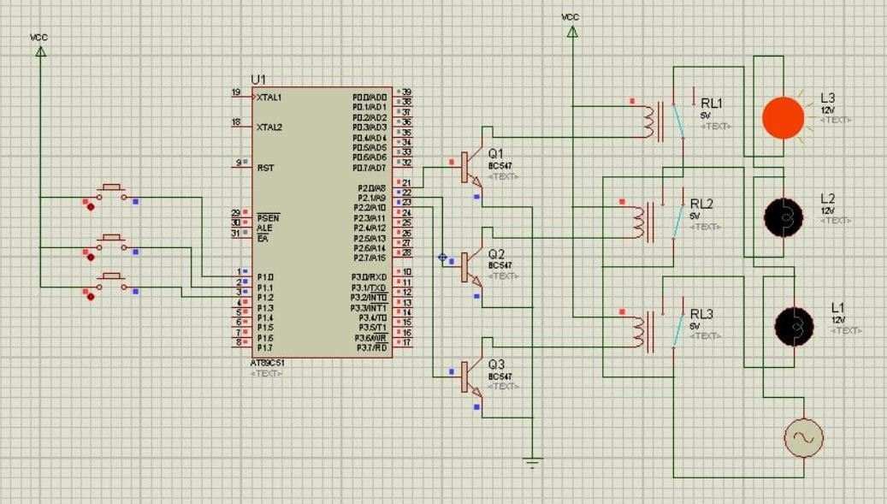
CIRCUTI REPRESENTATION:
Fig. a. Circuit in Its ideal State
Fig. b. Circuit in Its Operating State

Slide 9
Working Principle:
This proposed system provides a solution for energy saving.
This is achieved by sensing an approaching vehicle and then switching ON a block of streetlights ahead of the vehicle.
As the vehicle passes by, the trailing lights switch OFF automatically. Thus, we save a lot of energy.
However, there is another mode of operation where instead of switching OFF the lights completely, they remain ON with 10% of the maximum intensity. Streetlight That Glows on Detecting Vehicle Movement.

Slide 10
SOURCE CODE:
#include<stdio.h>
#include<reg52.h>
sbit sensor1=P1^0;
sbit sensor2=P1^1;
sbit sensor3=P1^2;
sbit load1=P2^0;
sbit load2=P2^1;
sbit load3=P2^2;
void main(){
\load1=load2=load3=0;
sensor1=sensor2=sensor3=0;
while(1){
if (sensor1==1){ load1=1;load2=0;load3=0;
}
if (sensor2==1){ load1=0;load2=1;load3=0;
}
if (sensor3==1){ load1=0;load2=0;load3=1;
}
}
}

Slide 11
Applications:
Parking Lightings.
Streetlights.
Garden Lights.
Highways.
At the Industries.
Parking lots at malls and open places.

Slide 12
Conclusion:
This project of ‘‘AUTOMATIC STRRET ALERTING SYSTEM’’ is a cost effective, practical, eco-friendly and the safest way to save energy. It clearly tackles the two problems that world is facing today, saving of energy and also disposal of incandescent lamps, very efficiently

Slide 13
Bibilography
https://rcciit.org/students_projects/projects/ece/2018/GR14.pdf
file:///C:/Users/dachu/Downloads/project%20work.pdf
Vishalsoni India ‘Smart Street Light Using IR Sensor with Arduino’, 2018. [Online]. Available:https://www.instructables.com/id/Smart-Street-Light-Using-Ir-Sensor- With Arduino/ [Accessed: 16- May- 2019].
Available:https://www.google.com/search?q=wastage+of+energy+street+lights&rlz=1C1 CHBD_enIN777IN777&source=lnms&tbm=isch&sa=X&ved=0ahUKEwjZ0tmo153iAhXp7nMBHZS7BlUQ_AUIDigB&biw=1920&bih=969#imgrc=go9kkfP6nJ6IeM:
D. A. Devi and A. Kumar, Design and Implementation of CPLD based Solar Power Saving System for Street Lights and Automatic Traffic Controller, International Journal of Scientific and Research Publications, Vol. 2, Issue11, November 2012.
K. S. Sudhakar, A. A. Anil, K. C. Ashok and S. S. Bhaskar, Automatic Street Light Control System, International Journal of Emerging Technology and Advanced Engineering, Vol. 3, May 2013.

Slide 14
Thank you

