Slide 2
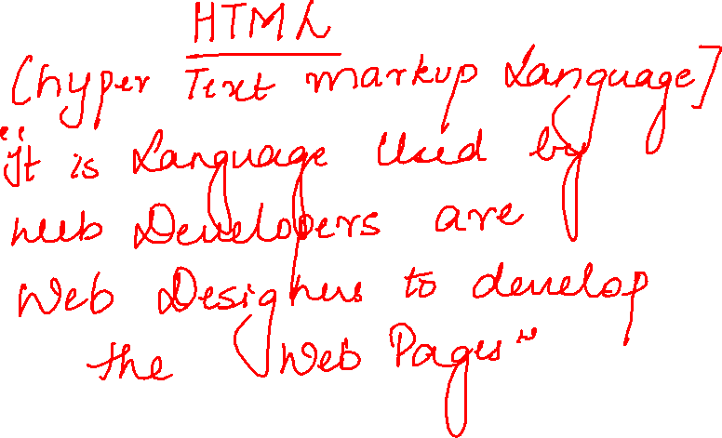

Slide 3
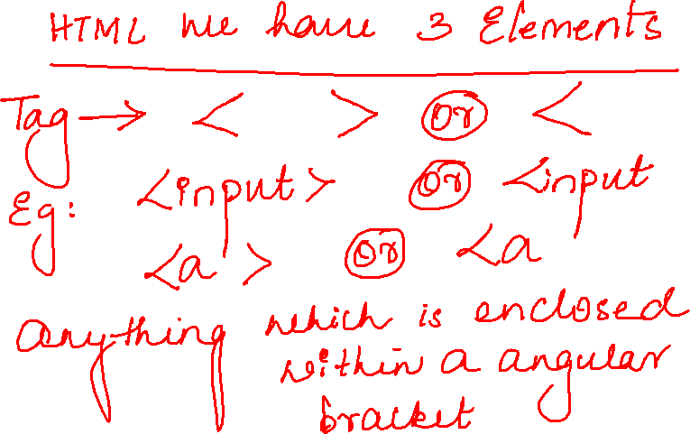

Slide 4
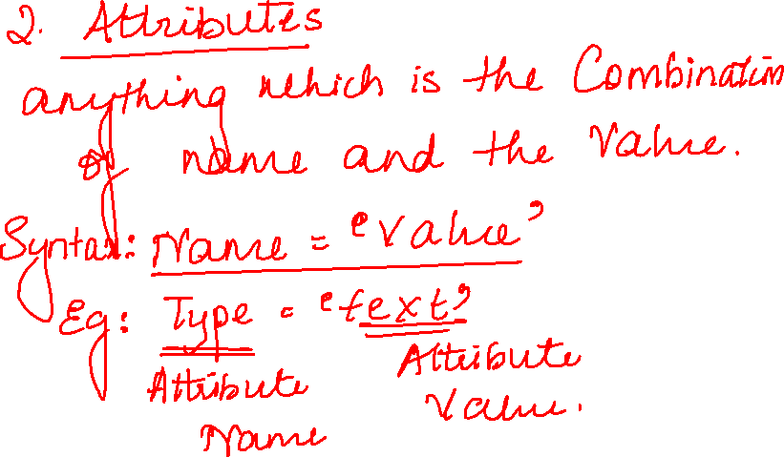

Slide 5
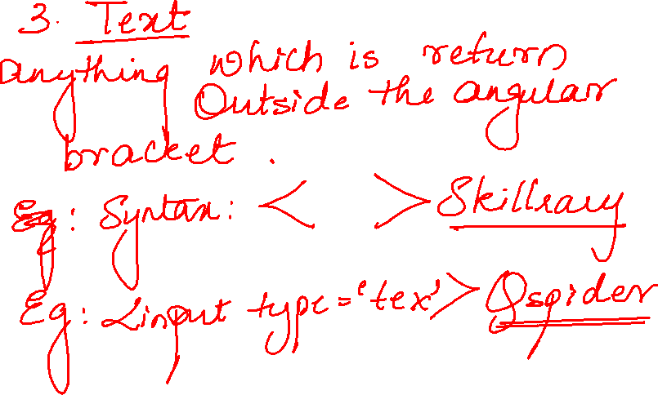

Slide 6
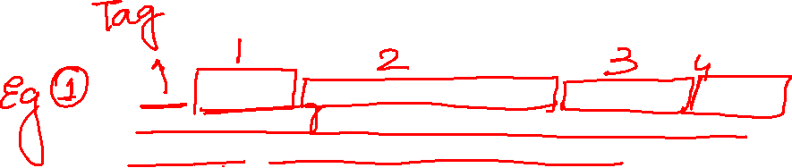
<input type="text" class="inputtext _55r1 _6luy" name="email" id="email" data-testid="royal_email" placeholder="Email address or phone number" autofocus="1" aria-label="Email address or phone number">

Slide 7
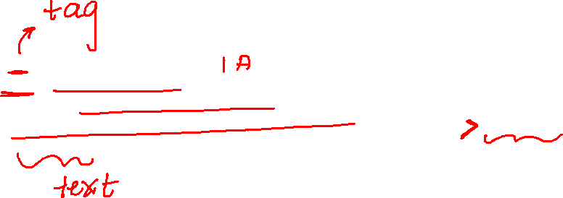
<a href="https://www.facebook.com/recover/initiate/?privacy_mutation_token=eyJ0eXBlIjowLCJjcmVhdGlvbl90aW1lIjoxNjQzNjI5ODIwLCJjYWxsc2l0ZV9pZCI6MzgxMjI5MDc5NTc1OTQ2fQ%3D%3D&amp;ars=facebook_login">Forgotten password?</a>

Slide 8
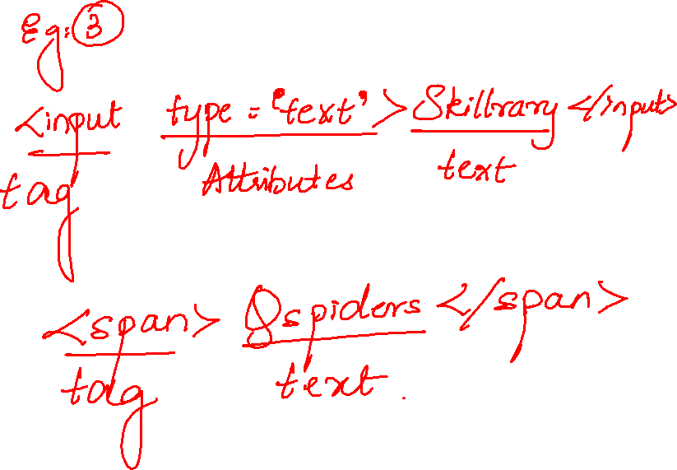

Slide 10
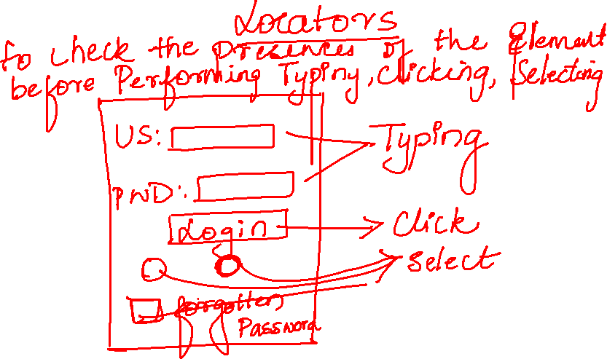

Slide 11
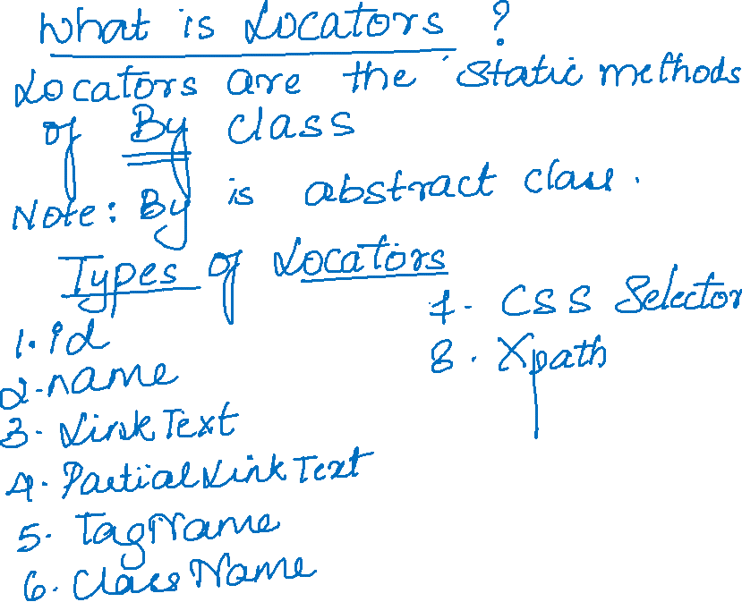

Slide 12
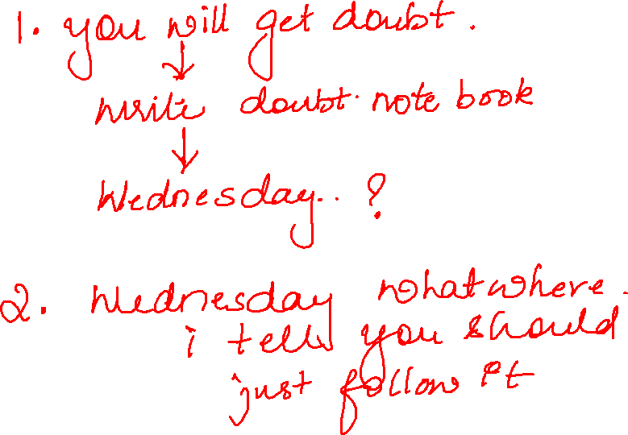

Slide 13

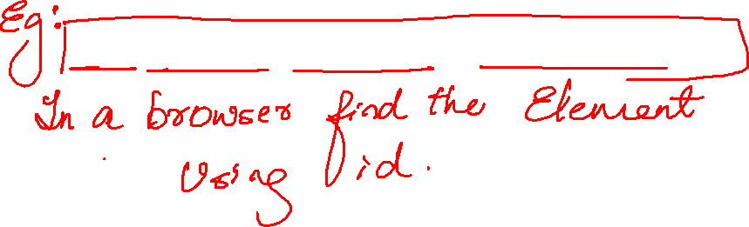
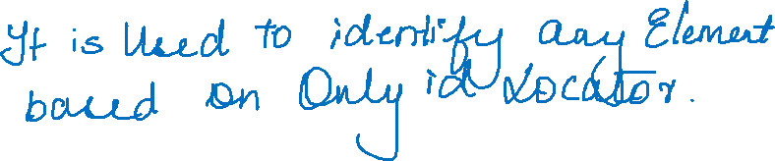
driver.findElement(By.id("email")).sendKeys("admin123");

Slide 14
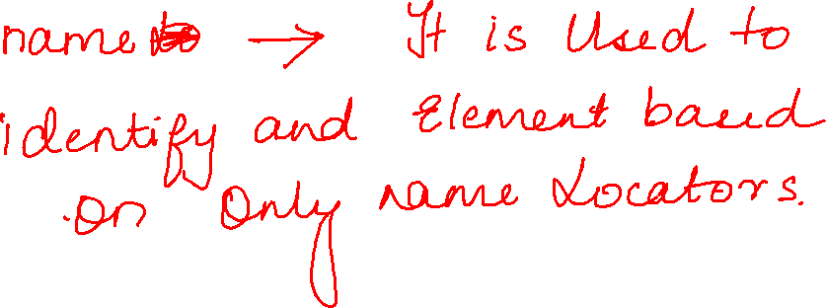

Slide 15
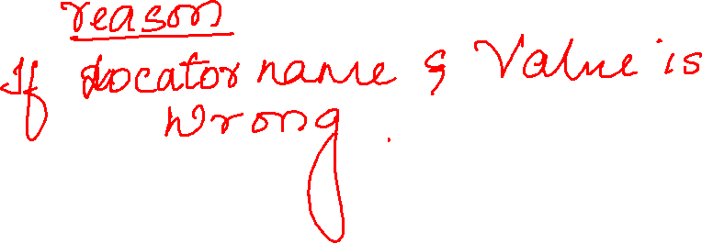

Slide 16
