Slide 1
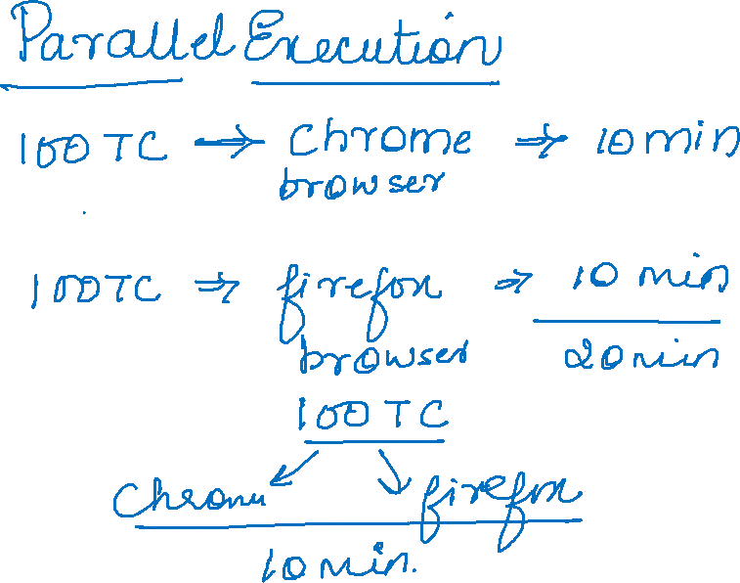

Slide 2
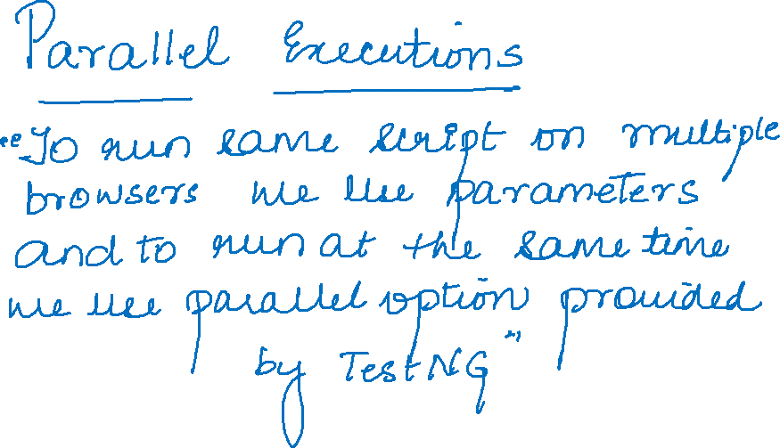

Slide 3
<suite name="Suite" parallel="tests">
<test thread-count="5" name="Test1">
<parameter name="browserName" value="chrome"/>
<classes>
<class name="testng.Parallel"/>
</classes>
</test> <!-- Test -->
<test thread-count="5" name="Test2">
<parameter name="browserName" value="firefox"/>
<classes>
<class name="testng.Parallel"/>
</classes>
</test> <!-- Test -->
</suite> <!-- Suite -->

Slide 4


Slide 5
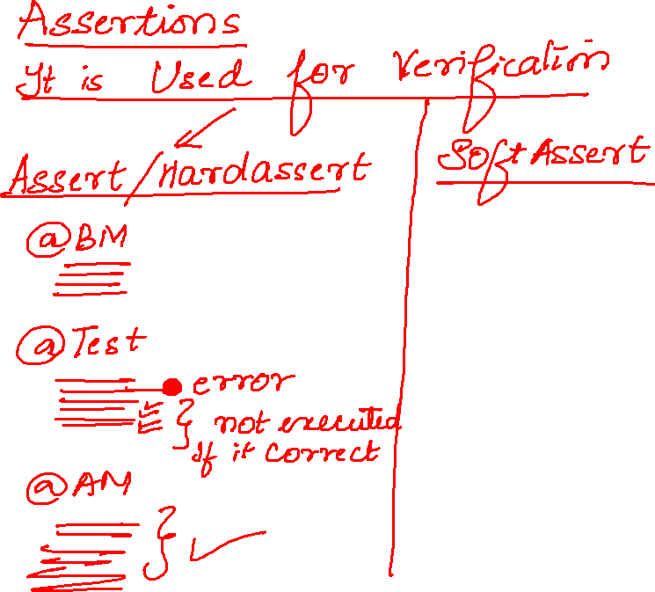

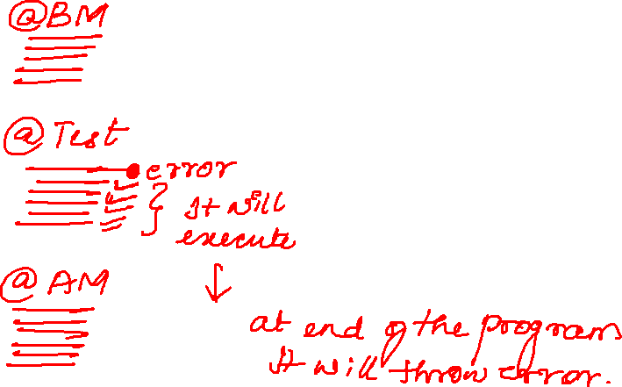

Slide 6
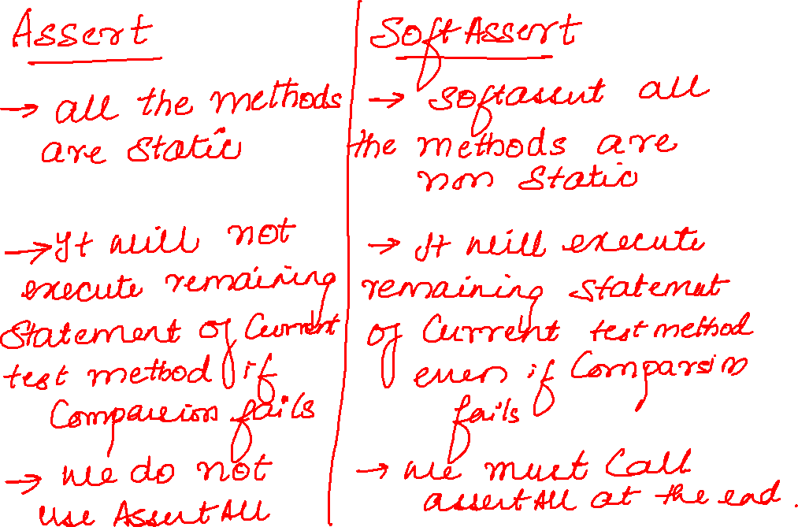

Slide 7
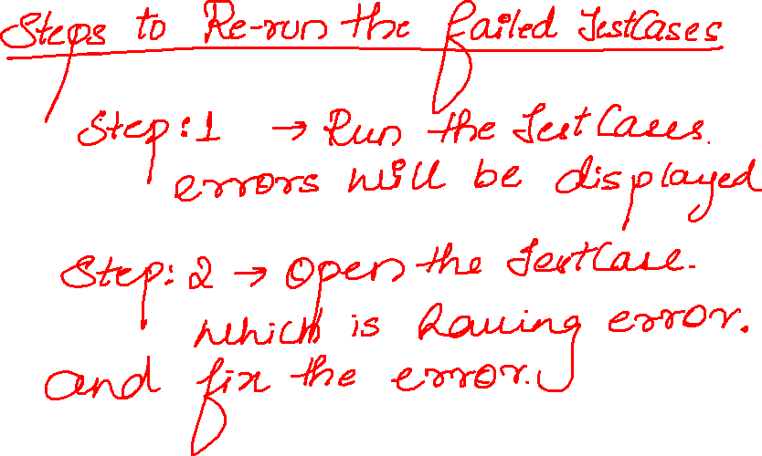

Slide 8
