Slide 1

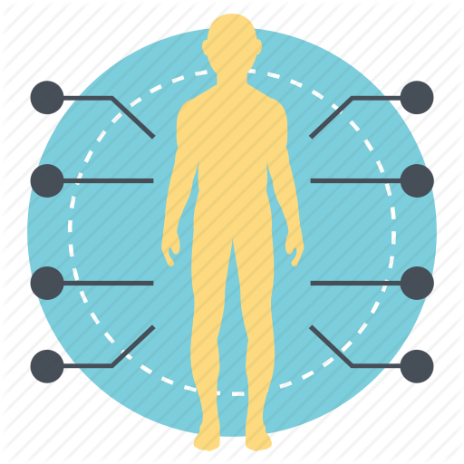
Body Area
Network System
GROUP 8
Ayushman Ayushman
Himanshu Gupta
Jiajing Zhao
Nishant Mohan

Slide 2

SCENARIO
Hospital premises
Patient Health Monitoring system
Periodic health status report sent to doctor

Slide 3

CHALLENGES
Optimizing power usage
Security of patient data
Scalability to cater to future needs

Slide 4
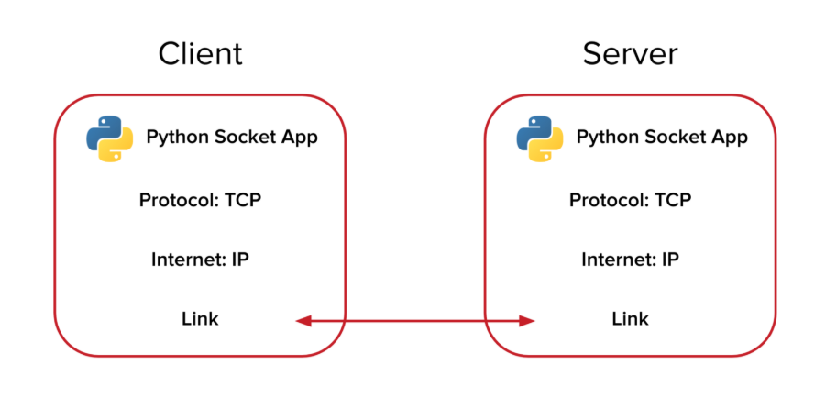
Socket Programming : Client-Server Communication

Slide 5
PLATFORM
Socket Programming
Python
GoLang

Slide 6

TOPOLOGY
&
COMMUNICATION

Slide 7
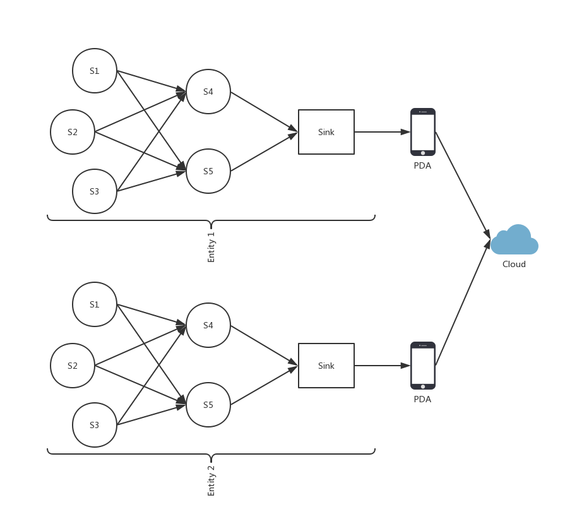

Slide 8
DEMONSTRATION

Slide 9
FEATURES
Multi-hop to minimize transmission and power loss
Duty-cycle helps reduce power consumption
Sink to Edge to Cloud framework
Data Encryption
Report published in cloud
Scalable- can add large number of number of sensors/instances

Slide 10
LIMITATIONS
Fixed coordinates of sensors
Sink reliability
Sink is always on during data receiving.
Every time new sensors is added, it has to register itself to sink.

Slide 11
Questions?

