Slide 1


Applets in Java

Slide 2
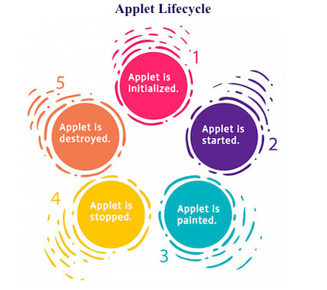

Slide 3
