Slide 1
Welcome to the Ocean of Java

Slide 2
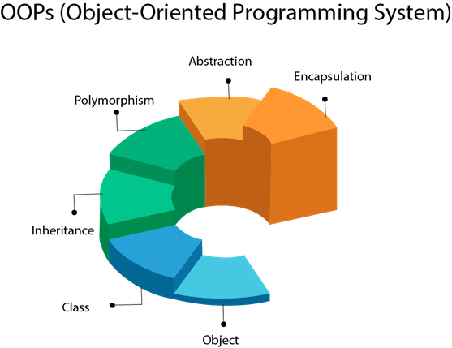

Slide 3
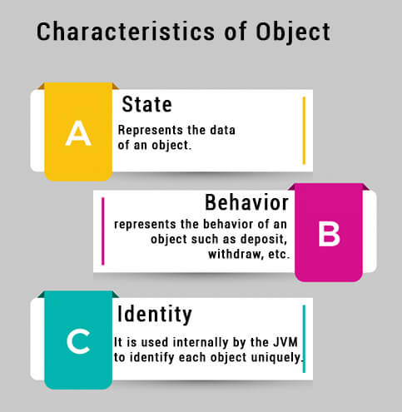

Slide 4
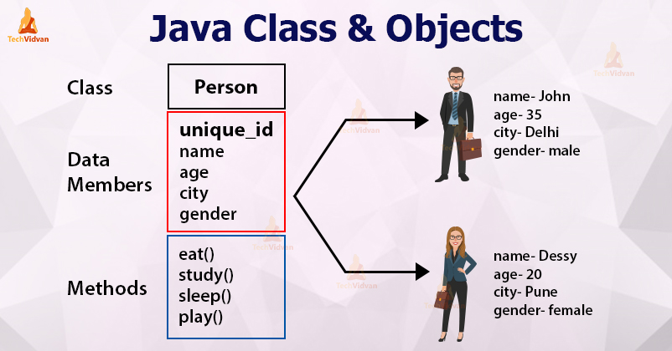

Slide 5
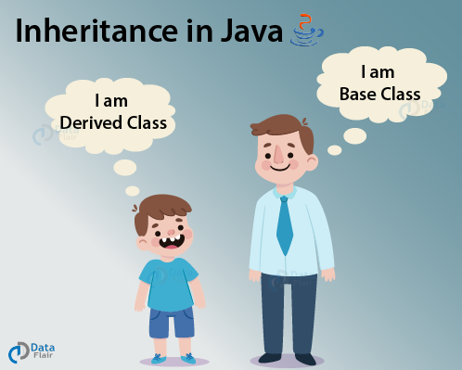

Slide 6
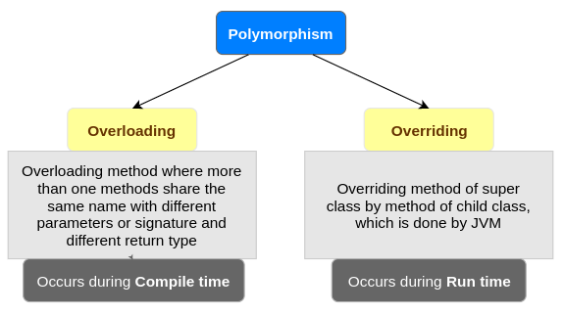

Slide 7
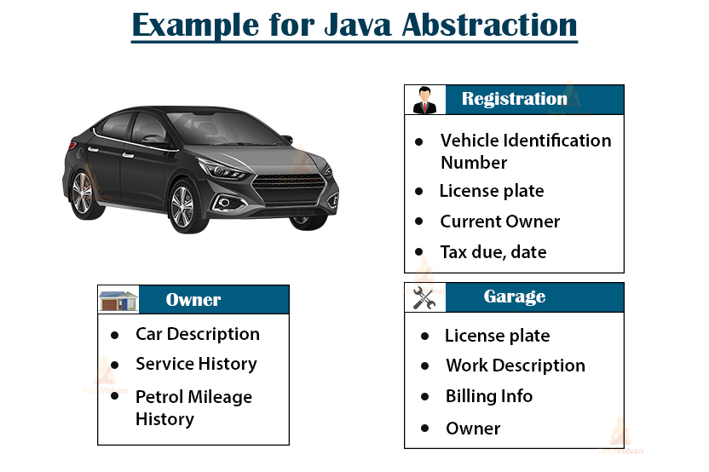

Slide 8
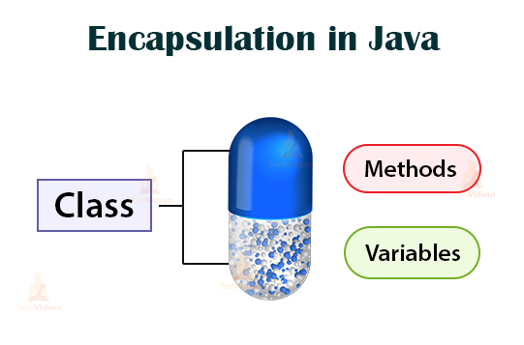

Slide 9


Lexical Issues:
Whitespaces
Identifiers
Literals
Comments
Separators
Keywords
Whitespaces: it is a freeform language which means there is no indentation rules.
3.
4.

Slide 10
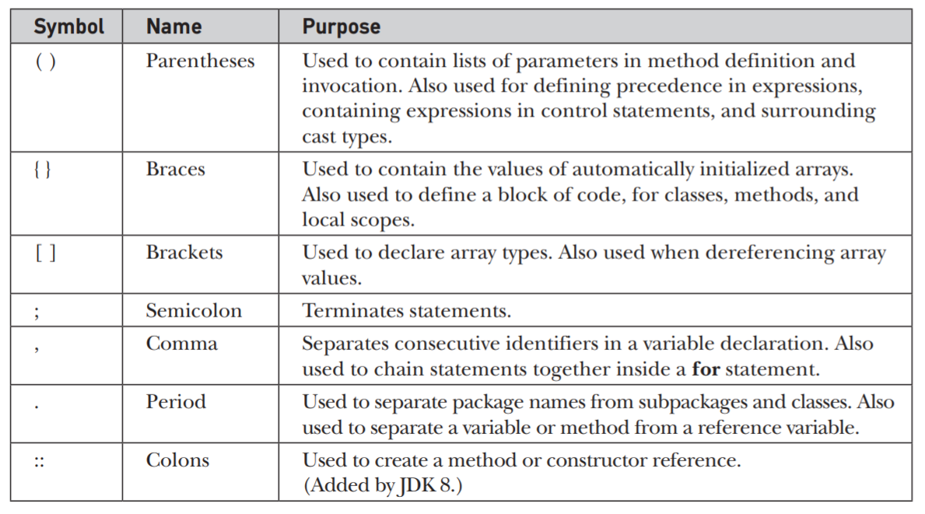
Separators

Slide 11
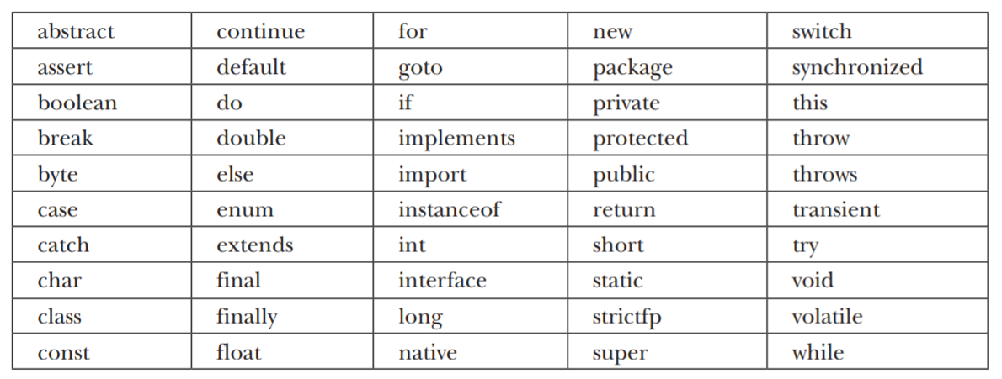
Keywords

Slide 12
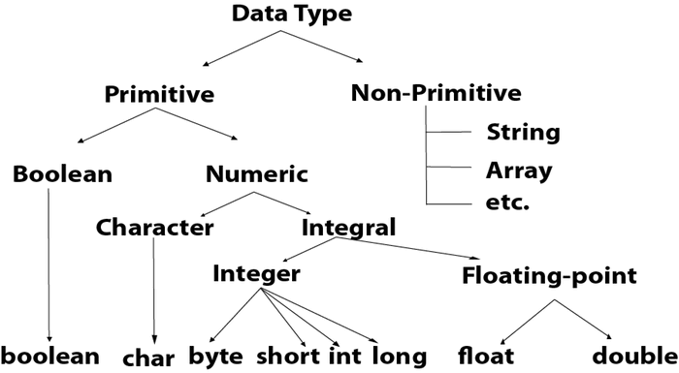

Slide 13
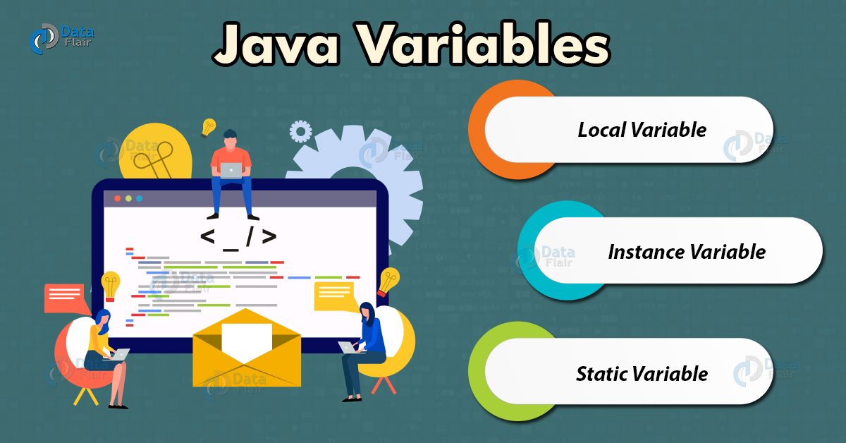

Slide 14
