Slide 1
Introduction to AWT
by
A.Harish

Slide 2
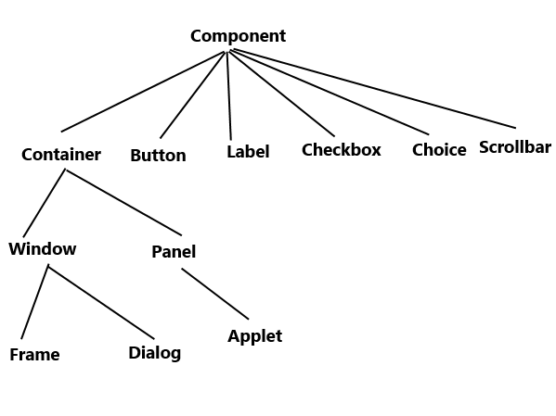
AWT Classes

Slide 3
AWT Control Fundamentals
Labels
Push buttons
Check boxes
Choice lists
Lists
Scroll bars
Text Editing

Slide 4
Layout Managers
FlowLayout
BorderLayout
GridLayout
CardLayout

Slide 5
THANK YOU!

