Slide 1

Unit-4 threaded programming
By
A.Harish,
Assistant Professor, IT, SVCE

Slide 2
Thread
Thread is a light weight process
Multi Tasking
1.Process based Multitasking
2.Thread based Multitasking

Slide 3
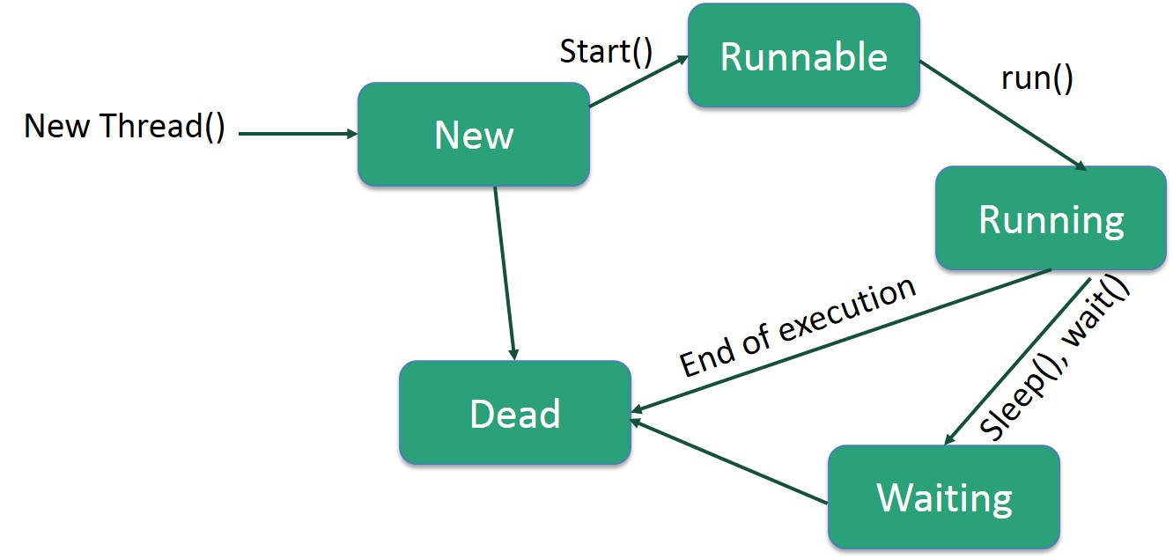
Java Thread Model
1.Single Threaded System
2.MultiThreaded System

