Slide 1

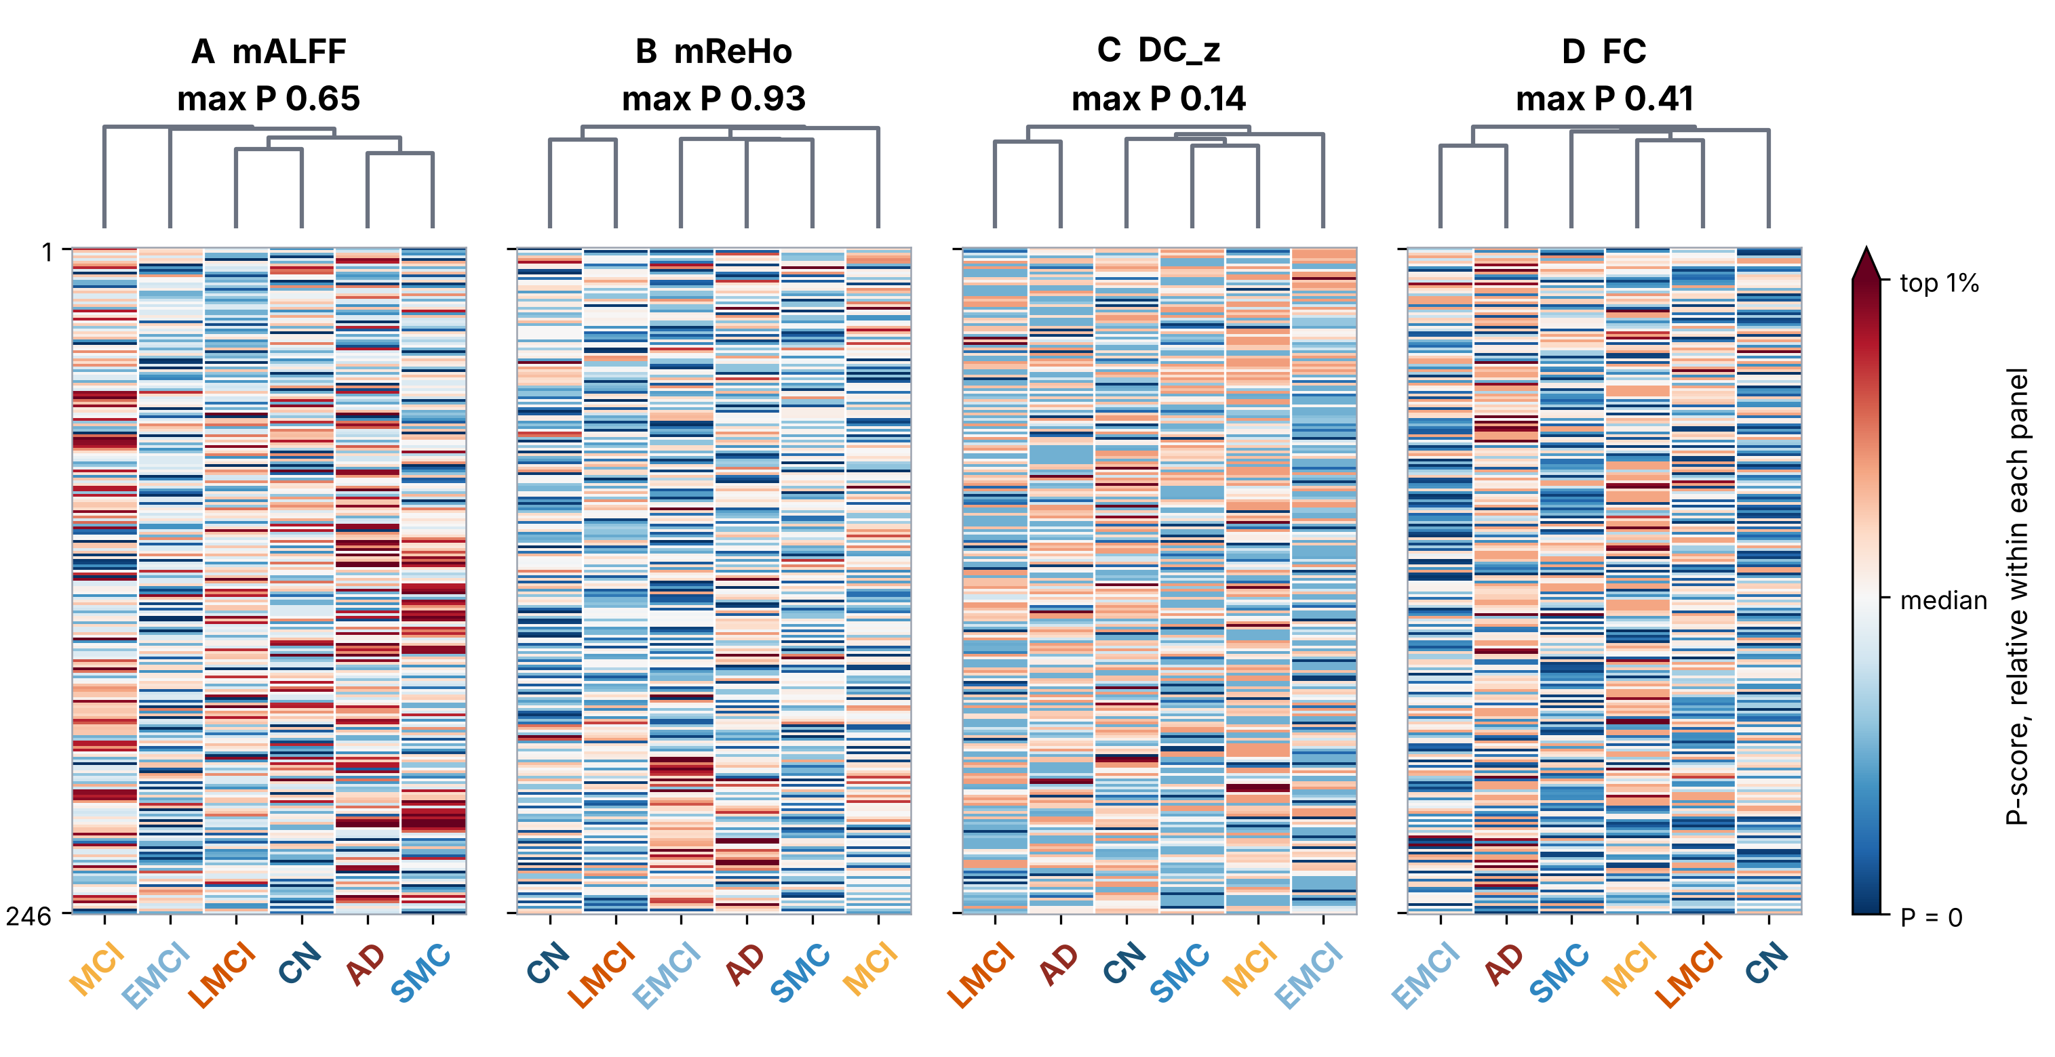
Sri Sivasubramaniya Nadar College of Engineering
Department of Computer Science and Engineering
Assessment of Alzheimer's Disease Progression Using a Comorbidity-Aware
Meta-Bayesian Framework with Resting-State fMRI
Harishkanna R (3122235001302) Dhananchezhiyan M (3122235001041) Nagindhar Sachein R L (3122235001702)
Guide: Dr. N. Ahana Priyanka, Assistant Professor
Problem Statement & Objectives
Methodology
Results and Analysis
Problem Statement
Resting-state fMRI biomarkers are analysed in isolation, without clinical context, and stage is predicted as unordered, overconfident labels.
Objectives
1. Build an auditable rs-fMRI pipeline: ALFF, ReHo, DC and FC
2. Assemble a leakage-free 116-subject cohort and test for stage structure
3. Predict six ordered stages with comorbidity and uncertainty (proposed)
DATA AND PREPROCESSING
1. Audit and dedup
175 raw acquisitions, 2 pre-excluded
2. DICOM to BIDS
dcm2niix v1.0.20260724, BIDS layout
3. Preprocessing
Motion corr., MNI 4 mm, 27 regressors, 0.01–0.10 Hz
4. Quality control
167 preprocessed; 8 refused (TR 6.02 s)
FEATURES AND COHORT
8. Cohort split
116 subjects: 81 train pool, 35 locked test
7. Normalisation
Scaled within each acquisition
6. Biomarkers
mALFF, mReHo, DC_z, FC (246x246 Fisher-z)
5. Brainnetome atlas
246 regions: 210 cortical, 36 subcortical
Related work and research gap
P-score = −log10(q). Colour is relative within each panel (blue = 0, red = top 1%), so panels are not comparable. Significance needs 1.30; the largest value is 0.93, so no cell qualifies.
Author/Year | Method | Key Findings | Limitations
Zang 2004 | ReHo (Kendall's W) | Local synchrony of BOLD signals | Single biomarker, no staging
Zou 2008 | fALFF power ratio | Suppresses non-specific signal vs ALFF | Single biomarker, no staging
Zuo 2012 | Degree centrality | Hub regions of the connectome | Group maps, no staging
Fan 2016 | Brainnetome atlas | 246 regions: 210 cortical, 36 subcortical | Atlas only, no prediction
Vaswani 2017 | Self-attention | Models long-range interactions | Needs large datasets
MODELLING
9. Feature reduction
PCA, L1, QUBO-QAOA, fitted per CV fold
10. Staging model
Multi-attention transformer and MLP
11. Fusion + MAML
Proposed: comorbidity covariates, meta-learning
12. Uncertainty head
MC-dropout built; ordinal head unresolved
Implemented and executed
Proposed or unresolved
Functional Modules and Dataset Description
Conclusion and future work
Modules
M1 Audit, BIDS conversion and preprocessing
M2 Brainnetome-246 biomarkers (mALFF, mReHo, DC_z, FC)
M3 Cohort selection, statistics, feature reduction
M4 Transformer staging (fusion, MAML: proposed)
Conclusion: The pipeline is complete and auditable, but the features do not separate the six stages after correction. Nothing reaches q < 0.05 and held-out accuracy is at chance level.
Contribution: A verified DICOM-to-features pipeline, a proven FC_Strength redundancy (= DC/245), 5.7–11.3% shared variance between biomarkers, and a leak-free benchmark of 26 feature-reduction methods including quantum QUBO.
Future work: Expand the cohort by subject, add motion and site covariates, then build comorbidity fusion and a Bayesian ordinal head.
Foundational method papers behind this work.
Research gap
Biomarker methods are validated one at a time; none addresses ordered six-stage staging with clinical context and calibrated uncertainty. This work builds one verified pipeline for four biomarkers, measures how much they overlap, and tests leak-free whether they separate the stages.
Dataset Description
ADNI resting-state fMRI, no T1-weighted scans: 175 raw acquisitions, 167 preprocessed (129 subjects), 116 analysed, one scan per subject.
CN | SMC | EMCI | MCI | LMCI | AD | Total
20 | 20 | 20 | 16 | 20 | 20 | 116
Data were obtained from the Alzheimer's Disease Neuroimaging Initiative (ADNI) database (adni.loni.usc.edu). Atlas: Human Brainnetome Atlas (Fan et al., 2016).
Notes:
Talking points
- Cohort: 116 subjects, one scan each; MCI has 16 because only 16 MCI subjects have valid data (not padded with repeat visits).
- 8 acquisitions were refused at preprocessing: TR 6.02 s puts Nyquist at 0.083 Hz, below the 0.10 Hz band-pass cutoff.
- FC_Strength was removed: it equals DC/245 exactly (max difference 6.9e-18).
- MMSE and CDR are not used as features: they feed the ADNI criteria that assign the stage (circular).
- Feature selection study: 26 methods, 285 configurations; best CV = PCA 738->10 at 0.253; test 0.172 (PCA), 0.228 (L1), 0.233 (QUBO+QAOA), all within chance range for n=35.
- Quantum QUBO+QAOA ran on a simulator (qiskit, 20 qubits) and gave no advantage over random subsets of the same candidates.
- MLP on DC_z held-out balanced accuracy 0.200; its CV score (0.307) did not carry over.
- Chart protocol: transformer = 5-fold CV; others = 5 seeds x 5 folds. Feature counts: no reduction 738, QUBO+QAOA 8, L1 10, PCA 10 components.
- P-score figure: poster-sized redraw (scripts/audit/pscore_poster_panel.py blue) of the four-panel variant, RdBu_r with a per-panel scale (blue = P 0, pale = panel median, red = 99th percentile), so panels are NOT comparable; the yellow fixed-scale version is pscore_poster_panel.png; max P-score 0.928 (mReHo) vs threshold 1.301. 0 of 5,904 ROI-stage tests reach q < 0.05.
- No test reaches q < 0.05. Smallest adjusted q by family: stage-level one-vs-rest 0.139 (mReHo, EMCI; 24 tests); ROI x stage 0.118 (mReHo; 1,476 tests per biomarker); pairwise ROI 0.067 (mALFF). Note 0.139 is the smallest only within the stage-level family.
- Related-work table lists the foundational method papers cited in the project report; replace with AD-staging literature if required.

