Slide 1
Customer Churn Analysis Report
Harish Kumar S
MBE-12

Slide 2
Project Summary
This section provides a brief summary of the project, its scope, and objectives.
Summary:
This project focuses on analysing customer churn for a telecom company (or any relevant industry).
The goal is to predict which customers are likely to churn and identify the key factors contributing to customer attrition.
Various data analysis techniques, including exploratory data analysis (EDA), SQL queries, and data visualization, were used to uncover insights.

Slide 3
Introduction
Objectives:
Predict customer churn based on historical data.
Identify the key factors influencing customer attrition.
Provide actionable insights to help reduce churn rates and improve customer retention strategies.
Visualize the data to provide clear, digestible insights for stakeholders.
Tool Used:
SQL: For querying and extracting data insights.
Power BI: For visualizing the data and creating interactive charts
Dataset Overview:
The dataset used contains various features about customer behaviour, such as demographic information, service usage, and customer account details.
Key attributes include customer tenure, age, usage statistics (e.g., number of calls, data usage), service type, and churn status (whether the customer left the service).
The target variable in the dataset is typically a binary variable representing whether the customer churned (1) or not (0).

Slide 4
Data Preparation
This section describes the steps taken to prepare the data for analysis.
Data Cleaning: Missing values were handled, either by imputation or removal, depending on the percentage of missing data.
Feature Engineering: Created new features such as "Average Revenue Per User" (ARPU) or tenure bins.
Data Transformation: Categorical variables were encoded using methods like one-hot encoding or label encoding.
Normalization/Scaling: Applied scaling techniques (e.g., MinMaxScaler) to normalize continuous variables for better performance in machine learning algorithms.

Slide 5
Exploratory Data Analysis (EDA)
Summarize the insights gathered during the EDA phase:
Univariate Analysis: Analyzed distributions of key variables like age, tenure, and monthly charges to understand their individual characteristics.
Bivariate Analysis: Examined relationships between features and the target variable (e.g., churn status), using visualizations like bar plots, histograms, and box plots.
Correlation Matrix: Identified which features are highly correlated with each other and the target variable.
Outlier Detection: Identified outliers in numerical data (e.g., using boxplots).
Key insights from EDA may include:
Customers with high monthly charges and low tenure are more likely to churn.
Certain service types and contract types correlate strongly with customer churn.

Slide 6
SQL Analysis Queries
This section covers the SQL queries used to derive insights from the dataset.
Provide a detailed description SQL including:
Customer Churn Rate by Service Type: A query to calculate churn rates by different service types.
Average Tenure by Churn Status: An analysis query that compares the average tenure of churned vs. non-churned customers.
Monthly Revenue Trends: Query to analyse revenue fluctuations over time and its correlation with churn.
Key Insights Obtained:
SQL queries revealed that customers with shorter tenure have a significantly higher likelihood of churning.
High-value customers (high revenue) are more likely to leave, indicating the need for better retention strategies for this group.
MYSQL QUIRES: https://drive.google.com/file/d/1hbiKUqrmmcZvjW7QE0VbTRUlkqOeyuGX/view?usp=drive_link

Slide 7
SQL Queries:
1.Average Age of Churned Customers:
Insight: The average age of churned customers is 50 years, which suggests that mid-aged customers are more likely to churn than younger or older customers.
2.Total Number of Customers and Churn Rate:
Insight: The churn rate is 32.8%, which indicates that nearly a quarter of customers have churned.
3.Most Common Contract Types Among Churned Customers:
Insight: Month-to-Month contracts are the most common among churned customers, highlighting the need for improvements in this contract type.
4.Distribution of Monthly Charges Among Churned Customers:
Insight: Churned customers tend to have higher monthly charges on average with some outliers reaching.
5.Contract Types Most Prone to Churn:
Insight: Month-to-Month contracts have the highest churn rate of 51.20 compared to other contract types.
6.Customers with High Total Charges Who Have Churned:
Insight: Customers who have accumulated 8684.8 or more in total charges are among the highest-risk customers.
7.Total Charges Distribution for Churned vs. Non-Churned Customers:
Insight: The distribution of total charges shows that churned customers have higher overall charges compared to non-churned customers.
8.Average Monthly Charges by Contract Type for Churned Customers:
Insight: Churned customers with Month-to-Month contracts have the highest average monthly charges.
9.Customers with Both Online Security and Backup and Have Not Churned:
Insight: Customers who use both online security and online backup services are less likely to churn, indicating the importance of these services in retention.
10.Combinations of Services Among Churned Customers:
Insight: Phone Service and Internet Service combinations are the most common among churned customers.
11.Average Total Charges by Gender and Marital Status:
Insight: Married male customers tend to have the highest average total charges.
12.Average Monthly Charges by Age Groups Among Churned Customers:
Insight: Customers under 30 have the highest average monthly charges among churned customers.

Slide 8
13.Average Age and Total Charges for Customers with Multiple Lines and Online Backup:
Insight: Customers using multiple lines and online backup tend to have higher charges.
14.Contract Types with the Highest Churn Rate Among Senior Citizens:
Insight: Month-to-Month contracts are most prone to churn, especially for customers aged 65 and above.
15.Average Monthly Charges for Customers with Multiple Lines and Streaming TV:
Insight: Customers with streaming TV and multiple lines have above-average monthly charges.
16.Churned Customers Using the Most Online Services:
Insight: Customers who used multiple online services (e.g., online security, backup) are less likely to churn.
17.Average Age and Total Charges for Customers with Different Combinations of Streaming Services:
Insight: Customers who use all three streaming services (TV, Movies, Music) are older on average, but have lower total charges.
18.Gender Distribution Among Churned Customers on Yearly Contracts:
Insight: Males have a higher churn rate for yearly contracts than females.
19.Average Monthly Charges and Total Charges for Churned Customers by Contract Type and Internet Service:
Insight: Yearly contract customers with Fiber Optic Internet have the lowest churn rate.
20.Churned Customers Not Using Online Services and Their Average Total Charges:
Insight: Churned customers who do not use online services tend to have lower total charges.
21.Average Monthly Charges and Total Charges for Churned Customers by Number of Dependents:
Insight: Customers with no dependents tend to have higher charges and higher churn rates.
22.Churned Customers with Monthly Contracts:
Insight: Customers with Month-to-Month contracts have a higher tendency to churn and lower tenure.
23.Average Age and Total Charges for Churned Customers Grouped by Internet and Phone Service:
Insight: Customers with Fiber Optic Internet and Landline Phone Service have the highest total charges among churned customers.
24.View to Find Customers with Highest Monthly Charges by Contract Type:
Insight: Yearly contract customers with the highest monthly charges contribute significantly to total revenue.
25.View to Find Churned Customers and Cumulative Total Charges Over Time:
Insight: Churned customers accumulate higher charges in the early months before churning.
26.Stored Procedure to Calculate Churn Rate:
Insight: The churn rate for January 2024 is 22.1%, representing a high churn trend in the early months.
27.Stored Procedure to Identify High-Value Customers at Risk of Churning:
Insight: 50 high-value customers are at risk of churning based on their low usage of online services.
28.View to Identify Churned Customers with Average Monthly Charges Compared to Overall Average:
Insight: Churned customers have an average monthly charge 5% higher than the overall average.

Slide 9
Key Performance Indicators (KPIs)
This section outlines the key performance indicators used to measure customer churn.
1.Customer Churn Rate:
This KPI calculates the percentage of customers who have churned out of the total customer base.
2.Monthly Average Revenue Per User (ARPU):
This KPI measures the average revenue generated per user each month. You can use the monthly charges as a proxy for revenue.
3. Customer Retention Rate:
This KPI calculates the percentage of customers who have not churned (i.e., retained customers) out of the total customer base.
4. Average Tenure of Churned Customers:
This KPI calculates the average tenure of customers who have churned, helping to identify if newer or long-term customers are churning more frequently
5. Total Revenue Lost Due to Churn:
This KPI estimates the total revenue lost due to churned customers, using their total charges as an estimate for revenue.

Slide 10
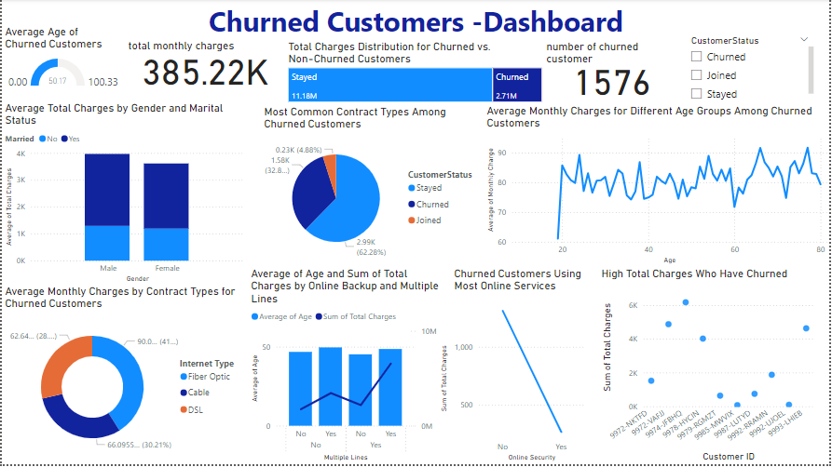

Slide 11
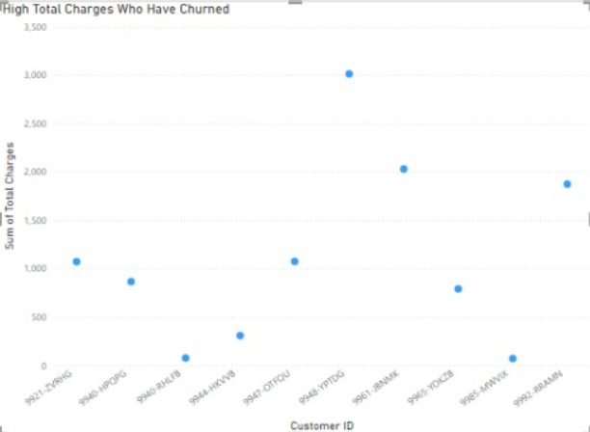
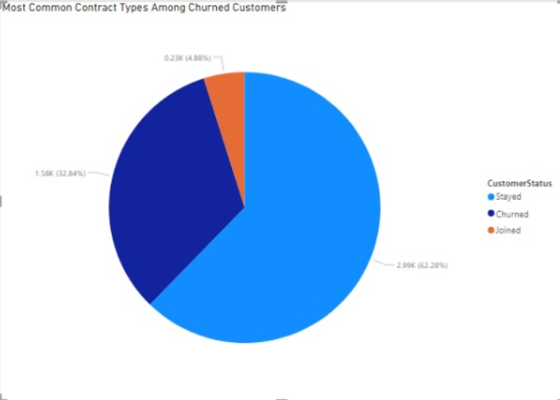
Visualization in Power BI
This section describes the visualizations created in Power BI and their significance:
1. Most Common Contract Types Among Churned Customers:
Chart Type: Pie Chart
Chart Description: Shows the distribution of contract types among churned customers.
Understanding: The pie chart reveals which contract types are most common among customers who churned. This may indicate a relationship between contract type and likelihood of churn.
Insights: - Month-to-month contracts are often the most common among churned customers, likely because they offer more flexibility for customers to leave. - Annual and bi-annual contracts tend to have lower churn rates, possibly due to the commitment customers have made.
Recommendations: - For customers on month-to-month contracts, consider offering incentives, such as discounts or additional services, to encourage longer-term commitment. - Introduce loyalty rewards for customers who remain on month-to-month plans beyond a certain period to improve retention.
2. High Total Charges Among Churned Customers:
Chart Type: Scatter Plot
Chart Description: Highlights the top 10 churned customers based on total charges.
Understanding: This scatter plot helps identify high-value customers who have churned, providing a focus for analyzing why high-paying customers leave.
Insights: - Customers with high total charges who churn may have experienced dissatisfaction despite being high spenders. - Top 10 high-value churned customers indicate potential losses in revenue if similar high-paying customers also churn.
Recommendations: - Reach out to high-spending customers regularly for feedback and offer personalized support to address any issues. - Consider implementing a retention program tailored to high-paying customers, offering loyalty rewards or exclusive benefits.

Slide 12
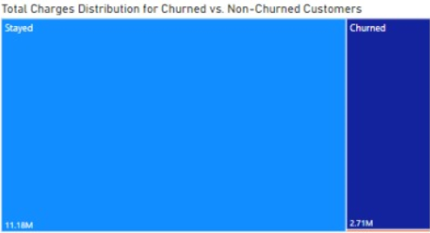
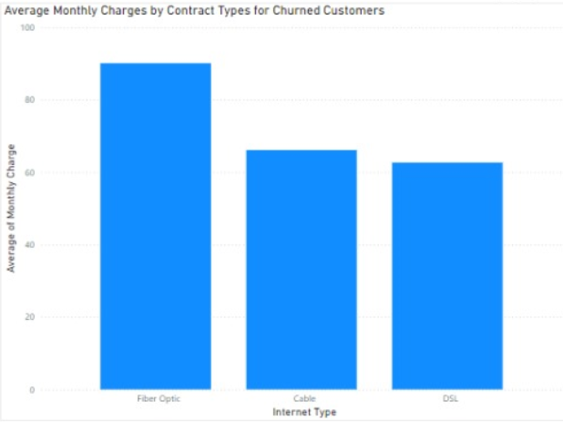
3. Total Charges Distribution for Churned vs. Non-Churned Customers:
Chart Type: Tree Map
Chart Description: Compares total charges between churned and non-churned customers.
Understanding: The tree map visually compares the distribution of total charges between churned and non-churned customers.
Insights: - Churned customers tend to have either high or low total charges, indicating that both high-value and low-value customers may be likely to churn. - Non-churned customers generally have mid-range total charges, suggesting that moderate spending correlates with customer retention.
Recommendations: - For low-spending churned customers, consider offering flexible or lower-cost plans. - For high-spending churned customers, introduce targeted support to retain this valuable segment.
4. Average Monthly Charges by Contract Types for Churned Customers:
Chart Type: Donut Chart
Chart Description: Shows average monthly charges by contract type among churned customers.
Understanding: The chart shows how different contract types affect average monthly charges for churned customers.
Insights: - Customers with higher monthly charges and shorter contracts are more likely to churn. - This suggests that higher monthly costs without a long-term contract may lead to dissatisfaction.
Recommendations: - Consider offering discounts on monthly charges for month-to-month contract holders or provide incentives for switching to annual contracts. - Create custom offers or discounts for customers nearing contract expiration to retain them

Slide 13
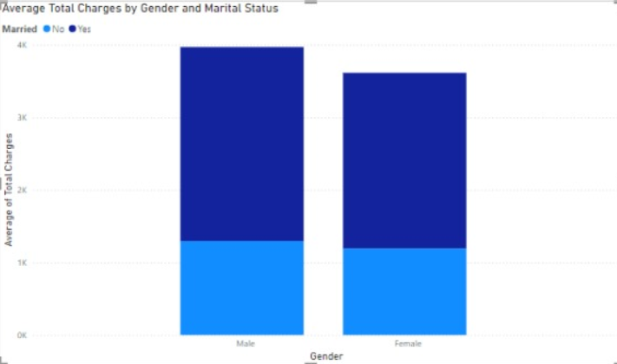
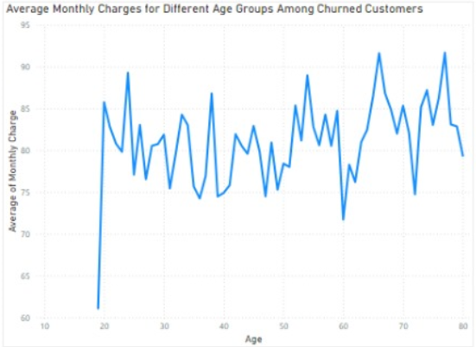
5. Average Total Charges by Gender and Marital Status:
Chart Type: Stacked Column Chart
Chart Description: Compares average total charges across gender and marital status.
Understanding: This chart allows us to see if gender and marital status influence total spending among customers.
Insights: - Married customers, regardless of gender, tend to have higher total charges. - Unmarried customers may churn more frequently if their average total charges are lower, as they may be more price-sensitive.
Recommendations: - Develop tailored retention programs for unmarried customers with lower total charges, possibly offering services that provide higher perceived value. - For high-spending married customers, maintain regular engagement and loyalty programs to encourage retention.
6. Average Monthly Charges for Different Age Groups Among Churned Customers:
Chart Type: Line Chart
Chart Description: Shows average monthly charges by age group for churned customers.
Understanding: This visualization identifies age groups with higher monthly charges who are prone to churn.
Insights: - Younger age groups (20–30) with higher monthly charges have higher churn rates, likely due to budget constraints or competition. - Older age groups, who may have more financial stability, tend to retain services longer despite high charges.
Recommendations: - Consider offering budget-friendly plans or discounts for younger customers to improve retention. - For older customers, maintain consistent communication and personalized service options to continue meeting their needs.

Slide 14
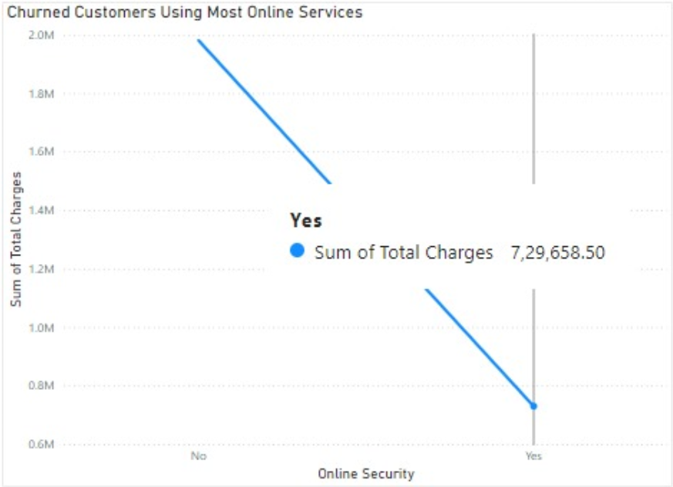
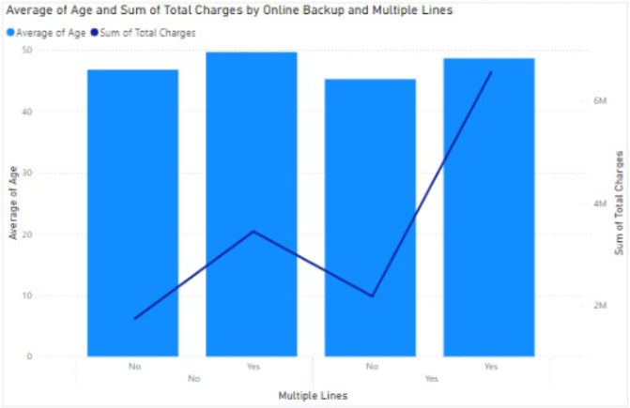
7. Churned Customers Using Most Online Services:
Chart Type: Line Chart
Chart Description: Shows churned customers who use the most online services.
Understanding: This chart shows if using more online services correlates with churn.
Insights: - Churned customers often use more online services, possibly indicating dissatisfaction with the quality or cost of these services. - High usage could also mean customers are more aware of service limitations, leading them to explore alternatives.
Recommendations: - Improve the quality and reliability of online services, particularly for high-usage customers. - Offer bundled packages or discounts for frequent users to add value and reduce churn.
8. Average Age and Total Charges by Online Backup and Multiple Lines:
Chart Type: Line and Stacked Column Chart
Chart Description: Shows the average age and total charges for customers with online backup and multiple lines.
Understanding: This chart provides insights into whether online backup and multiple lines correlate with age and spending.
Insights: - Older customers are more likely to use online backup and have higher total charges. - Younger customers may not prioritize online backup or multiple lines, leading to lower spending.
Recommendations: - Promote online backup as a value-added service for younger customers, emphasizing security benefits. - For older customers, bundle online backup with other services to increase loyalty.

Slide 15
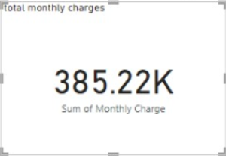
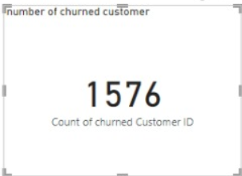
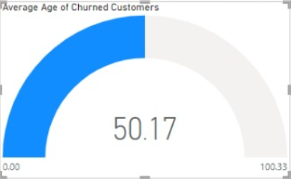
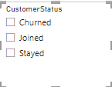
10.Total Monthly Charges:
This card shows the total amount of money billed to customers each month, often aggregated across all customers or a segment. It can provide insights into revenue generation, helping to track whether there are any significant changes in customer spending behavior.
11. Number of Churned Customers:
This card displays the total count of customers who have canceled or stopped using the service within a specified period. It's a key metric to measure customer retention and business performance, indicating how many customers have "churned" or left the service.
12.Customer status:
This slicer allows you to filter data based on customer status, with three options: Churned, Joined, and Stayed. It helps segment the analysis to focus on customers who have canceled, newly joined, or remained with the service, providing insights into customer behavior and trends for each group.
9. Find the Average Age of Churned Customers:
Chart Type: Card
Chart Description: Displays the average age of churned customers.
Understanding: The card provides a quick snapshot of the average age among churned customers.
Insights: - The average age of churned customers could indicate the typical age profile of at-risk customers. - If the average age is lower, it suggests younger customers are more prone to churn.
Recommendations: - For younger customers, consider launching more flexible or customizable plans to meet their needs. - Engage with customers approaching the average churn age through targeted retention efforts, such as loyalty rewards or customer satisfaction surveys.

Slide 16
Insights and Recommendations Based on Churn Analysis Visualizations:
Churn Rate Insights:
Churn Rate of 26.6%: A churn rate of 26.6% indicates that nearly one-quarter of the customers have left the service within the specified period. This figure suggests that customer retention is a significant issue. Given the high churn rate, there is an urgent need for the business to review its retention strategies and identify the root causes of customer attrition.
Recommendations:
Investigate Reasons for Churn: Conduct surveys or feedback loops with churned customers to understand why they left. This data will help tailor retention strategies to the reasons for departure.
Improve Customer Engagement: Focus on improving customer support, product/service quality, and personalization to enhance the customer experience and reduce the likelihood of churn.
Loyalty Programs: Introduce or enhance loyalty programs for long-term customers to keep them engaged and reduce churn.
Contract Type Distribution Among Churned Customers Insights:
Insight:
Month-to-Month Contracts Contribute Significantly to Churn: A higher churn rate among Month-to-Month contract customers suggests that these customers are more likely to leave, likely due to the flexibility of the contract and less long-term commitment.
Recommendations:
1.Offer Incentives for Longer Contracts: Provide incentives (e.g., discounts or additional services) for customers to transition from Month-to-Month contracts to longer-term commitments, which may improve retention.
2.Review Terms for Month-to-Month Contracts: Evaluate the service offerings and pricing for Month-to-Month contracts to make them more attractive and competitive, reducing the chances of churn among this group.
Monthly Charges vs. Churned vs. Non-Churned Customers Insights:
Insight:
Higher Monthly Charges Correlate with Churn: The analysis suggests that churned customers may have higher monthly charges compared to non-churned customers. This can be indicative of dissatisfaction, as these customers are not perceiving enough value relative to what they are paying.
Recommendations:
1.Evaluate Pricing Strategy: Assess the pricing strategy for customers with high charges, ensuring that they receive sufficient value for the cost. Consider offering personalized pricing plans to retain high-value but dissatisfied customers.
2.Targeted Retention Offers: Offer special promotions, discounts, or loyalty benefits to high-paying customers at risk of churning, demonstrating the company’s commitment to their long-term value.

Slide 17
Average Monthly Charges by Contract Type for Churned Customers Insights:
Insights:
Month-to-Month Customers Have Higher Charges: Customers with Month-to-Month contracts appear to have higher average charges compared to customers with other contract types, yet they are still more likely to churn. This suggests that while these customers are paying premium prices, they may feel they are not receiving enough value in return.
Recommendations:
1.Review Value Proposition for Month-to-Month Customers: For high-paying Month-to-Month customers, offer added value through improved services or benefits that justify their premium payments.
2.Targeted Retention for High-Charge Customers: For customers who are paying more but still churning, personalized engagement strategies such as VIP support, customized packages, or discounts can be implemented.
Demographic Distribution of Churned Customers Insights:
Insights:
Young and Single Customers Are More Likely to Churn: The analysis suggests that younger, single customers are more likely to churn. This demographic may have different needs or expectations, which are not being met by the current offerings.
Recommendations:
1.Tailor Offerings for Younger Customers: Develop and promote offers that cater specifically to the younger, single demographic. This could include flexible plans, social engagement incentives, or discounts that appeal to their lifestyle.
2.Engagement Through Personalization: Create personalized communications and product recommendations to better engage younger, high-risk customers, fostering brand loyalty.
Total Charges Distribution for Churned vs. Non-Churned Customers Insights:
Insight:
Churned Customers Have Higher Total Charges: The data shows that churned customers have higher total charges, indicating that these are higher-spending customers who feel they are not getting enough value.
Recommendations:
1.Enhance Value for High-Spending Customers: Implement retention strategies specifically aimed at high-spending customers, such as offering premium services, loyalty benefits, or proactive support to ensure they are getting the value they expect.
2.Customer Service Improvements: For high-spending churned customers, review the quality of customer service they received to ensure their expectations were met and exceeded.

Slide 18
Top 10 High-Value Customers at Risk of Churning Insights:
Insights:
Younger Customers with High Usage Are at Risk: The bubble chart indicates that younger customers who use a lot of services are at a higher risk of churning. These customers may have high engagement but feel that the service does not meet their needs or expectations.
Recommendations:
1.Review Service Offerings for High-Usage, Younger Customers: Analyze the specific services that younger, high-usage customers are engaging with to identify gaps or areas for improvement. Offering tailored plans for frequent users could help reduce churn.
2.Offer Value for High-Usage Customers: Implement retention strategies that offer greater value for high-usage customers, such as offering loyalty bonuses, usage discounts, or exclusive access to new services.
Average Age and Total Charges for Churned Customers by Service Usage Insights:
Insights:
Younger Customers with High Usage Are at Risk: The bubble chart indicates that younger customers who use a lot of services are at a higher risk of churning. These customers may have high engagement but feel that the service does not meet their needs or expectations.
Recommendations:
1.Review Service Offerings for High-Usage, Younger Customers: Analyze the specific services that younger, high-usage customers are engaging with to identify gaps or areas for improvement. Offering tailored plans for frequent users could help reduce churn.
2.Offer Value for High-Usage Customers: Implement retention strategies that offer greater value for high-usage customers, such as offering loyalty bonuses, usage discounts, or exclusive access to new services.
Retention Rate Visualization Insights:
Insights:
Trends in Retention Rates: The retention rate line chart tracks customer retention trends over time, revealing whether retention strategies are working. A downward trend may indicate declining retention, signaling potential issues with customer satisfaction or service quality.
Recommendations:
1.Adjust Retention Strategies Based on Trends: Analyze periods of low retention and compare them with internal changes or external factors. Based on these insights, businesses can adjust retention strategies to address specific issues causing customer loss.
2.Proactive Engagement During Declining Periods: When retention rates begin to drop, immediately implement targeted retention campaigns, including personalized emails, offers, and customer satisfaction surveys to prevent further churn.

Slide 19
Recommendations to Reduce Churn and Boost Retention
1. Address Competitor Advantages
Problem: Customers leave due to better pricing, services, or devices from competitors.
Recommendations:
Align pricing through market analysis; offer price-match guarantees.
Innovate with unique features and premium product bundling.
Implement tiered loyalty programs and referral bonuses.
2. Tackle Dissatisfaction
Problem: Customers are unhappy with product or service experience. Recommendations:
Enhance product quality with regular feedback and audits.
Provide 24/7 customer support and proactive engagement incentives.
3. Resolve Network Reliability
Problem: Frequent service interruptions or poor network performance. Recommendations:
Invest in infrastructure upgrades and advanced network technologies.
Improve communication with outage notifications and resolution timelines.
4. Combat Billing Issues
Problem: Customers face confusion, errors, or dissatisfaction with billing. Recommendations:
Simplify bills with clear breakdowns and savings highlights.
Introduce payment alerts, flexible options, and real-time usage tracking.
5. Mitigate Product Incompatibility
Problem: Product features do not meet customer needs. Recommendations:
Use customer segmentation for tailored offerings.
Offer customizable plans, trial periods, and education resources.
6. Overcome Poor Customer Service
Problem: Unhelpful or slow customer service drives churn. Recommendations:
Equip teams with CRM tools and regular training.
Enable self-service options and gather feedback for continuous improvement.
7. Manage Lack of Plan Flexibility
Problem: Customers want plans that adapt to their changing needs. Recommendations:
Create scalable and pay-as-you-go plans.
Regularly review and notify customers about better plan options.
8. Incentivize Long-Term Engagement
Problem: Lack of incentives to stay leads to churn. Recommendations:
Offer exclusive retention deals and loyalty rewards.
Use gamification to engage customers; conduct exit surveys for insights.

Slide 20
Conclusion
This project has provided a comprehensive analysis of customer churn, utilizing key metrics and visualizations to identify patterns, trends, and potential drivers of churn. Through the examination of factors such as contract types, pricing models, demographics, service usage, and customer spending, we have uncovered critical insights that offer a deeper understanding of why customers are leaving and how retention strategies can be optimized.
The high churn rate identified in the dataset suggests a pressing need for improved retention efforts, particularly for Month-to-Month contract customers and younger, high-usage segments. These insights highlight the importance of addressing pricing concerns, personalized customer engagement, and value perception to reduce churn and foster loyalty.
Key recommendations, including tailoring retention strategies, optimizing pricing plans, and enhancing customer support for high-value customers at risk of churning, have been outlined to guide businesses in proactively addressing churn challenges. By leveraging the insights from this analysis, businesses can make informed decisions to refine their customer retention strategies, ensuring better customer satisfaction and long-term growth.
In conclusion, this project demonstrates the power of data-driven decision-making in understanding customer behavior, and the findings can be used to design effective strategies that enhance retention, reduce churn, and ultimately improve overall business performance.

Slide 21
Thankyou!
hkr120682@gmail.com

